Slide 1
Unit 1 Part C
research advanced practitioners and review arts events

Slide 2
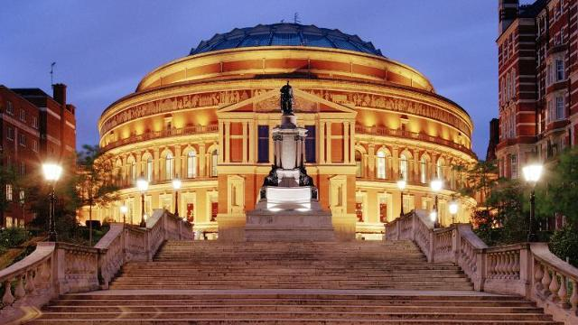
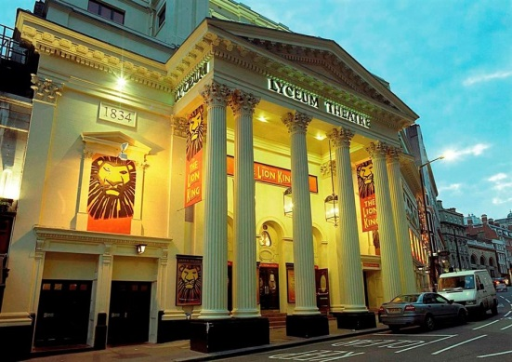
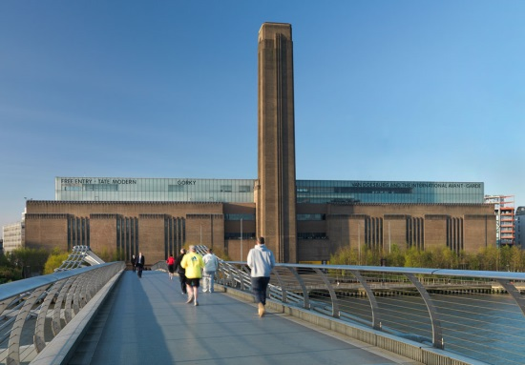
OVERVIEW
You should research more advanced practitioners within an art form, genre or arts practice undertaken elsewhere within your Gold Arts Award. This could be taken from Unit 1A, 1B or Unit 2
The emphasis is on active experience of the work of more advanced practitioners, including researching their work, interviewing the or others involved with their work an attending and reviewing a range of relevant arts events.
You should reflect on what you have learnt from your research and experiences and consider how it has influenced your own development potential and the way in which your arts practise might develop in the future.

Slide 3
Task 1
Look at the examples of the completed coursework below:
http://www.emrysgreen.co.uk/old/artsaward/artspractitioners.php
http://tominniss.com/artsaward/?page_id=15
Decide which practitioners you will research and which events you will review.
Fill out the ideas sheet and discuss with your teacher.
REMEMBER!
The practitioners/arts events must relate to some other part of your unit 1.
Note that everything is plural. You must research more than one practitioner/organisation and review more than one art event.

Slide 4
Task 2
RESEARCH ADVANCED PRACTITIONERS
Research into more advanced arts practitioners, their work and any organisations that support them including details of any contact with the more advanced arts practitioners chosen or others involved with their work.
Must show:
how to conduct active research into arts practitioners/organisations
how practitioners manage and sustain their arts practice
Complete written work similar in style to that in the exemplar portfolios looked at last lesson. Enhance written work with pictures/videos/any email communication etc.

Slide 5
Task 3
Review arts events
You will need to review some arts events that you have attended.
You will need to show an understanding of the nature and purpose of a review.
A good way to do this would be to find 2/3 reviews on any arts event and analyse them, annotating their features. Include this in your portfolio as evidence. You could also research how to write a review or what makes a good review.
You will then need to show that you can review the arts events using language appropriate to the art form.
Look at the exemplar portfolios for ideas on how to write your review, the length and detail required.

Slide 6
Task 4
You should reflect on what you have learnt from your research and experiences and consider how it has influenced your own development potential and the way in which your arts practise might develop in the future. This needs to be clearly documented in your portfolio.

