Slide 1
Gold arts award
Unit 1 Part d
FORM AND COMMUNICATE
A VIEW ON AN ARTS ISSUE

Slide 2
Overview
You should choose and explore an issue of interest or relevance to your art.
You should research and understand a range of views on the issue, extract relevant details, reflect on what you have found out, develop sound arguments and support your position regarding the issue.
You must share the details of your research and your views with others and collect feedback from people on their views on the issue.

Slide 3
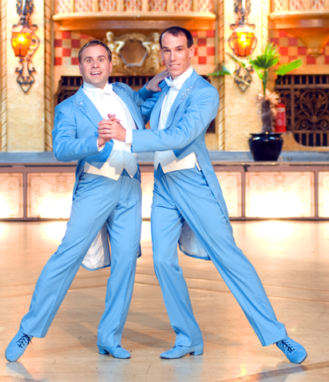
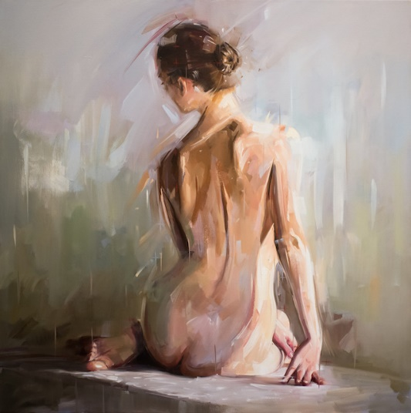
Art issue ideas
Dance:
Issues around body image, male dancers, same sex couples
Drama:
Issues around elitism, money, gender, censorship
Music:
Issues around elitism, money, women composers (gender), views on different styles
Art:
Government funding issues, nudity & gender, politics/propaganda, progression between/reactions against different movements, artist rivalry, what counts as art?

Slide 4
What you ultimately have to show
A description of the issue and explanation as to why you’ve chosen it
Evidence of research into a range of views on the issue (both supporting and differing from your own)
An understanding of current issues within the arts
Reflection on the research and how it has influenced your views
Presentation of your research that communicates your views to others effectively and persuasively
A copy of the final argument you have build up about the issue
Evidence of how the final argument was shared with others and their feedback

Slide 5
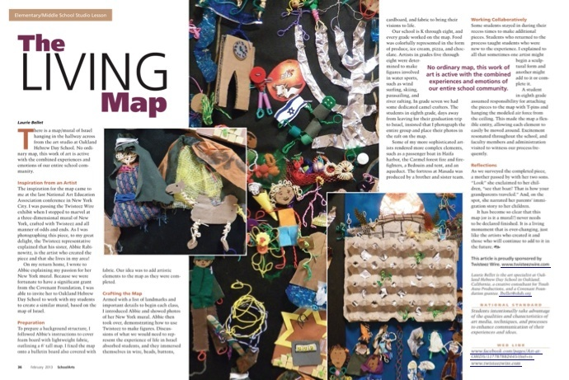
How to present your research
You could write a magazine article, set up a campaign website, set up a blog, do a presentation to your class, make a series of information leaflets…
Can you think of any other ways your could present your work?
Remember that you will need to share your work and
collect the views, opinions of those you have shared it with.
How will you do this?
Example of good work:
http://tominniss.com/artsaward/?page_id=17

Slide 6
You MUST reference all sources of research in your final project and you should create a bibliography.

Slide 7
By next week
Complete the ideas sheet and bring to lesson to discuss with teachers.
Come up with 3 possible options for your project.

