Slide 1
Unit 2 parts a-e
Leadership of an arts project

Slide 2
Unit 2: leadership of an arts project
You will have to lead an arts project!
This could include:
Running a series of workshops
Running a one off, day long event/workshop
Leading/directing a performance
Leading and creating an exhibition
Leading the development of a product
Leading the creation of an arts-based website
The outcome will have to be shared with an audience

Slide 3
Unit 2: leadership of an arts project
You will need to show:
Your creative input
Management of people
Management of resources
Organisation of the public showing
An evaluation of the project & your involvement in it
Feedback collected from the people you managed regarding your leadership

Slide 4
There are 5 parts to this unit:
A) Identifying the project aims and desired outcomes (e.g. explaining the leadership skills you hope to develop during the unit)
B) Producing a project plan from the point of initial organisation right up until the public performance/sharing
C) Collecting evidence throughout the project to show your delivery
D) Managing the public performance/showing
E) Creating a report which evaluates the whole project and reflects on your leadership skills development, taking into account feedback from the people you managed

Slide 5
TIMESCALES
Your teacher will make it clear to you how long you have to do this. Think about when the performance/public sharing will be and work backwards from that when planning.
Think about any performance platforms that you might be able to use at college - e.g. could you direct a Music group for the Spring concert? Could you direct a scene from a play or a dance for a Drama dept show? Could you organise an element of the college Arts Festival?

Slide 6
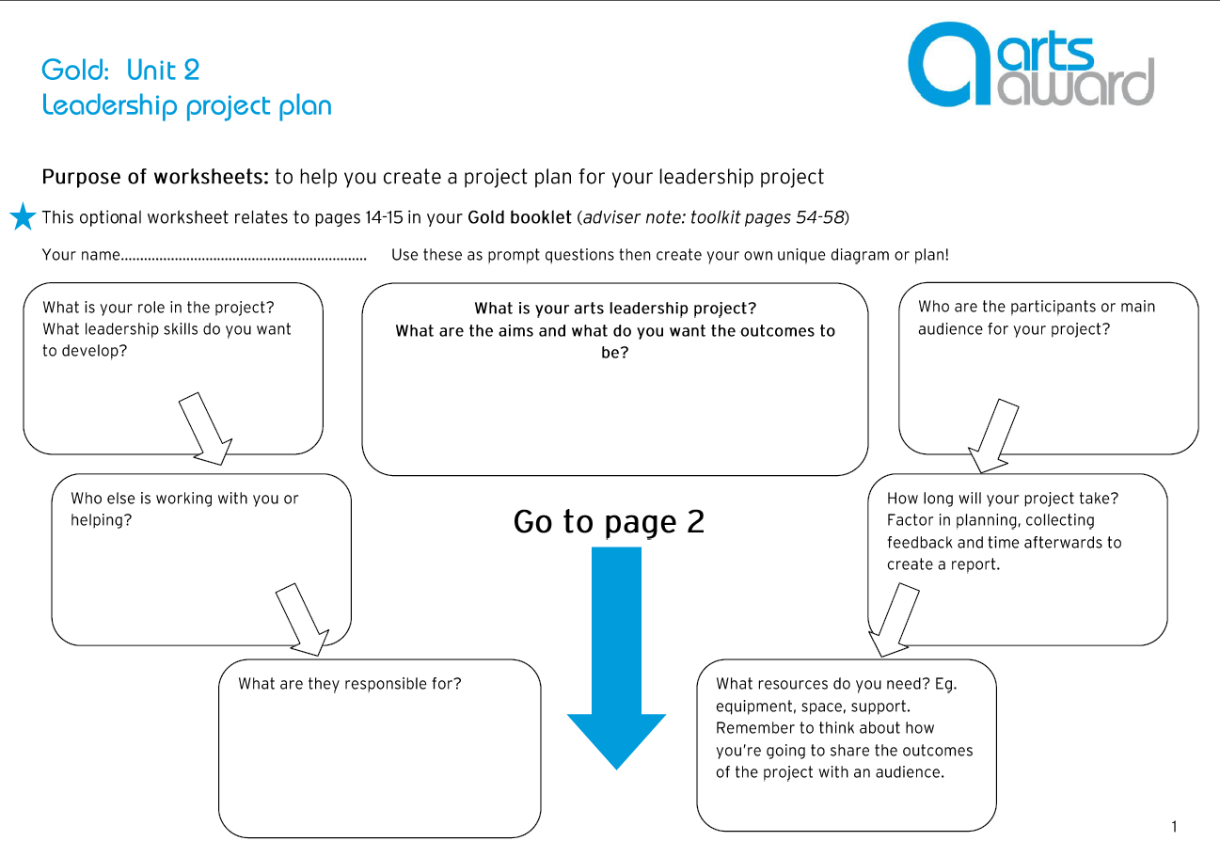
Task 1
Think about ways in which you could complete this unit
Fill out the ideas sheet
Discuss and negotiate with your teacher

Slide 7
Task 2
PART A – identify the project aims and desired outcomes
Produce a written project plan.
This can be in any form of your choosing, but must include the info on this slide AND the next slide.
What you need to show:
An understanding of effective arts leadership including identification of a distinct leadership role
How to establish the project’s aims and desired outcomes
How to provide the creative stimulus for an arts project including a public showing
How to ensure the project is relevant to its participants/audience
Development of an appropriate project plan

Slide 8
PART A – identify the project aims and desired outcomes
Evidence that you must include in your plan:
Reflection on the qualities needed for an effective arts leader. The qualities you think you already have and the qualities you want to develop.
A descriptions of the project, its aims and desired outcomes.
A description of your role and the leadership skills you want to develop.
How your role will relate to the roles of others (if any).
Plans for monitoring progress and collecting feedback.

Slide 9
Task 3
PART b – organise the people and resources required to run the project
You must create a DETAILED project plan showing thought and consideration for all of these things
Practical issues e.g. venue, resources, people Timescales Promotion of the project How you will deliver the project How you will evaluate their leadership development Budget/funding issues Your plans for the public showing Risk assessment Consideration of health and safety issues Consideration of any other relevant legislation e.g. licensing and insurance Contingency plans throughout Who to contact for advice/help

Slide 10
Task 4
PART C – manage the effectiveness of the project
You must collect substantial evidence of the delivery of the project.
This could be in the form of a diary/log entries, audio or video recordings, annotated photos, email or other correspondence, meeting minutes, registers, marketing etc. The more evidence the better – include anything and everything!
You must provide a reflection on where and how you are developing and applying your leadership skills, including:
inspiring and motivation participants
communicating
dealing with resources/budgets
dealing with challenges/unexpected problems
This could perhaps be in the form a diary, either in written or video form.
You must provide evidence of how you are collecting feedback from others, both about the project and your leadership skill development.
This could be evidenced through interviewing and videoing participants, asking participants to provide written feedback and by asking any senior leaders who are overseeing your project for their feedback.

Slide 11
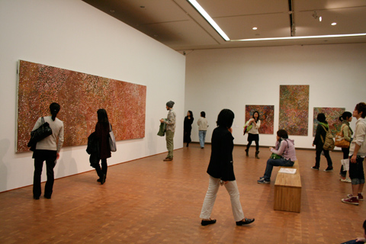
Task 5
PART D – manage a public showing of the work
You must provide the following:
Details of how the project will be shown/shared publically, including how the event will be marketed. This could be a written plan or other evidence of organisation e.g. emails etc. It should also be any marketing e.g. copies of flyers, posters, tickets, website adverts, email adverts etc.
Details regarding your responsibilities in relation to the public showing/sharing. This could be a written work.
Details of how you have organised people and resources. This could be a written work.
Evidence of delivery of the public showing. Ideally video evidence with photos.
Ongoing reflection on where and how you are developing and applying their leadership skills whilst managing the event. This could be a written work.
Feedback from participants and audience members. Survey? Focus groups? Video interviews?

Slide 12
Task 6
PART E – arts leadership project report
Now that your leadership project is coming to an end, you must write the project report.
Your project report must include:
How your leadership skills have developed
How the project has developed your art form knowledge and understating, creativity in arts practice and leadership, planning and review skills, and communication skills
How well your project plan worked
Achievement, successes and challenges
What you have learnt about working effectively with others
What you have learnt from the feedback they received
What you would do differently in future in terms of improving the project

