Slide 1


Functionalist Approaches to Crime and Deviance
Godalming College
Sociology department

Slide 2
durkheim

Slide 3
Durkheim and the functions of deviance
Durkheim’s ideas on deviance centre around the concepts of :
  conscience collective (the set of shared beliefs, ideas and moral attitudes which operate as a unifying force within society)
  Anomie (the lack of the usual social or ethical standards of a group or individual)

Slide 4
Durkheim and the functions of deviance
Durkheim (1893): ‘crime is normal… an integral part of all healthy societies’
Why do you think he thought this?

Slide 5
Make notes on Durkheim
Use the following slides, class discussion, your booklet and textbook sources to make notes on Durkheim’s theory of crime and deviance

Slide 6
Durkheim the functions of deviance
He believed:
Crime and deviance only remain “functional” so long as the conscience collective remains strong enough to be active.
In time of rapid social change there is the danger of ANOMIE - a state of normlessness where collective expectations lose their ability to regulate people - this can be very dangerous for society.

Slide 7
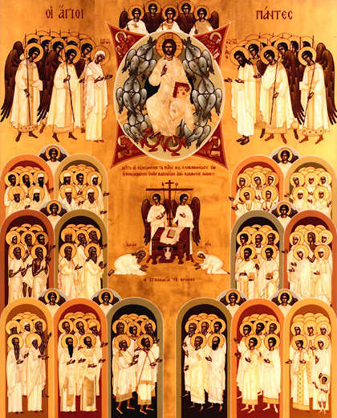
Durkheim and the functions of deviance
Crime is both inevitable and functional to society:
Inevitable because not everyone can be equally committed to collective sentiments - even in a “society of saints” some would be regarded as deviant and invite collective disapproval
Functional because crime may inspire / reflect innovatory behaviour, necessary to a healthy society to allow social change

Slide 8

Durkheim and the functions of deviance
Punishment through criminal law marks boundaries of acceptable behaviour
Police arresting a criminal show the rest of society that behaviour is unacceptable
Criminal behaviour constantly tests the boundaries of acceptable behaviour
Usually reinforces ideas about illegality
Sometimes public sympathy with “criminal” indicates need to reform the law

Slide 9
Additional notes
Use p.3-5 of your booklet to add to your notes on Durkheim.
On the next slide is an example of a very important case that helps demonstrate Durkheim’s view that crime can be positive, in terms of bringing about changes to boundaries and adaptations in society.
Research another case that has done something similar.

Slide 10
Case study: Murder of stephen lawrence
Stephen Lawrence (13 September 1974 – 22 April 1993) was a Black British man from Eltham, south east London, who was murdered in a racially motivated attack while waiting for a bus on the evening of 22 April 1993. The case became a famous cause and one of the highest profile racial killings in UK history; its fallout included profound cultural changes to attitudes on racism and the police, and to the law and police practice, and the partial revocation of double jeopardy laws, before two of the perpetrators were convicted almost 20 years later in 2012. [wikipedia]

Slide 11

What effect did the inquiry into his death have? (1)
The inquiry into the failure of the original police investigation to find and convict Stephen's killers, headed by Sir William MacPherson and which reported in 1998, became one of the most important moments in the modern history of criminal justice in Britain.
It concluded the Metropolitan Police were "institutionally racist", it made 70 recommendations and had an enormous impact on the race relations debate - from criminal justice through to all public authorities.

Slide 12

What effect did the inquiry into his death have? (2)
Scotland Yard has made numerous changes in an attempt to stamp out racism, and all public bodies are now obliged to promote equality and tackle discrimination.
The government has also tackled the double jeopardy rule which states that, in English law, anyone cleared of a crime in court cannot be retried for the same crime at a later date.
This led to the conviction of two of the five suspects in 2012.

Slide 13
Problems with Durkheim
He never explains why certain groups – the poor, young people, males – are more likely to commit crime.
His explanation of rising crime is rather vague (anomie caused by rising rates of egoism). It doesn’t say how much crime is good.
He neglects that some crimes are always dysfunctional e.g. rape, murder, child abuse.
Marxists argue he exaggerates the degree of consensus in society and underestimates the criminogenic nature of capitalism (Gordon). Inequality causes crime.
Neglects the role of the powerful in shaping the law (Snider) and the presence of white collar crime (Tombs).

Slide 14
Activities
Complete the summative activities on p.7-8 to evaluate and pick apart Durkheim.
10 mark question:
Item: Many people see deviance as being dysfunctional and negative for society because it represents the potential for social breakdown. However, some sociologists suggest that deviance might actually be functional for society and act as a warning. For example, imprisonment, fines, and so on are not simply there to punish offenders; they convey other messages as well. Society’s values are also not fixed and new ideas sometimes emerge to challenge existing values.
Applying material from the item, analyse two functions of deviance [10]

Slide 15
Strain theory

Slide 16
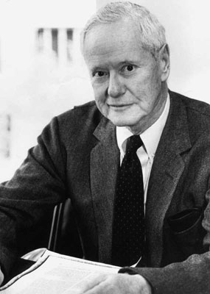
Merton and Anomie
Robert K Merton redefined Durkheim’s notion of the concept of anomie – seeing it as an inherent aspect of modern society
He tried to identify a typology (classification system) of deviance in modern society.

Slide 17


Merton and Anomie
The idea of the American Dream formed the basis of Merton’s typology – i.e. that hard work can create material success and that this is worth striving for, for yourself and your family
BUT while anyone might be President, everyone cannot! (Or can they??)
People deal with the ‘strain’ of not being able to necessarily achieve their goals in different ways

Slide 18
Adaptation | What it means | Acceptable Goals | Acceptable Means | Types of “deviance”
Conformity | The successful – “the few? |  |  | Not a deviant response
Innovation | Bending or breaking rules to succeed |  |  | Thieves, fraudsters – “utilitarian” crime
Ritualism | Going through the motions – but no aim for success |  |  | Low grade clerks, etc Is this deviance?
Retreatism | Withdrawing from the rat race altogether |  |  | Junkies, dropouts, cult members? Monks? Nuns?
Rebellion | Changing the goals and the means |  |  | Revolutionaries
Could we link social class to each of these?

Slide 19
Merton and anomie
For Merton deviance is the result of the strain between two things:
The goals the culture encourages individuals to achieve.
What the institutional structure of society allows them to achieve legitimately.
> The strain between the cultural goal (favoured in the West) of money and success and the lack of legitimate opportunities to achieve leads to frustration, and this in turn creates pressure to resort to illegitimate means such as crime and deviance.
> This pressure to deviate is called ‘the strain to anomie’

Slide 20
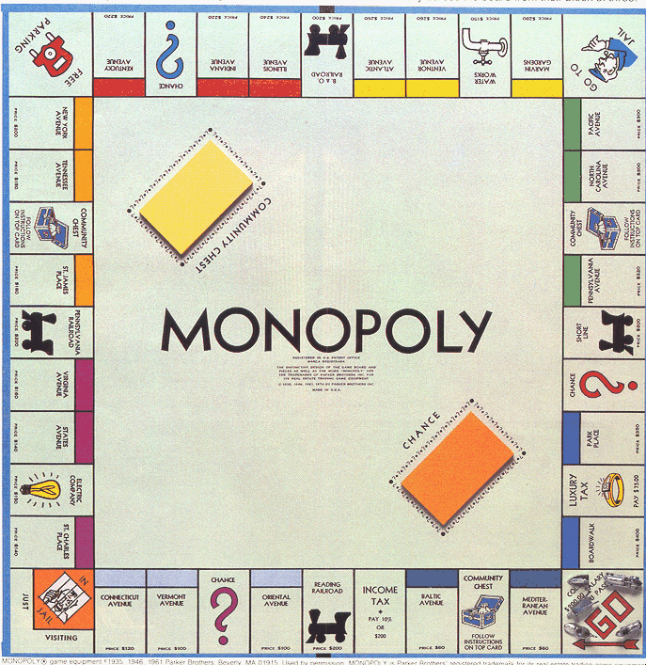
Merton and Anomie
Cheat
= Innovator
Rule changers
On the mobile
Or ending the game early
= Retreatist
= Rebel
Winner
Persistent player
= Conformist
= Ritualist

Slide 21
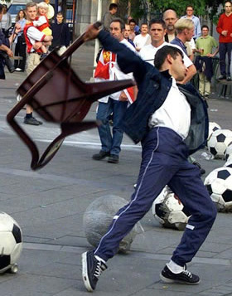
Merton and Anomie
Problems remain with Merton’s account
For example how do we deal with the issue of non-utilitarian crime – crime with no clear benefit to the individual criminal?
How can we use Merton’s approach to analyse crimes such as vandalism, gang violence, etc – and is it convincing?

Slide 22
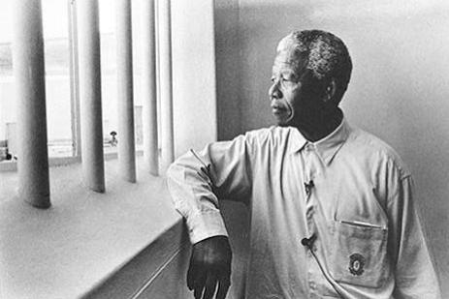
Merton and Anomie
  What about people who may be apparently following acceptable means – and yet these means are re-defined or re-viewed as unacceptable
  - or vice versa
  What is defined as deviant or criminal is the result of the power of those who define it, not an inherent quality of the action itself.
  It depends on social context.
How does Nelson Mandela indicate this?

Slide 23
Evaluation of merton
He doesn’t explain why some people commit crime, whilst others conform, retreat or rebel.
He doesn’t explain non utilitarian crime e.g. crimes with no financial benefit.
Doesn’t explain the role of subcultures.
Underestimates the amount of white collar/corporate crime where people do have the means.
He assumes the law treats everyone equally.

Slide 24
Recent strain theories
Recent strain theories argued that young people may pursue a variety of goals other than money success e.g. the wish to fit in, be popular etc.
The failure to achieve these goals may result in delinquency.
Downes and Hansen (2006) surveyed crime rates and welfare spending in 18 countries- found those with higher spending on welfare had lower rates of imprisonment. This indicates that societies that protect the poor have less crime.

Slide 25
Activities
Complete the activities about Merton on p.9-11 of the workbook

Slide 26
Subcultural theories

Slide 27
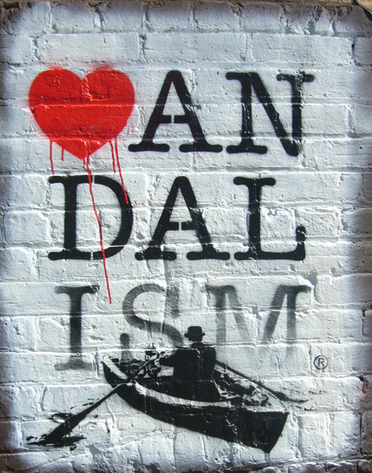
Alternative explanations: Functionalist subcultural strain theories
Subcultural theorists such as Cohen, Cloward and Ohlin, Miller and Matza developed theories which relied upon the lack of acceptance of a single “mainstream culture” to explain non-utilitarian, group behaviour.
They see deviance as the product of a delinquent subculture with different values to those in the mainstream.
Subcultures provide a an alternative opportunity structure for those who are denied an alternative opportunity for success

Slide 28
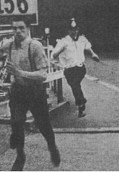
Reactive Approaches to the development of Deviant Subcultures
Reactive approaches assume that deviant subcultures form as a response and opposition to mainstream / conventional (usually middle class) culture.

Slide 29
Example of strain Approaches 1.
Albert Cohen - Delinquent Boys
Argued that young working class boys reacted against and opposed conventional culture due to status frustration
Conventional forms of status is denied them due to failure at school and (eventually) in the work place

Slide 30
activity
Complete notes about Cohen on p.12 of your booklet

Slide 31
Example of strain Approaches 2.
Cloward & Ohlin
Another response to Merton’s strain theory
Looks at collective rather than individual character of deviance and apparently irrational, “non-utilitarian” crime
Looks at opportunities available to groups and outlines alternative illegitimate opportunity structure

Slide 32

Example of strain Approaches
Three types of sub-culture :
Criminal opportunity subculture - linked to organized adult crime
Conflict subculture - linked to gang violence especially among adolescents
Retreatist subculture - especially linked to illegal drug use
Each of these are a reaction to failing to achieve legitimate ends by legitimate means

Slide 33
Problems with Cloward and Ohlin
It is not clear how distinct these subcultures really are
Participation in these groups would seem to be a short-term rather than a long term option
This explanation only attempts to explain a limited range of “deviance”
Is it clear that there is a mainstream culture out there?

Slide 34
Independent Approaches to the development of Deviant Subcultures
Independent approaches assume that deviant subcultures may differ from mainstream culture but are not best understood as a form of opposition or reaction against this culture.
Deviant subcultures are therefore best understood as an independent extension of lower class culture.

Slide 35
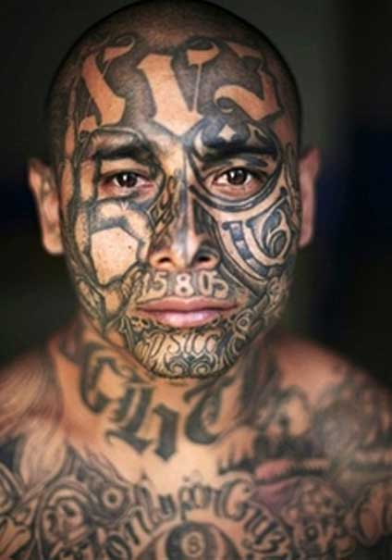
Example of Independent Approaches.
Walter B Miller - Lower Class Cultures as a Generating Milieu of Gang Delinquency
Argued that there are no common or widespread values: each social stratum has a distinctive subculture associated with it.
Middle class and working class are socialised into different subcultures based on their respective classes.
Lower working class youths are routinely exposed to a number of focal concerns
These predispose them towards a lifestyle of delinquency.

Slide 36

Miller’s focal concerns
Trouble – you should not run away from a fight
Toughness – an important aspect of “manliness”
Smartness - “Looking good”, “being sharp” – the basis of your self-respect
Excitement – Hedonism is reasonable – you should seek out “fun” and “enjoyment” while you can
Fate – what ever will be, will be
Autonomy – you should never let people push you around

Slide 37
Evaluation of subcultural theories
David Matza (an interactionists) suggests subcultural theories have the following problems:
Only a minority of young people actually get into trouble with the police or join gangs.
Young people may drift in and out of delinquency but eventually grow out of it.
Young people, when discussing their delinquency, haven’t joined subcultures to gain material success, instead their reasons for joining include risk taking, excitement and thrills.
Neglect the role of the police in labelling young people as trouble-makers. Middle class youths may be just as delinquent but the police overlook their behaviour or do not label it as problematic.

Slide 38
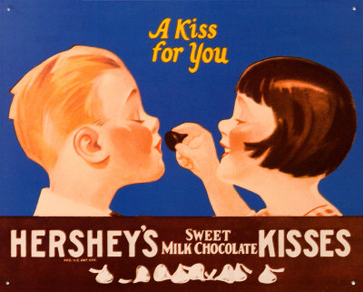
Hirschi and Control Theory
Rather than of starting from the question what causes deviance, Hirschi turns the question around and asks what causes conformity
He identifies 4 key social bonds

Slide 39
Belief
Commitment
Why I should obey society’s rules.
My investment in my life.
How I care for others around me
My everyday occupation in legitimate activities.
Attachment
Involvement

Slide 40

Hirschi and Social Bonds
It is these social bonds that hold me into my place in society – when these weaken then I could do … anything?
With a decline in the traditional family, etc the risk of anomie becomes greater
Like Durkheim, there is a sense of the threat posed by the weakening of bonds.

Slide 41
Hirschi and Social Bonds
Hirschi’s work is influential on the New Right who have taken the idea of anomie into a more “practical” direction
This moves us beyond the functionalist approach into a new policy making area.
We will return to this.

Slide 42
Conclusions
The concept of anomie is key to understanding Functionalist theory and the developments from it, in both subcultural and right realist approaches
It remains an elusive concept to pin down
Whilst functionalist theory has its gaps, it has set the terms of debate for later sociological approaches

Slide 43
evaluation
On p.15 explain the general criticisms of classical functionalist theory on deviance using p.454 of Browne.

Slide 44
Homework
Make notes on:
Durkheim
Merton – strain theory (how is he different to Durkheim)
Subcultural theories – Cohen, Cloward and Ohlin
Independent subcultural theories – Miller, Hirschi

Slide 45
Exam focus
Outline two reasons why functionalists see crime as inevitable [4]
Outline three reasons why some crime and deviance may be necessary and beneficial for the well-being of society [6]
Item B: Strain theories focus on the ways in which people may resort to crime of deviance when they are unable to achieve socially approved goals by legitimate means. For example, Merton argues American culture emphasises achieving success, but an unequal structure limits some individuals’ opportunity to do so legitimately. This may induce frustration in the individuals concerned. Some strain theorists see the response to this situation as a group reaction, in which individuals create or join deviant subcultures.
Applying material from Item B and your knowledge, evaluate the contribution of strain theories to our understanding of crime and deviance [30 marks]

