Slide 1
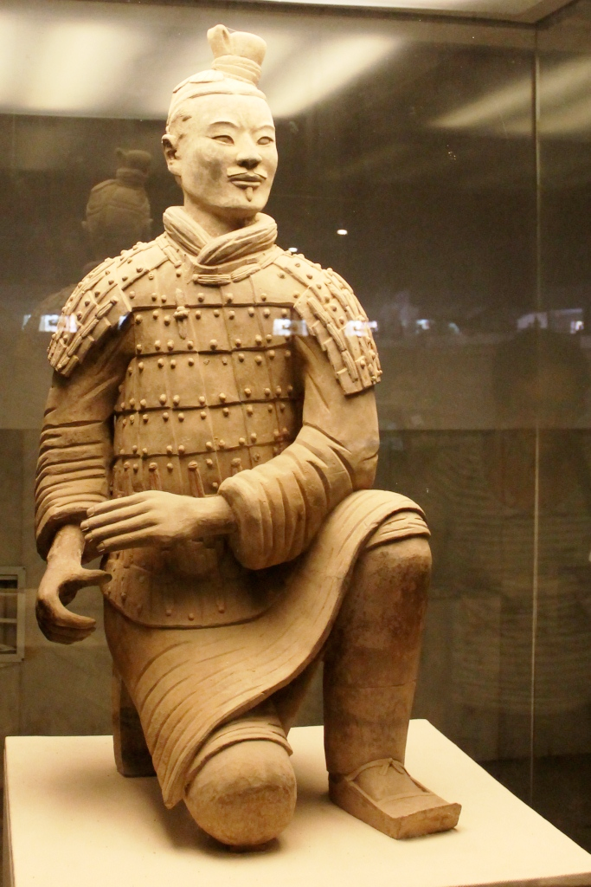
Participants in War 2D or 3D
Kneeling Archer (from the Terracotta Army)
Size: Lifesize
Material: Terracotta.
Date: c210BC.
Location: Museum of the Terracotta
Warriors of Qin Shihuang, Xi'an, PRC

Slide 2
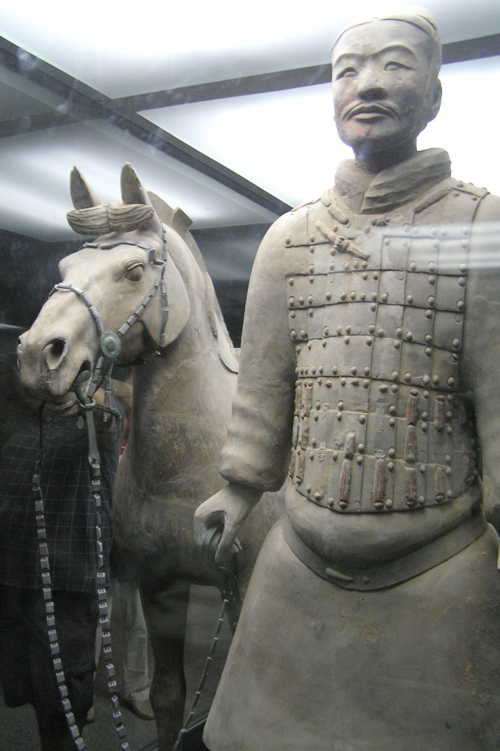
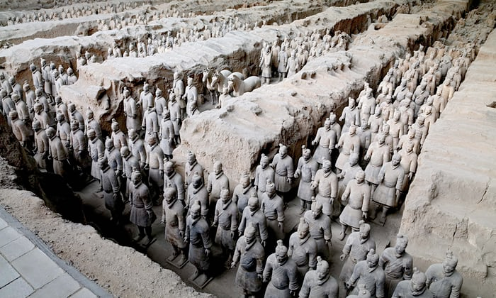
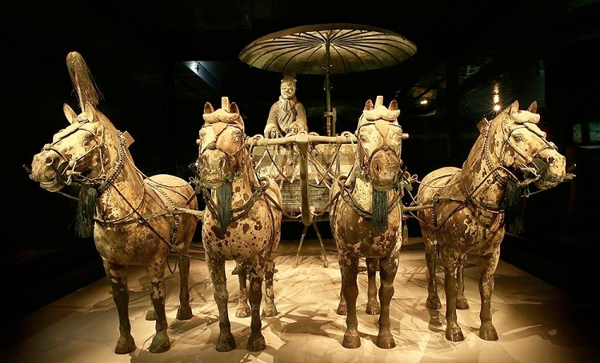

Slide 3
Background
Qin Shi Huang Di was the first Emperor of
China. He lived from 259 to 210 BC.
He came to the throne at the age of 13 and would unify all the warring kingdoms which had made up China into one huge country which he then ruled.
Shortly after coming to power he commissioned a huge mausoleum which would act as his burial tomb
Over 700,000 labourers worked on the project for almost 40 years, by which time Qin Shi had died.
By controlling such a large country as China during his life, he also wanted to conquer the afterlife.
The terracotta army contains soldiers of all ranks including generals to archers and foot soldiers.
Other members of a royal court from the period were also sculpted, including court officials as well as acrobats, musicians, dancers

Slide 4
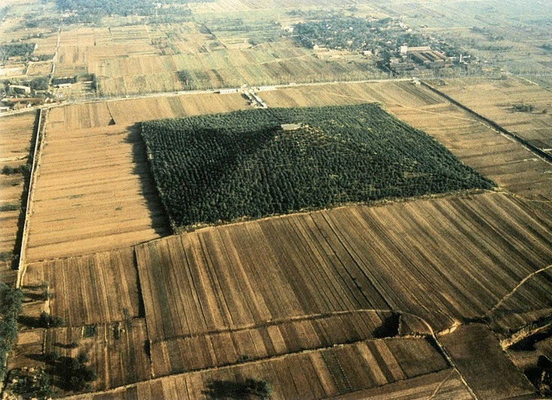
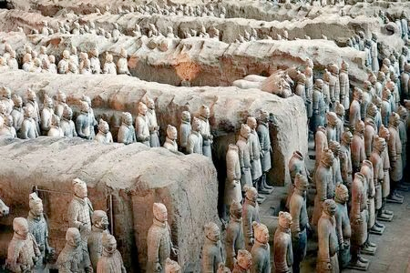
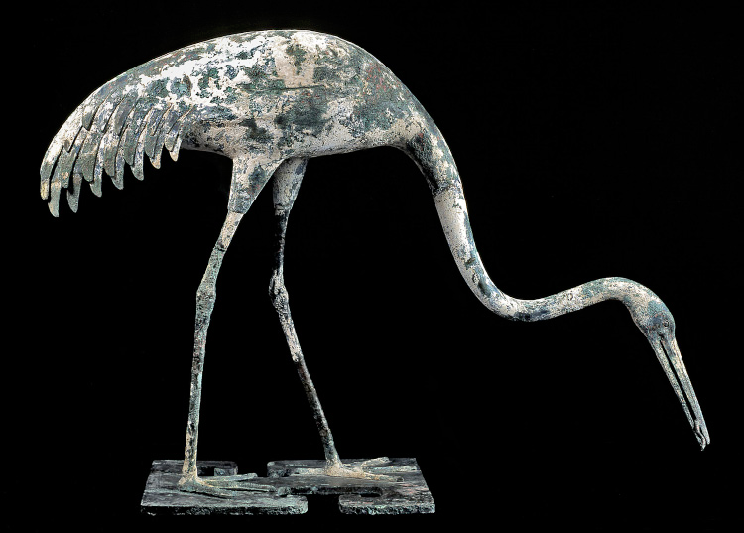
Background
The mausoleum of the Emperor was designed like as an underground city for the Emperor to rule after his death.
Thousands of sculpted terracotta figures were placed in an area estimated to be about 38 square miles in scale.
The terracotta army guard the tomb of the Emperor while other sculpted figures including acrobats and musicians were intended to entertain the Emperor as had been done during his life.
Palaces, towers and gardens were all constructed beneath the earth and huge rivers and lakes were created which contained liquid mercury.

Slide 5
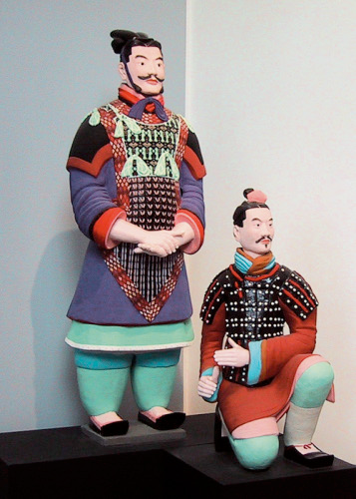
Participants in War 2D or 3D
This figure is life-sized and is shown
kneeling and alert.
His left hand appears to reach towards a
missing weapon which would have been held
in his right hand.
This weapon would have been a bronze
crossbow and the archer is prepared to kill to
protect the Emperor.
Sculpting in terracotta (clay) allows for detail
which gives realism to the figure and would
also have meant the figure could be painted.
In addition to protecting the Emperor this
archer also reminds us of the military power
the Emperor wielded during his lifetime.
Qin Shi Huang Di was successful in creating a
united Chinese Empire. He achieved this
through a series of wars. Thus the huge scale
of the terracotta army tells us he achieved
power and used war as a means of ruling an
empire.

Slide 6
Participants in War 2D or 3D
https://www.youtube.com/watch?v=W73GLWEJuQA#t=116
‘Each face is unique and shows the various
ethnic groups that made up the army’
Why might so many Chinese ethnicities be represented in this army?
How would you describe the presentation and appearance of this archer?
How does this sculpture fit the theme of a participant in war?

