Slide 1
WEEK 1

Slide 2
30

Slide 3
RWS13 - Trade and Protectionism 30: Introduction to Trade and Protectionism Key Concepts
Trade: Exports, Imports and ‘Globalisation’ (the recent pattern of trade)
Protectionism: Tariff’s, Quotas and Subsidies
Benefits of Trade: Absolute and Comparative Advantage - Ricardo’s Theory
Benefits of Protectionism: Infant and Sunset Industry Arguments
Problems with Trade: Resource Curse and Forced Specialisation, Inequality and Dumping
Problems with Protectionism: Welfare loss of tariffs (the tariff diagram)

Slide 4
WEEK 2

Slide 5
PREP

Slide 6
PREP HOMEWORK Due w/b 25th September (Up to 3 hours to complete)
TRADE AND PROTECTIONISM = LEDC’s…..
Watch or read the following sources and use them to answer the questions to the right:
Coffee Industry
Watch the video ‘Black Gold’ on estream (click on link or search)
Read the article on coffee markets and ‘Tariff Escalation’ (see GOL)
Agricultural Industry
Watch the videos - the Happiest Nut in the world (click on the link or google the highlighted part) “CAP-Oliver Watson Critique” (click on the links or search for the video’s by typing what is highlighted into estream search). Only watch (00:00-00:07; 14:00-15:00)
Read the article on subsidies and dumping (same article as above)
Take notes to answer the following Questions (MIND MAP!?):
Coffee Industry
How important is coffee to Ethiopia’s economy?
Why do farmers in Ethiopia get paid record low prices for their coffee yet the demand for coffee is at an all time high?
What are the criticisms of the WTO from the video?
How are the EU arguably to blame for the plight of the farmers (take info from both the article and documentary)
What do you think of ‘Starbucks’ as a company after watching the video?
What is preventing coffee producers in Ethiopia from developing?
What hope is there for the future?
Agriculture
Why would a Government giving subsidies to an industry within it’s country be considered to be a form of protectionism?
Provide a brief overview of the case studies in the ‘Happiest Nut in the World’? What are the countries involved and what has happened?
What is the problem with the EU and UK farming according to Oliver Watson?
How do these subsidies prevent countries in Africa from developing?

Slide 7
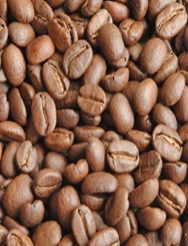
Trading Relationship: Protectionism CASE STUDY: Tariff Escalation in the Coffee Markets of Africa
Tariffs - taxes on imports to prevent national consumers buying foreign imports and to therefore force them to buy from national/local firms)
Tariff Escalation - escalating tariffs on manufactured products but allowing primary products to be imported.
For 1lb bag of coffee, the following receive:
PRIMARY: Farmers (green coffee beans) = $1.41
SECONDARY: Roasting the coffee beans, grinding them down and packaging = $26
TERTIARY: Selling the coffee (via supermarkets or coffee houses – Starbucks etc) = $214
Some Facts about COFFEE
2.25 billion cups consumed every day
90% grown in developing countries but majority consumed and manufactured in developed countries. Brazil is the biggest exporter of green coffee beans
Green coffee beans are the beans straight from the tree. They are an important commodity which is globally traded every day
Roasted coffee beans have gone through a production process and are then either ground down, packaged and sold to retailers.
Notes:
20 mins: Teacher led and student note taking - slides 19 and 20
Ultimately, ask the question….

Slide 8
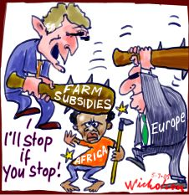
Trading Relationship: Protectionism CASE STUDY: US and EU Subsidies and the problem of ‘Dumping’
Subsidies: Free grants given to businesses (in this case farms and farmers) by EU and US Governments. Means the cost of producing food for these farms is reduced which leads to lower prices for EU and US produced food.
Two main problems
UNEQUAL PLAYING FIELD: Developing countries cannot compete with the subsidised prices on top of the fact that the US and EU have greater productivity due to Economies of Scale and Specialisation. Equally, ‘developing countries’ do not have the fiscal power to subsidise their own farmers.
DUMPING: The EU and US produce too much as they are incentivised to do so with the subsidies (shift to the right in the supply curve for agricultural markets). What do these countries do with the surplus? Give them for free to the ‘starving Africans’! Problems? Well, what happens to the domestic agricultural markets in African countries if there is a sudden increase in essentially free imports? Collapse! And a dependency on the EU and US for food.
CAP
EU Farmers enjoy protectionism in the UK
(00:00-00:07; 14:00-15:00)
US subsidies and the luckiest nut in the world - 8 mins
Notes:
20 mins: Teacher led and student note taking - slides 19 and 20
Ultimately, ask the question….

Slide 9
30

Slide 10
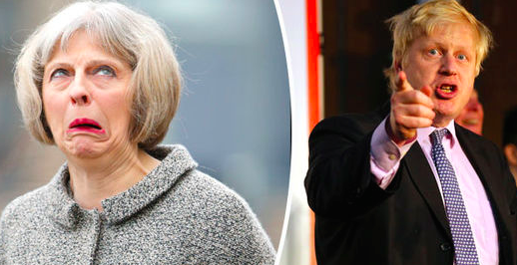
STARTER ACTIVITY: Macroeconomics At 0900, I will be picking out students to answer the questions below. Feel free to confer with the person next to you but you are only allowed to use each other and your PREP homework notes (NO PHONES PLEASE). You do not need to take notes unless you want to but can simply discuss the questions verbally. You should be prepared to put forward an answer and justify it.
Economics in the News this Week
BREXIT and UK Trade
(3) What is the difference between a ‘customs union’ and the ‘single market’?
(4) Which of the 6 options from the Financial Times article is the best one for the UK and why in March 2019?
(5) Which of the 6 options from the FT article is the WORST one for the UK and why?
(6) Should the UK still BREXIT?
(7) What is the role of the WTO?
(1) Why did the pound suddenly shoot up this week? HINT: It was to do with someone saying something?
(2) Why over the weekend has Boris Johnson upset Theresa May? HINT: It is to do with an article he has written…

Slide 11
BREXIT - Final Solutions?

Slide 12
90

Slide 13
RWS13 - Trade and Protectionism STARTER: Should you trade?
The two countries below can use its resources to produce either Plastic Toys OR Cars:
Plastic Toys
Cars
10
60
100
5
The UK and India produce Textiles and Books:
Notes:
For the UK to produce 1 unit of textiles, it has an opportunity cost of 4 books.
For India to produce 1 unit of textiles it has an opportunity cost of 1.5 books
Therefore India has a comparative advantage in producing textiles because it has a lower opportunity cost
Opportunity cost of producing books
If the UK produces a book, the opportunity cost is 1/4 (0.25)
If India produces a book, the opportunity cost is 2/3 (0.66)
Therefore the UK has a comparative advantage in producing books
(because it has a lower opportunity cost of (0.25 compared to India’s 0.66)
The theory of comparative advantage
If each country now specializes in one producing good then assuming constant returns to scale, output will double.
Output after specialisation
Therefore output of both goods has increased illustrating the gains from comparative advantage.
The total output is now 4(T) and 8(B), which is higher than the previous totals.

Slide 14
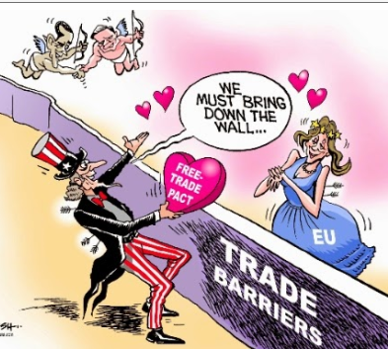
RWS13 - Trade and Protectionism TODAYS LESSON
Trade is beneficial: The Theory of Comparative Advantage
Protectionism (Tariffs) leads to a loss of welfare: The Tariff Diagram

Slide 15
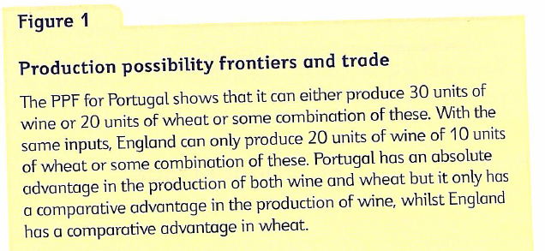
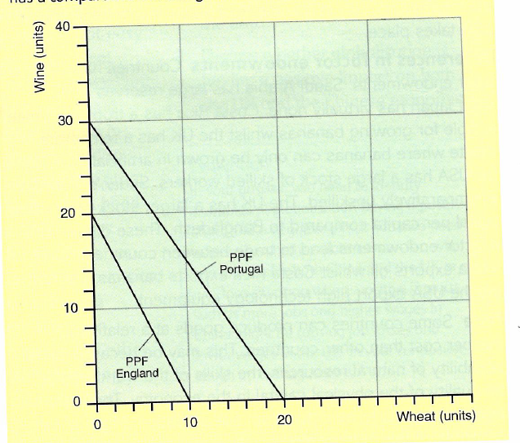
Key Terms RECAP Opportunity Cost and PPFs
What is opportunity cost?
What is the opportunity cost (in terms of wheat) of Portugal producing one unit of wine?
What is the opportunity cost (in terms of wheat of England producing one unit of wine?
What is the OC (in terms of wine) of Portugal producing one unit of wheat?
What is the OC (in terms of wine of England producing one unit of wheat?
Who should specialise in what?
Notes:
What is opportunity cost?
What is the opportunity cost (in terms of wheat) of Portugal producing one unit of wine? 20/30: 1 wine = 0.66 wheat
What is the opportunity cost (in terms of wheat of England producing one unit of wine? 10/20: 1 wine = 0.5 wheat
What is the OC (in terms of wine) of Portugal producing one unit of wheat? 30/20: 1 wheat = 1.5 wine
What is the OC (in terms of wine of England producing one unit of wheat?) 20/10: 1 wheat = 2 wine
Therefore who should specialise in what?

Slide 16
RWS13 - Trade and Protectionism Absolute Advantage

Slide 17
KEY TERMS
Absolute advantage: where a country using a given set of resource inputs is able to produce more than other countries with the same input.
Comparative advantage is when a country can produce a good or service at a lower opportunity cost than another country. So they are ‘relatively’ better at specialising in a particular good.

Slide 18
WEEK 3

Slide 19
30

Slide 20
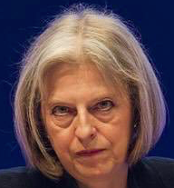
STARTER ACTIVITY: Macroeconomics At 0900, I will be picking out students to answer the questions below. Feel free to confer with the person next to you but you are only allowed to use each other and your PREP homework notes (NO PHONES PLEASE). You do not need to take notes unless you want to but I would advise you taking rough notes on the back of your PREP work. can simply discuss the questions verbally. You should be prepared to put forward an answer and explain or justify it.
Economics in the News this Week
PROBLEMS WITH PROTECTIONISM & LEDC’s
(2) What are the criticisms of the WTO in the video and articles? Do you think they are justified?
(3) What is ‘dumping’, how does it relate to protectionism and why can it cause global inequality?
(4) Tariff escalation is an example of something called ‘forced specialization’. What do you think this is?
(5) Ethiopia’s export revenues revolve around coffee and everyone wants it! Therefore what might happen to the “Birr” (the currency of Ethiopia) as a result and how might this affect other exports from Ethiopia?
(1) What was Theresa May’s speech about on Friday and how does it link to the topic we are studying?

Slide 21
THIS WEEK
TESTS?
MONDAY: MACRO
RWS13: Trade and Protectionism: Tariff Diagram
TUESDAY: MICRO
RWS13: Perfect Competition Model (bring your MICRO PREP)
THURSDAY: MACRO
RWS13: Trade and Protectionism:
CONSOLIDATION HOMEWORK FOR MONDAY 02nd October:
Complete two revision worksheets (see GOL). 2.25 to 3 hours EACH = 4.5 to 6 hours

Slide 22
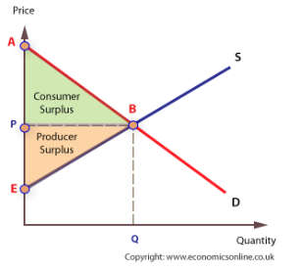
RWS13 - Trade and Protectionism 45: Why is protectionism so bad for our welfare?
RECAP OF KEY TERMS FROM 1st YEAR
Efficiency
Allocative efficiency
Productive efficiency
Welfare
Consumer surplus
Producer surplus

Slide 23
RWS13 - Trade and Protectionism 45: Tariff Diagram – take some risks!!!
The UK Wheat Market and the Common External Tariff: An example of trade diversion (not creation!)?
FOR EACH QUESTION, DRAW ON THE DIAGRAM THE INFORMATION REQUESTED
What would the equilibrium price be for wheat if there was NO trade and there was a closed economy
How much is the tariff per unit if international trade occurs and the UK is bound by the common external tariff of the customs union (which includes tariffs on wheat!)?
Without the tariff, where is the equilibrium point and how much is being produced from foreign countries and from domestic production?
With the tariff, what happens to both international production and domestic production?
HARDER QUESTIONS!
What is the total Government revenue raised by the tariff?
Where is the increase in producer surplus for domestic producers
How much does consumer surplus fall by?
What is the overall loss to society of implementing this tariff?
Which economics agents have gained and who has lost in the UK as a result of this tariff?

Slide 24
RWS13 - Trade and Protectionism 45: Tariff Diagram
BASICS
What is the equilibrium price without trade?
What will the price of imports be if a tariff is imposed?
What is the quantity of imports with a tariff imposed?
What would the price and quantity be if there was free trade?
GOVERNMENT TARIFF REVENUE
What is the total Government revenue from putting a tariff on imports?
CONSUMER SURPLUS
How much is the consumer surplus with:
….no trade
….After a tariff
….Free trade
How much do tariffs reduce consumer surplus by?
PRODUCER SURPLUS
How much is the producer surplus with…
….No trade
….After a tariff is imposed
….Free trade
How much do tariffs increase producer surplus?
OVERALL WELFARE EFFECT
What is the net welfare loss to UK society of implementing the common external tariff?

Slide 25
RWS13 - Trade and Protectionism 45: Why is protectionism so bad for our welfare?
In this case, the tariff is P1-P2.
The tariff leads to a decline in imports. Imports were Q4-Q1. After the tariff, imports fall to Q3-Q2.
Consumer surplus falls by 1+2+3+4
Government raises tariff revenue of area 3
Domestic suppliers gain an increase in producer surplus of area 1
The net welfare loss is (1+2+3+4) = (1+3) = 2+4

Slide 26
RWS13 - Trade and Protectionism 45: Tariff Diagram
BASICS
Without any trade, the equilibrium price is £1.80 and a quantity of 40 million
With a tariff of £0.40, the price of imports will be £1.60.
The quantity of imports at £1.60 is (50-30) = 20 million.
WIth free trade (no tariffs) the price would be £1.20 and quantity bought 60 million.
GOVERNMENT TARIFF REVENUE
Tariff revenue = tariff × q. of imports (£0.40 × 20 million) = £ 8 million
CONSUMER SURPLUS
This is the difference between the price consumers pay and the price they are willing to pay; therefore we find the area of the triangle between demand curve and price
With no trade = (£3.20 – £1.80 × 40) /2 = (£1.40 ×40)/2 = £28 million
After tariff – (£3.20 – £1.60) × 50)/2 = £40 million
With no tariff (free trade)- £3.20 – £1.20 × 60)/2 = £60 million
Tariffs reduce consumer surplus by £20 million
PRODUCER SURPLUS
The difference between the price and the price firms are willing to supply at (supply curve
With no trade (£1.80 – £0.5) × 40)/2 = £24 million
With tariff (£1.10 × 30)/2 = £15 million 16.5
With free trade and no tariff (£0.7 ×20)/2 = £6 million.
Tariffs increase producer surplus by £9 million
OVERALL WELFARE EFFECT
Welfare effect of tariffs = gain in producer surplus (£9 m) + gain in tariff revenue (£8m) – loss of consumer surplus £20m)
Therefore net welfare loss = £3 million

Slide 27
RWS13 - Trade and Protectionism 45: Tariff Diagram
BASICS
Without any trade, the equilibrium price is £1.80 and a quantity of 40 million
With a tariff of £0.40, the price of imports will be £1.60.
The quantity of imports at £1.60 is (50-30) = 20 million.
WIth free trade (no tariffs) the price would be £1.20 and quantity bought 60 million.
GOVERNMENT TARIFF REVENUE
Tariff revenue = tariff × q. of imports (£0.40 × 20 million) = £ 8 million
CONSUMER SURPLUS
This is the difference between the price consumers pay and the price they are willing to pay; therefore we find the area of the triangle between demand curve and price
With no trade = (£3.20 – £1.80 × 40) /2 = (£1.40 ×40)/2 = £28 million
After tariff – (£3.20 – £1.60) × 50)/2 = £40 million
With no tariff (free trade)- £3.20 – £1.20 × 60)/2 = £60 million
Tariffs reduce consumer surplus by £20 million
PRODUCER SURPLUS
The difference between the price and the price firms are willing to supply at (supply curve
With no trade (£1.80 – £0.5) × 40)/2 = £24 million
With tariff (£1.10 × 30)/2 = £15 million 16.5
With free trade and no tariff (£0.7 ×20)/2 = £6 million.
Tariffs increase producer surplus by £9 million
OVERALL WELFARE EFFECT
Welfare effect of tariffs = gain in producer surplus (£9 m) + gain in tariff revenue (£8m) – loss of consumer surplus £20m)
Therefore net welfare loss = £3 million

Slide 28
RWS13 - Trade and Protectionism Arguments for Free Trade (and against protectionism)
Free Trade leads to the best outcomes
Theory of absolute and comparative advantage. Greater specialisation leads to greater output = higher living standards
Lower prices and increases in consumer surplus (see tariff diagram)
Protectionism leads to a loss of welfare for countries who implement the tariff (EU) but ALSO for other countries like LEDC’s trying to develop (Ethiopia, Ghana etc.).
Loss of welfare to society (see tariff diagram), and especially for consumers
Protectionism by MEDC’s (EU example): Forced Specialisation and Dutch Disease Issues leading to global inequality for LEDC’s

Slide 29
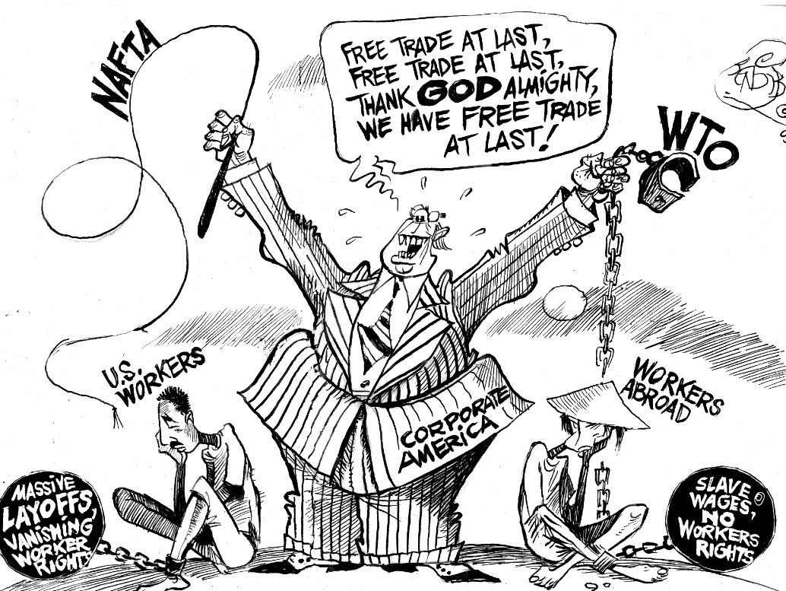
RWS13 - Trade and Protectionism Is trade really that good and protectionism so evil?

Slide 30
90

Slide 31
RWS13 - Trade and Protectionism Is trade really that good and protectionism so evil?

Slide 32
RWS13 - Trade and Protectionism Disadvantages of Trade
Greater global inequality: ‘Forced specialisation’ into low value added agricultural products - e.g. Ethiopia prevented from developing further as they have a ‘comparative advantage in growing green coffee beans’
Vulnerable to external shocks: ‘Dutch Disease’ and price volatility - e.g. Zambia
Environmental: increased pressures on habitats, more energy needed to transport goods, greater waste etc.
Dumping: floods of imports into a country can damage the domestic industry - e.g. Zambia
Consumerism: too much choice? ‘Small is Beautiful’?
MNC’s have too much power: vast economies of scale mean very wealth companies are able to trade non-stop and become wealthier, often threatening sovereignty of nations?
TASK:
Which is the strongest argument and why?
Which is the weakest argument and why?

Slide 33
RWS13 - Trade and Protectionism Advantages of Protectionism - for each argument, justify at least one evaluation point….
Advantages of Protectionism for a country
Infant Industry Argument (Chang’s Theory)
Diversify the economy (prevent ‘forced specialisation’, Dutch Disease and price volatility). Also leads to greater self-sufficiency
Raise revenue for the Government
Protect unemployment in general
EVALUATION?
(a) Low tax revenues
A small overall increase in the total tax take
(b) Retaliation?
Protectionism leads to retaliation and therefore higher import prices and higher consumer prices
(c) High Prices
Smaller firms and more inefficient firms stay in business leading to higher prices overall. Higher prices lead to lower overall demand causing job losses in other industries and loss of welfare overall
(d) Low tax revenues
A small overall increase in the total tax take

Slide 34
RWS13 - Trade and Protectionism To what extent should Government’s remove protectionist policies? 25 Marks
Yes they should remove protectionist policies because they are harming the welfare of the citizens in their economy
As: Tariff Diagram
Ae: Infant industry, raise revenue for Government etc.
Yes they should remove protectionist policies because free trade leads to better outcomes for it’s people
As: Comparative advantage theory
Ae: Problems with free trade?
Yes they should remove protectionist policies because they harm the welfare of others?
As: EU example - tariff escalation etc.
Ae: would this happen under free trade anyway?

Slide 35
THE END

Slide 36
WEEK 1

Slide 37
INTRODUCTION TO THE EU
European Political Institutions: European Parliament and Commission
European Economic Institutions: European Central Bank
Free Trade and the Single Market

Slide 38
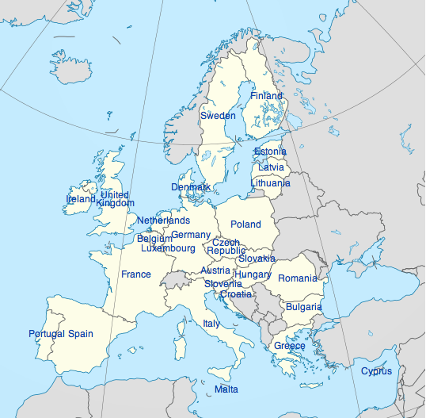

Slide 39
European Economics
Issues in the European Union

Slide 40
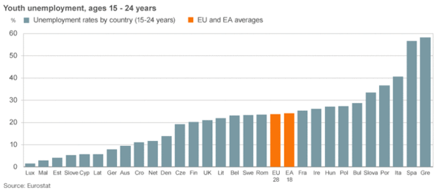
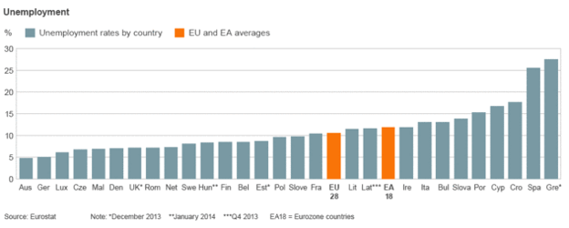
Issues in the EU Today?

Slide 41
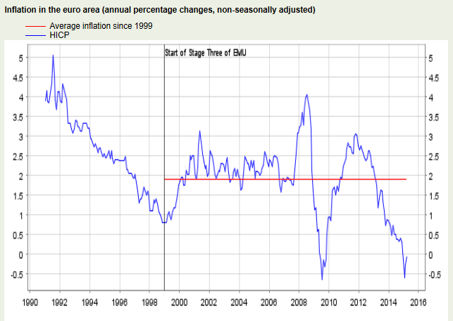
Issues in the EU Today?

Slide 42
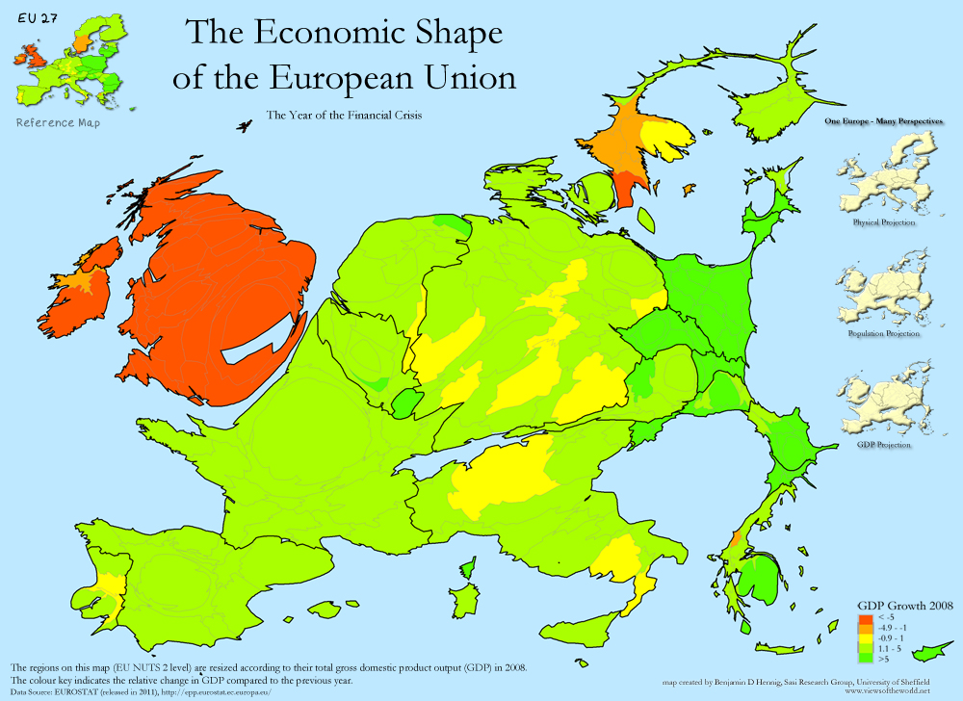
Issues in the EU Today?

Slide 43
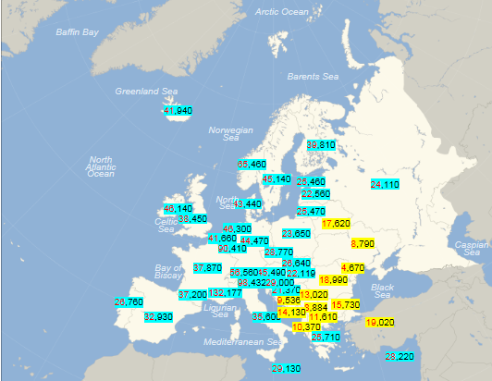
Issues in the EU Today? GDP per capita ($)

Slide 44
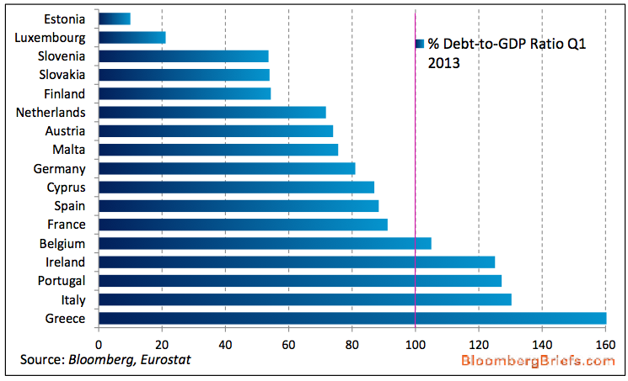
Issues in the EU Today?

Slide 45
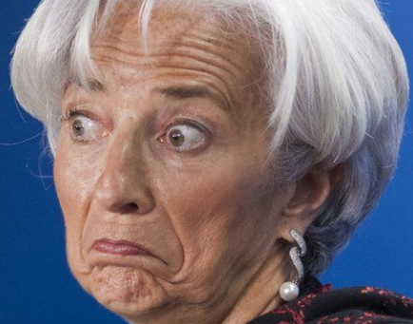
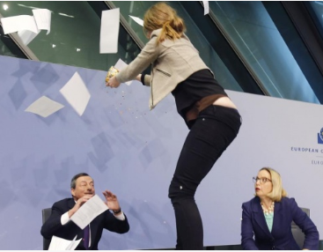
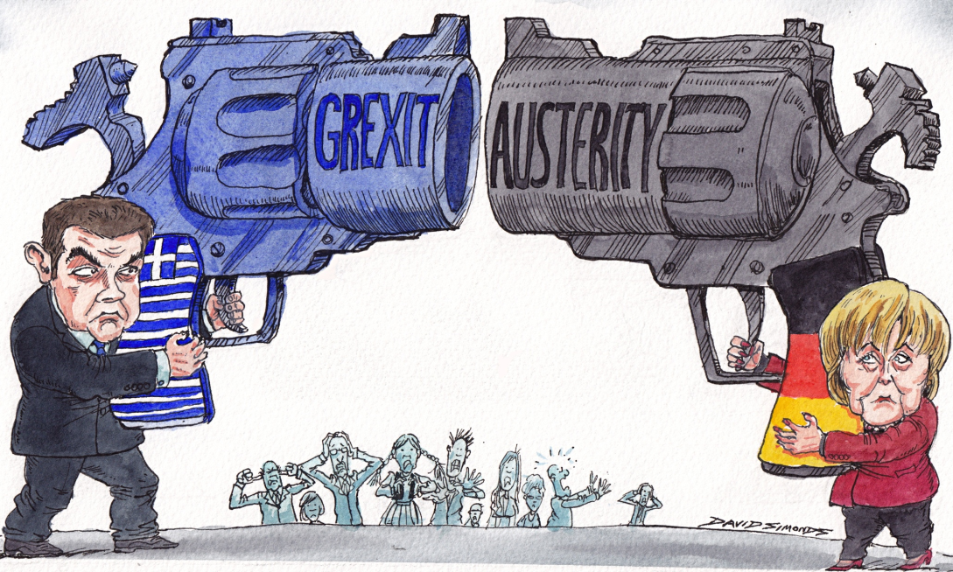
Issues in the EU Today?

Slide 46
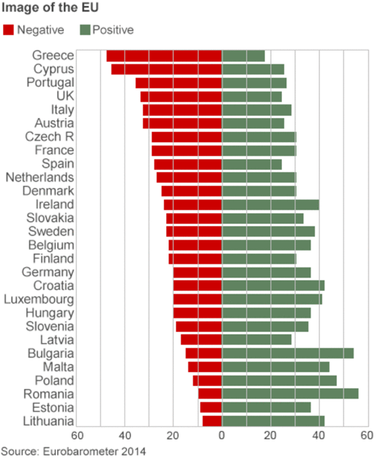
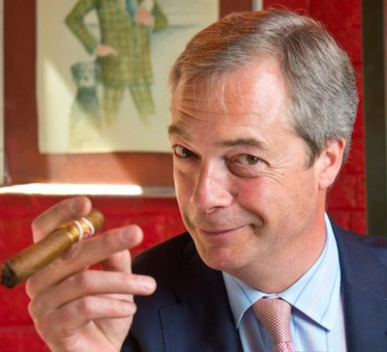
Issues in the EU Today?
View of the EU of it’s citizens…

Slide 47
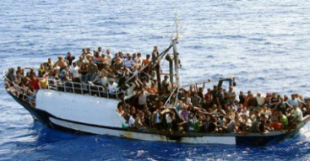
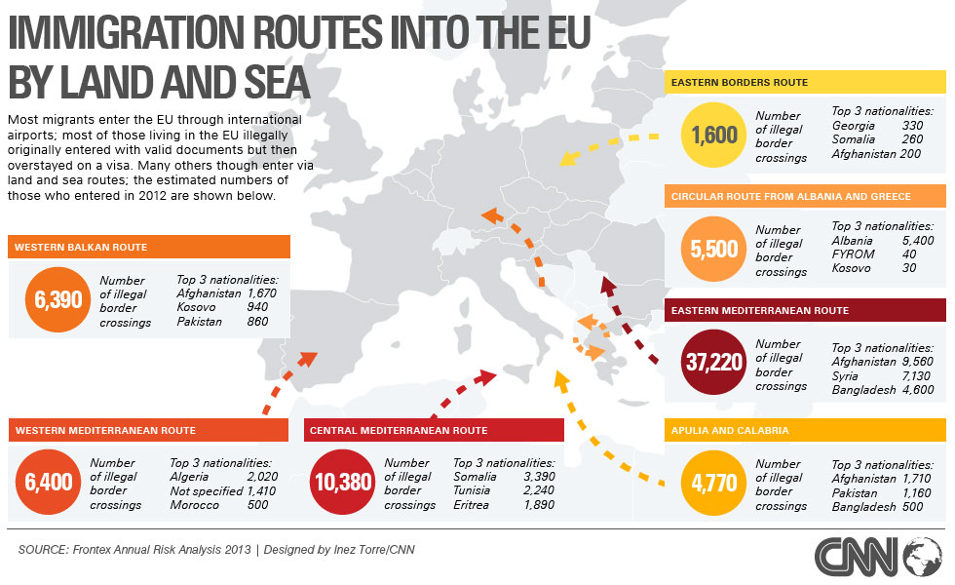
Issues in the EU Today?

Slide 48
Issues in the EU Today?

Slide 49
European Politics
European Council (heads of state): decides on the ‘general direction of the EU’
The European Commission (A representative from each member state): proposes laws and checks they are being obeyed
The European Parliament (made up of 751 MEP’s from 28 member states - 73 from UK) considers and approves the European Commissions proposals
Council of Ministers (made up of one Government minister from each member state depending on what is being discussed) considers and approves the European Commissions proposals
Political Party in Government (Coalition?): decides on the general direction of the UK
Cabinet (chosen by PM): proposes laws
Parliament
House of Commons (made up of 650 elected MPs representing constituencies around the UK. Considers and approves the laws put forward by the cabinet (or private members bill).
House of Lords (made up of hereditary and non-hereditary peers who are chosen by PM/Queen). Considers and approves the laws approved by the House of Commons

Slide 50
European Central Bank
ECB
Made up of a council which is represented by every Governer of the National Central Bank for every Eurozone member
Price stability is the target
Ability to influence monetary policy tools
National Central Banks
NCB
(Portugal)
National Central Banks
NCB
(Slovakia)
National Central Banks
NCB
(Malta)
National Central Banks
NCB
(Austria)
National Central Banks
NCB
(Netherlands)
National Central Banks
NCB
(Finland)
National Central Banks
NCB
(Germany)
National Central Banks
NCB
(Belgium)
National Central Banks
NCB
(Cyprus)
National Central Banks
NCB
(Slovenia)
National Central Banks
NCB
(Estonia)
National Central Banks
NCB
(Spain)
National Central Banks
NCB
(France)
National Central Banks
NCB
(Luxembourg)
National Central Banks
NCB
(Greece)
National Central Banks
NCB
(Italy)
National Central Banks
NCB
(LAtvia)
National Central Banks
NCB
(Lithuania)

Slide 51
European Central Bank and the EURO

Slide 52
WEEK 2

Slide 53
THE EU DISCUSSIONS
FREE TRADE: the Single Market and Customs Union
FISCAL POLICY: EU Budget, Fiscal Rules and the CAP
ENLARGEMENT: Enlargement of the EU and Immigration Issues
BREXIT: Should we stay or should we go. Also, implications of a UKIP and Conservation win – should we have a referendum?

Slide 54
FREE TRADE, THE SINGLE MARKET AND THE CUSTOMS UNION

Slide 55
STARTER EXERCISE: The EU Single Market
ADVANTAGES
EXPORTS:
Local multiplier: greater jobs and living standards
National multiplier: greater tax revenues and public expenditure
International multiplier: attracting FDI
IMPORTS:
Specialisation (CA/AA), economies of scale and lower costs = higher productivity and lower inflation
Greater choice and higher living standards
INFLUENCE ON WORLD STAGE
EU can organise trade deals; protecting UK from foreign competition
DISADVANTAGES
EXPORTS:
Reliant on EU economy for exports
Poor productivity in the UK means uncompetitive
Exchange rate volatility against Euro
Inflationary dangers?
IMPORTS:
Structural unemployment
Balance of payments issues?
INFLUENCE ON WORLD STAGE
EU distorting
TASK: Using the ‘bigger is better’, ‘growing inequality’ and ‘not sustainable’ essay structure, provide an essay plan using the arguments above to this essay:
“To what extent is the EU’s single market beneficial to for the UK?”

Slide 56
To what extent is the EU’s single market beneficial for UK
Bigger is Better
As: Exports and Import arguments
Ae: Poor productivity, exchange rate volatility
Growing Inequality
As: North/South divide – greater structural unemployment
Ae: EU regional fund, UK still able to alter interest rates etc.
Not sustainable
As: Over-reliance on EU, inflation and balance of payments deficit?
Ae: Influence on world stage,

Slide 57
THE EU DISCUSSIONS – Today
Note Taking
FREE TRADE: the Single Market and Customs Union
FISCAL POLICY: EU Budget, Fiscal Rules and the CAP
ENLARGEMENT: Enlargement of the EU and Immigration Issues
BREXIT: Should we stay or should we go. Also, implications of a UKIP and Conservation win – should we have a referendum?

Slide 58
FISCAL POLICY IN THE EU
The EU Budget
The Growth and Stability Pact
The Common Agricultural Policy

Slide 59
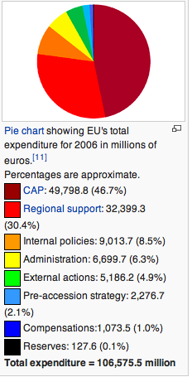
The EU BUDGET
INCOME
129 billion Euros
EU members contributions
GDP based
VAT based
Tariff Income

Slide 60
The EU BUDGET and UK Contribution

Slide 61
Fiscal Rules: The Growth and Stability Pact
What is it?
Set of budgetary rules to enforce fiscal discipine; encouraged by founding fathers (Germany and France)
Specific Rules
Limit of 3% of budget deficit to GDP in one year
National Debt of no more than 60%
Failure to meet rules = fines
Why is it needed
Loss of monetary policy
Criticisms
Germany and France have not met the pact in early naughties
Fines not the best thing for countries who are mired in unemployment and stagnation?
Fines not enforced for Germany and France
Smaller countries wondering why they’ve bothered?
Deficit in one year not over
Abandoned in light of the financial crisis – currently under review

Slide 62
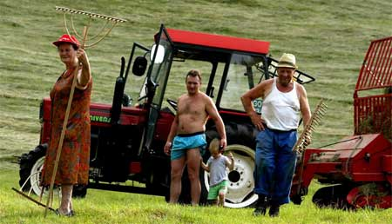
CAP Case Study: Waste of money or vital support for farmers
“agricultural subsisidies fuel EU budget row”

Slide 63
Market Failure? WHY DO WE HAVE THE CAP? (you should be taking notes as we go along, to help with your revision worksheet)
Fluctuating prices and falling profits?
(why are agricultural goods prone to fluctuating prices and therefore the incomes of farmers? What is the income elasticity of demand for farmer’s produce?)
Preserving farming heritage
(is the traditional farming way of life under threat in EU countries? If it wasn’t for the EU, where would we be buying the majority of our produce and why?)
Lack of economic power for farmers?
(think about who the farmers sell to – supermarkets – how much power do they have ??)
National security issues?
PAIRS: Provide explanations as to why these points have been put forward to highlight the need for the CAP

Slide 64
Government Intervention: HOW DOES THE CAP WORK TODAY?
Buffer Stocks and Guaranteed Intervention Prices
Quotas
Set-Asides
Direct Subsidies (“decoupling”)
CAP

Slide 65
WHEAT MARKET
PRICE
S bad harvest
S normal harvest
P high
C
S good harvest
Excess Supply
RELEASE
P target
B
D
BUY UP
D1
P low
Excess Demand
A
D
HOW DOES THE GOVERNMENT MAINTAIN THE PRICE OF P target at point A
QUANTITY
HOW DOES THE GOVERNMENT MAINTAIN THE PRICE OF P target at point C

Slide 66
GOVERNMENT FAILURE: OVERPRODUCTION ONE OF THE BIG PROBLEMS WITH THE CAP!
(1) Why is there always over production?
PROVIDE ONE REASON
(2) What could the EU do to get rid of the excess food?
PROVIDE THREE IDEAS
(3) Name two other problems with the CAP?

Slide 67
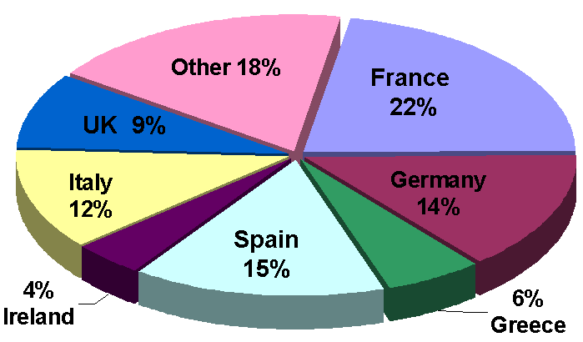
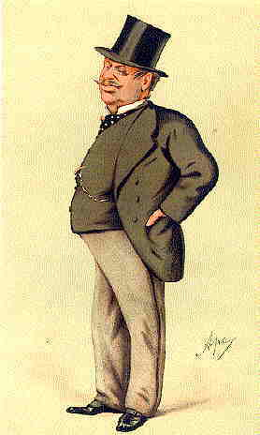
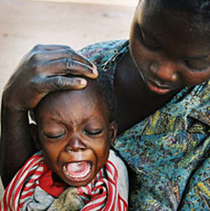
CONTROVERSY PROBLEMS WITH THE CAP
GOVERNMENT FAILURE
Intervention Price is too High
Too much Government Intervention
COST
Largest single cost of EU budget
ALLOCATION OF FUNDS
French (50%?)
Big Business and the Rich
Only large farms?
IMPACT ON LEDC’S
Subsidies and ‘Dumping’
RESISTANCE TO REFORM

Slide 68
REFORMS OF THE CAP?
1960’s CAP BEGINS
Intervention prices and buffer stocks
1992 MCSHARRY REFORMS
Introduction of set-asides and quotas
2000 AGENDA 2000
Reducing guaranteed prices and limiting CAP budget to 40.5 billion euros per annum
2002 MID TERM REVIEW
Introduction of decoupling and single farm payment based upon size of farm and meeting environmental regulations
2013 NEW REFORMS
The CAP budget has shrunk relatively from 71% in 1984 to an expected 39% of the total EU budget in 2013
2015?
What will the future hold? Full membership of the new member states? Cut in CAP funding?
Non!

Slide 69
ENLARGEMENT OF THE EU

Slide 70
EU ENLARGEMENT
Main Waves of EU Enlargement
1951 (France, Germany, Luxembourg, Italy, Netherlands and Belgium)
1973 (UK, Ireland and Denmark)
1981 (Greece)
1986 (Portugal and Spain)
1995 (Austria, Finland and Sweden)
2004 (Ten new countries)
2007 (Bulgaria and Romania)
2013 (Croatia)
Future (Turkey, Albania, Serbia, Macedonia and Montenegro)

Slide 71
EU Enlargement and Immigration
Legal immigration
Illegal immigration
The Turkey Question

Slide 72
Future Enlargement of the EU?
Potential Gains for Existing EU Countries
EXPORT potential: jobs, tax and FDI multiplier
Greater IMPORTS: Lower wage costs - exploitation of economies of scale and specialisation
More diverse European labour market
A cleaner environment; more countries forced to comply with regulations
Catalyst for further structural reforms in the EU
Reforms to the CAP
Spur to countries to reform their labour markets in the face of lower labour cost competition
Many countries are already engaging in tax competition
Potential Concerns for EU Members
Extra budgetary costs for the EU
New members receive regional subsidies
Greater burden for CAP (agricultural economies?)
Can accession countries continue to meet stricter EU environmental standards?
Social concerns from increased labour migration
Labour Market Issues
Fears of higher structural unemployment among accession countries – which might lead to large immigration of labour into higher-income countries + political and social tensions
Fears of a surge in economic migration from East to West
Concerns about organised crime and illegal immigration from Russia, Belarus and the Ukraine through weak Eastern European borders
In Germany, Austria and Italy (countries that border accession states) there are intensive debates about controlling the flow of migrants from former Eastern Europe
Notes:
All the studies that have looked into the economic effects of the enlargement conclude that it will lead to prosperity gains, albeit moderate, for the EU owing mainly to a better, Union-wide allocation of resources. Therefore the more abundant (and at present cheaper) supply of labour must be used efficiently (i.e. full freedom of movement immediately upon entry), trade in goods and services must be freed from barriers (i.e. exceptions for particular sectors should be kept to a minimum), and capital must flow unimpeded to the best use if the Union is to take full advantage of the growth opportunities offered by enlargement

Slide 73
The Turkey Question?
First application in 1987
Strengths to the UK
Enlargement issues
75 million people (Exports)
16th biggest global economy and 6th biggest EU economy
Worries to the UK
Legal enlargement issues?
Illegal enlargement issues?
Low GDP per capita ($13000 – although tripled from 2003)

Slide 74
Enlargement: Diagram corner
Useful diagrams for this topic: For each heading, draw a diagram explaining what would happen
AD-AS diagrams
Increased exports
Greater supply of labour
Inward investment effects
Lower costs from cheaper imports through increased specialisation and
Adverse economic shocks within the enlarged EU economy
Micro diagrams
Economies of scale
Labour market diagrams e.g. impact of migration

Slide 75
SHOULD WE STAY OR SHOULD WE GO

Slide 76
GENERAL ESSAY THEMES THAT COULD COME UP
OVERALL: Should we stay or should we go?
SINGLE MARKET: EU economy effect on the UK – fiscal rules, Eurozone, debt crisis etc.
ENLARGEMENT: Issues of legal and illegal immigration as well as the advent of Turkey
EURO: Arguments for and against the UK joining

Slide 77
Extended writing Questions
‘EU Government’s have been spending their way out of trouble since the financial crisis and this has caused a debt crisis in the EU’.
Explain the term ‘spending their way out of recession’ and analyse two reasons for government spending OTHER than to influence the economic cycle. (15 marks)
To what extent would leaving the EU be beneficial to the UK Economy? (25 marks)

Slide 78
Should we stay or should we go?
POINTS | WE SHOULD STAY |  | POINTS | WE SHOULD LEAVE
 | AS | AE |  | AS | AE
Free Trade |  |  | Immigration
Increased FDI |  |  | Loss of sovereignty
Stability and influence |  |  | Fiscal Burden

Slide 79
UK Referendum
Uncertainty?
SNP and Scottish Referendum

Slide 81
EXAM PRACTICE
TODAY
DATA RESPONSE: In two’s, you will take a past exam paper and provide rough answers to the three questions to become the EXPERT in the areas below. You will then form a new group where you will feedback to others and guide them through the answers
OVERALL: Should we stay or should we go?
SINGLE MARKET: EU economy effect on the UK – fiscal rules, Eurozone, debt crisis etc.
ENLARGEMENT: Issues of legal and illegal immigration as well as the advent of Turkey
FRIDAY LESSON
EURO: Arguments for and against

Slide 82
EXPERT LEARNING – Threes
Everyone taking notes on the three questions
Just rough planning (not full sentences)
Plan needed for 25 marker
Make sure you read the materials and make use of the extract in question C.

Slide 83
SHARING
Everyone taking notes on the three questions
Do not copy; others in the group to read and resident EXPERT in the group to lead discussion

Slide 85
Eurozone Debates
17 Members of the Eurozone

Slide 86
THE END

Slide 87
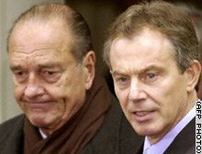
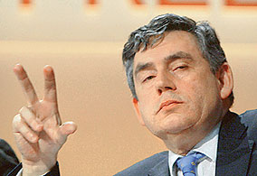
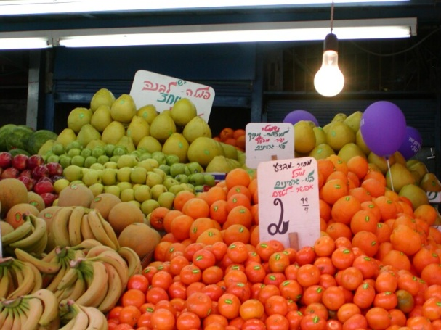
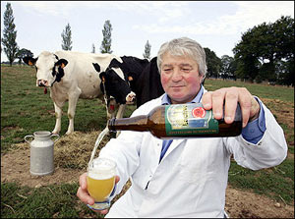
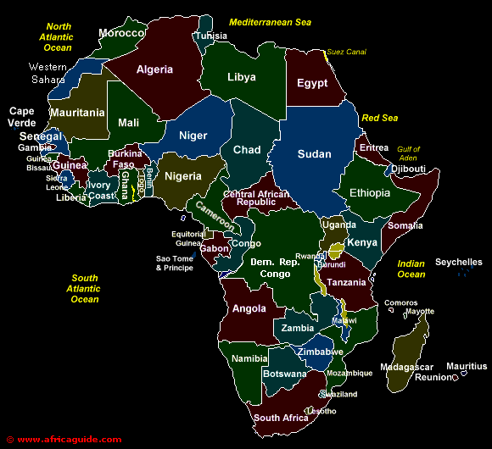
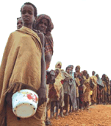
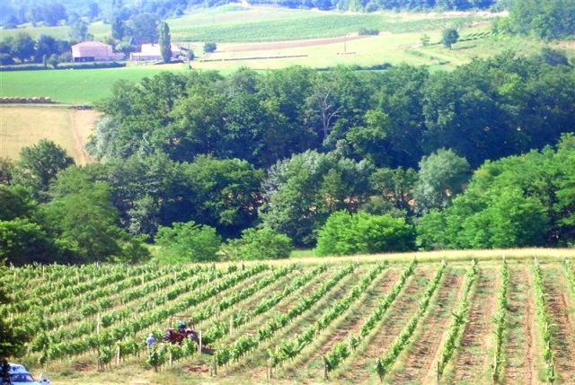
COMMON AGRICULTURAL POLICY (CAP)

