Slide 1
Unit 35 - Multi-Camera Techniques
BTEC Dip. Level 3 Creative Digital Media (Film & TV) – Year 2

Slide 2
Learning aims
In this unit you will:
A Understand different types of multi camera production and the role of the crew
B Prepare material for a multi camera programme in a recognisable genre and format
C Carry out a key role in the production of a multi camera programme in a recognisable genre and format.

Slide 3
Learning aim A
For this part of the Unit it is important that you can demonstrate that you understand the purpose and function of multi camera productions across both narrative (sit-coms, soaps etc.) and non-narrative (panel shows, talk shows etc.) formats and the role of the teams involved.
Divided into two sections;
1) purpose and format (AP1 / M1 / D1)
2) role of production team (AP2 / M2 / D1)
Television studio floor manager

Slide 4
Grading criteria

Slide 5
Evidence
Blog posts;
1) Investigative report with images and embedded Youtube clips
2) A roles and personnel document that corresponds with the above report

Slide 6
THE Ronnie Barker Comedy Lecture 2017
1) Make notes on what makes a multi-camera situation comedy different to single camera. Bullet points are useful, but remember to use specific examples.
2) Read the article The Evolution Of The Sitcom: The Age of the Single Camera. Bullet point the arguments against multi-camera situation comedies.

Slide 7
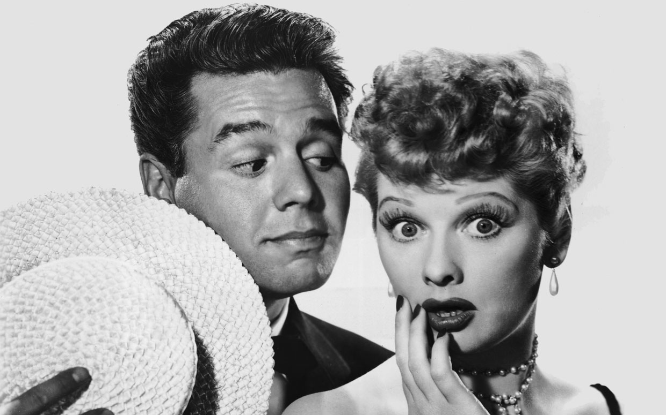
I love Lucy (1951-57)

Slide 8
The birth of multi-cam

Slide 9
Introduction
Research and write 500 words on the following –
What is a multi-camera production and why is it different to a single camera production?
Benefits of a MCP
Specific techniques employed in MCPs
You may wish to reuse some of the material from SCP UNIT 20

Slide 10
Multi-cam director

Slide 11
Floor manager

Slide 12
Vision mixer

Slide 13
Robot camera operator

