Slide 1
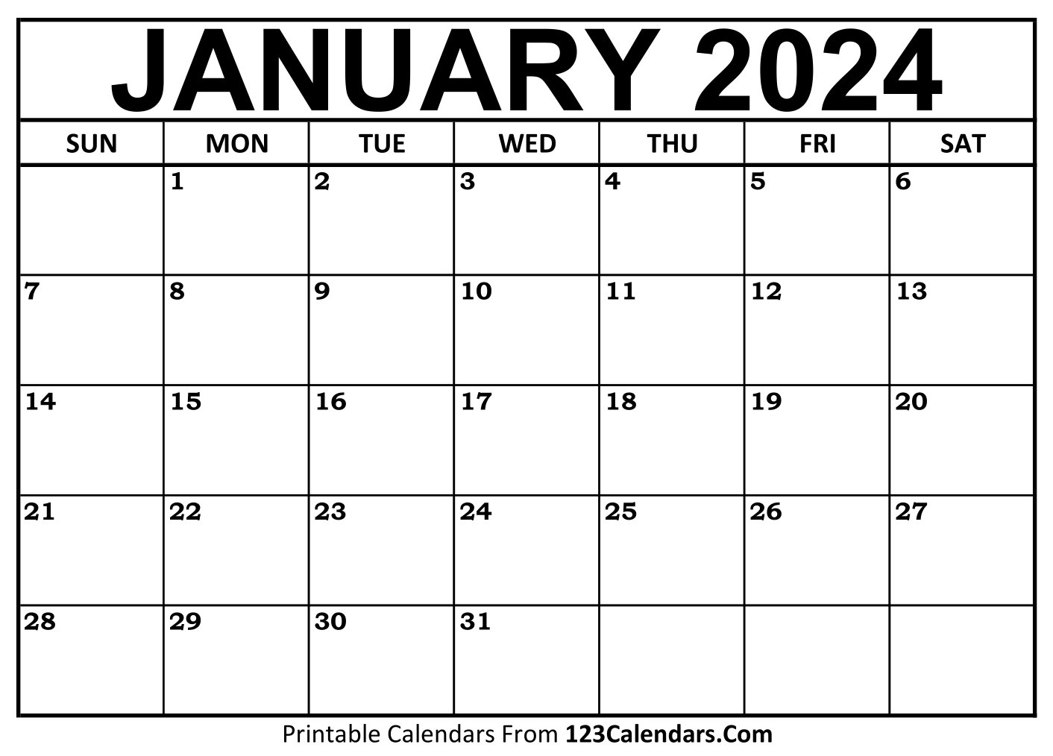
Unit 8 – Responding to a Commission
Save the date(s)…
January you will be off timetable for one day, to do your Unit 8 Media exam.
Notes:
Actual date TBC

Slide 2
Unit 8 – Responding to a Commission
This unit considers the commissioning process and how media producers respond to clients by generating ideas using a range of skills.
In this unit, you will understand how to respond to a commissioning brief with ideas based on the required content, style, audience, purpose and approach proposed by the client.
You will work independently, within the requirements and constraints of the client’s specifications and consider your response in terms of ethos, format, budget, platform and duration.

Slide 3
Unit 8 – Responding to a Commission Cont.
This unit is assessed through a task set and marked by Pearson, consisting of a Part A and a Part B.
Part A gives learners a commissioning brief for a media production. It will entail research activities to be completed- to set you up for the assessment tasks in Part B.

Slide 4
Unit 8 – Responding to a Commission Cont.
You will begin initial research and development into the client, target audience etc. in preparation for the externally assessed exam period.
There are 4 activities to complete during the exam that you will be graded on.
1. Research and Rationale
2. Pitch (written)
3. Proposal
4. Treatment
(5 - 6 hours)

Slide 5
1. Rationale

Slide 6
1. Rationale with research and prep evidenced

Slide 7
1. Rationale with research and prep evidenced

Slide 12
2. Pitch

Slide 13
3. Proposal

Slide 18
4. Treatment

Slide 19
Approximate timings
1. Research and Rationale – Two weeks
2. Pitch (written) – 1 hour
3. Proposal – 2 hours
4. Treatment – 2 - 3 hours

