Slide 1
Energetics

Slide 2
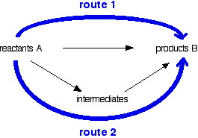
Hess’s Law
The enthalpy change for the reaction is independent of the route ie route 1 = route 2
All the arrows in one direction = all the arrows in the other direction.
The hardest part of a hess cycle is working out which way the arrows go. Tip They always go from reactants to products, you then need to figure out what are the reactants and what are the products.
If you have learnt your definitions then this becomes easy.

Slide 3
The standard enthalpy change, ΔH₁ , for the decomposition of sodium hydrogencarbonate, NaHCO₃, is impossible to determine directly.
ΔH₁
2NaHCO₃ (s)--> Na₂CO₃(s) + CO₂ (g) + H₂ O(l)
The value of ΔH₁ can be calculated from the standard enthalpy changes which accompany the reactions below:
ΔH₂
NaHCO₃ (s) + HCl(aq) --> NaCl(aq) + CO₂(g) + H₂O(l)
ΔH₃
Na₂CO₃ (s) + 2HCl(aq) --> 2NaCl(aq) + CO₂(g) + H₂O(l)
Construct a hess cycle to calculate
ΔH₁

Slide 4
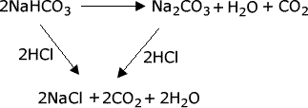

Slide 5
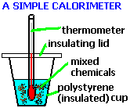
Calorimetry
Energy = mass x SpHtCap x change in T
Note this is the mass of the solution, the SpHtCap of the solution and the temperature change of the solution NOT the chemicals. However because of the 1st law of thermodynamics we can say that
The energy given out/lost by the water = the energy lost/gained by the chemicals
Enthalpy = energy / no of moles of chemical

Slide 6
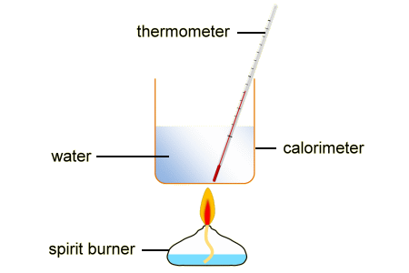
Calorimetry; When things go wrong
A classic question is why your calculated value is different from the data book
The main reasons are
Heat Loss to the surroundings
Measured under non standard conditions
The assumptions you have made in your calculations, usually that the density of the solution is = to water, and the SpHtCap of your solution is also = to water.

Slide 7
Bond Enthalpies
The energy required (and note it is always required) to break one mole of bonds of a substance in the gas phase.
The gas phase bit is very important. If it is not in the gas phase you would need to vapourise your sample first.
Eg HCl (g) H(g) + Cl (g)
Do not muddle this up with atomisation, which starts with the element in its standard state
Eg ½ I₂(s) I (g)
We can use these to also work out an enthalpy change

Slide 8
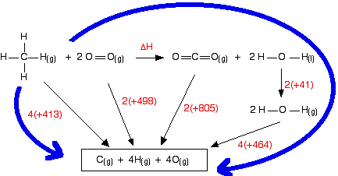
Bond Enthalpies Calculations

Slide 9
Bond Enthalpies vs Average bond enthalpies
Most data is given as average bond enthalpies, in the last example we used
4 x the average bond enthalpy of the C---H Bond, for methane
You always need to remember that each bond has a slightly different bond enthalpy and
Therefore when we use the averages we get a slightly different result than if we had used
The actual values
Also watch out for changes in state, this is usually a bigger problem.

Slide 10
C2H5OH(l) + 3O2(g) → 2CO2(g) + 3H2O(l)

Slide 11
Enthalpy of combustion = -1276 kjmol⁻¹

Slide 12
Lattice Enthalpy
SIZE & CHARGE
Effects
Melting point the higher the lattice enthalpy,
the higher the melting point of an ionic compound
Solubility solubility of ionic compounds is affected by the relative
values of Lattice and Hydration Enthalpies

Slide 13
Born-Haber Cycle - NaCl
1
Enthalpy of formation of NaCl
Na(s) + ½Cl₂(g) ——> NaCl(s)
Na(s) + ½Cl₂(g)
This is an exothermic process so energy is released. Sodium chloride has a lower enthalpy than the elements which made it.
VALUE = - 411 kJ mol⁻¹
1
NaCl(s)

Slide 14
Born-Haber Cycle - NaCl
1
Enthalpy of formation of NaCl
Na(s) + ½Cl₂(g) ——> NaCl(s)
Enthalpy of atomisation of sodium
Na(s) ——> Na(g)
2
Na(g) + ½Cl₂(g)
2
Na(s) + ½Cl₂(g)
This is an endothermic process. Energy is needed to separate the atoms. Sublimation involves going directly from solid to gas.
VALUE = + 108 kJ mol⁻¹
1
NaCl(s)

Slide 15
Born-Haber Cycle - NaCl
1
Enthalpy of formation of NaCl
Na(s) + ½Cl₂(g) ——> NaCl(s)
Enthalpy of atomisation of sodium
Na(s) ——> Na(g)
Enthalpy of atomisation of chlorine
½Cl₂(g) ——> Cl(g)
2
3
Na(g) + Cl(g)
3
Na(g) + ½Cl₂(g)
2
Na(s) + ½Cl₂(g)
Breaking covalent bonds is an endothermic process. Energy is needed to overcome the attraction the atomic nuclei have for the shared pair of electrons.
VALUE = + 121 kJ mol⁻¹
1
NaCl(s)

Slide 16
Born-Haber Cycle - NaCl
1
Enthalpy of formation of NaCl
Na(s) + ½Cl₂(g) ——> NaCl(s)
Enthalpy of atomisation of sodium
Na(s) ——> Na(g)
Enthalpy of atomisation of chlorine
½Cl₂(g) ——> Cl(g)
Ist Ionisation Energy of sodium
Na(g) ——> Na⁺(g) + e¯
Na⁺(g) + Cl(g)
2
4
3
Na(g) + Cl(g)
4
3
Na(g) + ½Cl₂(g)
2
Na(s) + ½Cl₂(g)
All Ionisation Energies are endothermic. Energy is needed to overcome the attraction the protons in the nucleus have for the electron being removed.
VALUE = + 500 kJ mol⁻¹
1
NaCl(s)

Slide 17
Born-Haber Cycle - NaCl
1
Enthalpy of formation of NaCl
Na(s) + ½Cl₂(g) ——> NaCl(s)
Enthalpy of atomisation of sodium
Na(s) ——> Na(g)
Enthalpy of atomisation of chlorine
½Cl₂(g) ——> Cl(g)
Ist Ionisation Energy of sodium
Na(g) ——> Na⁺(g) + e¯
Electron Affinity of chlorine
Cl(g) + e¯ ——> Cl¯(g)
Na⁺(g) + Cl(g)
2
5
4
3
Na⁺(g) + Cl–(g)
Na(g) + Cl(g)
4
3
Na(g) + ½Cl₂(g)
5
2
Na(s) + ½Cl₂(g)
1st Electron affinity is exothermic. Energy is released as the nucleus attracts an electron to the outer shell of a chlorine atom.
VALUE = - 364 kJ mol⁻¹
1
NaCl(s)

Slide 18
Born-Haber Cycle - NaCl
1
Enthalpy of formation of NaCl
Na(s) + ½Cl₂(g) ——> NaCl(s)
Enthalpy of atomisation of sodium
Na(s) ——> Na(g)
Enthalpy of atomisation of chlorine
½Cl₂(g) ——> Cl(g)
Ist Ionisation Energy of sodium
Na(g) ——> Na⁺(g) + e¯
Electron Affinity of chlorine
Cl(g) + e¯ ——> Cl¯(g)
Lattice Enthalpy of NaCl
Na⁺(g) + Cl¯(g) ——> NaCl(s)
Na⁺(g) + Cl(g)
2
5
4
3
Na⁺(g) + Cl–(g)
Na(g) + Cl(g)
4
3
Na(g) + ½Cl₂(g)
5
2
6
6
Na(s) + ½Cl₂(g)
1
Lattice Enthalpy is exothermic. Oppositely charged ions are attracted to each other.
NaCl(s)

Slide 19
Born-Haber Cycle - NaCl
CALCULATING THE LATTICE ENTHALPY
Apply Hess’s Law
Na⁺(g) + Cl(g)
Enthalpy of formation = all the others
5
4
Na⁺(g) + Cl–(g)
Na(g) + Cl(g)
3
= - - - - +
Na(g) + ½Cl₂(g)
2
6
Na(s) + ½Cl₂(g)
1
NaCl(s)

Slide 20
Born-Haber Cycle - MgCl₂
1
Enthalpy of formation of MgCl₂
Mg(s) + Cl₂(g) ——> MgCl₂(s)
Enthalpy of atomisation of magnesium
Mg(s) ——> Mg(g)
Enthalpy of atomisation of chlorine
½Cl₂(g) ——> Cl(g) x2
Ist Ionisation Energy of magnesium
Mg(g) ——> Mg⁺(g) + e¯
2nd Ionisation Energy of magnesium
Mg⁺(g) ——> Mg²⁺(g) + e¯
Electron Affinity of chlorine
Cl(g) + e¯ ——> Cl¯(g) x2
Lattice Enthalpy of MgCl₂
Mg²⁺(g) + 2Cl¯(g) ——> MgCl₂(s)
Mg²⁺(g) + 2Cl(g)
2
5
6
3
Mg⁺(g) + 2Cl(g)
4
4
Mg²⁺(g) + 2Cl–(g)
Mg(g) + 2Cl(g)
5
3
Mg(g) + Cl₂(g)
2
7
6
Mg(s) + Cl₂(g)
1
7
MgCl₂(s)

Slide 21
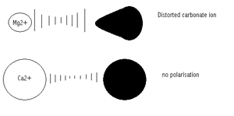
Theoretical vs actual
The theoretical model assumes 100% ionic bonding, the closer the bonding is to 100% ionic, the closer the agreement.
However if there is a significant difference, this is due to the polarisation of the bond giving it covalent characteristics as well as the ionic bonding.
Small +ve ions polarise large –ve anions,
Why does AgI show a degree of covalent character but not AgF
Compare NaCl and MgCl₂

Slide 22
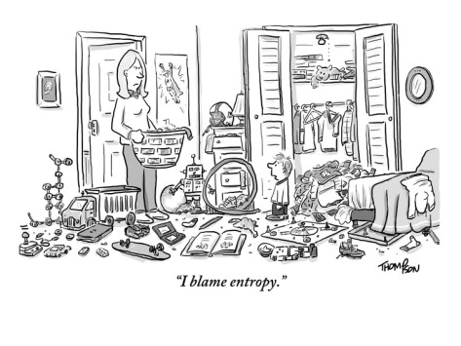
Important equations and units
You must know these
ΔS = Δ S_{sys} + ΔS_{sur}
Δ S_{sys} = sum S_{prod} – sum S_{reac}
Δ S_{surr} = - ΔH/T
@equ or the tiping point ΔS_{total} =0 or ΔG =0
Therefore Δ S_{sys} = - Δ S_{surr} = ΔH/T
ΔG = ΔH – TΔS_{sys}
ΔG = -RTlnK

Slide 23
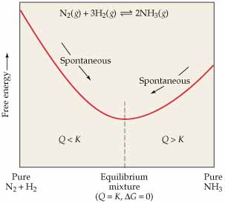

Slide 24
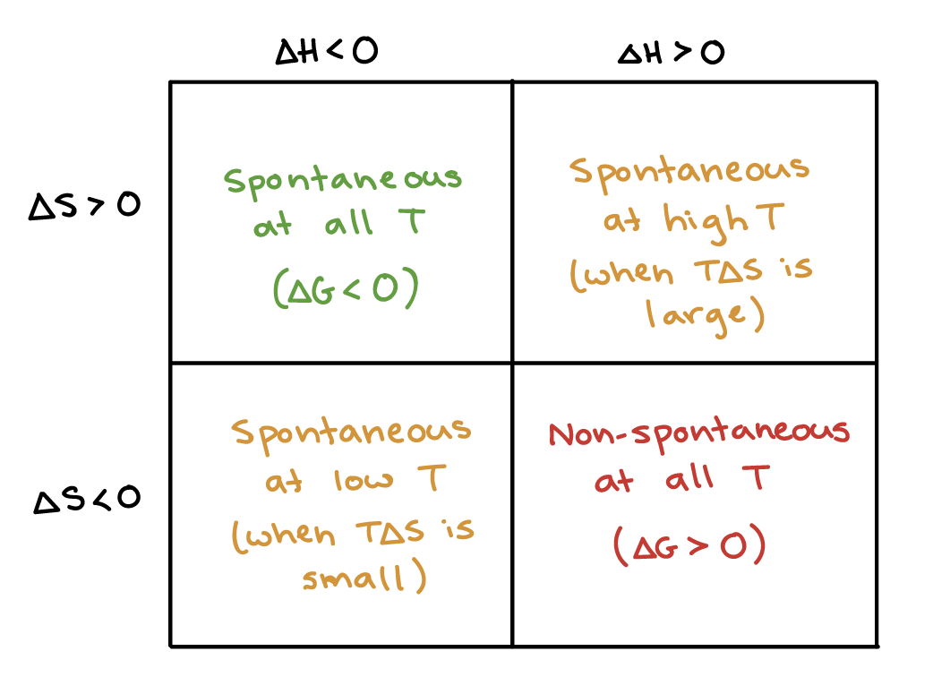

Slide 25
Using either Entropy or Gibbs energy explain why an exothermic reaction become less feasible at higher temperatures.

Slide 26
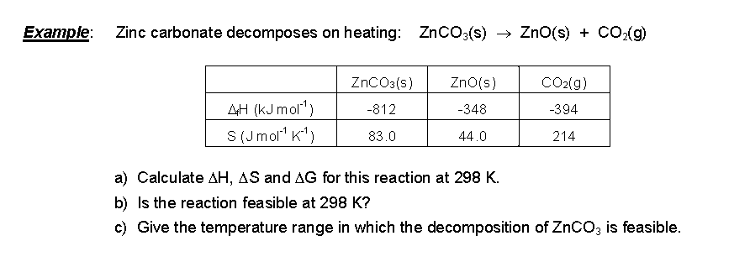

Slide 27
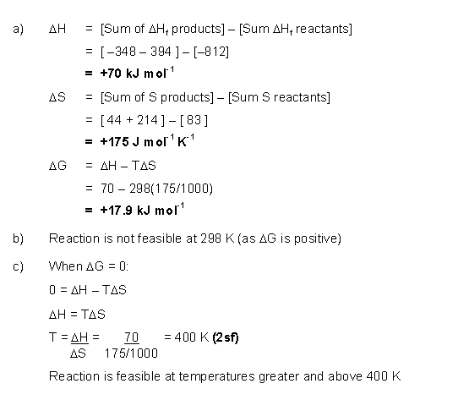

Slide 28
Solubility
CaCl₂ (s)
Ca²⁺(aq) + 2Cl⁻(aq)
Label the above
Ca²⁺(g) + 2Cl⁻(g)

Slide 29
ΔH solution
CaCl₂ (s)
Ca²⁺(aq) + 2Cl⁻(aq)
ΔH Lattice
ΔH hydration
Ca²⁺(g) + 2Cl⁻(g)
Define Hydration, Solution and Lattice
The more exothermic the enthalpy of solution the more likely the substance is to be soluble.
Hydration and Lattice both depend of the size of the ions and he charges, think back to ionic bonding

Slide 30
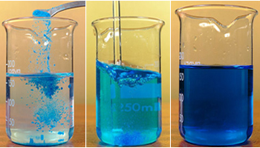
When solubility goes wrong
Sometimes an exothermic enthalpy of solution does not dissolve, but an endothermic enthalpy of solution does. When this happens we need to think not only about the entropy of surroundings but also the entropy of the system
NaCl has a slightly +ve enthalpy of solution yet it still dissolves. Why?
MgO has a slightly –ve enthalpy of solution yet does not dissolve. Why?

