Slide 1
Methods of Research
BTEC Creative Digital Media
UNIT 8 – Responding to a Commission

Slide 2
Why is research carried out in the Media?

Slide 3
Notes:
Large organizations use r&d

Slide 4
Why is research carried out in the media?
To establish how large the audience is for a media product
To establish who the audience is in terms of age, gender, ethnicity, class, region
To find out what audiences like/dislike about a product
To find out about aspects of lifestyle, hobbies etc. of audiences
To find out about how and when people use the media or particular media products (e.g. television viewing habits)
To help generate ideas for new media products.

Slide 5
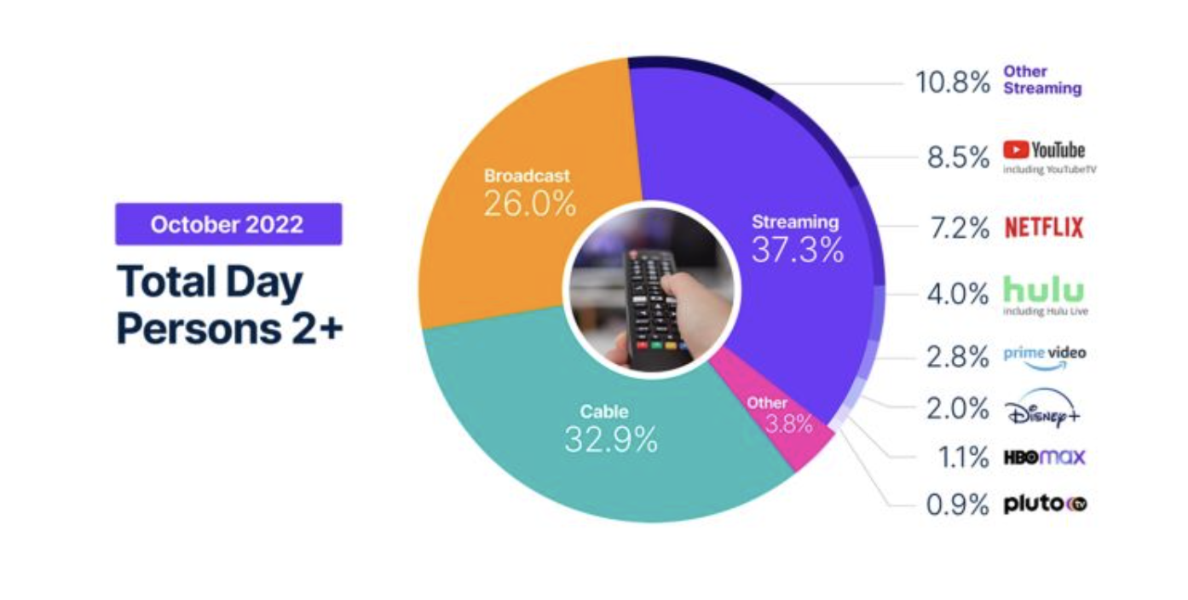
Notes:
Video – netflixs use of analytics to drive business
Link in image – how audience research is being used by streamers.

Slide 6
Types of Research
Primary Research
Original research gathered by the researcher themselves
Secondary Research
Using research already carried out by other people
Quantitative Research
Research based on numbers, statistic or tables, producing “hard” data. Usually involves working with large groups of people.
Qualitative Research
More detailed, in-depth research which may involve discussion or analysis of peoples attitudes and behaviour. Usually involves working with smaller groups of people.

Slide 7
Methods of Research
Questionnaires – a list of written questions requiring written answers
Structured interviews – Basically a spoken questionnaire, where the interviewer writes down the responses
Unstructured interviews – Much less formal interviews where the interviewer is able to change the order of questions, re-phrase them or just provide a general guide for discussion

Slide 8
Focus groups – Interviews carried out with groups of people rather than individuals
Content analysis – Analysis of the content of media products. Can be quantitative or qualitative (e.g film language, analysis…a bit like LA A Unit 10)
Books/internet
Audience research organisations’ data – Using data produced by various research organisations.

Slide 9
Sources of Secondary Research Organisations
Television – BARB
Radio - RAJAR
Film – Box Office Mojo

Slide 10
Audience Segmentation
Segmenting the audience into different categories makes it easier for media producers to identify and target groups
Q. Which 4 categories are the most commonly used?

Slide 11
Audience categories
Age
Gender
Culture / Ethnicity
Income / Social Class
…otherwise known as Audience Demographics

Slide 12
Audience Demographics
Social Grade | Social Status | Chief Income Earner’s Occupations
A | Upper middle class | Higher managerial, administrative or professional
B | Middle class | Intermediate managerial, administrative or professional
C1 | Lower middle class | Supervisory or clerical and junior managerial etc.
C2 | Skilled working class | Skilled manual workers
D | Working class | Semi and unskilled manual workers
E | Those at the lowest levels of existence | State pensioners or widows, students, zero hours contracts and lowest grade workers.

Slide 13
Notes:
Links in pictures – Red media pack / Bluey – how students are watching too / Blue Story – how marketing helped reach young black audiences

Slide 14
Example of Audience Research
Average number of hours a day spent watching Television according to age
 | Total %
 |  | 16 – 24 year olds | 25 – 44 year olds | 45 – 64 year olds | 65+ year olds
Less than 1 hour | 3 | 1 | 6 | 4 | 1
1 - 2 | 16 | 17 | 20 | 17 | 10
2 - 3 | 23.5 | 24 | 27 | 26 | 18
3 - 4 | 20 | 23 | 17 | 20 | 19
4 - 5 | 15 | 14 | 13 | 14 | 19
5 - 6 | 8 | 10 | 8 | 6 | 9
6 – 7 | 4 | 3 | 2 | 4 | 5
7+ | 10.5 | 7 | 6 | 9 | 19
Source: OFCOM
Notes:
398 participants

