Slide 1
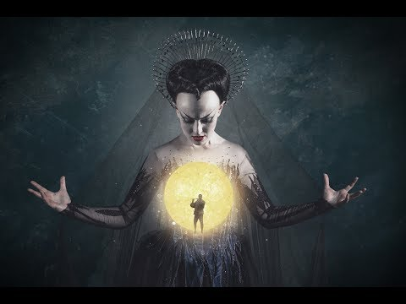

The Magic Flute
September 2017
All information taken from digital programme given out at performance

Slide 2
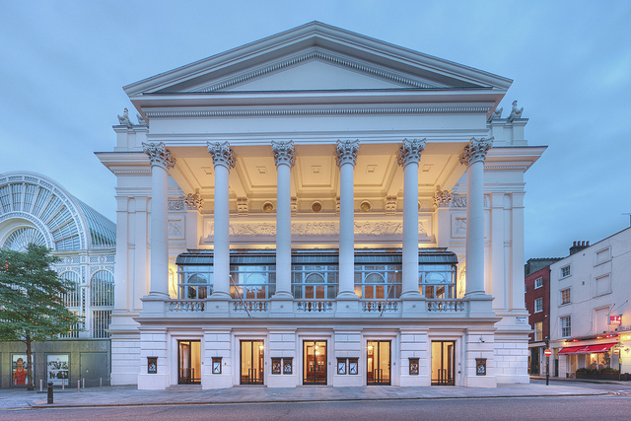
Performance Information
Royal Opera House, Covent Garden, London
September 2017
Music Wolfgang Amadeus Mozart
Libretto Emanuel Schikaneder
Director David McVicar
Revival director Thomas Guthrie
Designer John Macfarlane
Lighting designer Paule Constable
Movement director Leah Hausman
Revival movement director Angelo Smimmo
Directed for the screen by Jonathan Haswell
Approximate timings
Act I 65 minutes
Interval 25 minutes
Act II 90 Minutes

Slide 3
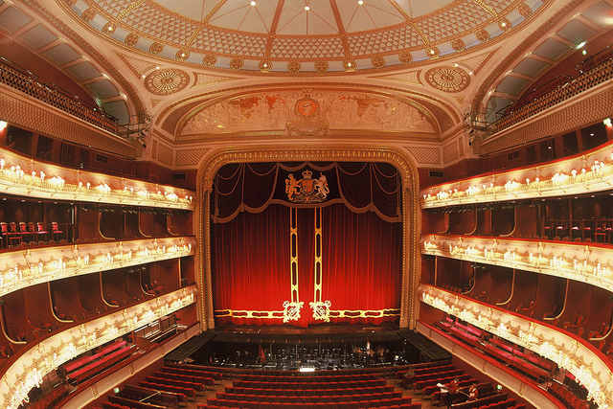
Cast & Creatives
Cast
Conductor Julia Jones
Pamina Siobhan Stagg
Tamino Mauro Peter
Papageno Roderick Williams
Sarastro Mika Kares
Queen of the Night Sabine Devieilhe
First Lady Rebecca Evans
Second Lady Angela Simkin
Third Lady Susan Platts
Monostatos Peter Bronder
Papagena Christina Gansch
Speaker of the Temple Sebastian Holecek
First Priest Harry Nicoll
Second Priest Donald Maxwell
First Man in Armour Thomas Atkins
Second Man in Armour Simon Shibambu
Royal Opera Chorus
Concert Master Vasko Vassilev
Orchestra of the Royal Opera House
Creatives
Music Wolfgang Amadeus Mozart
Libretto Emanuel Schikaneder
Director David McVicar
Designer John Macfarlane
Lighting designer Paule Constable
Movement director Leah Hausman

Slide 4
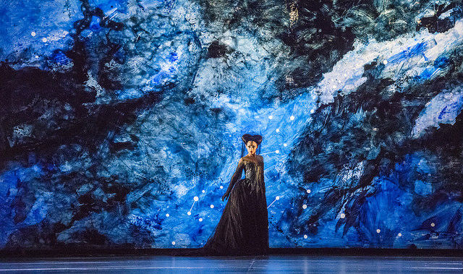
Introduction to the opera
Fantasy, fireworks and freemasonry: an introduction to Mozart's Magic Flute

Slide 5
The Story Begins…
Tamino promises the Queen of the Night that he will rescue her daughter Pamina from the enchanter Sarastro. But as they begin their quest, Tamino and his companion Papageno realize that things are not what they seem…
An Exquisite Fantasy
David McVicar’s production of Die Zauberflöte embraces both the seriousness and the comedy of Mozart’s opera, and takes the audience into a beautiful dreamlike world, where dancers turn into magical animals at the sound of Tamino’s flute, three boys arrive by flying machine and a rising golden sun hails a new dawn in the opera’s celebratory final chorus.
From Folksong to Fireworks
The score of Die Zauberflöte is extremely varied. The folksong-like arias of the robust ‘man of nature’ Papageno contrast with the coloratura fireworks of the Queen of the Night. Much of the music for the priests, and the duet of the Men in Armour, have a stately Baroque simplicity. There are exquisite lyrical solos for Pamina and Tamino. Extended passages – such as the finales to both acts, in which there is no spoken dialogue – look forward to German Romantic opera.

Slide 6
Conductor, Sir Colin Davis on Die Zauberlote:
https://www.youtube.com/watch?v=fH9occwIeIo
Mozart and Freemasonry
Mozart was an enthusiastic member of the Freemasons and many critics have seen Die Zauberflöte as being in part a Masonic allegory. The use of numbers in the score – particularly the number three – has been linked to Masonic rites, and it is possible that the wise Sarastro may have been modelled on Ignaz von Born, a scientist and prominent Viennese Freemason.
A Popular Success
Mozart wrote Die Zauberflöte for the Theater auf der Wieden, a suburban theatre in Vienna run by the larger-than-life actor and impresario Emanuel Schikaneder. As well as writing the libretto, Schikaneder was the first Papageno in the opera. At its premiere, Die Zauberflöte was acclaimed by the general public and by connoisseurs, including Mozart’s supposed rival Salieri, who adored it. Die Zauberflöte has been performed more than 300 times at the Royal Opera House.

Slide 7
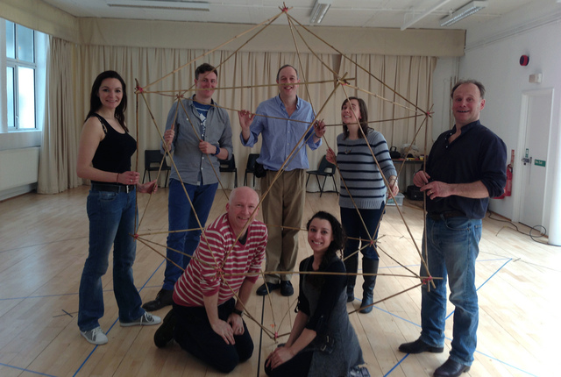
A beautiful fusion of maths and music’: Marcus du Sautoy on The Magic Flute
The mathematician and broadcaster on the power of Mozart’s opera.
By Marcus du Sautoy (Charles Simonyi Professor for the Public Understanding of Science and Professor of Mathematics)
The Magic Flute has always fascinated me. The last of Mozart’s operas was written just months before his death and has a very particular flavour. Don Giovanni and Le nozze di Figaro are set in the world around us, full of humanity and realism (and the odd stone statue coming to life). The Magic Flute is much more abstract piece, less wedded to stories of people and verismo. It is full of strange symbolism and ideas that challenge the listener to unravel and decode.
It’s for this reason that I’m thrilled to be leading audiences in the Linbury Studio Theatre on an interactive performance lecture exploring the significance of the symbols that pepper the opera, their mathematical and philosophical roots and why Mozart might have been drawn to them. Just as Tamino and Pamina underwent trials to reach enlightenment, I shall be taking the audience on their own initiation into my mathematical perspective on The Magic Flute. Mathematics in my view is not a spectator sport, so the audience will be encouraged to join us on stage to explore the mathematical ideas bubbling beneath this beautiful opera. This is an interactive and immersive performance of the mathematics and music of Mozart where everyone in the Linbury will play a part in creating a piece of mathematical musical theatre.
One of the central themes - both of Freemasonry and The Magic Flute - is the movement from chaos to order. This is Mozart writing at a crucial moment in history, both politically and musically. The work had its premiere in Vienna in 1791, two years after the revolution that swept the streets of Paris. The trials that Tamino and Pamina will under go are representative of this transition of a society.
The opera starts in the realm of the Queen of the Night, a world of chaos and darkness. But Tamino’s journey brings us to Sarastro's kingdom where light and order reign. Mozart had been initiated into the Masons seven years before he wrote The Magic Flute and one can detect many parallels between Sarastro's society and the Masonic order that Mozart had joined. Mathematical ideas are central to the rituals of the masons and we can see Mozart playing with these ideas throughout the opera. The number three for example, crops up often: from the Queen of the Night’s three attendants to the three boys, and even in the key of much of the music – E flat major is a key with three flats.
But this also a statement of a musical revolution. Mozart is a few months from his death. In this opera he is laying out his vision for the music for the future. He is leaving behind the baroque coloratura of the music of the Queen of the Night and taking music into a new dimension.
One of the rituals of the masons calls on its order to become ‘lovers of the arts and the sciences.’ That is a sentiment I too am passionate to promote. I hope that the event at the Linbury will help audiences to see the beautiful fusion of mathematics and music that is at the heart of The Magic Flute. Just as Sarastro’s order can only continue to a new level through the union of Tamino and Pamina, man and woman, both the arts and the sciences need each other to make progress and break new ground.

Slide 8
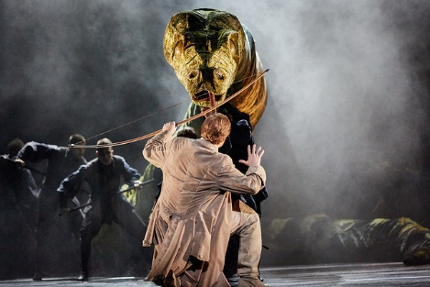
Synopsis
A full, illustrated synopsis for this production of Die Zauberflöte
Act I
Tamino is pursued by a monstrous serpent and appeals to the gods to save him. He falls unconscious. Three Ladies arrive and slay the monster. They admire the handsome youth and argue about who should go and tell their mistress, the Queen of the Night, about him and who should stay (Ich sollte fort?). They reluctantly decide they must all go.
Tamino wakes, hears someone approaching and hides. It is Papageno, chasing birds and describing his way of life (Der Vogelfänger bin ich ja). Tamino introduces himself to Papageno. Papageno is only too happy that Tamino has assumed that it was he, Papageno, who killed the serpent. But the Ladies have overheard and, instead of the expected wine and bread, bring Papageno water, a stone and a padlock for his mouth. They also give Tamino a present: a portrait of the Queen’s daughter, Pamina. Tamino is enraptured by it and begins to fall in love with Pamina (Dies Bildnis ist bezaubernd schön).
The Ladies return, saying that the Queen has chosen Tamino to rescue Pamina from the clutches of the evil Sarastro, who has abducted her. With a clap of thunder, the Queen of the Night herself appears (O zitt’re nicht, mein lieber Sohn!). She says that if Tamino can rescue her beloved daughter, he may marry Pamina.
When she has left, Papageno returns, his mouth still padlocked. The Ladies bring him the Queen’s pardon and unlock him. Everyone draws the moral: if liars were silenced, brotherly love would prevail (Bekämen doch die Lügner alle ein solches Schloss vor ihren Mund). The Ladies give Tamino a magic flute, which will protect him and which has the power to turn sorrow to joy. They order Papageno, to his dismay, to accompany Tamino. The Ladies give Papageno magic bells for protection and tell him and Tamino that Three Boys will guide them on their journey (Drei Knäbchen, jung, schön, hold und weise).
Pamina is trying to escape from Monostatos. He orders that she be tied up, then sends his slaves away. Pamina faints. Papageno appears; having checked Pamina’s identity against the portrait, he tells her of the prince her mother has sent to rescue her. Papageno tells her that he has nobody. He and Pamina reflect that when man and wife are united in love, their lives are sanctified (Bei Männern, welche Liebe fühlen).

Slide 9
Act I continued…
The Three Boys leave Tamino, telling him to be steadfast, patient and silent. He sees three Temple doors and, realizing he is in a sanctified place, reaffirms his vow to save Pamina. Tamino approaches the Temple of Reason only to be turned back by voices from inside. The same happens when he goes to the Temple of Nature. But from the Temple of Wisdom there appears a priest, the Speaker. He asks Tamino what has led him to this sanctuary, and Tamino replies that he has come in search of love and truth. The Speaker reprimands Tamino for confusing these virtues with revenge and hatred and says that Tamino has been deceived over Sarastro.
Alone, Tamino asks whether there is an end to the darkness that has befallen him. Voices from the Temple tell Tamino that Pamina is alive. Ecstatic, he starts to play his flute: strange animals gather round him – but Pamina does not come, in spite of his calls. Suddenly Tamino hears Papageno’s pipe and rushes off to find him. Papageno and Pamina enter, and are seized by Monostatos and his slaves. Papageno remembers his magic bells. As he plays them, the slaves become entranced and, with Monostatos, dance happily away (Das klinget so herrlich).
Fanfares announce the arrival of Sarastro. Papageno is frightened but Pamina tells him to be truthful. She tells Sarastro that she fled not from him but from Monostatos. Sarastro reassures her but says he cannot return her to her mother, whose pride is beyond forgiveness.
Monostatos brings in Tamino. Recognizing each other, Tamino and Pamina embrace, to Monostatos’s fury. Sarastro rewards Monostatos’s service by sending him for a whipping. Tamino and Papageno are led away to Sarastro’s sanctuary. The people praise Sarastro’s wisdom and declare that virtue and forgiveness will sanctify life on earth (Wenn Tugend und Gerechtigkeit).
Interval

Slide 10
Act II
The Priests assemble and Sarastro tells them that Tamino wants to undergo the ordeals that will allow him to become enlightened. Sarastro says that Pamina has been chosen as Tamino’s bride, and together the couple will defend the brotherhood against the evil of the Queen of the Night. The Speaker enquires whether Tamino is equal to the ordeal, as he is a prince. Sarastro replies that he is more: he is a man. The brotherhood calls on Isis and Osiris to give the couple courage to achieve their goal (O Isis und Osiris).
Tamino and Papageno, blindfolded, are led in with their tutor-priests. Papageno is frightened. The Priests test their commitment to the trials ahead. Papageno is hesitant until he is told that he will not otherwise find a wife. The Priests warn Tamino and Papageno of the temptations ahead and the risks of failure and swear them to silence (Bewahret euch vor Weibertücken). The Priests leave and the Three Ladies appear. They ask why Tamino and Papageno are in this place of death: the pair are doomed if they disobey the Queen of the Night. Papageno starts to respond but Tamino silences him. The Ladies try tempting them, but admit defeat and disappear. Papageno faints. The Priests return to lead Tamino and Papageno to the next trial.
Monostatos discovers Pamina asleep and resolves to rape her. He asks the moon to close its eyes while he kisses her (Alles fühlt der Liebe Freuden). He is stopped by the Queen of the Night, who asks her daughter where Tamino is. When Pamina replies that he has joined the brotherhood her mother reveals her true plan: her dying husband gave up the sevenfold circle of the sun to the brotherhood and she wants to regain its power (Der Hölle Rache). The Queen gives Pamina a knife to kill Sarastro.
Monostatos has overheard and threatens Pamina. Sarastro intervenes and sends Monostatos away. Pamina begs Sarastro to spare her mother. He explains that in his sacred halls it is love, not vengeance, that overcomes evil (In diesen heil’gen Hallen).
The Priests leave Tamino and Papageno, telling them to remain silent. Papageno says he is thirsty. An old woman brings him drink and he forgets his vow of silence: he chats to her and she tells him she is 18 and that her boyfriend is Papageno.
The Three Boys bring Sarastro’s gift of food and drink and the magic flute and bells (Seid uns zum zweiten Mal willkommen). As Papageno eats, Tamino plays the flute, and Pamina answers its call. Overjoyed, she tries to talk to him, but he turns away. His rejection of her is worse than death (Ach, ich fühl’s).
The Priests praise Tamino’s virtues in a hymn to Isis and Osiris. Sarastro brings Pamina to him and tells the couple to bid each other a last farewell before the greater trials ahead. Tamino is confident but Pamina is fearful; Sarastro reassures them. They leave.

Slide 11
Act II continued…
Papageno runs in, looking for Tamino. Voices tell him to go back. The Priests tell Papageno he will never achieve enlightenment, and they grant his one request: for a drink. To the accompaniment of his bells he says that all he really wants is a wife (Ein Mädchen oder Weibchen). The old woman dances in and says unless he marries her he will be locked up. When he swears he will be faithful to her she is transformed into Papagena, but sent away.
The Three Boys welcome the rising sun, which banishes darkness and death. They see the grief-stricken Pamina, who is clutching her mother’s knife, vowing to kill herself. The boys stop her and reassure her of Tamino’s love. Trusting them, Pamina allows the Boys to lead her to him.
Two Men in Armour guard the entrance to the place of trial. They recite to Tamino the words inscribed there: the man who treads this dangerous path will be purified by fire, water, air and earth. Tamino asks to be let in. Pamina’s voice is heard, saying she will go with him. Tamino is overjoyed: even death cannot separate them now. Pamina rushes in (Tamino mein! o welch ein Glück). She tells Tamino to play the flute, which her father, in a magic hour of violent storms, carved from an ancient tree. Together they pass through the trials of fire and water. Voices from the Temple praise their triumph and welcome the couple inside.
Papageno is searching for Papagena but there is no answer to his pipes. In despair, he prepares to hang himself. The Three Boys stop him and remind him of the bells. Their magic summons Papagena, and she and Papageno plan their future, which they hope will be blessed with many children.
Monostatos leads the Queen of the Night and her Ladies to attack Sarastro. The Queen has promised Pamina to Monostatos. But the sun shines brightly, banishing the forces of evil to infinite darkness.
Sarastro, with Tamino and Pamina, proclaims the sun’s victory over the night. Everyone sings a hymn of thanks to Isis and Osiris: virtue has been rewarded (Heil sei euch Geweihten!).

Slide 12
Watch the trailer:
https://www.youtube.com/watch?v=6SykVjA1mho

Slide 13
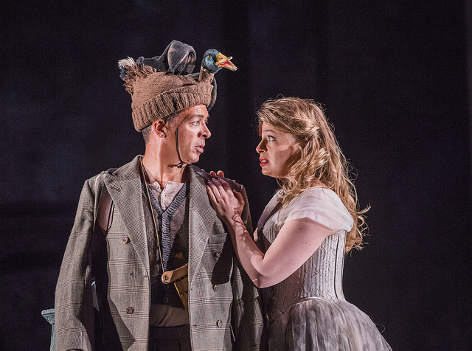
Watch: Die Zauberflöte Insight
Roderick Williams, Julia Jones and cast members discuss the opera
https://www.youtube.com/watch?v=IP5_E3Ye2os

Slide 14
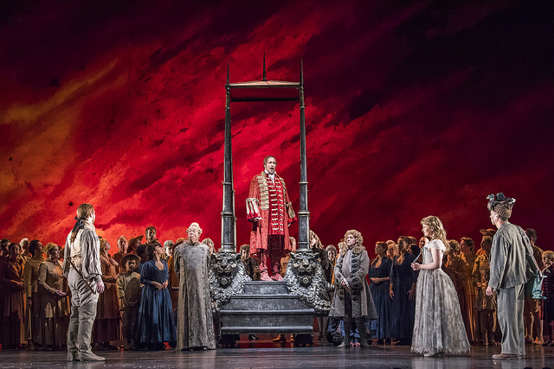
Listen: musical highlights
Die Zauberflöte is an opera of musical contrasts creating diverse and vivid characters with some of the best known operatic arias.
Use the YouTube links to listen to some of the key pieces in this opera

Slide 15
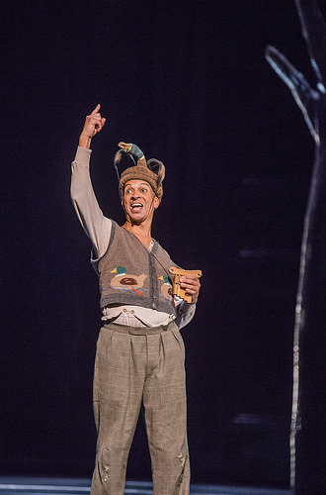
Der Vogelfänger bin ich ja’ (I’m the birdcatcher), Act I – Papageno
Papageno’s first aria is a charming introduction to this bumbling birdman. He’s one of the people, the audience’s representative on stage – and so he sings something like a folksong, with simple short phrases and repeated verses. We learn of his happy daily life and also of his longing for companionship – he wants a wife, to whom he could give as much sugar and as many cuddles as she likes.
https://www.youtube.com/watch?v=5-Qq-DeEXhw

Slide 16
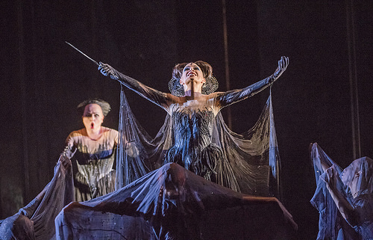
Der Hölle Rache’, Act II – the Queen of the Night
In her second aria the Queen of the Night rains shower after shower of arrow-like notes down on her poor daughter Pamina in tyrannizing anger. The stratospherically high vocal line illustrates her steely cruelty, as she commands her daughter to kill Sarastro or be cast off entirely. ‘Der Hölle Rache’ has become probably the most famous aria in the coloratura soprano repertory.
https://www.youtube.com/watch?v=qMSgzuTA38A

Slide 17
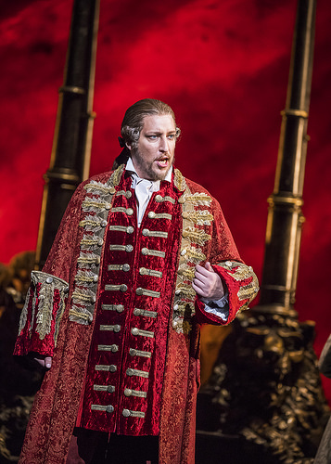
O Isis und Osiris’, Act II – Sarastro
This majestic aria at the start of Act II is Sarastro’s first extended solo. Mozart needs to achieve an about-turn with Sarastro; until the very end of Act I he was the opera’s absent villain, a shadowy figure fiercely reviled by the Queen of the Night. When we finally meet him, we, like Pamina and Tamino, must not only understand but believe in his goodness. With an authoritative bass voice Sarastro sings in long measured lines that convey his serenity and majesty in complete contrast to the Queen of the Night’s aria.
https://www.youtube.com/watch?v=WvejdHpyofw

Slide 18
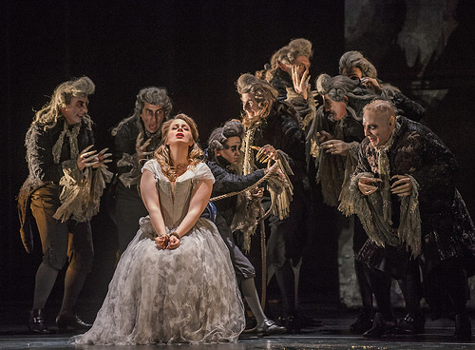
Ach, ich fühl’s’, Act II – Pamina
Pamina has been captured by Sarastro, assaulted by Monostatos, tormented by her mother. And now Tamino will not speak to her – unbeknownst to Pamina, he has been commanded to undergo a Trial of Silence. Mozart gives her an aria of haunting, anguished beauty – an expression of all the torment she has suffered, with the loss of Tamino’s love as her greatest pain. Her delicately ornamented line shines out against a bare accompaniment, a symbol of her desolation. Mozart takes the voice higher and higher as Pamina’s anguish increases before she ends in hushed resolve to take her life.
https://www.youtube.com/watch?v=53RwokMkgqk

Slide 19
Picture Gallery

Slide 20
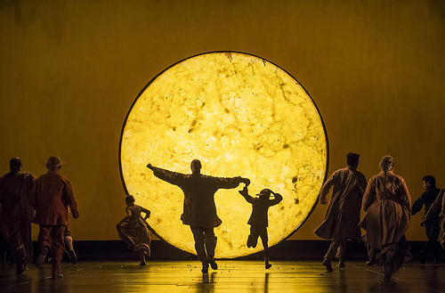

Slide 21
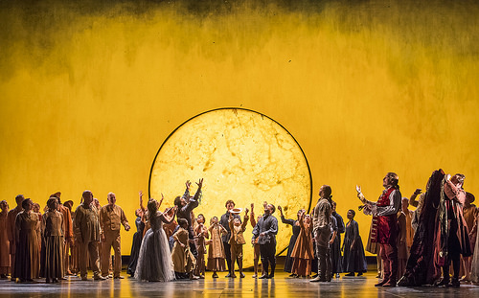

Slide 23
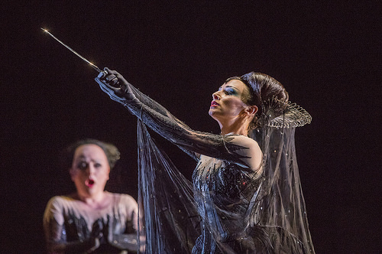

Slide 24
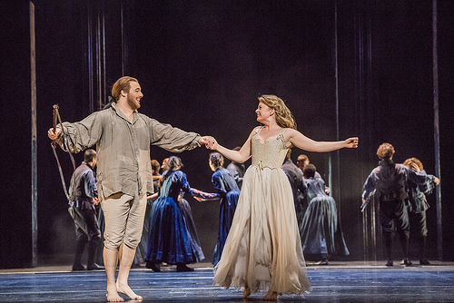

Slide 25
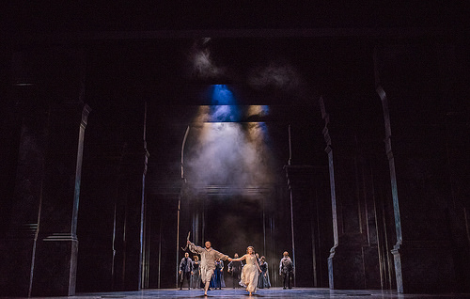

Slide 26
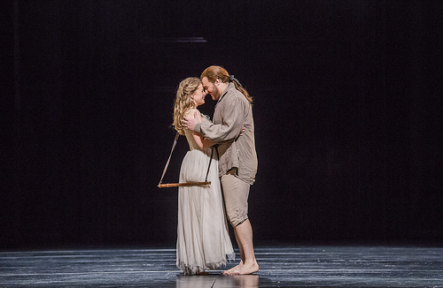

Slide 27
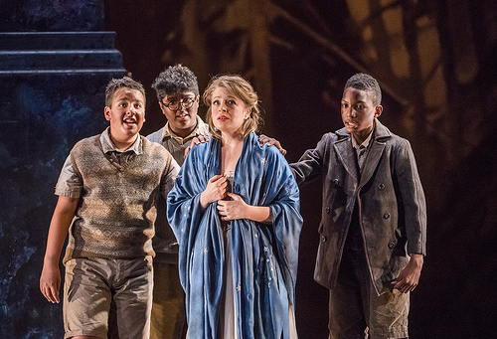

Slide 28
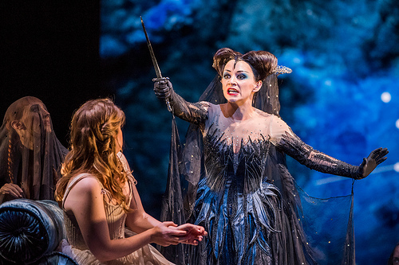

Slide 29
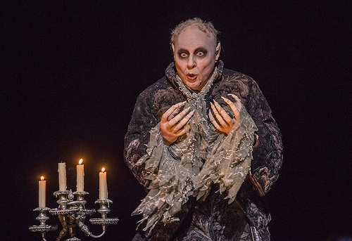

Slide 30


Slide 31
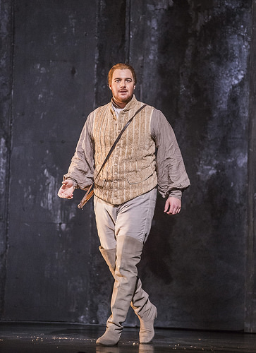

Slide 32
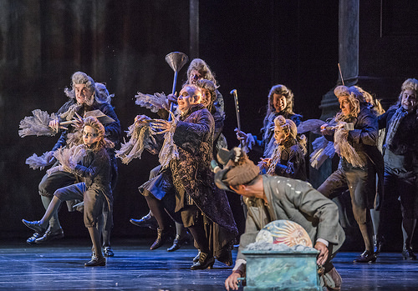

Slide 33
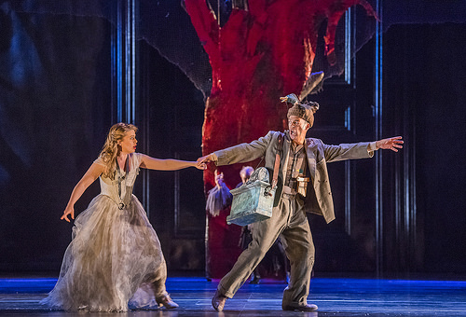

Slide 34
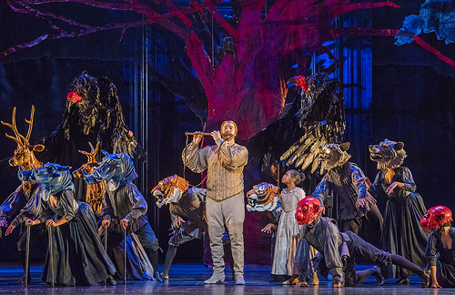

Slide 35


Slide 37
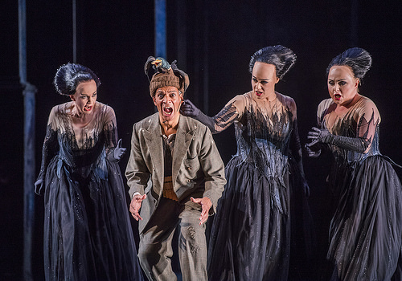

Slide 38
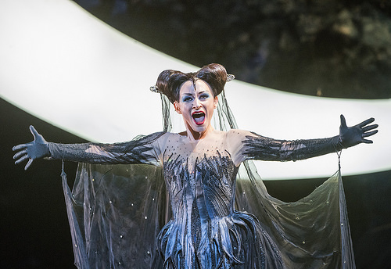

Slide 39


