Slide 1
15/11/19

Slide 2
Lesson plan
Recap and reminders – final sections on Rationale Document
Ideas generation – mindmaps, ideas generation and five finger pitch
Write up results for ideas 1, 2 and 3

Slide 3
Rationale:
Production Overview
Target Audience Research
Primary Research
Secondary Research
Understanding Client Commission
Competitors
Ideas Generation
Pitch
Proposal
Treatment

Slide 5
Competitors within the same industry and their products
See task sheet for details.

Slide 6
Deadline
Your Rationale document needs to be completed in full by Friday 13th 4:00pm.

Slide 7
Ideas generation
Three short tasks that encourage the students to be creative…

Slide 9
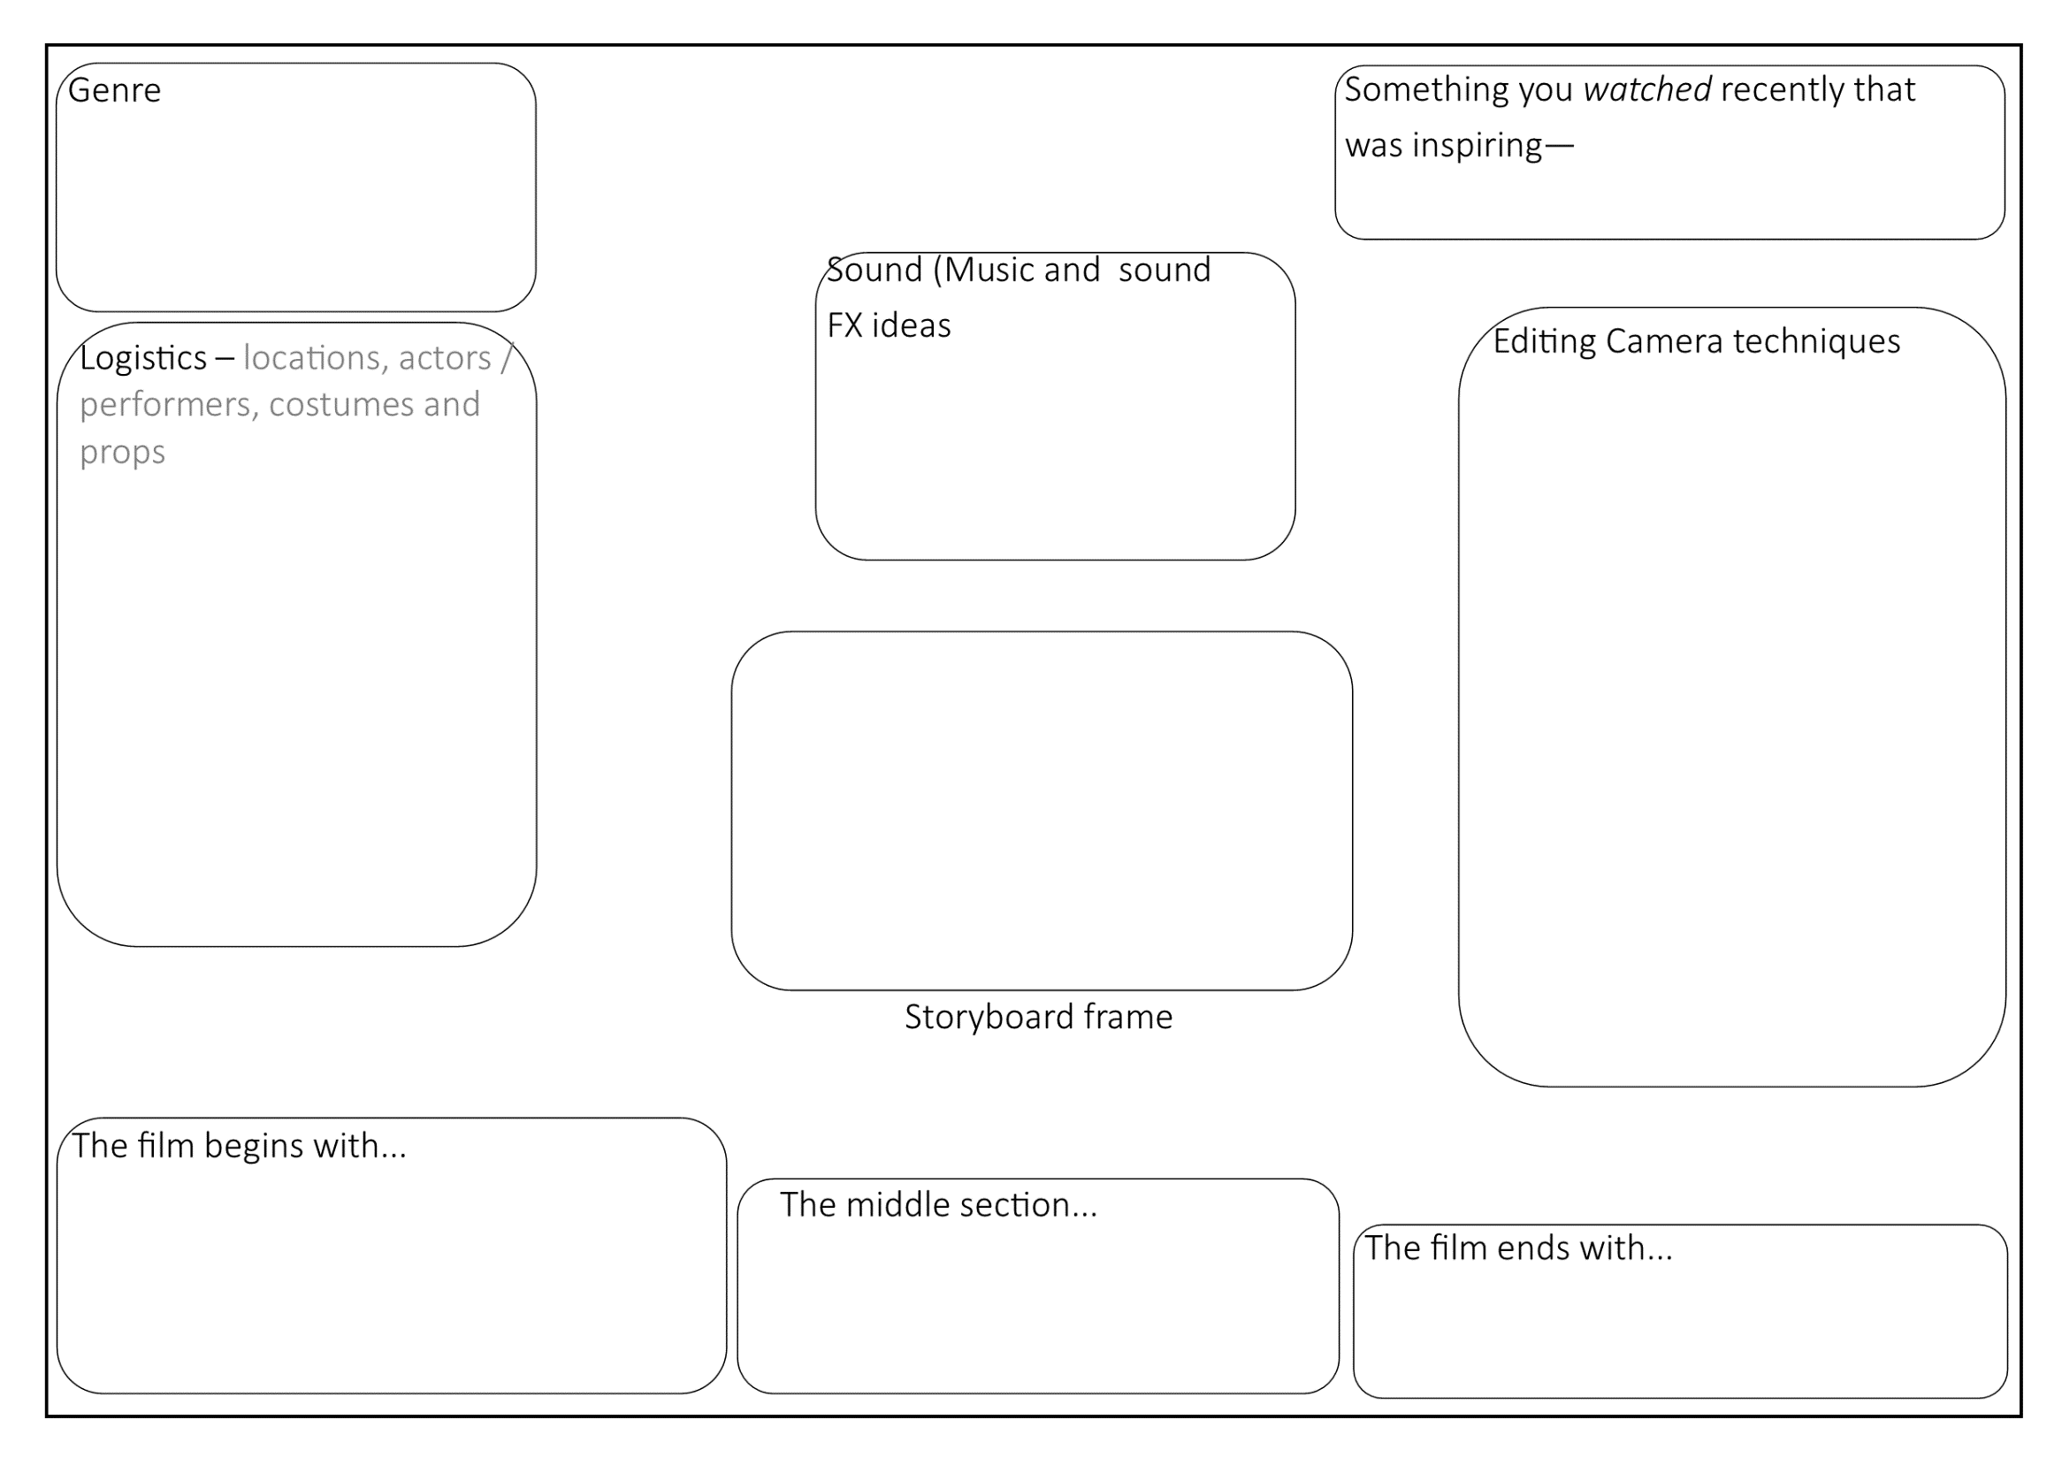

Slide 10
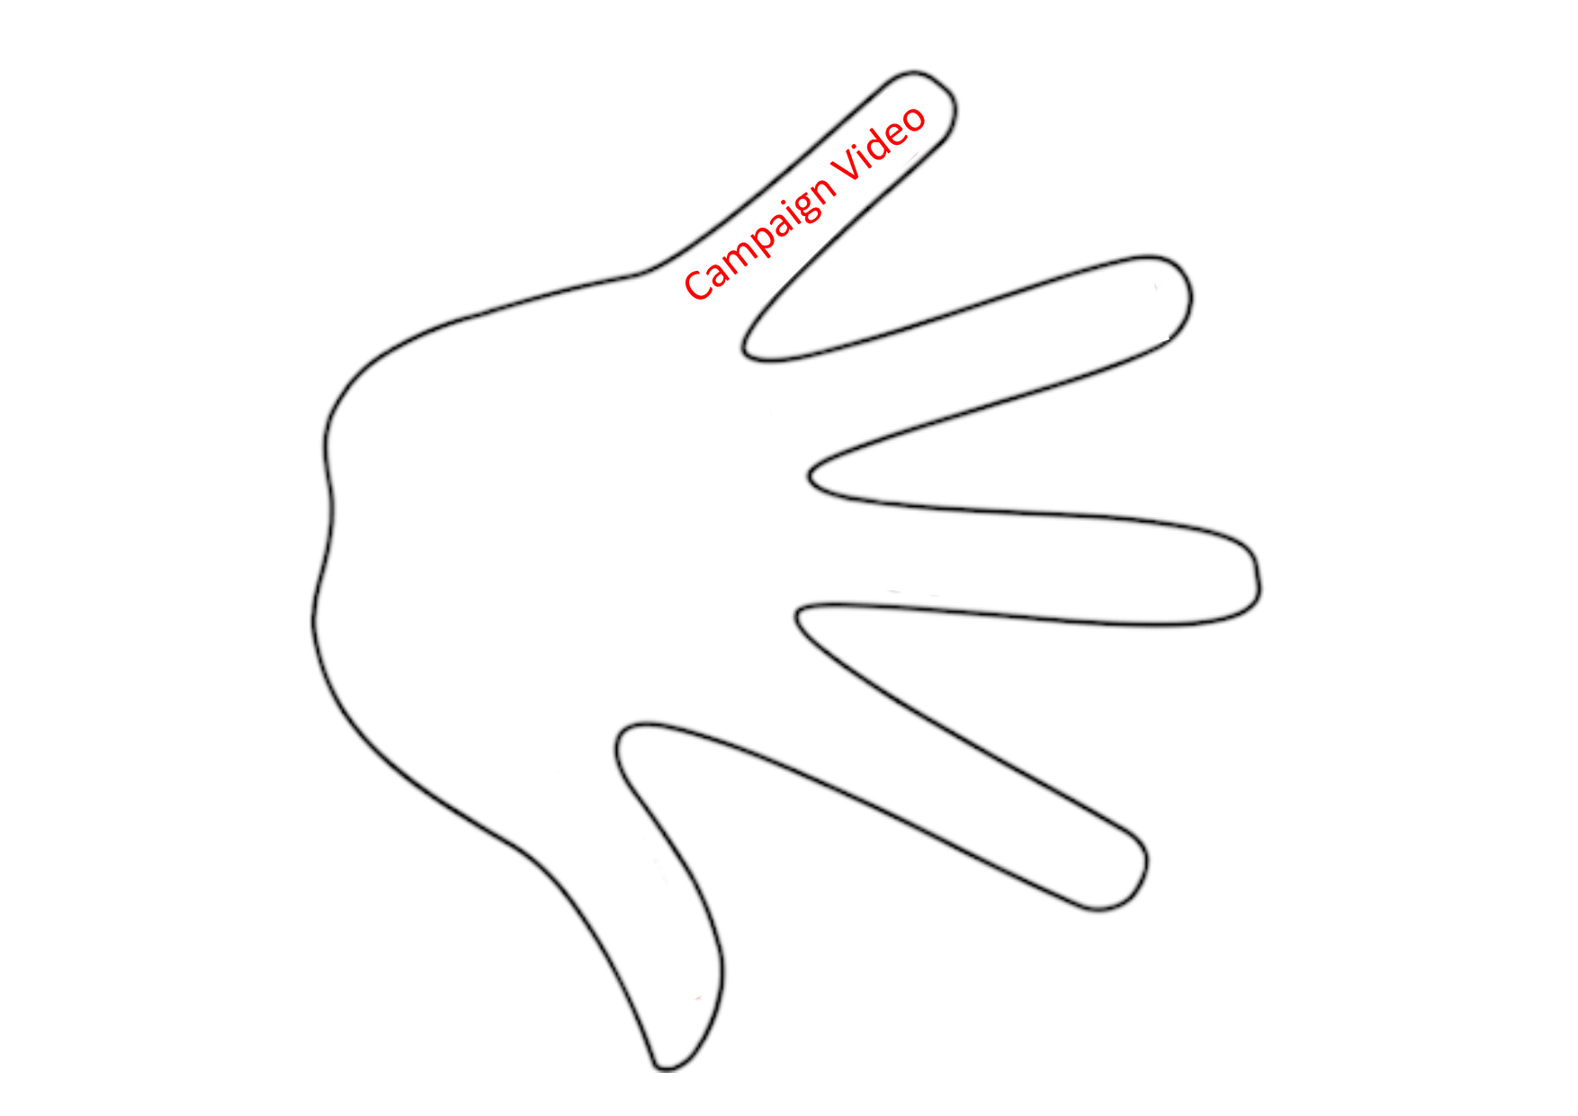

Slide 11
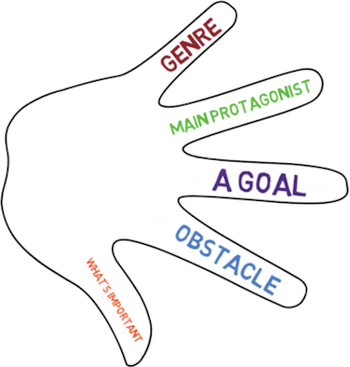

Slide 13
Task 1
Write a detailed paragraph describing and explaining what will happen in your short film
Write in the order of what will happen (from start to finish)
Refer to some specifics- camera, sound, editing, on screen text etc.
It’s ok if you don’t know all the details yet, there will be an opportunity later to elaborate.
Finally, complete a short paragraph on suitability of your ideas in relation to client’s criteria. It’s ok to be a little repetitive here

Slide 14
Once all 3 ideas are realised and written up…

Slide 15
The 30 seconds pitch
Choose your favourite idea. Pitch it to the class, in half a minute, in order to get feedback to be able to then complete the remaining subheadings below.
-Final idea
-Developments to final idea
-Justification for developments

