Slide 1
Unit 2 Composition
The NEW AS/A Level
2016-17

Slide 2
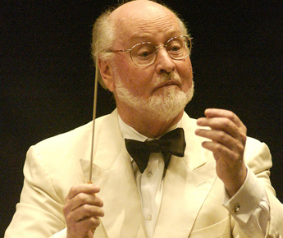
MY EXPECTATIONS
All work is completed on time meeting deadlines set.
Work is of high quality demonstrating mastery of skills and pride in the product – Composition is tough and for many of you is a NEW skill
Students have an open mind to all music, styles, artists and genres.
Students support and respect each other.
Attend every class – don’t flake out.
No phones – no one out there is more important than 100% focus on me (during lesson time) and the course.
No time wasting – that includes wasting my time!
Bring a Pen and Don’t be late to every class! That drives me crazy!
Do all this and you will be a Star.
John Williams would never forget a pen or be ill.
YOU could be this star!

Slide 3
Aims
During today’s lesson I will be introduced to composition. I will go on to study building Cadences, looking at typical harmony and voicings and using Sibelius.
I will be able to:
Understand the demands of the compositions brief.
Identify aurally and visually different Plagal and Perfect cadences
Set up a Sibelius project and Compose my own Cadence using Piano
Extra Challenge: to prepare extended cadences
Literacy Aim: to be able confidently articulate aurally the design of Plagal and Perfect cadences
Keywords: Plagal, Perfect, Interrupted, Imperfect, Cadence, Extended, Harmony

Slide 4
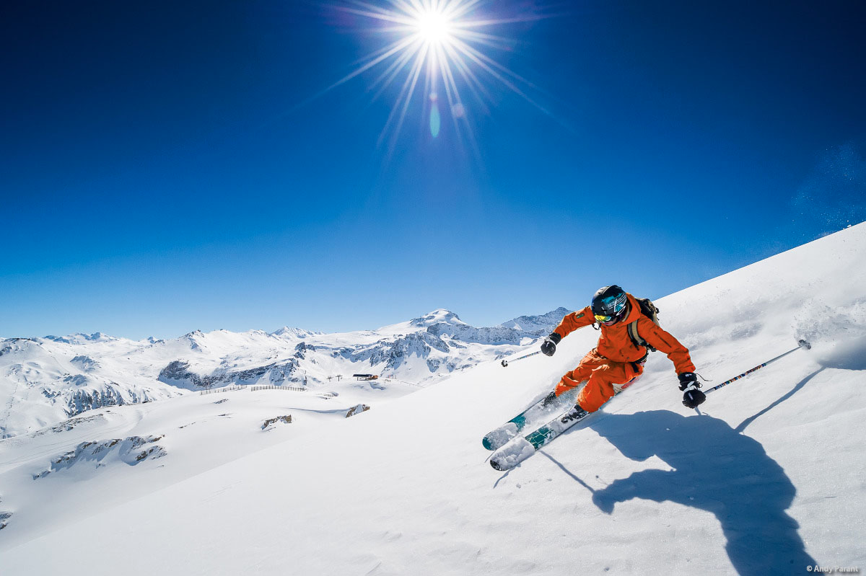
Introduction to the Course
Unit 2 is all about Composition - You will be composing two pieces of music to reflect the following briefs:
Composition 1 - Brief 3 – Music For Film
Compose music for a video promoting adventure holidays for teenagers.
The music must depict at least three contrasted activities (indicated on score).
It must be minimum 2.5 minutes long.
Composition 2 - Free Composition
Exploiting Your Instrument
Compose a piece for your own instrument with accompaniment.
It must exploit the technical and musical idiomatic features of your instrument.
Your piece must have at least one Cantabile Section.
It must be minimum 2 minutes long.

Slide 5
Course Overview
Autumn 1 – Compositional Techniques/Start Adventure Holidays Composition
Autumn 2 – Complete Adventure Holidays Composition
Spring 1 – Start Exploiting Instruments Composition
Spring 2 – Complete both Compositions
By Easter BOTH compositions are fully completed, printed and in some cases recorded!
Pro active high achieving students would consider getting started on their 2nd composition earlier rather than later….

Slide 6
Banned Phrases
The following phrases are banned:
Sibelius hates me
Composition is so difficult
It sounds bad
Everyone else’s sounds so much better than me
I hate computers
There is a fine to be imposed immediately for anyone who breaks this rule!

Slide 7
Harmony Writing Mark Scheme
Level 1 | Limited control of harmony detrimental to the music
Level 2 | Harmony is functional but uninteresting
Level 3 | Harmony is functional but uninteresting. The same chord set is used throughout.
Level 4 | Appropriately chosen harmonies with some variety of chord sets.
Level 5 | Imaginative harmony appropriate to the style.

Slide 8
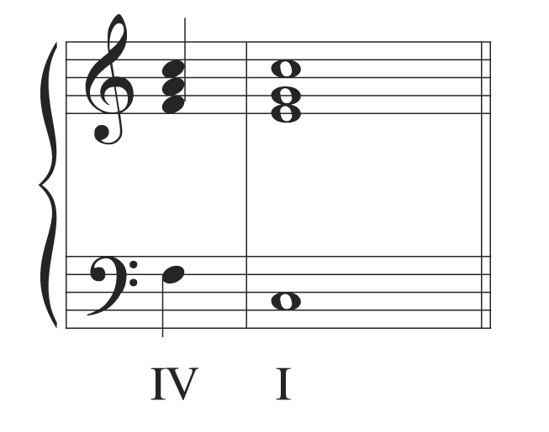
What Cadence is this?

Slide 9
PLAGAL

Slide 10
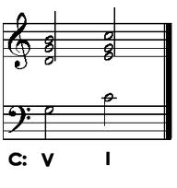
What Cadence is this?

Slide 11
PERFECT

Slide 12
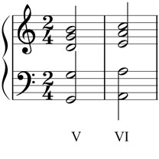
What Cadence is this?

Slide 13
INTERRUPTED

Slide 14
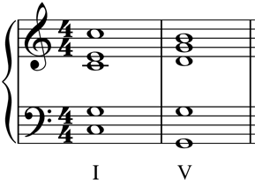
What Cadence is this?

Slide 15
IMPERFECT

Slide 16
What do we mean by Cadence?
Plagal Cadence: IV > I
In this case going F > C
Perfect Cadence: V > I
In this case going G > C
Can you hear the difference?

Slide 17
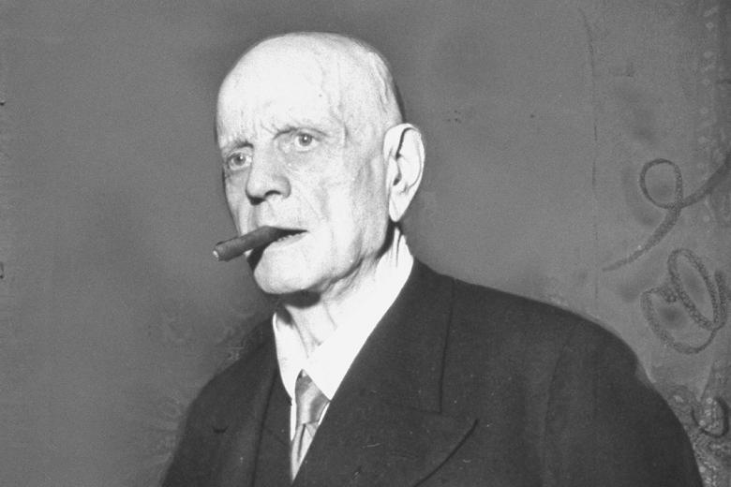
Introduction to Sibelius
You must:
Set up a new project with title (Unit 2 Composition) and composer name (Darren Rampton)
Set up a new project
Add piano as an instrument
Pick your tonal centre/key signature (I’d suggest C, D, F or G)
Map out 8 Bars
Draw in your chord I in the final bar
Prepare your final chord with either a Plagal or Perfect cadence
Save your work as “Unit 2 – Adventure Holiday Composition”
Extra Challenge: try using inverted chords!

Slide 18
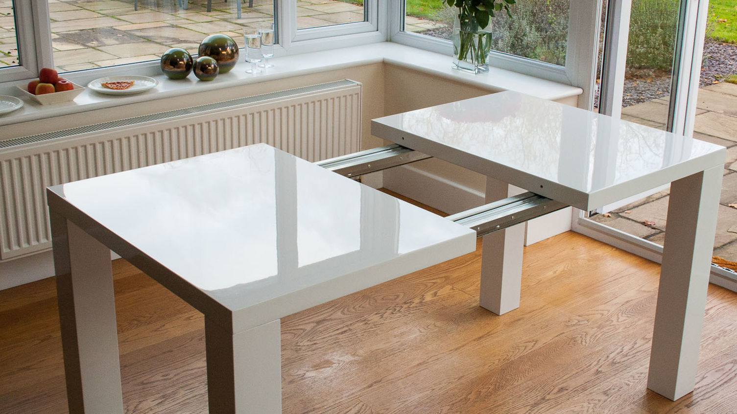
Extra Challenge: Extended Cadence
An extended cadence is where you prepare your penultimate chord with another chord.
Experiment with:
ii > V > I
IV > V > I
bVII > IV > I
iidim7 > V7 > im7

Slide 19
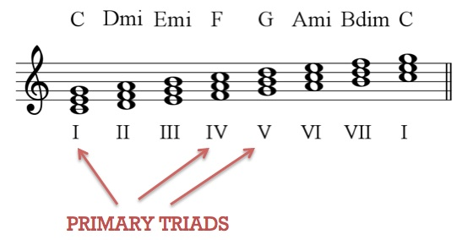
Sibelius Task 2 – Build a Chord Progression
You must develop your Sibelius Chart with the following:
Chord Progression for your Verse and/or Chorus
It must start from your Root Chord
Start by using Primary Chords
Enhance with Secondary Chords
Extra Challenge – add the following:
7th Chords
Different Chords in the 1st/2nd time bars

Slide 20
Plenary – Cadences
What chords make up:
Plagal Cadences in D, F and G
For example in C: F > C
Perfect Cadences in D, F and G
For example in C: G > C

Slide 21
Relative Listening List ‘Adventure Holidays’ brief – Homework 1
‘Water Music’ – G.F. Handel
‘Take Her To Sea, Mr Murdoch’ – James Horner
‘Hook – Flight to Neverland’ – John Williams
‘Carnival De Paris – Dario G
‘The Chain’ (second half!) – Fleetwood Mac
’Graceland’ (album) – Paul Simon
‘Pop Looks Bach’ (theme from Ski Sunday) – Sam Fonteyn
‘‘Master and Commander – The Far Side of the World’ – Iva Davies
‘Adventure Of A Lifetime’ - Coldplay
‘Harold In Italy’ – Hector Berlioz
‘Fly Away’ – Lenny Kravitz
Opposite is a full list of relative listening tunes that I have compiled.
Make a playlist of these tunes and listen like crazy!
Either using 3 of these or some of your own suggestions you are to complete a written musical analysis of the pieces.
Include: instrumentation, tonality, harmony – including specific progressions, notate the lead melody, structure, rhythm and metre
Include any additional information you feel is relevant. Work can be set out as paragraphs or in a table or mind map.
MUST BE THOROUGH – Substandard work is NEVER tolerated.

Slide 22
Unit 2 Composition
The NEW AS/A Level
2016-17

Slide 23
Starter – Think Pair Share Square
What did you listen to and how could this help inspire your compositions? Share with your partner first then share with the group.
Identify:
Composer, title and date composed
Key instrumentation and ensembles
Tonality
Textures
Harmonic Features
Melodic Features
Rhythmic Features

Slide 24
Objectives
Over the next 2 lessons we will analyse melody and compose our own melodic theme
We will:
Analyse melodic shaping, phrasing and rhythm to discover what makes an effective theme
Develop a lead melodic theme that is constructed over primary and secondary chords.
Use our first or second instrument to COMPOSE by PLAYING through our ideas. This will be followed by notation into Sibelius
Extra Challenge: to identify and explain melodic and harmonic features in the Back to the Future Main Theme by Alan Silvestri
Literacy Aim: to articulate aurally and through written work, key musical terminology when appraising a number of famous melodic themes

Slide 25
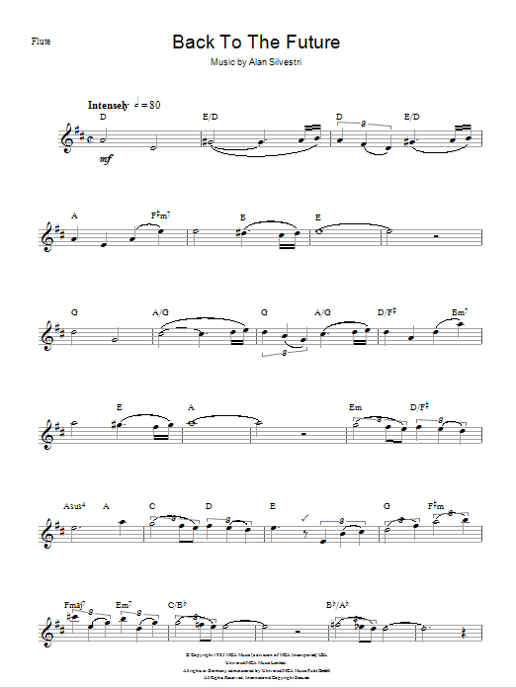
Task 1: Back to the Future by Alan Silvestri
Steps (in pairs or solo):
Analyse the chord progression – roman numerals
Analyse the notes of melody in relation to the chord
How long are phrases and how are they structured?
Extra Challenge – how has modulation been used to develop a sense of excitement?

Slide 26
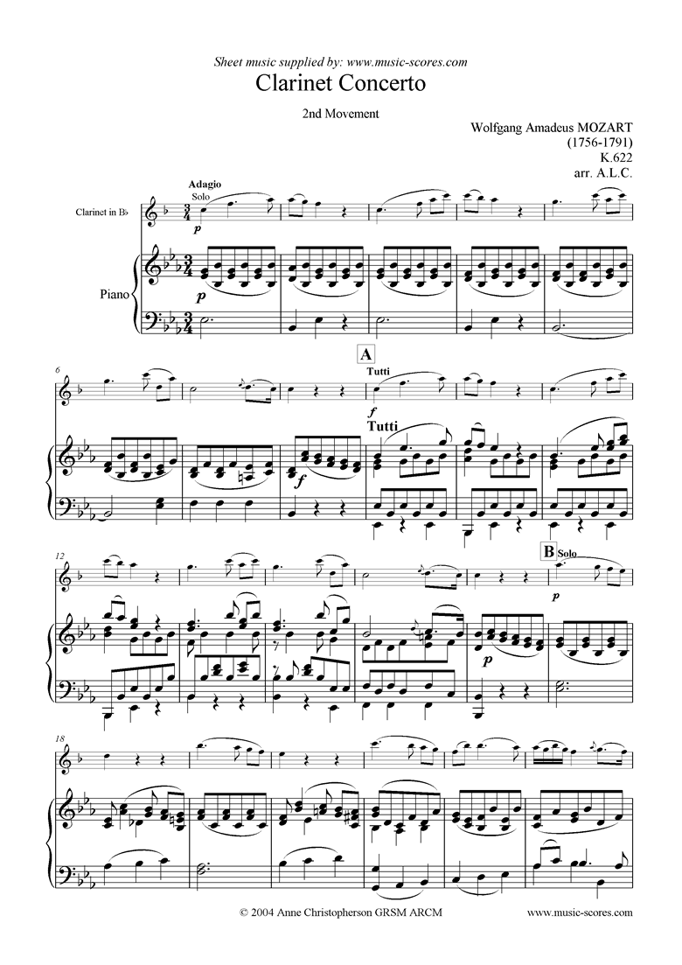
Phrasing – 2 bar, 2 bar, 4 bar Mozart’s Adagio from the Clarinet Concerto

Slide 27
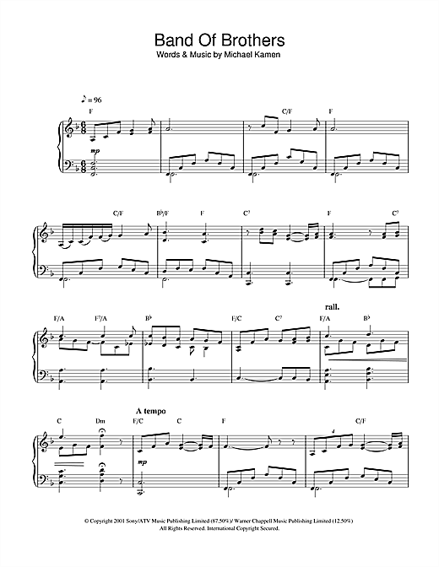
Phrasing – 2 bar, 2 bar, 4 bar Michael Kaman’s Opening Title Seuqence from ‘Band of Brothers’

Slide 28
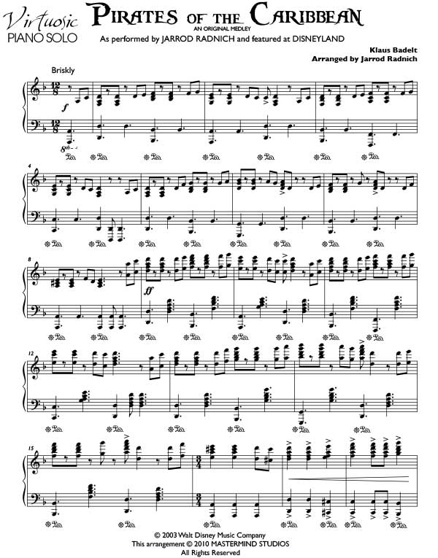
Pirate of the Caribbean – Main Theme Hans Zimmer

Slide 29
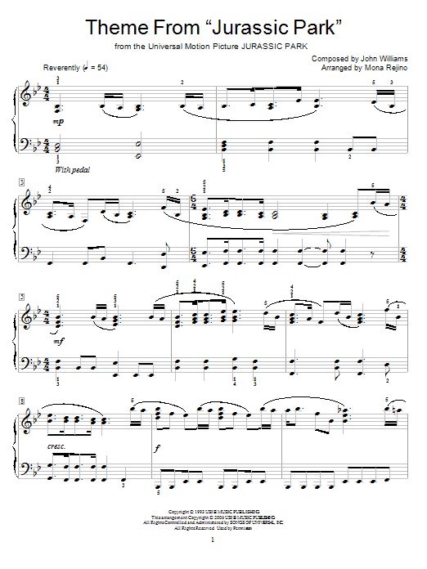
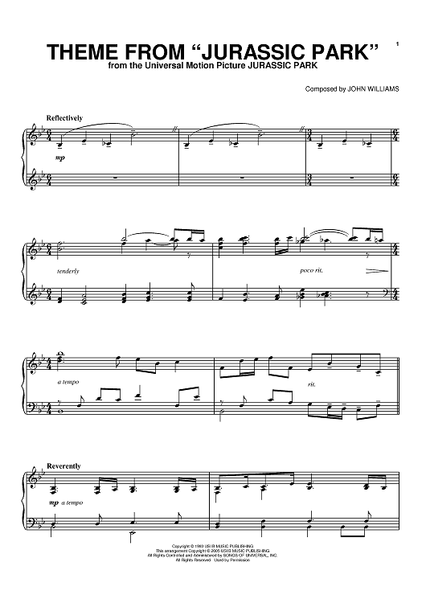
John Williams’ ‘Jurassic Park’

Slide 30
Task – Writing a Short Melody (16 bars)
3 Rules:
Must use chord notes on beats 1 and 3
Must be in neat 2 or 4 bar phrases
Should have flow in shape – no big leaps
If using a keyboard - hold down a chord and improvise using the notes of the scale.
Keep the chords simple initially and write on your instrument FIRST! Sibelius to notate ideas!
Homework - Must be finished and written up on Sibelius for next Thursday’s lesson!
Extra Challenges:
Link/extend phrases to perform over 2 chords
Notate your melody on manuscript paper

Slide 31
Unit 2 Composition
The NEW AS/A Level
2016-17

Slide 32
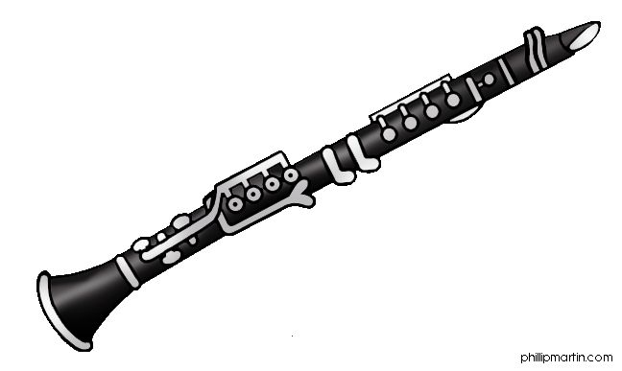
New Ensembles!
Guitar Group – Thursdays @ 12:15pm – 1pm
Wind Ensemble (Trio/Quartet) – Wednesdays @ Break (10:15 – 10:45pm)
Please stay behind after the lesson to speak to me if requested, or otherwise interested!

Slide 33
Composition 1-2-1 Tutorials
Feeling a bit overwhelmed, or just need a bit more help and guidance in composition?
Sign up for a tutorial (usually 20 mins) with Darren using the booking timetable
I try to see every student for a tutorial once per half term!

Slide 34
Listening starter
Why is this piece of music metrically / rhythmically well suited to portraying activity and adventure?
https://www.youtube.com/watch?v=yRh-dzrI4Z4

Slide 35
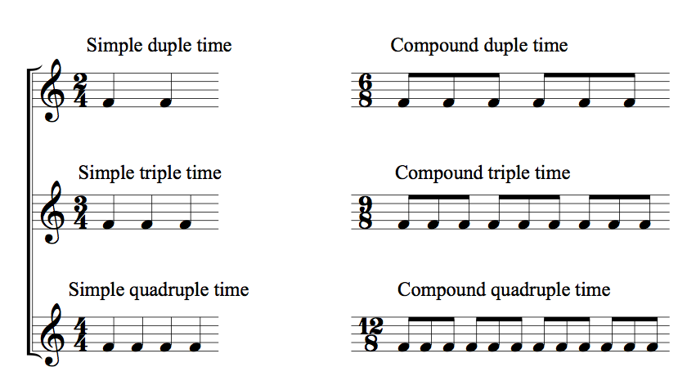
Listening starter
Why is this piece of music metrically / rhythmically well suited to portraying activity and adventure?

Slide 36
Objectives
Over the next 2 lessons we will analyse structure and how to use musical elements appropriately in a film brief composition
We will:
Plan our scenes and proposed musical content using a storyboard or grid
Analyse and plan use of metre (as appropriate to the chosen brief)
Continue to COMPOSE by PLAYING through our ideas. This will be followed by notation into Sibelius. The focus now will be on composing a second theme (chords and melody)
Extra Challenge: to begin arranging instrumental parts and textures in Sibelius
Literacy Aim: to articulate aurally and through written work, key musical terminology when planning storyboard/structure

Slide 37
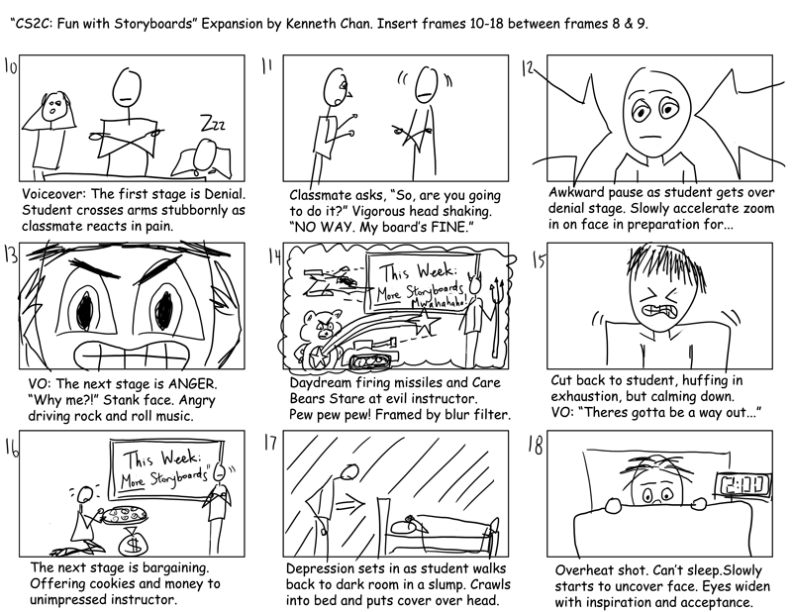
Storyboard/Structure
What rules/ideas could we apply to make your pieces musically interesting?
Must have 3 contrasting sections to show 3 different activities!
Modulation – ?
Tempo – ?
Time Signature – ?
Instrumentation – ?

Slide 38
Storyboard/Structure
These are my rules…
Must have 3 contrasting sections to show 3 different activities!
Modulation – Each section must be in a different key. At least one section should modulate to dominant, subdominant or relative minor DURING that section
Tempo – Each section must be at a different tempo
Time Signature – At least one section should be in compound time i.e. 6/8, 9/8, 12/8!
Instrumentation – It is unwise to feature too many instruments for only one section, however a different instrument(s) may take the lead in different section

Slide 39
Storyboard/Structure
It can be a good idea to have a shorter section which serves as an introduction (and possibly an outro) i.e. a ‘central’ theme, of around 8 bars
You may wish to use your existing chords and melody for this, or it can be composed separately
For such a section, it isn’t necessary to have a planned ‘activity’ in mind, although you should still have a good idea of what is being shown in the film trailer at this point

Slide 40
Activity (10 mins)
Using your structure planning grids (either given template or your own!) ensure you have at least penciled in ideas for at least 3 contrasting sections, covering all of the key musical elements
Melody, Harmony, Rhythm, Texture, Timbre
There must be a really clear link to the ‘activity’ that is being portrayed in the film trailer (you make this up yourself!)

Slide 41
Activity (10 mins)
PAIR & SHARE
Share your ideas with a partner (or in a three) and discuss your differing approaches in planning your sections and musical ideas
We will then share one idea per pair to the class!

Slide 42
WARNING!
You are composing one continuous piece of music, therefore there has to be some link still across the piece in order to create cohesion
Use a recurring motif (rhythmic or melodic or both)
Use a rhythmic ostinato that transforms through different tempi/metre
A clear intro/outro will help to create a sense of conclusion

Slide 43
Sibelius & Teacher listening!
I am now going to come round and listen to all of your melodic and harmonic sequences so far (should be at least 16 bars!)
As well as checking over your existing ideas, you can use the time now to begin drafting musical ideas for new and contrasting sections to your piece
You must use your storyboard/structure plans!
You are welcome to spend some time in a practice room to play through ideas first

Slide 44
Unit 2 Composition
The NEW AS/A Level
2016-17

Slide 45
Objectives
Today we will continue to analyse structure and how to use musical elements appropriately in a film brief composition
We will:
Plan our scenes and proposed musical content using a storyboard or grid
Analyse and plan use of metre (as appropriate to the chosen brief)
Continue to COMPOSE by PLAYING through our ideas. This will be followed by notation into Sibelius. The focus now will be on composing a second theme (chords and melody)
Extra Challenge: to begin arranging instrumental parts and textures in Sibelius
Literacy Aim: to articulate aurally and through written work, key musical terminology when planning storyboard/structure

Slide 46
Today’s lesson
Composition time
You must use your storyboard/structure plans!
You are welcome to spend some time in a practice room to play through ideas first (before notating into Sibelius)
REMEMBER – IN 4 WEEKS TIME YOU WILL BE HANDING IN A COMPLETED 1.5 MINUTES OF THIS PIECE (AT LEAST 2 SECTIONS)!

Slide 47
Homework
2 Parts – Due next Friday (29th September)
Part 1 – Research the construction of sevenths chords
Write a sentence explaining how each one is made up (intervals)
Write out an example of a major 7th, minor 7th, dominant 7th, diminished 7th chord with the root of C (on manuscript, or type in Sibelius and print)
Part 2 – Compose! At least 2 hours per week now please.
Come and use room 820 when it is free!

Slide 48
Unit 2 Composition
The NEW AS/A Level
2016-17

Slide 49
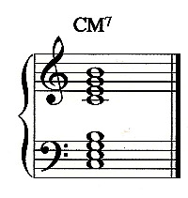
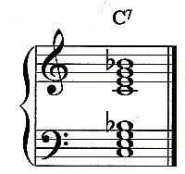
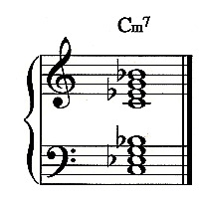
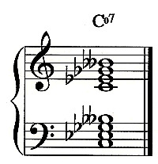
Starter - Constructing 7th Chords
Cmaj7
Major 7 - 1 > 3 > 5 > 7
Dominant 7 - 1 > 3 > 5 > b7
Minor 7 - 1 > b3 > 5 > b7
Diminished 7 - 1 > b3 > b5 > bb7
Cdim7

Slide 50
Lesson Aim & Objectives
Aim: In today’s lesson we will learn how to extend triads into seventh chords to add complexity to a harmonic sequence
We will:
Develop understanding of 7th chord construction (building on from homework)
Evaluate the different musical effects that 7th chords create
Continue to evaluate and develop our chord sequences including use of cadence
Continue to develop our compositions with a focus on effective harmony & melody
Extra Challenge: to further develop instrumental parts and textures in our pieces
Literacy Aim: to articulate aurally and through written work, key musical terminology relating to extended chords

Slide 51
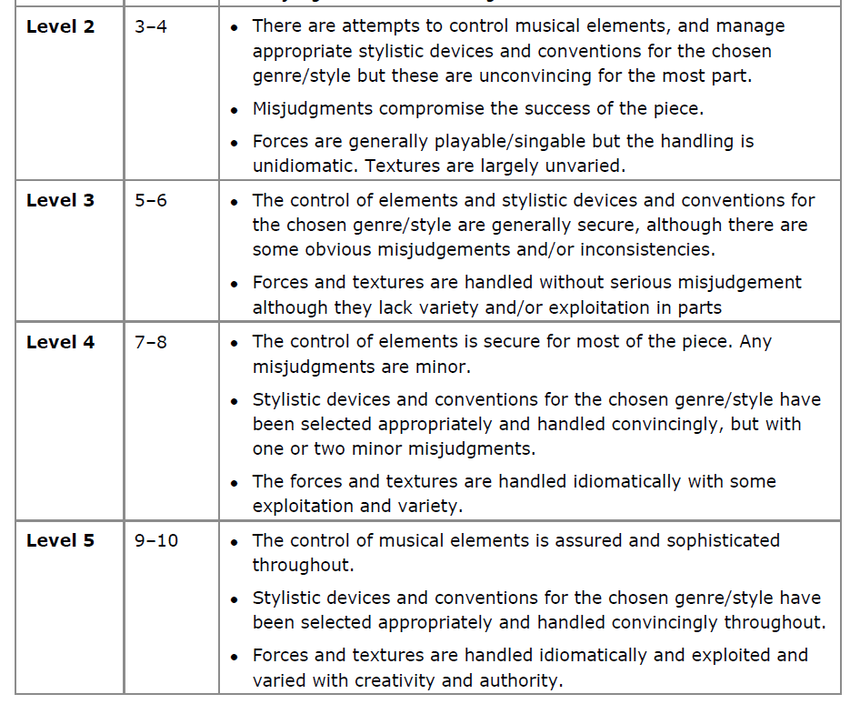
Composing with Technical Control Mark Scheme

Slide 52
Harmony Writing Mark Scheme
Level 1 | Limited control of harmony detrimental to the music
Level 2 | Harmony is functional but uninteresting
Level 3 | Harmony is functional but uninteresting. The same chord set is used throughout.
Level 4 | Appropriately chosen harmonies with some variety of chord sets.
Level 5 | Imaginative harmony appropriate to the style.

Slide 53
What type of 7th chords do we get by adding a 7th to the primary triads in a major key?

Slide 54
What about by adding a 7th to the secondary triads in a major key?
SECONDARY TRIADS

Slide 55
Seventh Chords in C Major

Slide 56
What musical effects do these chords have?
Major 7th chords
Erik Satie - Gymnopedie no. 1
https://www.youtube.com/watch?v=S-Xm7s9eGxU
Minor 7th chords
LaBelle – Lady Marmalade
Dominant 7th chords
Beatles – I Saw Her Standing There
https://www.youtube.com/watch?v=2xbig-xfCIQ
Diminished 7th chords
Bach – Toccata & Fugue in D minor
https://www.youtube.com/watch?v=ho9rZjlsyYY

Slide 57
Dominant 7th chord
Feels like it needs to resolve!
This is due to being built on the dominant (chord V) triad of the scale
The leading note wants to rise and the added 7th wants to fall!

Slide 58
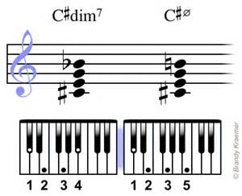
Diminished 7th chord
Doesn’t occur naturally in a major scale
It is a chromatic chord i.e. you need to add sharps or flats to create it
Sounds very tense and can be put in a sequence with other dim 7th chords!

Slide 59
Easy Composing Tips
Start by using 7th chords in root position
Try adding a 7th to chord V when you are at a perfect cadence
Major and minor 7th chords are easy to use but make sure the added notes don’t clash with your melody!
Don’t overuse a chord or it might lose its effect!

Slide 60
Composition Time
Focus on developing your harmony to include use of 7th chords
Keep using and developing your storyboard / structure plans!
You are welcome to spend some time in a practice room to play through ideas first (before notating into Sibelius)
REMEMBER – IN 3 WEEKS TIME YOU WILL BE HANDING IN A COMPLETED 1.5 MINUTES OF THIS PIECE (AT LEAST 2 SECTIONS)!

Slide 61
Homework
2 Parts – Due next Friday (6th October)
Part 1 – Complete worksheet on labeling 7th chords in A Harmonic Minor scale
Part 2 – Compose! At least 2 hours per week now please.
Come and use room 820 when it is free!

Slide 62
Seventh Chords in C Major
Please label the 7th chords below in C major (i.e. the first is Cmaj7)
Cmaj7 ________ ________ ________ ________ ________ ________
Major 7th = maj7
Minor 7th = m7
Dominant 7th = 7
Diminished 7th = dim7 (or o7)
One chords is a m7b5 (minor 7th with a flat 5^{th)} – which one??

Slide 63
Seventh Chords in A Minor
Please label the 7th chords below in A minor (i.e. the first is Am7)
Note that in chords V and vii, the leading note of G# has been raised, as per the harmonic minor scale
Am7 ________ ________ ________ ________ ________ ________

Slide 64
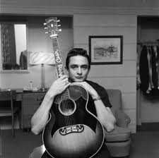
Task 1 – Why Modulate?
Listen to these examples of modulations
How have they modulated?
To what key have they moved to?
To what effect?
Johnny Cash - Walk the Line
http://www.youtube.com/watch?v=jmHNfWRw-qg
Dusty Springfield – Son of a Preacher Man
http://www.youtube.com/watch?v=DjydOI4MEIw
Michael Jackson – Man in the Mirror
http://www.youtube.com/watch?v=P5vz6iwV38U
Michael Jackson – Will you Be There?
http://www.youtube.com/watch?v=d-8KIIWrR6Y
Under the Sea
http://www.youtube.com/watch?v=NPQVrjnC1jo

Slide 65
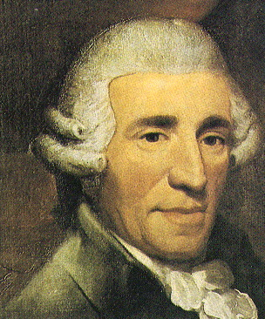
Task 2 – Pivot Chord Modulation
Look at the two examples of Pivot Chord Modulation
How have Haydn and Fats Waller used it to change the key of their music?
Fats Waller – Aint Misbehavin’
http://www.youtube.com/watch?v=97Wwhe9Hx_w

Slide 66
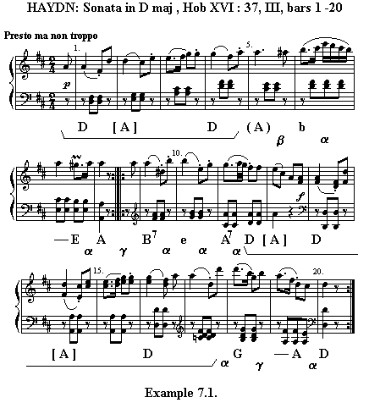
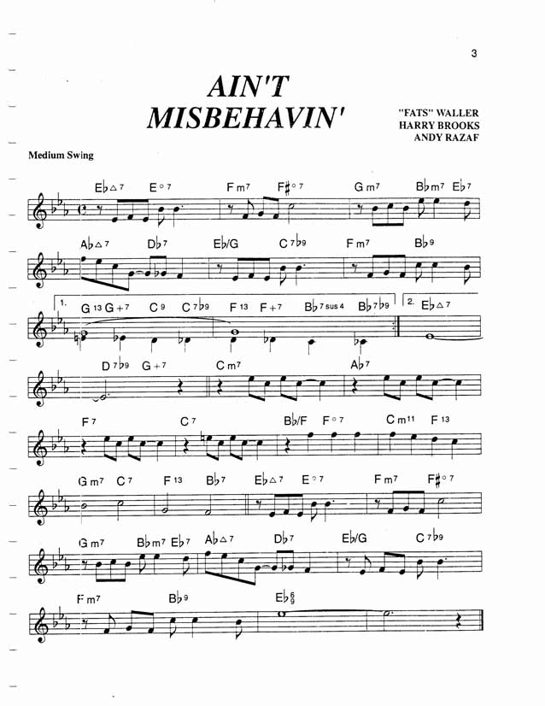

Slide 67
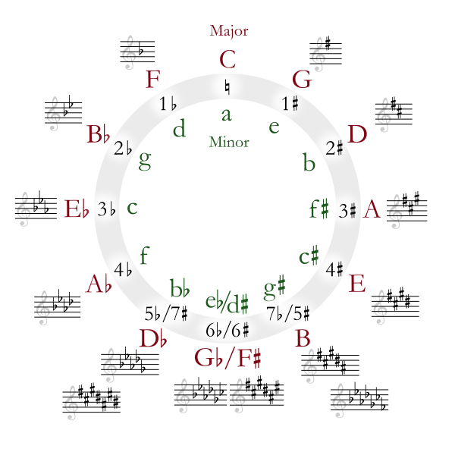
Circle of 5ths (or 4ths…..)

Slide 68
Composition Task – Compose a Chord Progression that Modulates at the end!
You decide, either modulate to the Dominant of Sub Dominant
Remember:
If moving to the Dominant “+1#” or “-1b”
If moving to the Sub-Dominant “-1#” or “+1b”

Slide 69
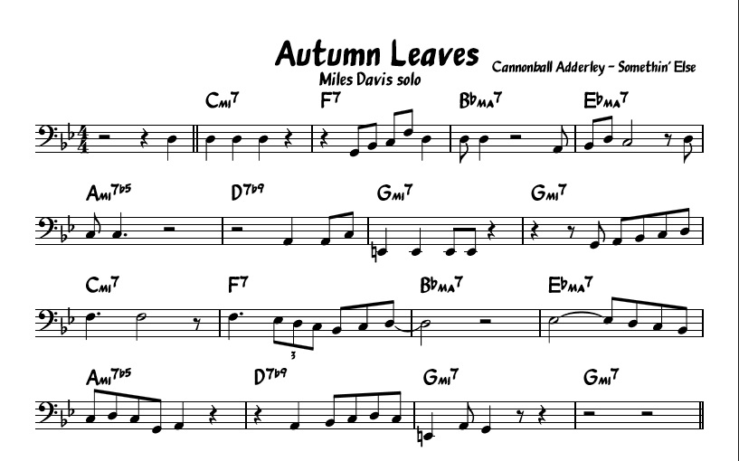
Composing with Cycle of 4ths

