Slide 1
WEEK 1

Slide 2
90

Slide 3
RWS14 – Pure Monopoly
Monopoly Power (firm and industry)
STARTER ACTIVITY: please discuss the following questions, using the whiteboards, ready to present to the class, if you get picked.
What is the difference between a firm in an industry with ‘pure monopoly’ and ‘monopoly power’…use the concept of ‘concentration ratios’ to explain your answer.
Draw a diagram for a firm in a perfectly competitive market. Explain the following?
  Why is the firm producing at this point (q1)
  Why is this firm considered to be statically efficient? Please refer to the diagram explicitly
  Why is the firm only able to earn normal profits?
Under what circumstances, might the perfectly competitive firm be able to earn abnormal profit? Will this last?
What happened in the news last night/this morning with regards to Monarch Airlines and why is this BRILLIANT news from an efficiency point of view?

Slide 4
Profit Maximisation Models: Monopoly Firm
Using the whiteboards, in pairs, use the following instructions to draw the ‘monopoly model’ (or a diagram that represents a monopoly firm in the market).
Draw two axis, one with ‘Price’ on the y-axis and ‘quantity’ on the x-axis
Draw the AR curve (remember this is also the demand curve) at 45 degrees
Draw the MR curve (make sure that the MR curve cuts the x-axis exactly half-way along from the AR curve. The MR curve MUST be below the AR curve)
Draw the MC curve
Draw a dotted line from where the MR=MC to the x-axis (this is your profit maximisation quantity of production)
Draw a dotted line from where the MR=MC curve to the AR curve and draw a horizontal line at 90 degrees towards the y-axis….(this is your profit maximisation price)
TRICKY PART: Draw the AC curve, making sure that it cuts the MC curve at the AC’s lowest point. If you can, make the AC curve go through the point where the MC=AR point is as well….
Where does your vertical dotted line in stage 4 and 5 hit the AC curve? Draw another horizontal line to the y-axis….this is your AC at this quantity of production (your profit maximisation quantity)
Label the abnormal profit this monopoly firm is earning on your diagram…..
EXTRA QUESTIONS TO ANSWER SUBSEQUENTLY TO GETTING YOUR DIAGRAM CHECKED
Why is the AR curve downward sloping for the monopoly but not for the perfectly competitive firm
Why is the AR curve not perfectly inelastic if this is a monopoly?
This diagram represents 100% monopoly power. What would happen to the diagram if it represented a monopoly with 25% market share (or monopoly power)
Anything else?

Slide 5
Revenue Theory
Perfect Competition and Monopoly
DEFINITIONS?
GRAPHS
Costs
(industry and firm for perfect competition and monopoly)
Revenue
(firm facing lots of competition)
Revenue
(Firm and Industry in a Monopoly Position)
£
£
£
MC
No sales
AC
D=AR=MR
No sense
MR
AR=D
Output
Output
Output

Slide 6
THEORY OF THE FIRM
SUMMARY
PROFIT MAXIMISING CONDITION
MR=MC
PRODUCTIVELY EFFICIENT CONDITION
Bottom of the AC curve
ALLOCATIVELY EFFICIENT CONDITION
P=MC
MC = SUPPLY CURVE
Price & Cost (£)
Price & Cost (£)
MC
Price & Cost (£)
AC
AR = DEMAND CURVE
MR
Q1
Q2
Q3
Output
Q1
Output
QU
Q2
QO
Output
There is no diagram for dynamic efficiency – apart from the LRAC curve shifting downwards – why?

Slide 7
RWS#13 and 14: Efficiency and Welfare
Profit Maximisation Models:
PERFECT COMPETITION
PURE MONOPOLY
MANY sellers
Price & Cost (£)
Price & Cost (£)
MC
MC
AC
AC
P1
AC
P1
D=MR=AR
AR
MR
Q1
Output
Q1
Output

Slide 8
Using the rule P=MC, explain why the monopoly is considered to be allocatively inefficient at Q1
Draw dotted lines on the diagram to demonstrate the price and quantity at where a monopoly should be allocatively efficient
Explain why the monopoly firm would be more allocatively efficient at this point
Why is this new allocatively efficient position more productively efficient as well?
Monopoly Firm
Price & Cost (£)
MC
AC
P=AR
AC
AR
MR
Q1
Output

Slide 9
Technical Practice
Monopoly firm earning normal profit
Monopoly firm making a loss
Perfectly competitive firm making supernormal profit
Perfectly competitive firm making a loss
Monopoly firm earning supernormal profit
Perfectly competitive firm earning normal profit
Monopoly firm benefitting from greater economies of scale (dynamic efficiency?)
Monopoly firm producing at the socially optimal point

Slide 10
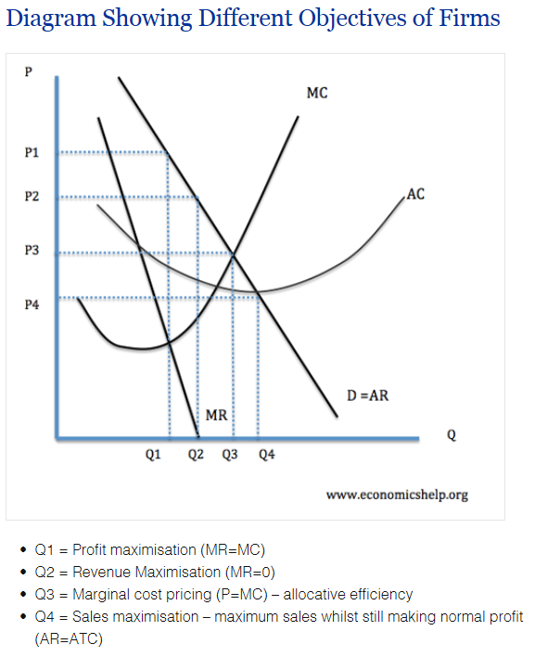
EXTENSION QUESTIONS
Profit Maximisation Model and The Objectives of Firms….
Using a profit maximisation model, demonstrate the quantity and price for a firm with 40% of the industry who has the objective of sales maximisation rather than profit maximisation
Now highlight where the profit maximisation price and quantity is at the point above and highlight the differences between sales and profit maximisation objectives. What do you notice?
Draw a second profit maximisation diagram and highlight the price and quantity of a profit maximisation objective. To achieve ‘allocative efficiency’ the firm needs to be producing at where P=MC. Draw in the price and quantity at where this is. What type of profit is your firm now making?

Slide 11
WEEK 2

Slide 12
30

Slide 13
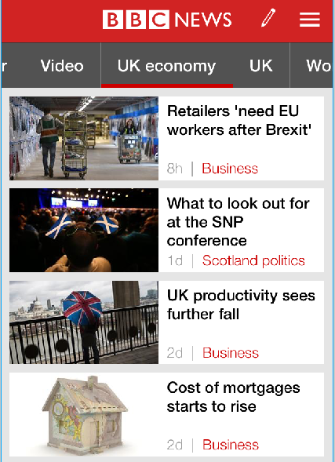
RWS14 - Monopoly
STARTER (PREP Inspection) - Finish TASKS by 0900
TASK 1 (MICROECONOMICS): Finish the price discrimination worksheet in pairs and threes USING your prep homework
TASK 2 (ECON IN THE NEWS):
  What were the stats for UK productivity this week?
  What were the economic growth figures for this week?
  Why do retailers need EU workers after Brexit? What will happen if they cannot get them according to the British Retail Consortium? All have been prominent news stories on the BBC Economy News
Notes:
This diagram shows the following:
There are two different submarkets (elastic and inelastic) and on the right is the entire market for the monopolist (i.e. demand from both submarkets).
It is assumed it costs the same to price discriminate or to serve the industry as a whole. Therefore, we trace across the AC and MC at the profit maximising quantity from the industry diagram.
We can then see that when we profit maximise in the elastic market the price is lower than when we profit maximise in the inelastic market.
The conclusion from the diagram is that profits should increase as the sum of the profit from the inelastic and elastic markets (i.e. profits from price discriminating) is greater than the original industry profit (i.e. when not price discriminating).

Slide 14
RWS14 - Monopoly
Godalming Nightclub
Notes:
This diagram shows the following:
There are two different submarkets (elastic and inelastic) and on the right is the entire market for the monopolist (i.e. demand from both submarkets).
It is assumed it costs the same to price discriminate or to serve the industry as a whole. Therefore, we trace across the AC and MC at the profit maximising quantity from the industry diagram.
We can then see that when we profit maximise in the elastic market the price is lower than when we profit maximise in the inelastic market.
The conclusion from the diagram is that profits should increase as the sum of the profit from the inelastic and elastic markets (i.e. profits from price discriminating) is greater than the original industry profit (i.e. when not price discriminating).

Slide 15

RWS14 - Monopoly
Price Discrimination and Apple
New iPhone release = charge higher price in the first three weeks of sales. Who is apple discriminating against?

Slide 16
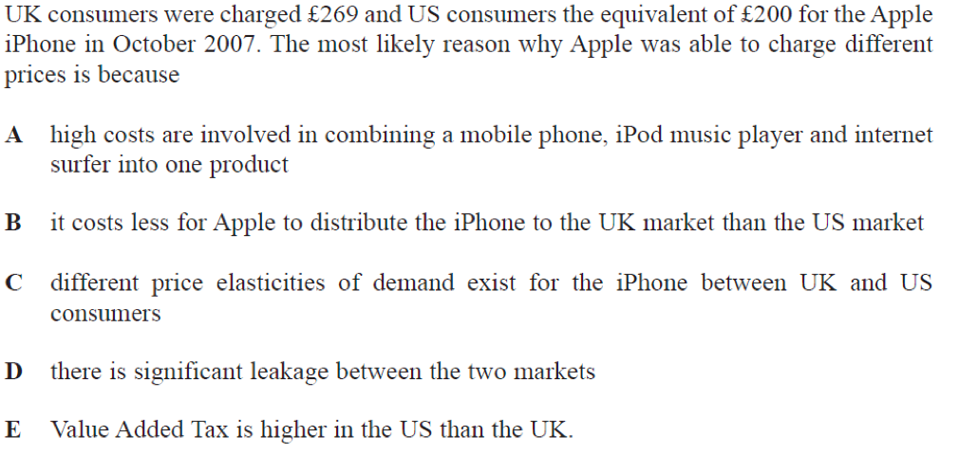
RWS14 - Monopoly
Price Discrimination and Apple

Slide 17
RWS14 - Monopoly
Explain the conditions under which a business is able to engage in price discrimination (15 Marks)
Price discrimination is when a firm charges a different price to different groups of consumers for an identical good or service, for reasons not associated with costs.
Many different forms of price discrimination can take place such as 1st degree, 2nd degree and third degree price discrimination. However, for all these to take place certain conditions must be met.
First the market must be a form of imperfect competition. If there was perfect competition then price discrimination would be not possible as a producer would not be able to control their prices. There must be some level of monopoly power to allow producers the ability to price set and not price take. For example Nurofen created higher prices on the same painkiller which had the same result. This was able to occur as there was asymmetric information among consumers and some monopoly power of nurofen.
Another condition for price discrimination is the prevention of re-sale. If consumers can simply buy a product at cheaper prices and sell it on for a profit to a consumer who would have paid a higher price then there is no price discrimination. This re-sale could take the form of second hand shops and re-sale ticket companies such as stub-hub. These companies capitalise on this arbitrage and re-sell the good creating a profit. Prevention of re-sale could be enforced in many different ways. For example students can only receive student discounts with a legitimate student ID. Furthermore airplane and train tickets are registered to one name and ID must be shown which certifies this.
A key condition for price discrimination to occur is the identification of different market segments. If this is possible different groups have different price elasticities of demand (PED). Therefore the firm can charge different prices depending on the consumers sensitivity to price changes. For example they could charge higher for richer, inelastic consumers who continue buying no matter the price rise. The firm continues to gain profit as long as the marginal revenue is greater than marginal cost.
To gain knowledge of different groups of PED and different individual consume PED firms may have to gain information or market intelligence on consumers through means such as deep data digging in cookies and browser histories. Companies such as Amazon use this technique in order for them to suggest relevant items for each consumer with specialised deals put together based on individual consumer preference. Consumers leave a digital footprint every time they go online, this makes it cheaper and easier for many firms to engage in price discrimination.

Slide 18

PRICE DISCRIMINATION
Advantages of Price Discrimination
Firms will be able to increase revenue. This will enable some firms to stay in business who otherwise would have made a loss. For example price discrimination is important for train companies who offer different prices for peak and off peak.
Increased revenues can be used for research and development which benefit consumers
Some consumers will benefit from lower fares. E.G. old people benefit from lower train companies, old people are more likely to be poor.
Disadvantages of Price Discrimination
Decline in consumer surplus.
Those who pay higher prices may not be the poorest. E.g. adults could be unemployed, OAPs well off.
There may be administration costs in separating the markets.
Some consumers will end up paying higher prices. These higher prices are likely to be allocatively inefficient because P > MC.
DEFINITION
Some buyers in the market will be able to pay a higher price than others for a particular good (with the same marginal cost – i.e. the same good).
A monopoly tries to exploit this by charging different prices to different consumers.
They may be able to discriminate because of
  Time
  Place
  Income
CONDITIONS
The monopolist must face different demand curves from separate groups of buyers.
The monopolist must be able to split the market into distinct groups of buyers
The monopolist must be able to keep the markets separate at relatively low cost
1st Degree - ‘perfect’ = zero consumer surplus (‘haggle’)
2nd Degree - ‘bulk’ = charging different prices dependent on whether a larger quantity is bought
3rd Degree - ‘most common’ = charging different prices for different segments of the market

Slide 19

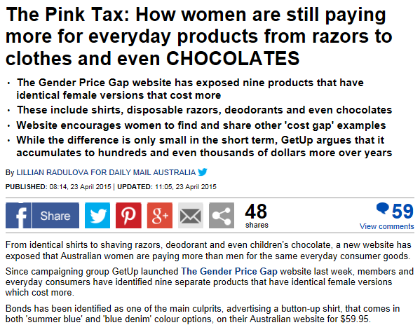
Examples in the news?

Slide 20
90

Slide 21
Revenue and Costs Diagram: Pure Monopoly Model
Productive Inefficiency
The monopoly firm is being ‘lazy’ due to a lack of competition and not fully exploiting it’s increasing marginal returns through specialisation
STARTER ACTIVITY
Individually (7 minutes): SPLIT AN A4 PAPER INTO 4 BOXES:
BOX1: Draw a monopoly diagram earning abnormal profit (highlight this). Why might we argue the first diagram is dynamically efficient?
BOX 2: Draw a second monopoly diagram earning abnormal profit. Explain why the monopoly is considered to be statically inefficient. You will need to draw where the monopoly should be producing to be efficient.
BOX3: Draw a third monopoly diagram, showing a firm earning normal profit
BOX 4: Draw a fourth diagram, showing a monopoly firm making a loss
PRICE: Costs/Revenues
MC
PMON
AC
PPC
MR
AR
QMON
QPC
QUANTITY: Output
Underproduction = Allocative Inefficiency (P>MC)
More scarce resources could be allocated away from other areas to the production of this good.

Slide 22

RWS14 - Pure Monopoly models
Evaluating Pure Monopoly .v. Perfect Competition Models
(1) Maximise Efficiency
(To get to a point where there is minimum waste of our scarce resources)
STATIC (Short-Term): ‘Allocative’ and ‘Productive’ Efficiency
DYNAMIC (Long-Term): ‘Technical’ Efficiency
(2) Maximise Welfare
(To get to a point where no one can be made better off without harming others)
Consumer and Producer Surplus Maximised
No Deadweight Loss (welfare triangles!)

Slide 23
RWS14 - Pure Monopoly Model
(1) Measuring ‘success’ with ‘Economic Efficiency’
PRICE: Costs/Revenues
PRICE: Costs/Revenues
MC
MC
AC
P1
AC
P1
MR=AR=D
MR
AR
QPC
QUANTITY: Output
QMON
QPC
QUANTITY: Output

Slide 24
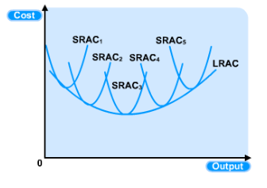
RWS14 - Pure Monopoly Model
(1) Measuring ‘success’ with ‘Economic Efficiency’
DYNAMIC EFFICIENCY and Natural Monopoly
(are monopolies good??)
Examples of natural monopolies:
Gas (pipes) and Electricity (grids)
Water and sewage (pipes)
Microsoft?
LRAC
SRAC1 - small firm
Price & Cost (£)
SRAC2 – large firm
Q1
Q2
Output

Slide 25
RWS14 - Pure Monopoly Model
(2) Measuring ‘success’ with ‘Economic Welfare’
ECONOMIC WELFARE
How much welfare does the production of a good provide to society? This is the concept of economic welfare and is important when dealing with inefficiencies in the market, caused by market structures who are too dominant (price makers)
CONSUMER SURPLUS
The difference between the value to buyers of a level of consumption of a good and the amount that buyers actually pay for that amount
PRODUCER SURPLUS
The difference between the revenue which sellers take from the sale of a good and the minimum amount they would expect to produce it for

Slide 26
WHITEBOARDS
QUESTIONS (back of the A4 sheet - three boxes):
BOX 1
Draw this diagram and identify the areas of consumer and producer surplus.
Why at the equilibrium are we maximising the total welfare to society of producing this product?
BOX 2
Draw a second demand and supply diagram. If there was a monopoly firm producing this good where would they produce and why? Label on your diagram the total welfare loss to society (sometimes called the ‘deadweight loss’)
What will happen to producer and consumer surplus as a result of a monopoly firm producing this good?
What can we conclude about the impact of monopoly firms, producing goods on the welfare of our society
BOX 3
Draw a ‘revenue and cost’ diagram for a pure monopoly firm earning abnormal profit. Highlight the deadweight loss to society of the Monopoly on this diagram.
NEW CONSUMER SURPLUS
Price
DEADWEIGHT LOSS
Supply
CONSUMER SURPLUS
Pmon
NEW PRODUCER SURPLUS
Ppc
PRODUCER SURPLUS
Demand
Qmon
Qpc
Quantity

Slide 27

RWS14 - Pure Monopoly Model
Evaluate the view that monopolies are an undesirable market structure
(25 marks)
EXAM QUESTION: How would you split this up into three points?
(1) Short Term Efficiency
Allocative (what is made and for whom?)
Productive (how its made?)
(2) Long Term Efficiency
Dynamic (innovative aspects)
(3) Welfare
Maximising consumer welfare – no deadweight loss and a lack of price discrimination

Slide 28
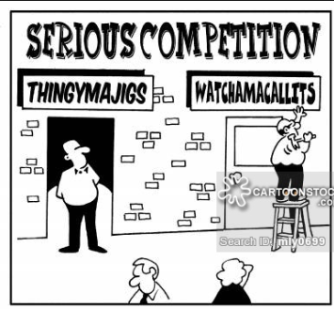
RWS14 - Pure Monopoly Model
Evaluate the idea that promoting perfect competition in markets leads to the best outcomes for society (25 marks)
How would you split this essay into 3 points?
(1) Short Term Efficiency
Allocative (what is made and for whom?)
Productive (how its made?)
(2) Long Term Efficiency
Dynamic (innovative aspects)
(3) Welfare
Maximising consumer welfare – no deadweight loss and a lack of price discrimination

Slide 29
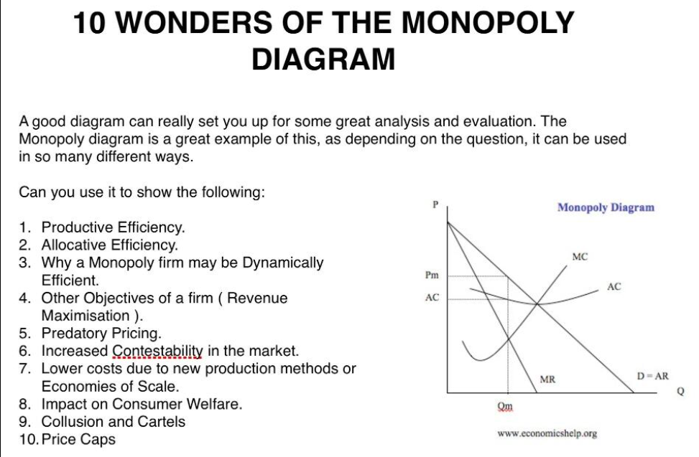

Slide 30
THE END

Slide 31
90

