Slide 1
WEEK 4

Slide 2
HOMEWORK - PREP
Due for the w/b….

Slide 3
60
Notes:
Introduction to Globalisation - definition, causes and history
Development and Global Inequality

Slide 4
RWS 14: Globalisation and Development
Introduction to Globalisation and Development
Development
Global Inequality
Globalisation

Slide 5
Development and Global Inequality
Why are Western nations more economically developed than “the rest”?
The Old Inequality?
  Developed Nations (First World)
  Developing Nations (Third World)
The New Inequality?
  (1.2 Billion) Developed nations
  (4.4 Billion) Emerging Economies - Brazil, Russia, India and China
  (1 Billion) Poverty Traps and The Bottom Billion?
Largest economies in 2003 | Largest economies in 2025 | Largest economies in 2050
USA | USA | China
Japan | China | USA
Germany | Japan | India
UK | Germany | Japan
France | India | Brazil
China | UK | Mexico
Italy | France | Russia
India | Russia | Germany
Brazil | South Korea | UK
Notes:
5-10 mins STARTER: Teacher led - through slides 2,3 and 4
Explain structure and go through stats
Emphasis is on the ‘Old inequality’ - i.e. why are there variations in development or why is there a difference between ‘developed’ and ‘developing countries’
The new inequiality is only a small part of next week but asks the question is the traditional way of dividing the world into ‘developed and developing’ still relevant today with the emergence of the BRIC countries etc.

Slide 6

Development and Global Inequality
What about the future?
WESTERN DOMINANCE THREATENED:
However is this changing? Emergence of the BRICS shifts power from the West to the East (especially India and China) – recent visits to India (by Obama) and China (by Cameron) to beg these countries to buy their products highlights this. China are also becoming a lot more vocal on the world stage and throwing their weight around. Is US and UK dominance coming to an end?
GLOBAL TRADE IMBALANCES:
The Chinese are selling too much and the UK and USA are buying too much – trade wars?! Normally currency exchange rates adjust to keep a balance in the World however this has not happened due to Government intervention.
As a result, the USA’s unemployment has increased (now 10% - 2010) and China has a lot of excess cash which it is using to buy up copious amounts of Natural Resources from continents such as Latin America and Africa (is this the new colonialism?)
Notes:
5 mins: Video….and discussion about China’s growing power in the world

Slide 7
Globalisation
Economic
Social
Political
Trade Relations
Free Trade
Fair Trade
EOI
Capital Flows
Foreign Direct Investment
International Money Flows
Social Organisation (multiculturalism and assimilation)
Cultural Imperialism?
Migration Issues
Global Institutions: Supra Governmental Organisations
Bretton Woods: IMF, World Bank and UN
G8 and G20
Democracy for all?
Leading to increases in standards of living?
But for all?
What about the future – will it last?
Increased contact between differing cultures and societies?
Do human beings react well to different cultures?
Moving towards a more harmonious world?
A harmonious world for who – competing agendas’ and priorities over development lead to conflict?
Notes:
TEACHER LED - 10 MINS INTRO TO THE TOPIC
Next few slides

Slide 8
What is Globalization?
Globalisation is the integration of economies through markets across frontiers (Martin Wolf)
Globalisation is the “death of distance” – (Frances Cairncross)
“The international integration of markets for goods, labour and capital” (Niall Ferguson, Historian)
1950’s until today but took off in the 1980’s and to 2000’s.

Slide 9



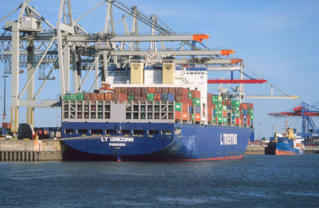

Some core drivers of globalisation

Slide 10
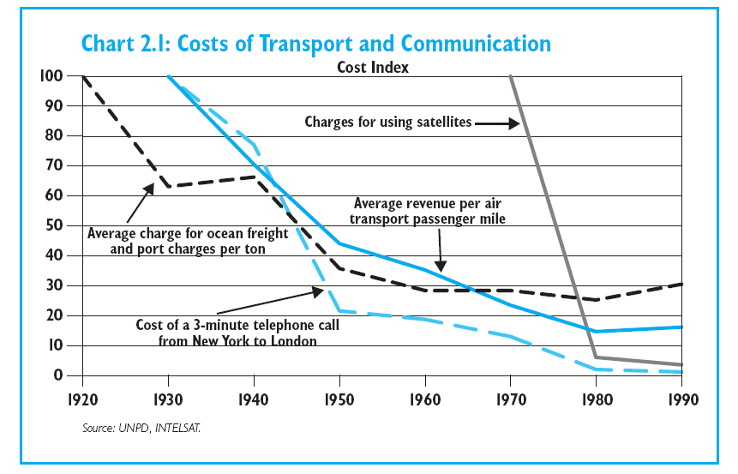
Technology and the death of distance
Notes:
The world is getting smaller, it is becoming cheaper to communicate, to connect and to compete with each other.
Cheap international phone calls, the speed and convenience of the internet; take-off for low cost airlines
This cost index chart shows how the costs of communicating has collapsed

Slide 11
History of Globalisation
Changes in the Pattern of Trade, Labour and Capital
Before 1945: North-South trade predominant – the “old empire”. UK dominant force but by 1945 and the end of World War II, they are in the periphery and USSR (Russia and USA) in the ascendancy.
1945 to 1960’s: North-North became significant as a result of trade BLOCs (e.g. EU) and the Cold War.
1960’s to 1970’s: North-South increased with vast flows of low tech manufactured goods to the West from Asia who started to industrialise in exports. African nations starting to find independence but tended to follow more of an import substitution industrialisation.
1979-2007: Golden era of Globalisation (and neo-liberalism). Trade, capital and labour flows increased significantly with the emergence of India and China and the emergence of the BRIC countries and trade flow
Who are the “North?” and South?

Slide 12
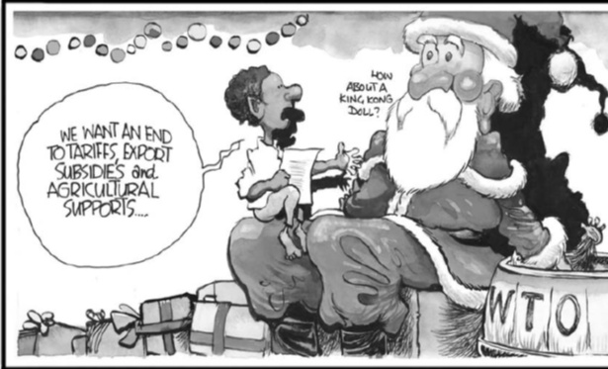
History of Globalisation
Globalisation Today 2007-2017
Financial crash of 2007 brought the effects of globalisation, particularly growing inequality to the forefront of global politics. The prospect of protectionism started to be heard and victories of the likes of Trump and BREXIT were ‘anti-globalisation votes’. The Euro crisis from 2010-2013 and the subsequent refugee crisis of Europe, coinciding with a rise in terrorism have led us to the situation where people are questioning whether Globaliaation has provided us with benefits or not.

Slide 13

History of Globalisation
Did we ever really have true Globalisation 1979-2007?

Slide 14
90
Notes:
Controversies of Globalisation and the ‘Anti-Globlisation Movement’
Introduction to Globalisation Essay

Slide 15
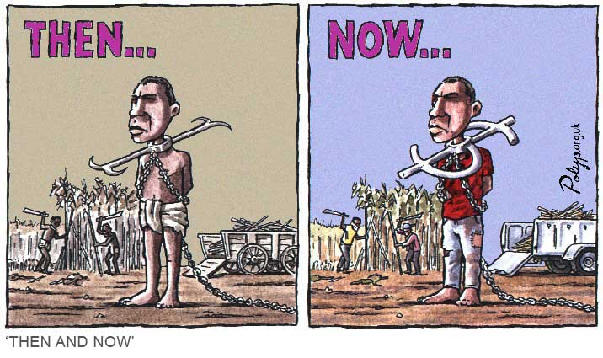
RWS 14: Globalisation and Development
Why is Globalisation so controversial?
STARTER ACTIVITY: Look at the 8 cartoons and for each one write rough notes along the side:
Describe what is going on in the cartoon or diagram
What possible issues with Globalisation might this represent?

Slide 16
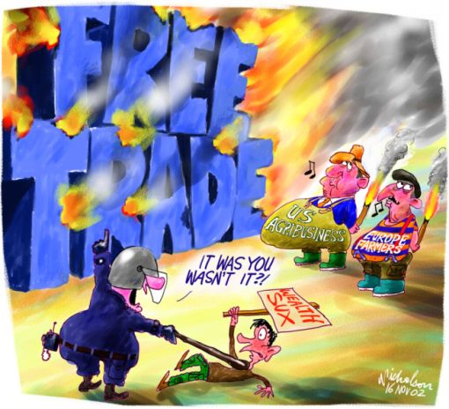
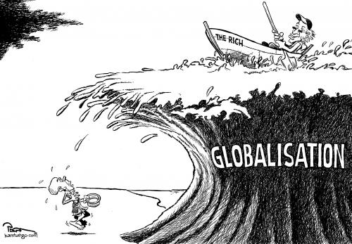
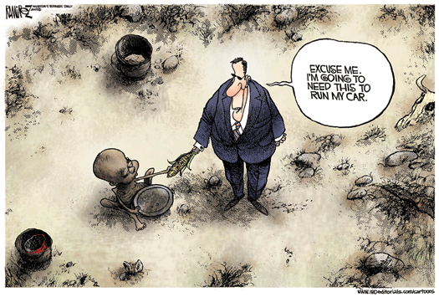
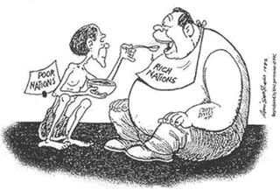
1
2
4
3
Notes:
WRITE NOTES FOR EACH CARTOON BELOW

Slide 17
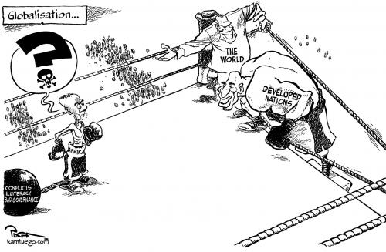
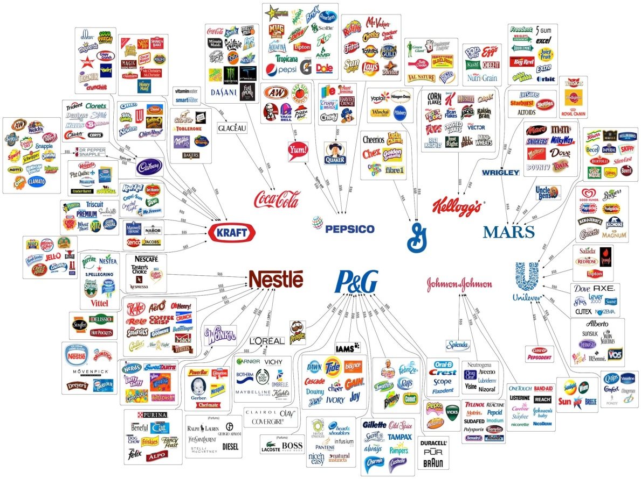
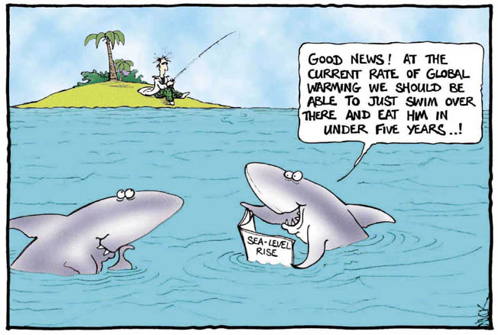
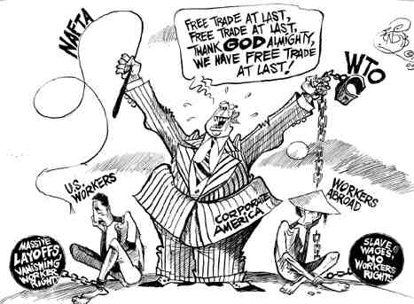
5
6
7
8
Notes:
WRITE NOTES FOR EACH CARTOON BELOW

Slide 18



Why is Globalisation so controversial?
MNC’s are companies such as BP, McDonalds, Vedanta, H&M etc.
They invest money into other countries to build factories or stores to produce or sell their products
Some say this is leads to greater investment and jobs for these countries, reducing poverty etc. More investment should be encouraged
Others say that these companies exploit vulnerable countries through paying lower wages and having poor working conditions. They should be regulated more.
A more extreme view is taken by some to say that they employ children and others under slave like conditions in the sole pursuit of profit. They should be stopped!

Slide 19

Ethical Issues with Trade Today
What responsibility do we have as developed nations in terms of dealing with less developed nations?
Global Trading Rules
  Lack of access to world markets by developing countries
  Failure of the WTO to promote free trade in developed countries?
Global Prices for Poorer Countries
  Developing countries maybe forced into low GDP through specialising in lower value added production – i.e. primary
  Coffee – Farmer’s prices are too low to earn a living but how much was your Starbucks coffee this morning?
“Fast Fashion”
  Sweatshops: poor wages and working conditions
  Why is a Primark hoodie only £5?

Slide 20
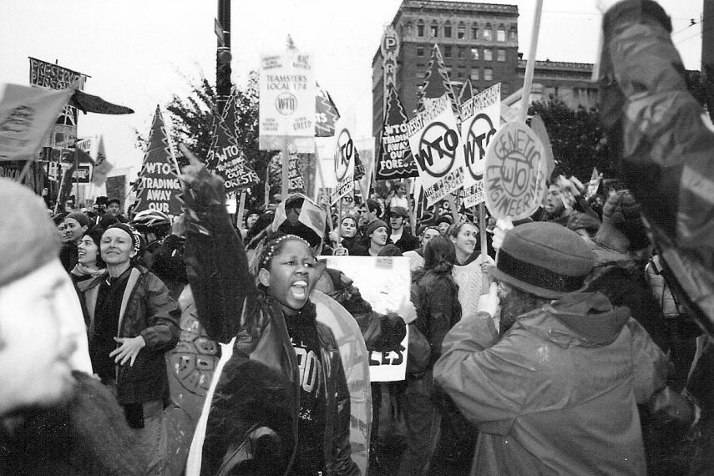
Aims of the ORIGINAL ANTI GLOBALISATION MOVEMENT
They are critical of and oppose a wide variety of different aspects of Globalisation:
Critical of the globalisation of capitalism – neoliberalism (some of them are!)
the unregulated power of multi national companies and big business
The unregulated global financial markets
The powers exercised through trade agreements – through organisations like the WTO
What they are not:
Oppose “free trade” in principal and think all countries should use protectionism
The integration of societies and cultures necessarily
Notes:
15: Teacher led, video and student feedback
Go through powerpoint slides (next 4 including this one) and get students to take notes / ask questions

Slide 21



The Battle for Seattle!
1999
The Background
The Riot
The Movie!?
Notes:
See slide above
I would show them the trailer (hover over the movie picture) for a giggle. But again optional
Important to give the background to the 1999 WTO talks in Seattle though.

Slide 22
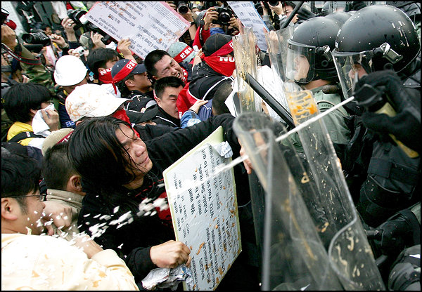
Anti Globalisation Movement - Protests!
1999: Seattle /N30 (WTO)
2001: May 1st May Day Protests (or riots!?) – and every year since
2001: Genoa (WTO)
2003: Cancun, Mexico (WTO)
2005: Gleneagles Summit (G8)
2009: London (G20)
2009: Copenhagen
2011: St Pauls Cathedral? / Central Park, New York and the Occupy Movement
Notes:
See slide above

Slide 23
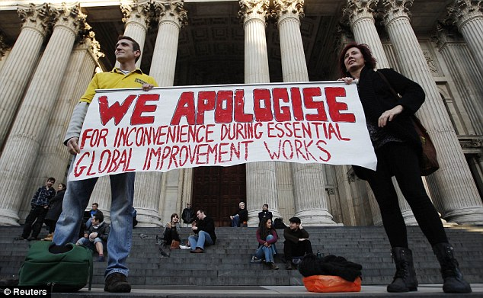
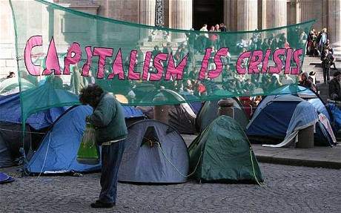
The Occupy Movement (2011)
Notes:
15 Minutes: Videos and Discussion
7: Videos and note taking
8: Class discussion and note taking

Slide 24
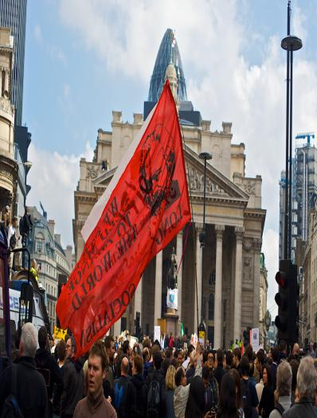
Has the anti-globalisation movement been a success??
Raised awareness
Set a new “anti-corporate” agenda with the help of pivotal books such as “No Logo” by Naomi Klein. Suddenly people were not trusting corporate power
Changed corporate behaviour
Businesses today are very keen to talk about “ethical business”. Multi-national companies are very keen to see their company as a “good guy” and spend large amounts of money on infrastructure projects in the countries they are in.
Challenged the concept of ‘neo-liberalism’
Notes:
15: Teacher led and group exercises
5: go through powerpoints and talk them through the arguments
5: in threes, they must say whether it has been a success or not and be ready to justify
5: Final class feedback - has the movement been a success….

Slide 25


Criticisms of the Movement 1990’s until Today
Lack of evidence?
  Poverty has decreased in countries exposed to Globalisation whereas those who have not. e.g. Africa have suffered at the hands of corrupt Governments
Disorganisation
  Lacks coherent goals and there is too much division between the movement e.g. free trade and protectionism or fighting big business or both!? The “anti-globalisation” movement has as much to argue with itself about as anyone else
Arguably lost momentum after 9/11
  Debate moved onto terrorism and the “anti-globalisation” message was lost
Lack of widespread support from the third world
  e.g. strongest critics are “rich” people from the developed world
Been hijacked by the right wing?
Often the ‘anti-globalisation’ movement has been associated with ‘left wing’ political stances but more recently, traditionally more ‘right-wing’ politicians have enjoyed success
BREXIT in the UK 2016
Trump in the USA 2016
Le Pen (France) a front runner for president in 2017
Election of far-right in 2017 German election

Slide 26






ANTI GLOBALISATION MOVEMENT: A Diverse Bunch!!
People who support aspects of the “Anti-Globalisation” movement
Left Wing…..
Right Wing…..
Nigel Farage
He embraces aspects of globalisation as long as it does not involve ‘uncontrolled immigration’
Naomi Klein
“No Logo” & “The Shock Doctrine”
Joseph Stiglitz
“Globalisation and it’s Discontents
Marine Le Pen
Noam Chomsky
“American Hegemony”
Notes:
See slide above
Giving an overview of some of the commentators and their books (can skip this slide if you want)

Slide 27
Globalisation Essay
How does it affect Developed Countries, Emerging Industrialised Countries and the ‘Bottom Billion’?
Economic growth argument
Rising inequality argument
Un-Sustainability argument

Slide 28
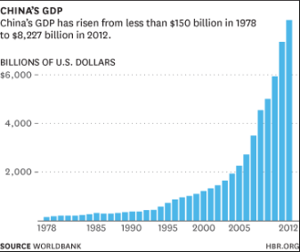
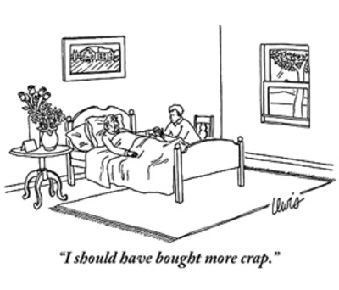
Economic Growth Argument:
(Point 1) Globalisation has benefitted because it has raised living standards (and reduced poverty) through greater economic growth.
ARGUMENT TO SUPPORT
Globalisation delivers increased standards of living and reductions in poverty through specialisation & trade and increases in capital flows and FDI and therefore is a success. Economic impacts are on a local, national and international basis. If anything it needs to be expanded to make sure the poor of the world get out of poverty
ARGUMENT TO EVALUATE
Or do we put too much emphasis on growing output as a means to an end. Do more material goods actually raise our standard of living – do they make us happy? Schumacher thinks that ‘Small is Beautiful’.
Notes:
30: Teacher led
Teacher to dish out A3 essay plan worksheet - see class resources
The rest of the slides until 30 should be gone through. Use articles (provided) and questioning….students should be adding to their plan

Slide 29

(1) Globalisation causes economic growth
CASE STUDY: Small is Beautiful” – 1974…
Schumacher’s Arguments: what were they?
  Big is not necessarily better: it cannot go on forever - so called “Gigantism”….cockroach example
  Large organisations strip the “satisfaction” from work - greater productivity at the expense of boredom…we may have more stuff but are we happy?
  Well being and human happiness cannot be improved through material wealth
  Warned of increases in mental health issues
  Decisions being made on a profit making basis not with the thought of human need
  Cities should be no larger than 500,000 as they are unsustainable (remember Theme 1 AS!?)
Schumacher’s Arguments: do you agree?
  To what extent do you agree with Schumacher’s arguments?

Slide 30
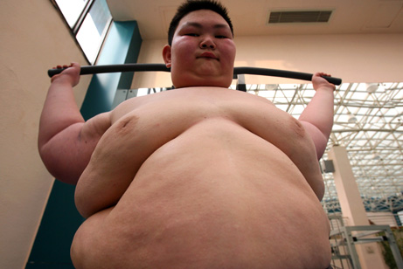

(1) Globalisation causes economic growth
CASE STUDY: Economics of Happiness?
The People of Bhutan Case Study (“Happiness Formula” 13mins to 17mins)
Chinese Depression and Obesity Case Study (“China battles obesity in growing economy” 3 mins)

Slide 31
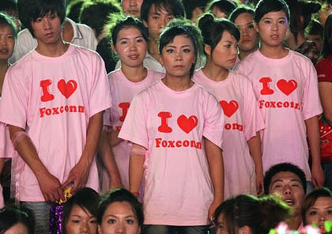
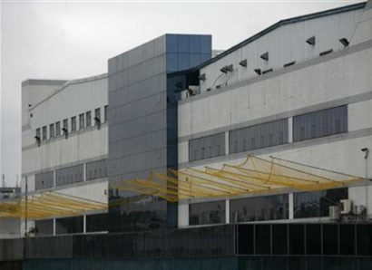
Rising Inequality Argument:
(Point 2) Globalisation has not benefitted because it has led to growing inequality - nationally and globally
ARGUMENT TO SUPPORT
GLOBAL: Globalisation has led to greater global inequality between LEDC’s and MEDC’s. A dependency has developed and been reinforced. ‘Forced specialisation’ and a ‘race to the bottom’ have marginalised ‘LEDC’s’.
NATIONAL: Within countries nationally, there has been a greater divide - UK has North/South divide, China and Zambia have rural and urban splits of living standards.
ARGUMENT TO EVALUATE
GLOBAL: Global inequality distinctions are old hat and we now have emerging economies such as China and India reducing poverty for the population. Also, Globalisation is not necessarily the issue for any growing inequality; a failure of the WTO has also led to the power of the EU and US to prevent pure Globalisation.
NATIONAL: Although some areas are richer than others, wealth and income will eventually spread to these areas.

Slide 32
(2) Globalisation causes Inequality Point
CASE STUDY: Geo Politics is Changing?
WESTERN DOMINANCE THREATENED:
However is this changing? Emergence of the newly industrialised countries shifts power from the West to the East (especially India and China). China are also becoming a lot more vocal on the world stage and throwing their weight around. Is US and EU dominance coming to an end?
Notes:
5 mins: Video….and discussion about China’s growing power in the world

Slide 33
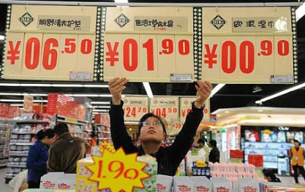
(3) The Sustainability Argument:
Globalisation has not benefitted because it is not sustainable….
ARGUMENT TO SUPPORT
We are growing too fast today at the expense of future generations due to Globalisation. In terms of the degradation and depletion of the environment which might lead to less resources and more natural disasters limiting future growth. Also though because of rising economic reasons (reliance on FDI, UK’s current account deficit, inflationary and debt pressures). Socio-political reasons in countries like China and the pressure for democracy may blow. Overall, this is a shortcut to prosperity and will not last for future generations.
ARGUMENT TO EVALUATE
Or will the human race confront these issues and building on a solution together via new technologies and greater economic co-operation through institutions like the United Nations?

Slide 34
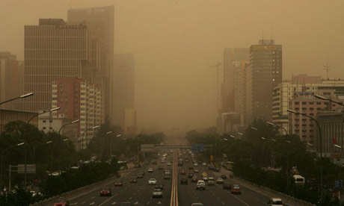
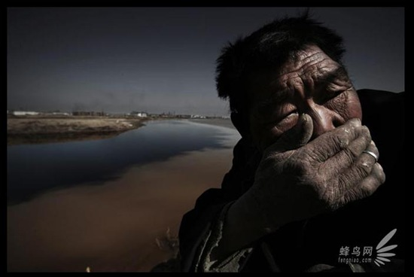

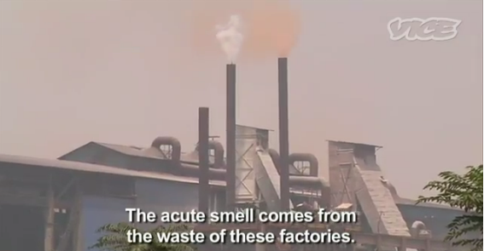
(3) Globalisation isn’t Sustainable CASE STUDY:
Chinese Progress - Will it last?
Economically?
  Rising wages: CNBC News Clip (3 mins)
Environmentally? (see vids below)
  ‘Cancer villages’
  Smog and respiratory issues?
Socio-Politically
  Rising unrest and calls for political change
Depletion
First 5 mins
Degradation
First 4 mins

Slide 35
WEEK 5

Slide 36
HOMEWORK - RWS’s
Due for the w/b….
RWS 14 (Micro): Pure Monopoly Model
RWS 14 (Macro): Globalisation and Development

Slide 37
90
Notes:
45: Complete A3 Sheet in Groups
15: Introduce A3 sheet and pollution video for example
30: Group activities (5 and 5 per point)
15: Planning essays 2x5 minutes
30: Writing conclusions
10: Talking heads
20: Writing questions
5 Intro
5 Conclusion Write
5 Class Feedback
5 Overall

Slide 38
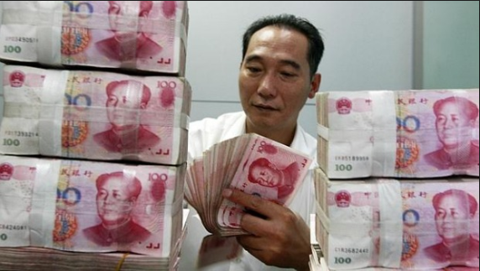
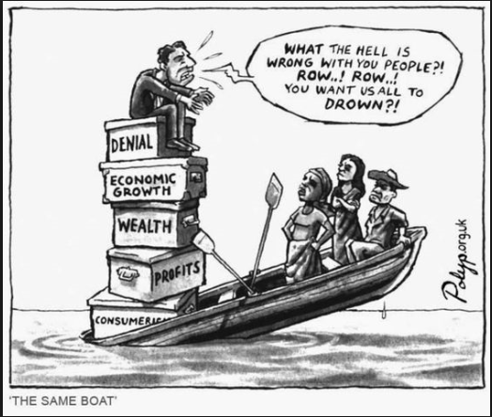
RWS 14: Globalisation and Development
Evaluating Globalisation

Slide 39
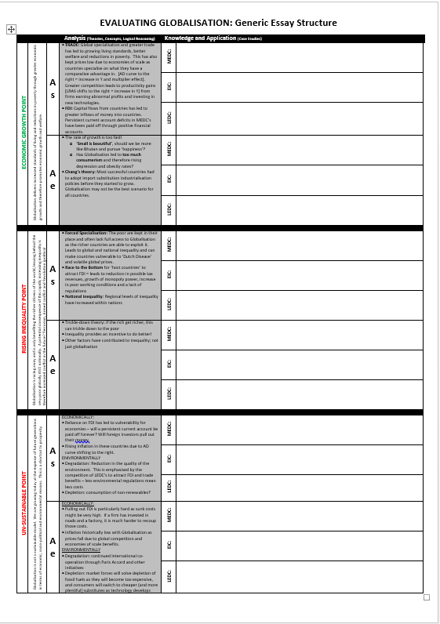
Globalisation Essay
How does it affect Developed Countries, Emerging Industrialised Countries and the ‘Bottom Billion’?
Economic growth argument
Rising inequality argument
Un-Sustainability argument

Slide 40
RWS 14: Globalisation and Development
Planning in 5 Minutes….
JAN12: “Globalisation is, on balance, highly desirable.” Evaluate the economic consequences of globalisation for developing countries (25 marks)
JAN10: “Globalisation is, on balance, highly desirable.” Evaluate the economic consequences of globalisation for developed countries (25 marks)

Slide 41
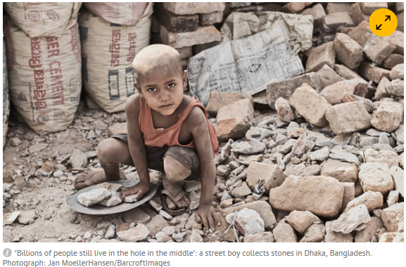
RWS 14: Globalisation and Development
Writing Conclusions: Evaluating Globalisation
Talking Heads: Pretend you are one of these stakeholders… each give a quick background (and a name) to your character and then explain whether you think Globalisation is good or bad.
MNC CEO and Chinese rural villager working in urban factory
UK manual labourer (textiles) and UK consumer
Ethiopian citizen and Chinese Government official

Slide 42
RWS 14: Globalisation and Development
Writing Conclusions
“Globalisation is, on balance, highly desirable.” Evaluate the economic consequences of globalisation for developing countries (25 marks)
“Globalisation is, on balance, highly desirable.” Evaluate the economic consequences of globalisation for developed countries (25 marks)
Good Conclusions have three elements to them:
State a position (‘highly desirable’, ‘not highly desirable’, ‘depends’
Justify your position (pick key arguments which you think carry the most weight)
Defend your position (pick the strongest arguments against your position and explain why they are not valid arguments)

Slide 43
“Globalisation is, on balance, highly desirable.” Evaluate the economic consequences of globalisation for developing countries (25 marks)
INDIVIDUALLY: Read these three conclusions for this essay and highlight (1) the position (2) the supporting justification and (3) the defending justification
GROUPS: Which conclusion do you agree with the most? Try to reach a consensus in your group….
The economic consequences of globalisation for developing countries are highly undesirable and disastrous. Forced specialisation and a ‘race to the bottom’ have generated even larger inequalities between the rich and poor countries. National inequalities have also increased between urban and rural areas. The impact environmentally is also not sustainable and relying on market forces to ‘save the world’ from the rapid depletion and degradation of our resources is disgraceful. Arguably, China and India have had significant reductions in poverty but at what cost: a generation of over-worked, unhappy citizens who are facing the prospect of future generations just feeding the richer nations with cheap products so to ‘benefit’ from specialisation. Equally, smaller countries like Zambia need to implement protectionist policies to protect their infant industries just like the MEDC’s and EIC’s were allowed to do. Future global security is at risk if the unbalanced effects of Globalisation continues in the way it is.
The economic consequences of globalisation for developing countries have the potential to be desirable but perhaps not for everyone. On one hand, greater FDI and trade leads to jobs, economic growth and better living standards. On the other, specialising in primary production like Zambia is with Copper does not provide an equal opportunity to the world’s wealth necessarily. Yet we would not deny the chance for certain areas (China, India) to improve their well-being. There is no denying that Globalisation has been a powerful force but the economic consequences of Globalisation are complex and it is perhaps dangerous to pass a too extreme judgement either way. Ultimately global society needs to think of ways we can harness the positive aspects of Globalisation (growth, reductions in poverty) whilst minimising the negative (inequality and sustainability) and maybe the current rate of Globalisation is too fast but there is no denying it has benefits as well to help eradicate poverty in all countries.
If managed correctly, the economic consequences of Globalisation could be highly desirable for developing countries. The prospects of greater FDI flows and overall increases in trade to China and India have brought much needed money flows to countries who have high levels of poverty. Globalisation is sustainable; it provides jobs, better products and can also lead to better technologies to combat any environmental concerns. There maybe a case for inequality for some poorer developing countries but there are also other factors such as political and geographical factors which have prevented countries like Zambia from developing further. Perhaps the inequality gives these countries an incentive to do better as well and what we would consider poor working conditions are the norms in these countries; certainly returning to their poverty stricken lives in rural areas would be a worse outcome? Maybe the biggest issue with LEDC’s is that there is not enough Globalisation with developed countries still carrying elements of protection in granting their farmers subsidies and developing trade blocs.

Slide 44
“Globalisation is, on balance, highly desirable.” Evaluate the economic consequences of globalisation for developed countries (25 marks)

Slide 45
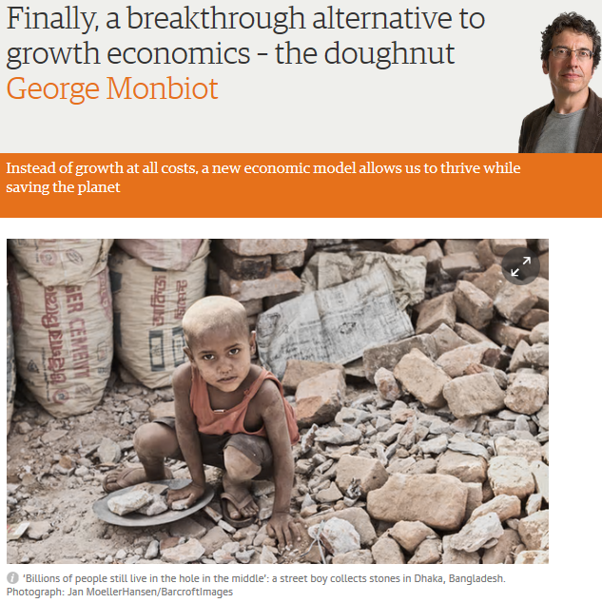
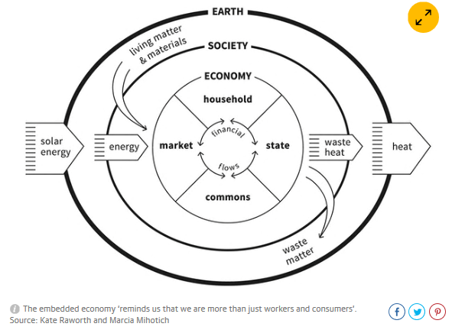

RWS 14: Globalisation and Development
Doughnut Economics??
Notes:
A different take on the circular flow of income: A recognition that economic growth is not some fairy dust and we are not just classified as ‘consumers’ and ‘workers’

Slide 46
THE END

