Slide 1
New Brand Design
For this project we want you focus on designing a new brand for one of the following options:
Food/Drinks product
Sportswear brand
Cosmetic company
Entertainment company
For whichever option you choose we want you to make a least one piece of packaging as an outcome.

Slide 2
LOGO / BRAND
BUSINESS CARD TASKS
Firstly decide on what product you are going make. Research existing products for inspiration
Deciding on a brand name for your product…you must show other options for your brand prior to deciding on your final product name.
The name of your product can be kept simple.
Write down words relating to your product. Then use an online thesaurus such as http://www.thesaurus.com/ and add alternative words to your mind map.
You can also consider USP’s (unique selling points of your brand)
Alter the spellings of some words, for example use ‘Z’ instead of ‘S’.
You can spend a little time using online business name generators. They’re helpful to inspire but often a little irrelevant so don’t waste too much time on these.
https://www.brandroot.com/business-name-generator
http://www.businessnamegenerators.com/

Slide 3
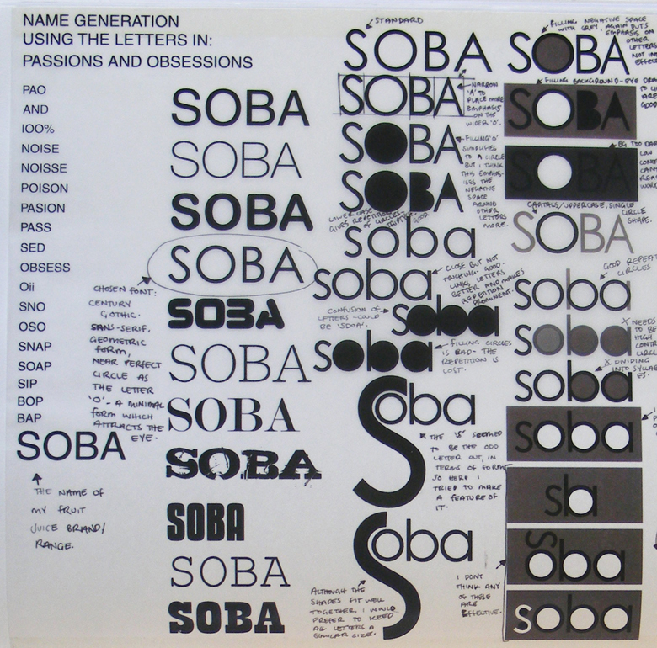
Starting Font/logo Investigation
Once you have decided on a brand name start with some hand drawn sketches, expressing your critical thoughts
Kern the font condensed/expanded
Change size
Mixed case
Lift font off the base line
Rearrange horizontally vertically
Rotate letters
Manipulate Nodes
Colour variations
Thick/thin lines (line weight)
Patterns inside letters
Think about whether you are going to include imagery in your logo
Find Brand name Explore Font styles Manipulate font(s)

Slide 4
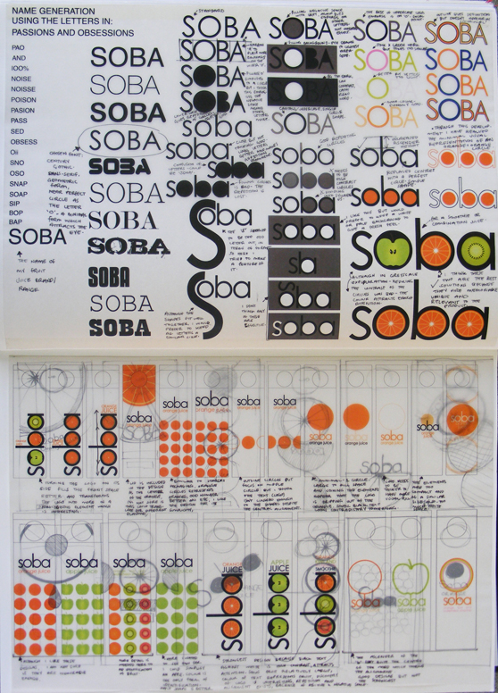

Slide 5
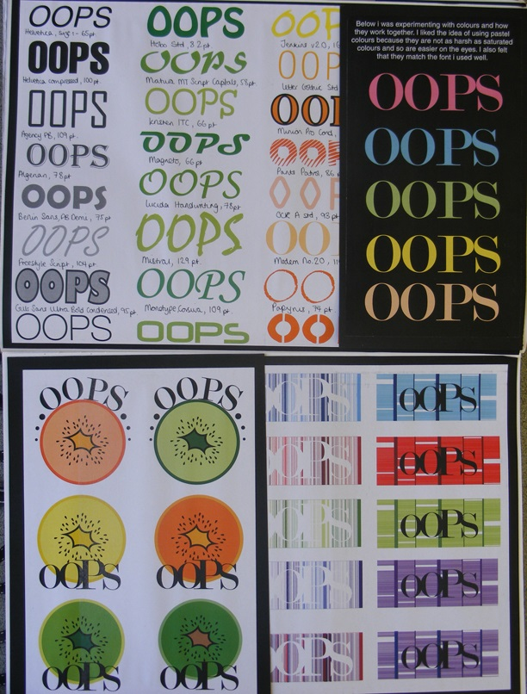

Slide 6
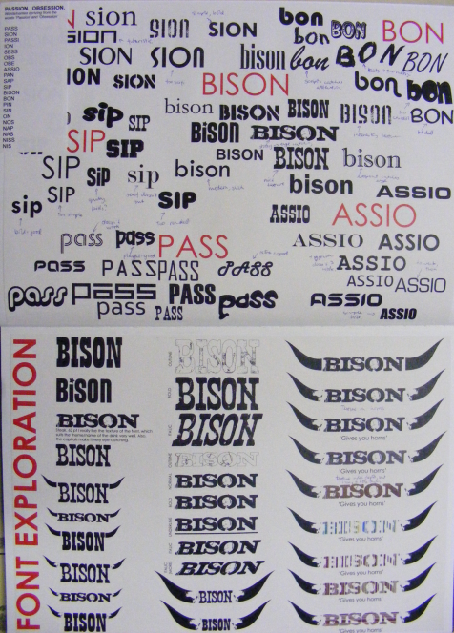

Slide 7
You must think about the packaging you are going to make:
Explore different flat nets
Explore imagery that can be incorporated into your designs
Experiment with different layouts.
Secondary font exploration
Factual information e.g. food/drinks products must include ingredients, weight, manufacturer etc for legal reasons.
You must include links to designers you have already researched in your personal study (a minimum of 2)

Slide 8
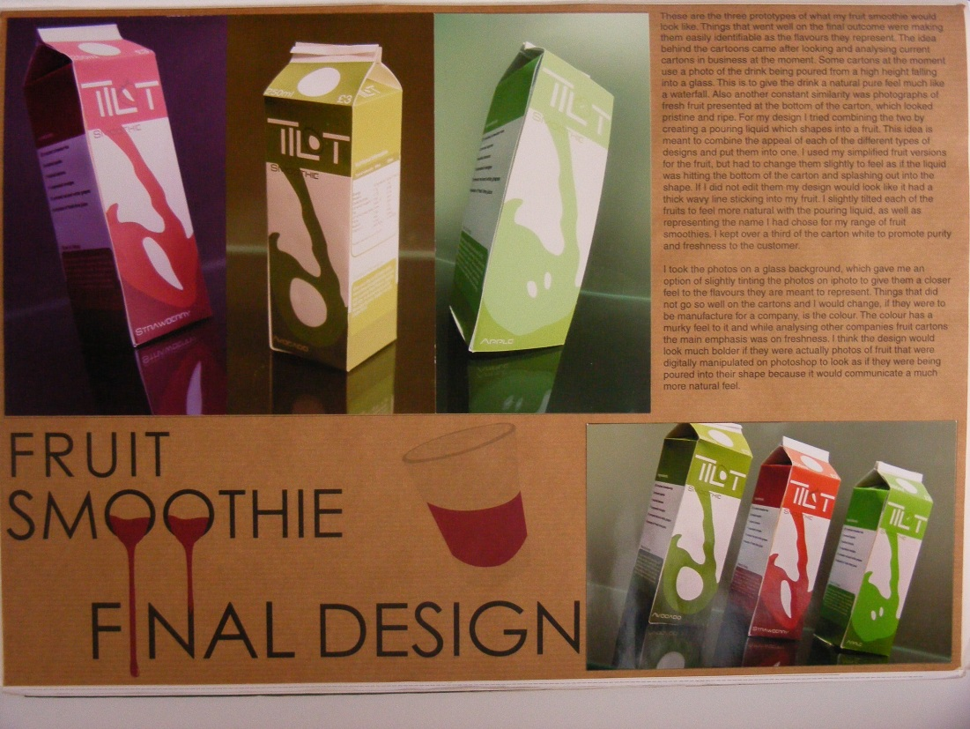
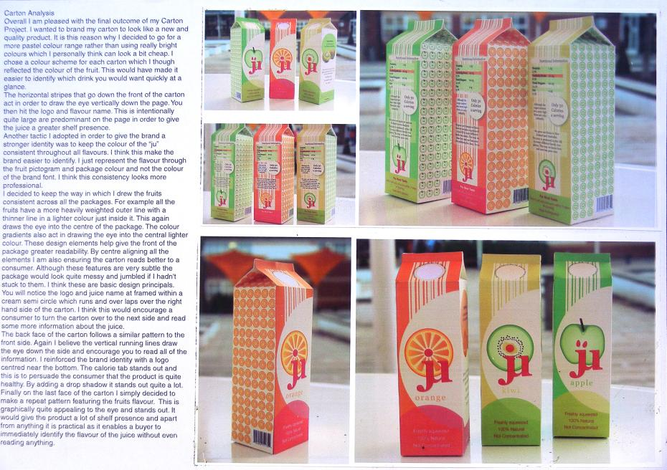
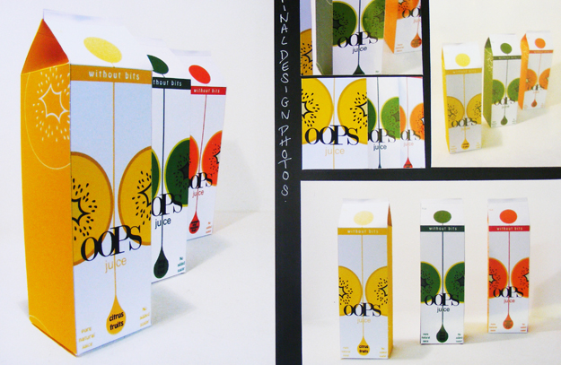
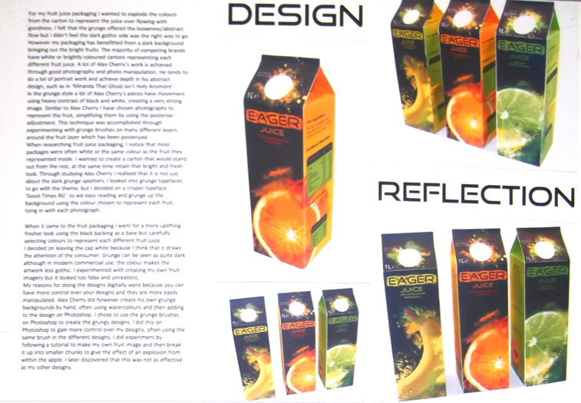
Presentation examples

Slide 9
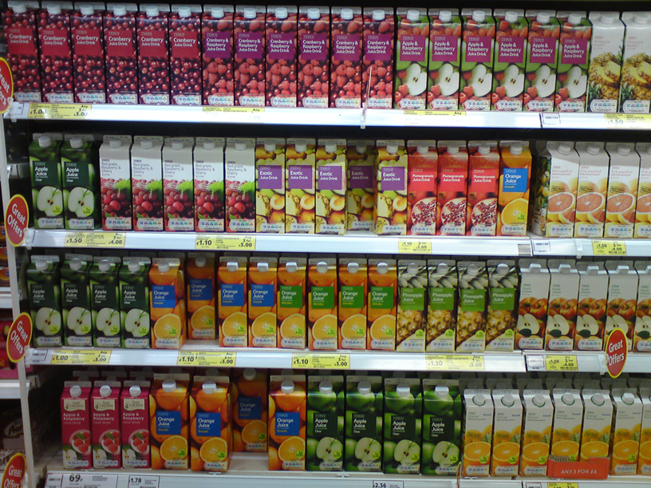
Shelf presence

Slide 10
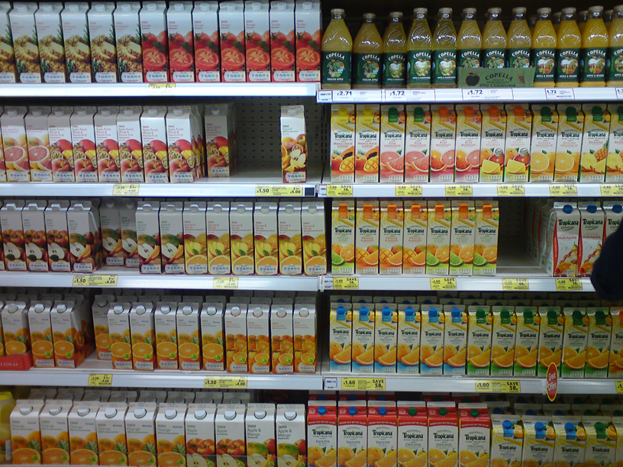

Slide 11
