Slide 1
2. Pitch

Slide 2
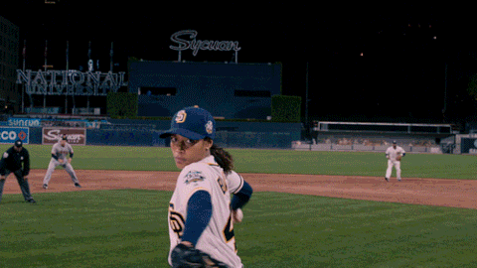

Slide 3
According to BTEC a Pitch is…
A succinct way of selling your idea to the client, explaining why your solution to the brief should be chosen.

Slide 4
Traditionally on a BTEC course Pitches are delivered like this…
…but, luckily, for the sake of this task your Pitch will be WRITTEN.

Slide 5
In the actual timed assessment you need to write approximately 300 - 350 words and will have just ONE hour to write it.
You will have the following subheadings to help guide you to complete it:

Slide 6
The Message
A very brief overview of what the idea is. Refer to target audience and what relevant research you’ve done.
Act 1
Outline what will happening in the opening sequence / first few scenes.
Act 2
Outline what will happen in the middle part of your film.
Act 3
Outline the resolution / closing few scenes of your film idea. This is the point where you can elaborate further on what you’ve written in Rationale.
Why choose our production company for this commission?
Briefly explain why Move It should choose your production company. You can start referring to ‘how’ you are going to create this piece. Remember you are selling your services, so use persuasive language.

Slide 7
Deadline for Pitch
As you will only have ONE hour in the actual timed assessment in January, we should be able to complete this work over a couple of lesson. So…
By the end of lesson 2 this week, you should have your written Pitch completed, ready to move on to the next task (Proposal) for next week.

Slide 8
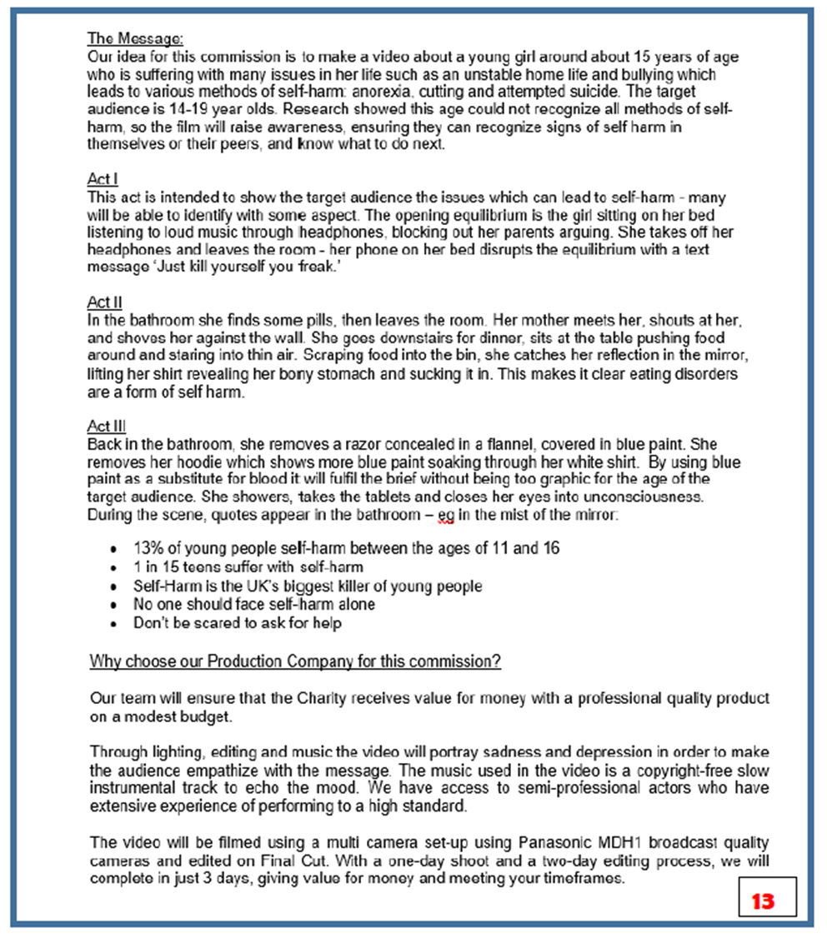
Exam board example

