Slide 1
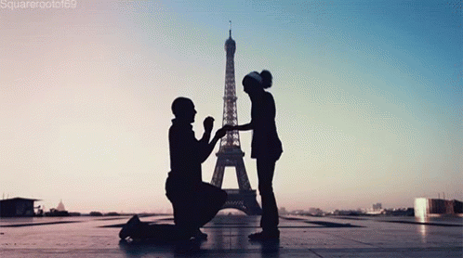

Slide 2
A proposal is…
A document that outlines all the aspects of your idea, including how it is going to be made and the content, as well as consideration of legal issues.

Slide 3
In the timed assessment you will have approx. 2 hours to complete the proposal which should consist of 5 pages of written work.
You will have subheadings to help you complete it. As well this, the exam board giving you a template to fill in each section.
This document is on GOL for you to start filling in this week.

Slide 4
5 subheadings
content overview
technical considerations
contributors, assets, locations and equipment
legal and ethical considerations
scheduling and planning considerations.

Slide 5
Exam board example
Your opportunity to fully explain and elaborate
your idea from start to finish. Think about what
happens in each scene. Be as creative as possible
with your choices for cinematography, editing,
sound and mise en scene.
Your brief is for just approx. 6 minute video.

Slide 6
How many days will it take to film? How much
does each piece of equipment cost to hire?
Will your production be amateur, low budget or
have a professional aesthetic?
What type of equipment will this short film be created on?
Film, HD, 4K? Will you use a tripod, shoulder mount or
Steadicam?
See ‘Budget folder’ on GOL to work out
accurate professional costs. Put in a spreadsheet
like the above example

Slide 7
Think about potential risk assessment hazards that might occur when filming. Where are you filming and what is the potential hazard? How are you going to address the hazard?
Where your film will be filmed? (Unlike this example,
you don’t need to find images for the locations).
Give reasons as to why each location is suitable
Now list all the specific equipment that you
will need to make this film.

Slide 8
Legal considerations – will you need copyright clearance for a piece of music?
Ethical considerations – What BBFC certificate would your film achieve?

Slide 9
What is the schedule for the production? Think about preproduction, production and post production.
Use real dates. Don’t just copy the example on the right!
Where will your finished film be shown? How best to reach your chosen target audience?

