Slide 1

Proposal – part 2

Slide 2
A proposal is…
A document that outlines all the aspects of your idea, including how it is going to be made and the content, as well as consideration of legal issues.

Slide 3
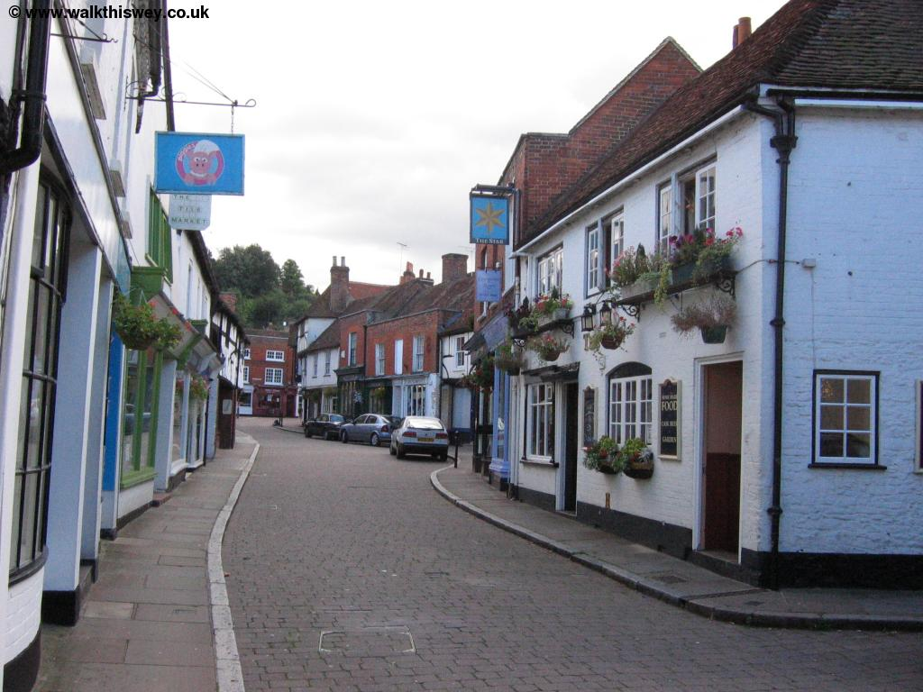
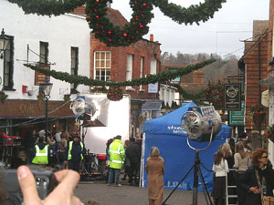
Location recce
A location recce is common practice in the professional film and television industry. A small section of the pre-production team will go out with the sole purpose of scouting locations to be used.
Often the Location Scout, will create a document that documents the suitability of the location for the needs of the production.

Slide 4
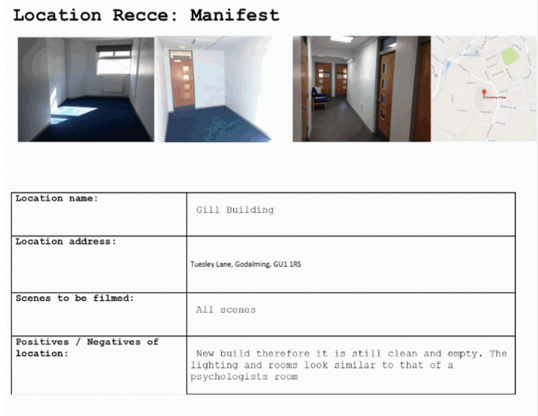

Slide 5
Risk Assessment
Like the Location recce a Risk Assessment is common practice in a professional film and television environment.
A member of the production team would visit all the locations and try to predict any potential hazards that might arise for the cast, crew or members of the public.

Slide 6
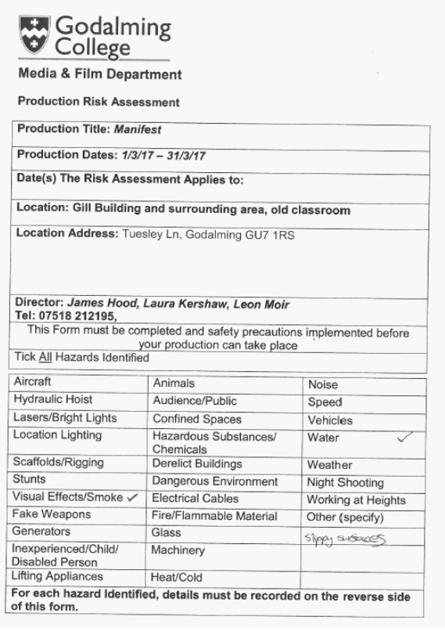
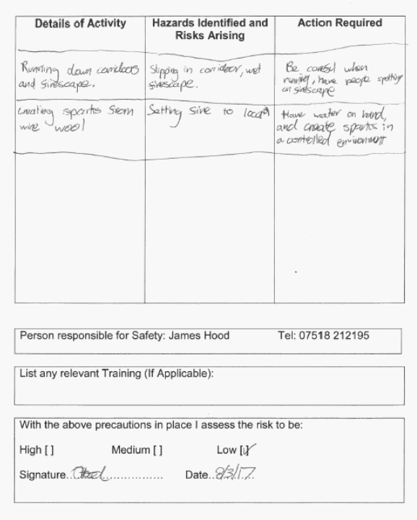

Slide 8
Legal and Ethical considerations
Legal considerations for a student production usually consist of obtaining permission to use something. For example a location, a person’s image or a professional piece of music.

Slide 9
Legal and Ethical considerations
The ethical considerations that you will be writing about are usually regarding the suitability of the content. For example how a person / social group are represented or whether the images in your film are appropriate for your assigned target audience.
You may wish to refer to the British Board of Film Classification (BBFC) or Advertising Standards Agency (ASA) when writing up this section.
http://www.bbfc.co.uk/
https://www.asa.org.uk/

Slide 11
Scheduling and planning
Professional Film and Television production is expensive. Thus, they are often organised around a tight schedule.
PROFESSIONAL FILM – Pre production (6 months to a year) Production (1 to 3 months) Post Production (6 months to a year)
MUSIC VIDEO – Pre production (2 to 4 weeks) Production (1 to 2 days) Post Production (3 to 5 days)

Slide 12
Feel free to use a similar structure to how this student has planned their production. But try and be a little more detailed and give more accurate dates.

Slide 13
And finally…
Think about where hypothetically your final film will end up. Would it be best screen in cinemas before a trailer? Or playing on an affiliated website? Or at an opportune time on a specific television channel.

