Slide 1
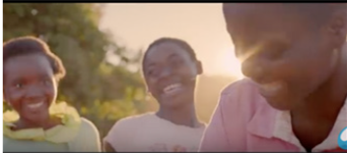
WATER AID (2016)
WJEC A-Level Media Studies
Component 1: Media Products, Industries and Audiences

Slide 2
Aims
For this part of Component 1 we shall be studying a TV Charity Advertisement for Water Aid. The areas we will be covering include;
Media Contexts –historical, political and social
Media Language – signs and signifiers
Representation –gender, culture, ethnicity
Audience – targeting, reception theory and cultivation theory

Slide 3
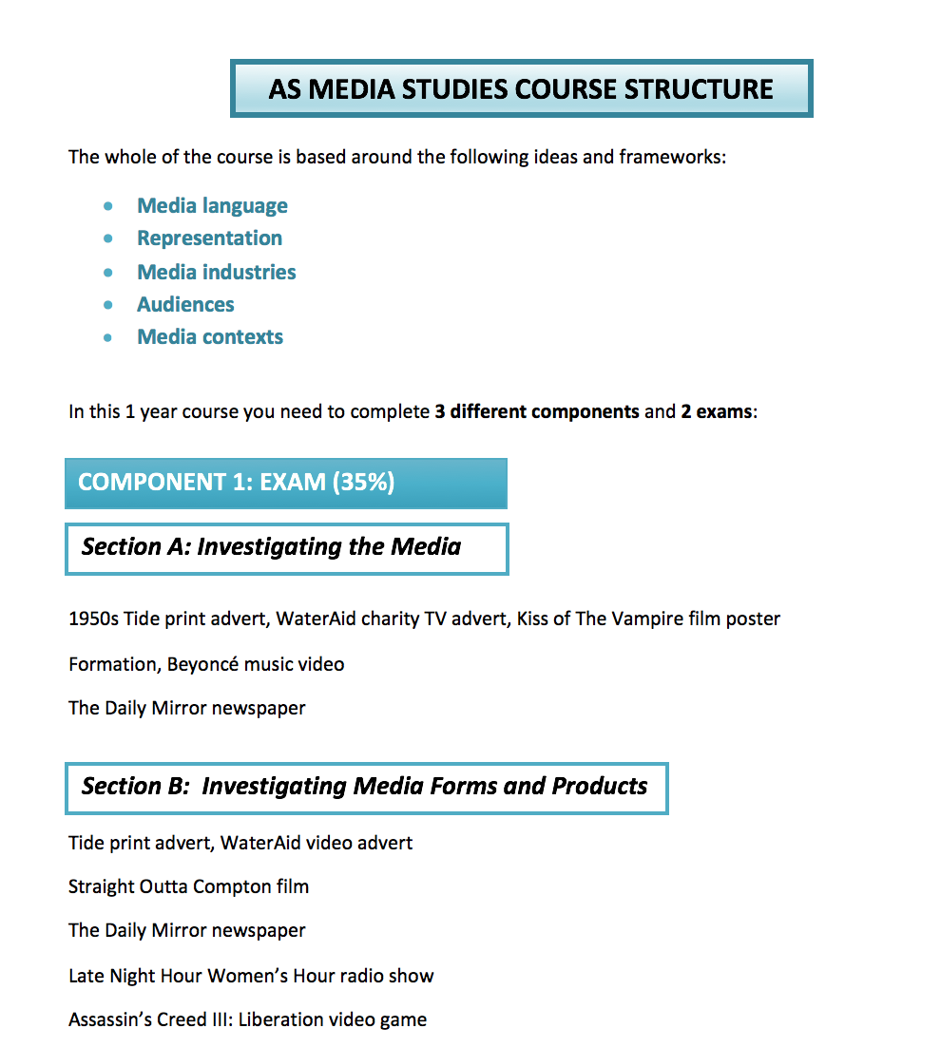

Slide 4
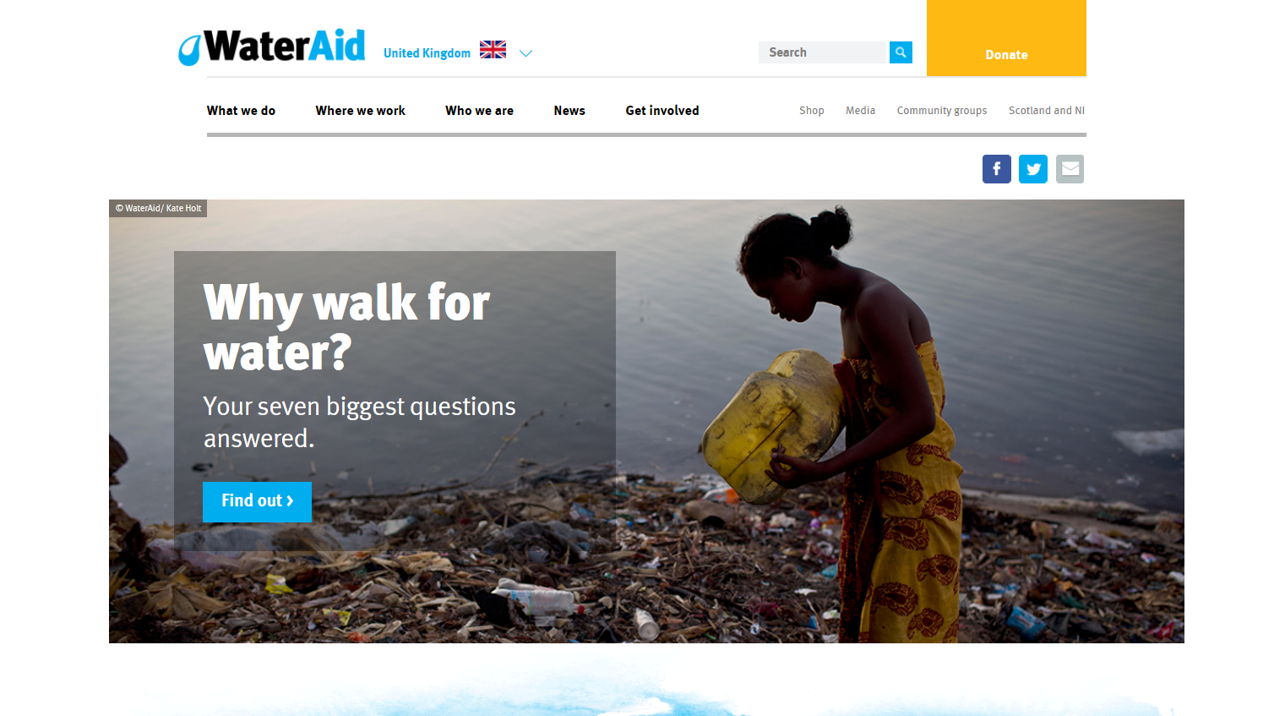
Water Aid – background
The charity Water Aid was established in 1981 as a response to a United Nations campaign for clean water, sanitation and water hygiene education. It now works with organisations in 37 African, Asian and Central American countries plus the Pacific region. Since 1991 its patron has been Prince Charles.

Slide 5
Cultural context:
Following 1984’s Do They Know It’s Christmas? single for Band Aid, 1985’s Live Aid was the first global charity event aiming to raise funds for relief of the ongoing famine in Ethiopia.
The Comic Relief telethon was launched by Richard Curtis and Lenny Henry in 1985 with the same initial famine relief aim, and went on to raise over £1bn for charitable causes across Africa and in the UK. The contemporary audience for this advert could be assumed to be familiar with the codes and conventions of both audio-visual adverts and those for charitable organisations in particular.

Slide 6
Production context
Created by Atomic London in October 2016, this advert (titled Rain For Good) stars 16 year-old Zambian student Claudia and aims to show how communities benefit from clean water by depicting everyday chores such as farming and laundry.

Slide 7
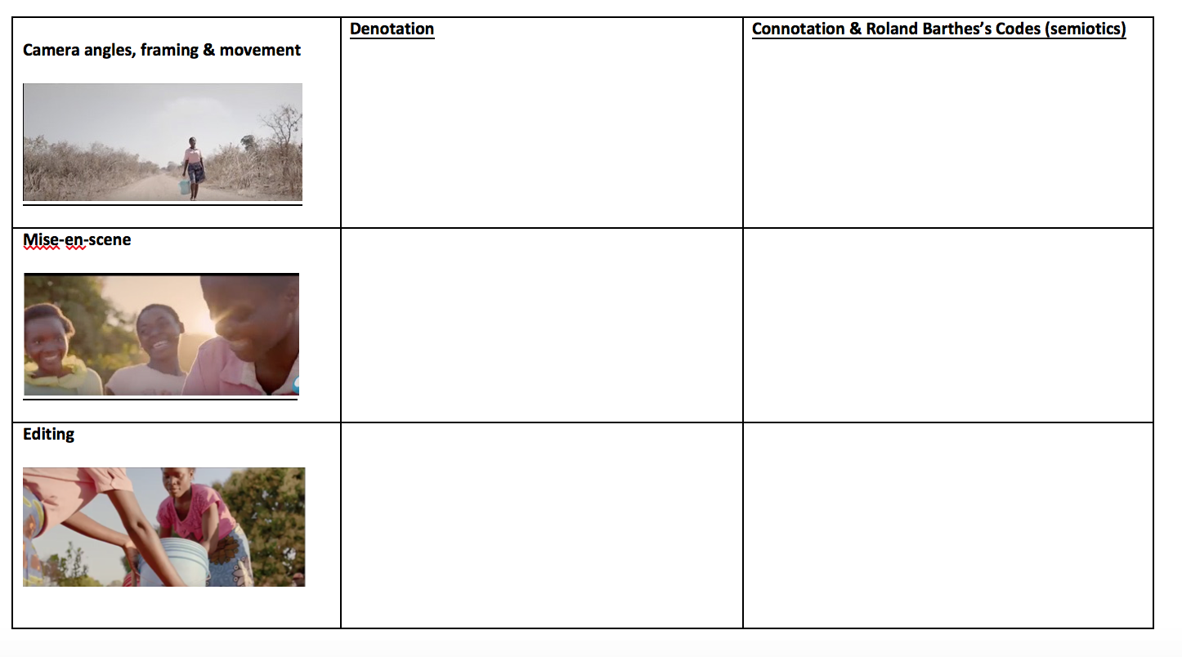
TASK ONE -
Consider the codes and conventions, and how media language influences meaning in the advert. Also consider and apply Roland Barthes’ semiotic codes

Slide 8
Some observations you may have made;
Genre conventions
The Water Aid advert reinforces charity advertisement conventions by including key information about the concern; a personalised narrative to which this information is relevant, and a direct appeal to the audience for money.
However, the fact it lacks a non-diegetic voiceover, melancholic audio codes and black and white visual codes could all be seen as unconventional of this advertising sub-genre.

Slide 9
Media language
The opening medium shot with a pull focus between the digital radio and the rain against the window establishes the advert in a modern, British setting (the audio codes are of an announcer with an English accent). It’s connoted that the scenes that follow (in an unnamed but likely African country) are happening at the same time.
The visual and audio codes work together to construct the narrative of “sunshine” (in Africa) “on a rainy day” (in Britain) with the associated problems of drought and “lack of access to clean drinking water” that the charity is aiming to relieve.

Slide 10
Applying Barthes
Suspense is created through the enigmatic use of the slow-motion, medium close-up, low-angle tracking shot of Claudia’s feet and the swinging bucket (Barthes’ Hermeneutic / Enigma Code) and emphasised by the crescendo of the song in the scene at the water pump over which the informative on-screen graphic appears (Barthes’ Proairetic / Action Code).
Barthes’ Semantic Code could be applied to the lines from the song used from 00.34 diegetically and then as a sound bridge over the medium shot of a group of women carrying water buckets on their heads: “make me feel, make me feel like I belong… don’t leave me, won’t leave me here”. The connotation here being that the text’s audience can help Claudia “feel like she belongs” and “won’t leave” her there / in that situation if they donate to Water Aid.
The Symbolic Codes (Barthes) of drought-ridden African countries are reinforced both visually and through the advert’s audio codes up until about 00.47.

