Slide 1
Case Study 1: Hacked off How successful was this group?

Slide 2
Hacked off questions
Further discussion points:
What distinguishes Hacked Off as an ‘outsider’ pressure group? Is this actually true? Why might they prefer to define themselves as an outsider group?
How successful, in your view, was Hacked Off in achieving its aims?
What do you think they would need to have done to become more successful?
What contribution, if any, do you think ‘Hacked Off’ is making to our democracy?
Research what has happened in the time since this film was made? What do you think?

Slide 3
HW recap: Which pressure groups did you find out about?
Share your PG with the person next to you
What PGs did we have around the class?
Pressure Group EXAMPLES are essential in this part of the course.
You will be asked to refer to different groups in your answers.

Slide 4
HW recap – What methods do they use?
Lobbying parliament
Public campaigning
Working with parties and MPs
Media campaigns
Use of illegal methods and civil disobedience
Use of courts

Slide 5
What methods do they use?

Slide 6
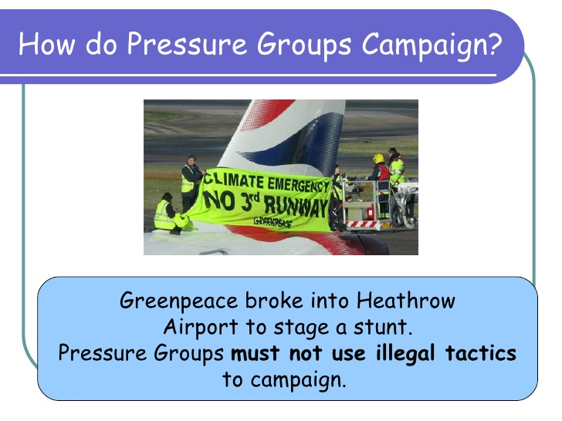

Slide 7
Add these examples to your ‘methods’ charts…
http://www.bbc.co.uk/learningzone/clips/insider-pressure-groups/4048.html - insider groups
http://www.bbc.co.uk/learningzone/clips/outsider-pressure-groups/4049.html - outsider groups

Slide 8
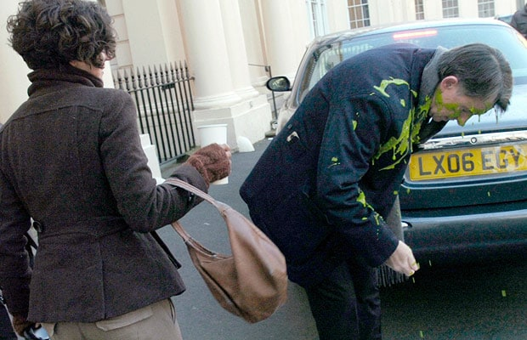
And this….
Up to 2 mins 30.

Slide 9
HW recap – methods – which do you think is most effective?
Lobbying parliament
Public campaigning
Working with parties and MPs
Media campaigns
Use of illegal methods and civil disobedience
Use of courts

Slide 10
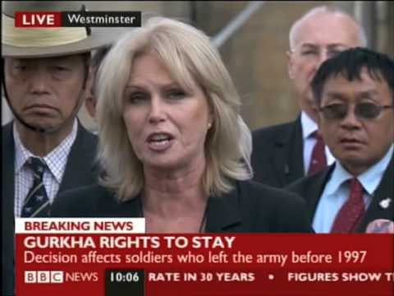
What factors make a pressure group successful?
Pressure group successes:
The Snowdrop campaign gained 750,000 signatures in 6 weeks and called for tougher gun laws in the UK.
Snowdrop managed to force the government to ban all handguns due to the huge public backing they received after the Dunblane massacre on 13th March 1996.
Joanna Lumley & the Gurkhas
https://www.youtube.com/watch?v=sF5FR6Op1zM

Slide 11
What factors make a pressure group successful?
Using pages 26-28 of the textbook, decide which factors are the most / least important in deciding why a pressure group is successful or not.
Record your ideas on the circle on page 32 of your booklet.

Slide 12
Case study 2 of a PG in action – the BMA
Read the article on pages 27 and 28 and answer the questions on page 28/29

Slide 13
Building up to your 1st benchmark… “Evaluate the extent to which pressure groups enhance democracy in the UK. In your answer you must refer to at least three pressure groups”. (30)

Slide 14
Essay writing technique
Same technique as for the essay for U2.
Look at your handout.

Slide 15
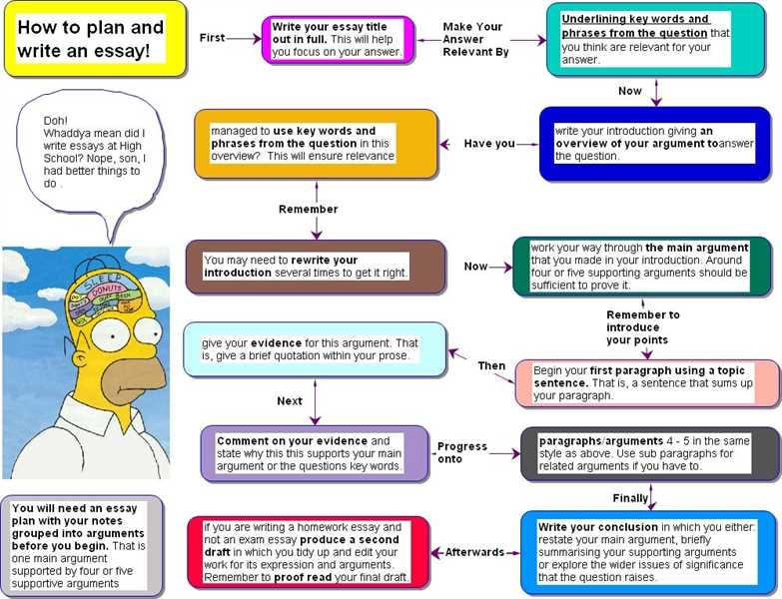

Slide 16
Essay writing
Introduction:
Identify the issue/ debate, including definition of any key terms
Set context using own knowledge
Sum up the two sides of the argument
Indicate what your own judgment will be.

Slide 17
Essay writing
First argument for
Point: Clearly identify a point for the question
Explanation: Explain/expand on your point
Evidence: Use own knowledge to give an example that supports your point and explain how it does
Link back to the Q: Analyse this point- how valid is it?
First argument against
Point: Clearly identify a point for the question
Explanation: Explain/expand on your point
Evidence: Use own knowledge to give an example that supports your point and explain how it does
Link back to the Q: Analyse this point- how valid is it?
Mini conclusion
Evaluate the strengths of the two sides of the argument opinion so far.
Do the above 3 times in total – 3 arguments for and 3 arguments against

Slide 18
Essay writing
Conclusion
Give own decisive judgement on the issue
Add clinching evidence to support own judgement .

Slide 19
Homework – create a plan for the question “Evaluate the extent to which pressure groups enhance democracy in the UK. In your answer you must refer to at least three pressure groups”. (30)
You will be doing this in timed conditions next week
You won’t be allowed the plan when doing the assessment, as it is your benchmark
But I will give you 5 minutes at the beginning of your lesson to read over your plan before we begin.

Slide 20
Pluralism
What do you understand by pluralism?
Pluralism is essentially the distribution of power throughout society.
How can this seen to be linked to Pressure Groups?

Slide 21
Pluralism
Pressure groups enhancing pluralism in a society tends to rest on following points:
Citizens are represented through pressure groups
All groups have some measure of political influence
There are a large range of different ways to be successful as a PG
No group can achieve dominance – there will always be others to challenge it

Slide 22
Elitism
The idea that power in politics is concentrated in the hands of the few.
This can also be seen to be linked to Pressure Groups
The influence that PGs wield is argued to be not spread particularly fairly
They also are not particularly internally democratic

Slide 23
Are PGs good or bad for society?
Use page 29 in your textbook to complete the table on page 34 in your booklet
Give each argument a score out of 10, for how strong you think it is
Once you have done this, select your top 3 arguments

Slide 24
Are PGs good or bad for society?
Then create a spider diagram for these points. Include:
The point of the argument
An explanation/detail for it
A specific PG that could be used as an example of it
Try to add links between the points on either side, where they disagree or conflict with each other

Slide 25
Useful research links:
https://politics-blog.ashbournecollege.co.uk/unit-one-people-politics/pressure-groups/ old spec – careful (the questions are not the ones you will be asked, although the content is helpful)
http://www.politicscymru.com/en/cat1/article19/
http://alevelpolitics.com/pressure-groups-uk/ old spec - careful

Slide 26
Are PGs good or bad for society?
Overall, which do you think is the stronger argument?
Write a persuasive argument, stating your case

Slide 27
Are PGs good or bad for society?

Slide 28
Homework – create a plan for the question: “Evaluate the extent to which pressure groups enhance democracy in the UK. In your answer you must refer to at least three pressure groups”. (30)
You will be doing this in timed conditions next week – ON MONDAY!!!
You won’t be allowed the plan when doing the assessment, as it is your benchmark
But I will give you 5 minutes at the beginning of your lesson to read over your plan before we begin.

