Slide 1
AS Film Studies
Continuity and Discontinuity Editing

Slide 2
Continuity Editing
Widely established editing style used through early Hollywood and much of today's film
This editing style tries to ‘hide’ cutting from the audience, so they immerse themselves in the world of the film instead of looking at the editing.
This system enables the audience to quickly understand what was happening and avoid confusion.
It developed into a set of ‘continuity rules’ designed to make storytelling clear.

Slide 3
The Rules
Continuity editing is a technique that relies on particular shots being ordered (cut) in a familiar, conventional sequence.
Audiences are so familiar with these techniques, that they barely notice them.
This is not a definitive list, but it does represent the key techniques.
1) The 180 ° Rule
2) Shot/reverse-shot
3) Eyeline match
4) Match on action

Slide 4
The 180 Degree Rule
http://www.youtube.com/watch?v=oNOT9iHDSXU&feature=related

Slide 5
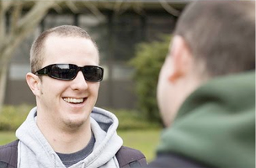
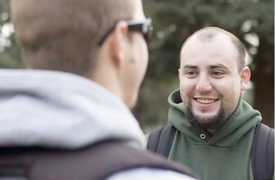
Shot/reverse-shot
This shows characters reactions to another person or object. It creates a relationship between the two characters in a shot.

Slide 6
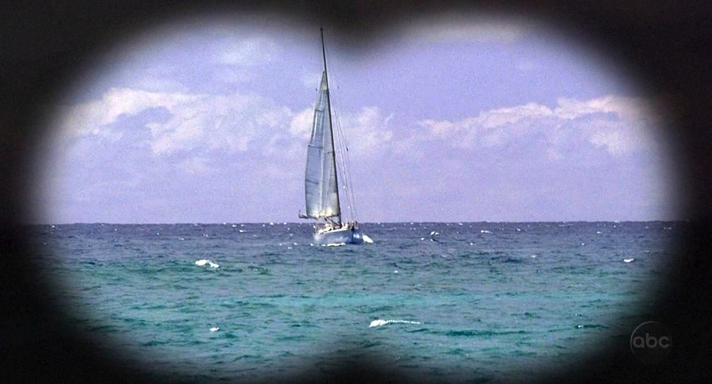
Eyeline match
A character looks at an object or person and the audience are shown a shot of what they are looking at.

Slide 7
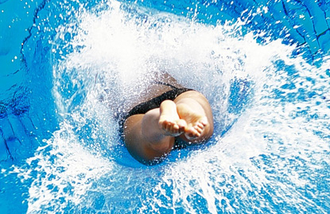
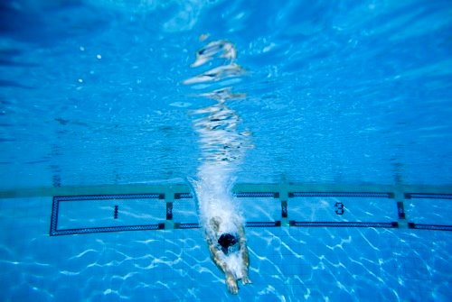
Match on action
It is used mainly in action scenes to increase pace.
If we show the character's movement beginning in shot 1, & then we can cut to shot 2, which shows the continuation of the movement

Slide 8
Discontinuity Editing
The opposite of continuity editing it is not seamless.
It draws attention to itself.
It often disrupts the audience's suspended disbelief
It can be deliberately confusing and/or shocking, playing with time and space.

