Slide 1
4. Treatment example

Slide 2
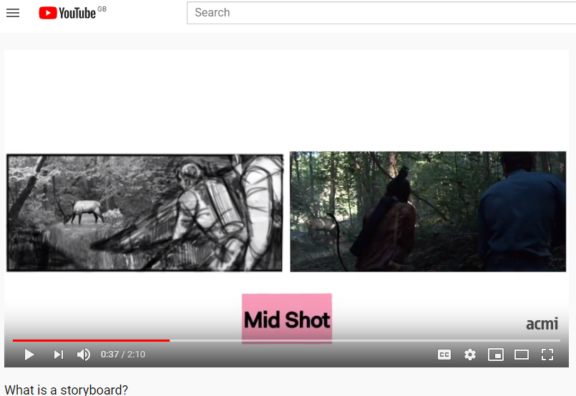
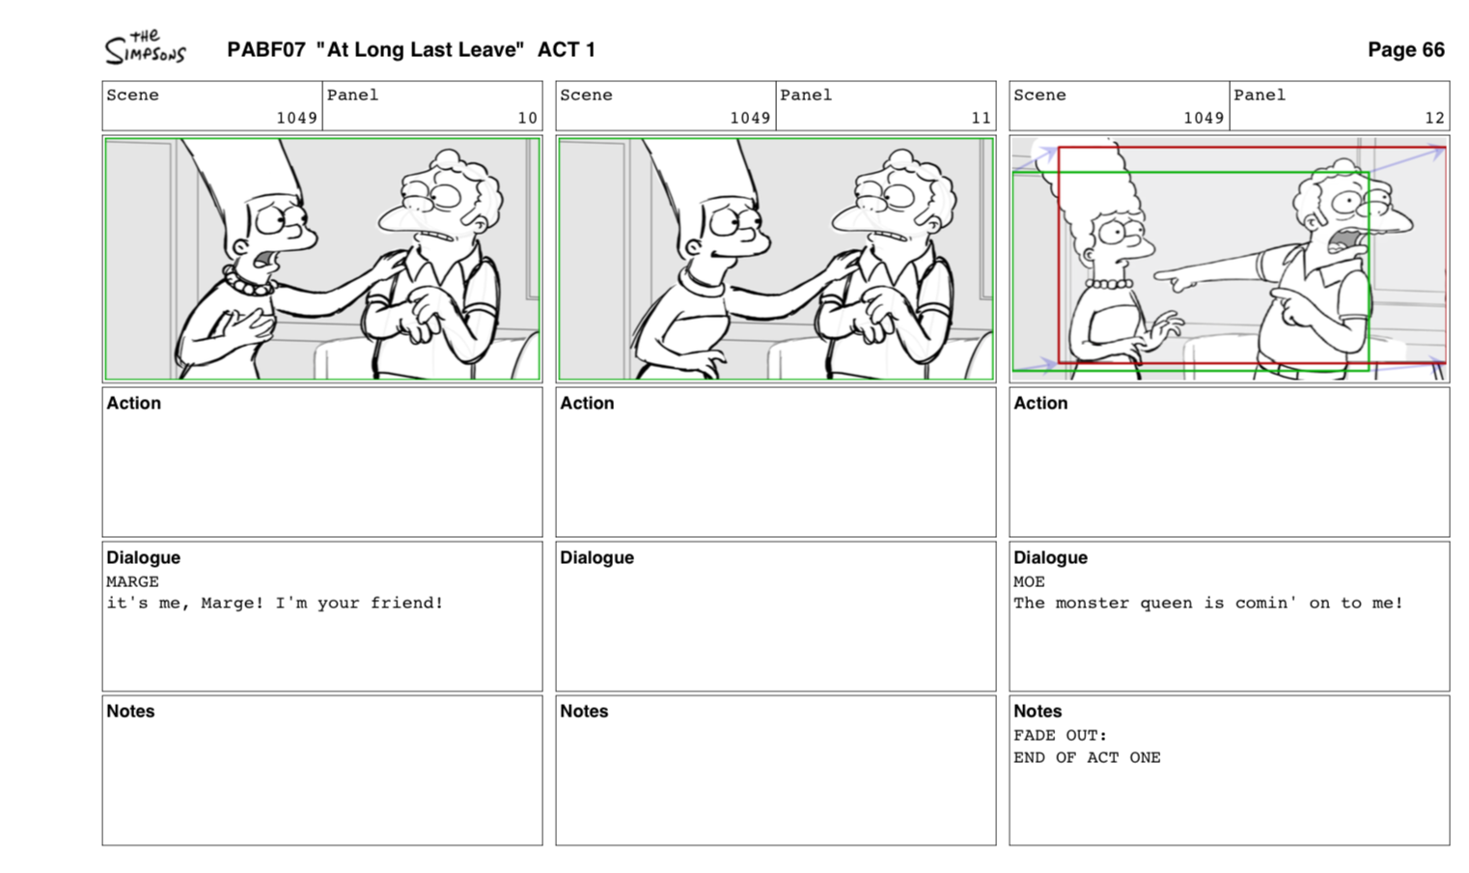
What is a storyboard?
Click on image to play clip

Slide 3
Editing info
Image
Visual description
More Editing info
Shot number
Audio description

Slide 4
Justification document
Along side either the Storyboard you will need to write a justification of your creative choices. This is the last stage of the assessment and is a little bit like an analytical evaluation.

Slide 5
Each section of
Storyboard or
Screenplay needs
to have an
accompanying
Justification about
creative ideas
and choices.

Slide 6
TASK
Create TWO pages of Storyboard for the first TEN images of your chosen idea (Approx. the first 20-40 seconds).
Then,
Write a justification document (in Word, TEN short sentences) that reflects the creative decisions you made when creating your Storyboard.

