Slide 1
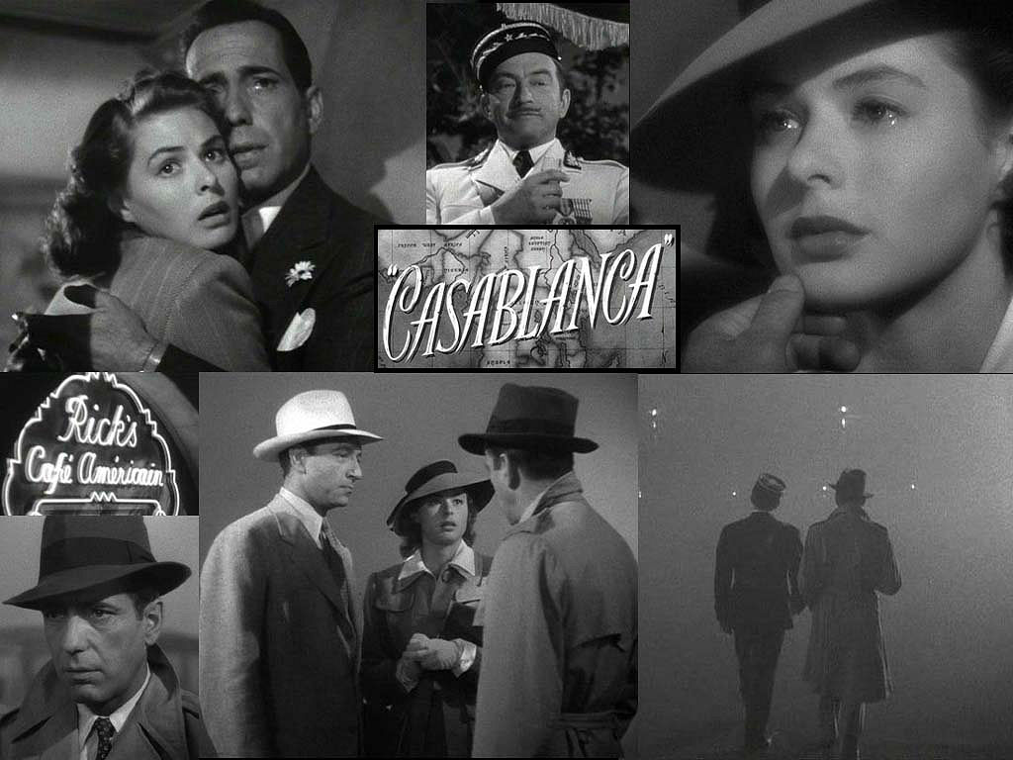
CASABLANCA
The Production Process
& reception of the film
http://hollywoodlostandfound.net/stories/casablanca/

Slide 2
Studio context
Casablanca is certainly a product of the studio system, where movie moguls/studio executives held creative power, cycling through contracted actors, writers, and directors as they saw fit. These creative individuals, meanwhile, had no hope of making a living unless they complied with the studios' rules.
https://www.youtube.com/watch?v=SeqA7R8TSoM
(10 min clips – the making of Casablanca)

Slide 3
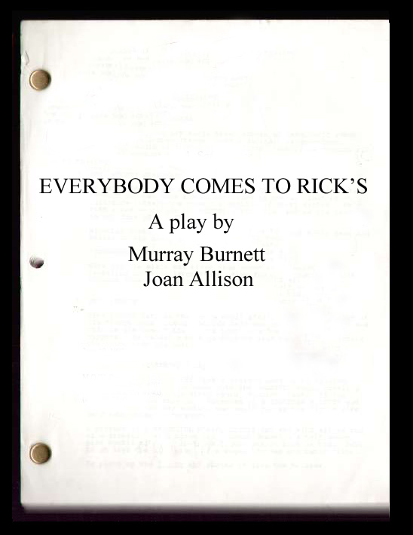
development
In 1938, Murray Burnett and his wife took a trip through Europe. During the trip, the two visited a small town in the South of France where they found a nightclub overlooking the Mediterranean. There, a black pianist playing jazz was entertaining a crowd of French, Germans, and refugees.
Two years later, Burnett and his collaborator Joan Alison wrote a play called "Everybody Comes to Rick's."

Slide 4
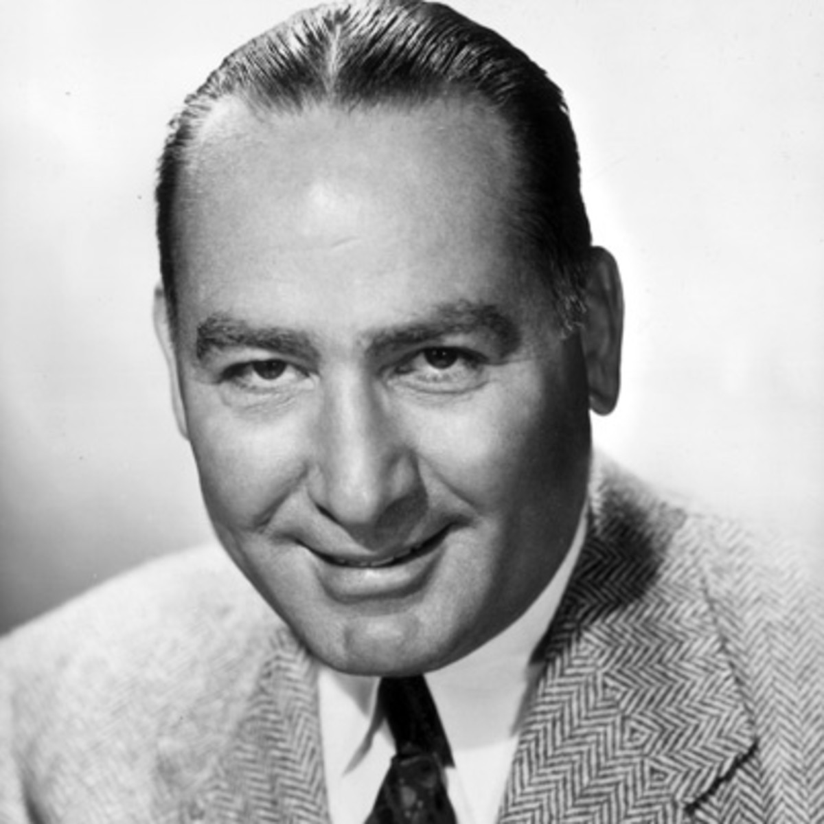
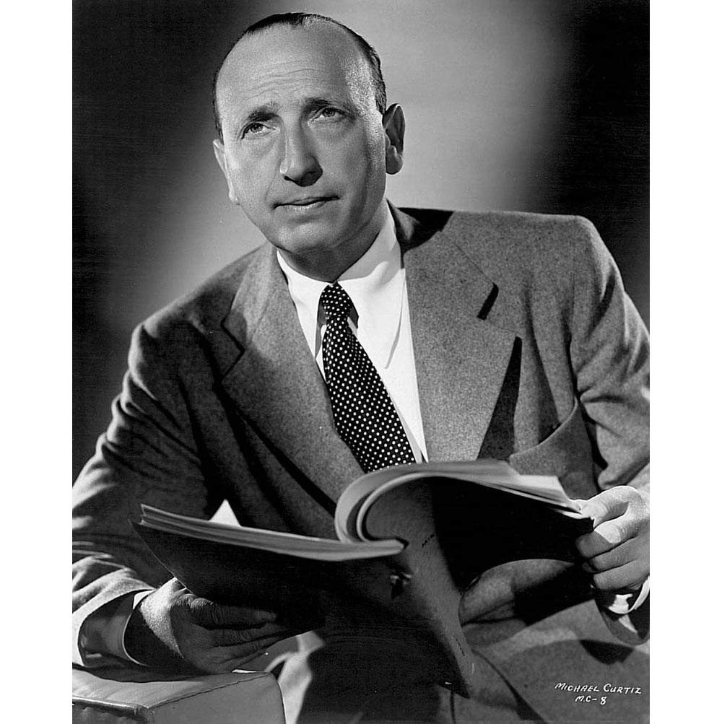
On December 8, 1941 - the day after Pearl Harbour had been attacked - Warner Bros. story analyst read the play, and submitted a synopsis to production head Hal B. Wallis, along with the recommendation to turn it into a film. On the 27th of December, the studio purchased it for $20,000.
To direct the film, Wallis chose Michael Curtiz, who had previously directed "Captain Blood" (1935), "Angels With Dirty Faces" (1938), and "The Adventures of Robin Hood" (1938).

Slide 5
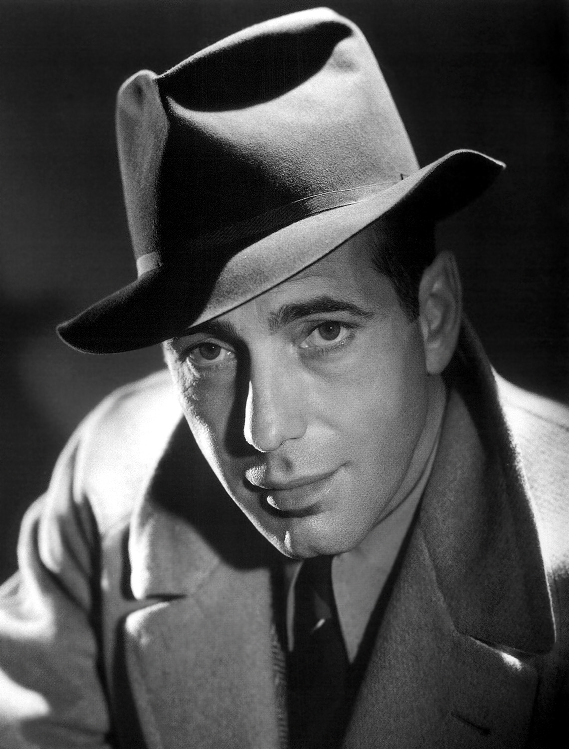
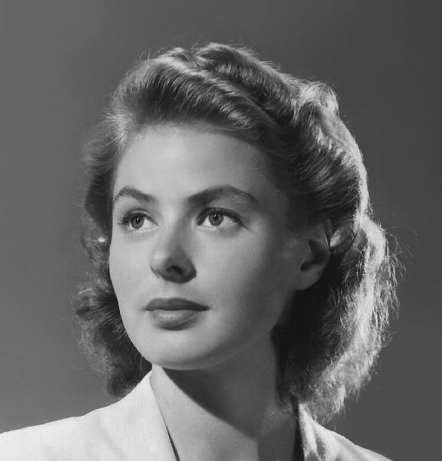
Casting
On February 14, 1942, Wallis sent a memo to Steve Trilling, the head of casting at Warners, stating that Humphrey Bogart and Ann Sheridan would be the leads in the project.
A few days later, it was decided that the female lead should be European, and the character's name was changed to Ilsa Lund. The beautiful Swedish star Ingrid Bergman was chosen for the role.
But She was under contract to David O Selznick, head of production at MGM. Bergman was then traded for Olivia de Havilland for 8 weeks.

Slide 6
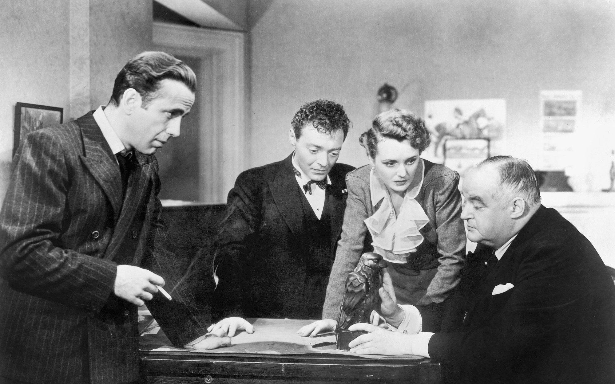
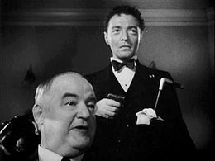
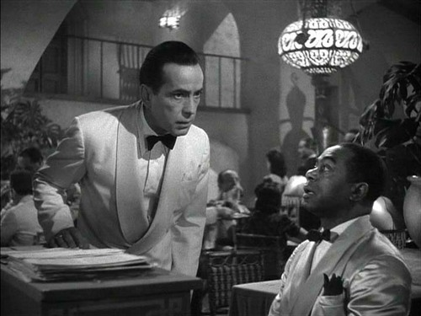
For the role of Rick, George Raft, James Cagney, and Humphrey Bogart were all mentioned. Raft reportedly campaigned for the part, but Wallis and Curtiz decided Bogart was their Rick. After previously appearing in John Huston's directorial debut, "The Maltese Falcon" (1941), Bogart was already on his way to becoming a star.
Dooley Wilson, was borrowed from Paramount for the role of sam. He had been a professional drummer, and couldn't play the piano. Elliot Carpenter played for him off-stage.

Slide 7
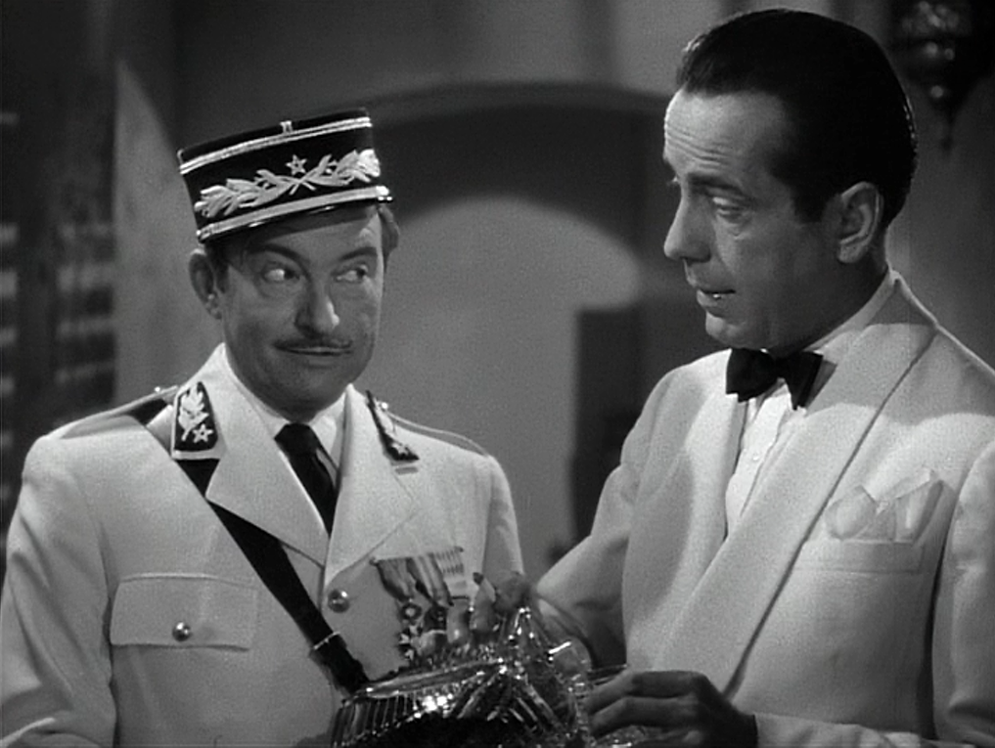
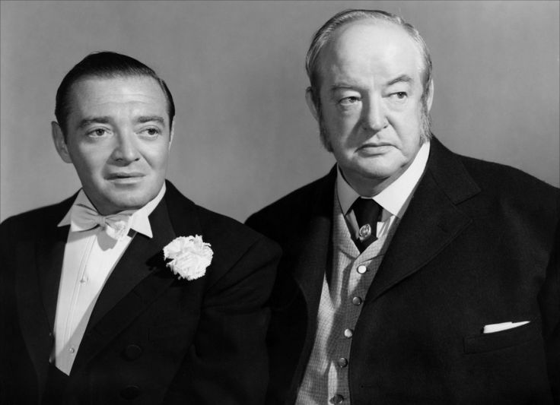
Claude Rains, who had made his debut as "The Invisible Man" (1933), was set as Renault, which would be his 32nd film role.
Peter Lorre and Sydney Greenstreet, both having been in "The Maltese Falcon" with Bogart, were ideal for Ugarte and Ferrari.

Slide 8
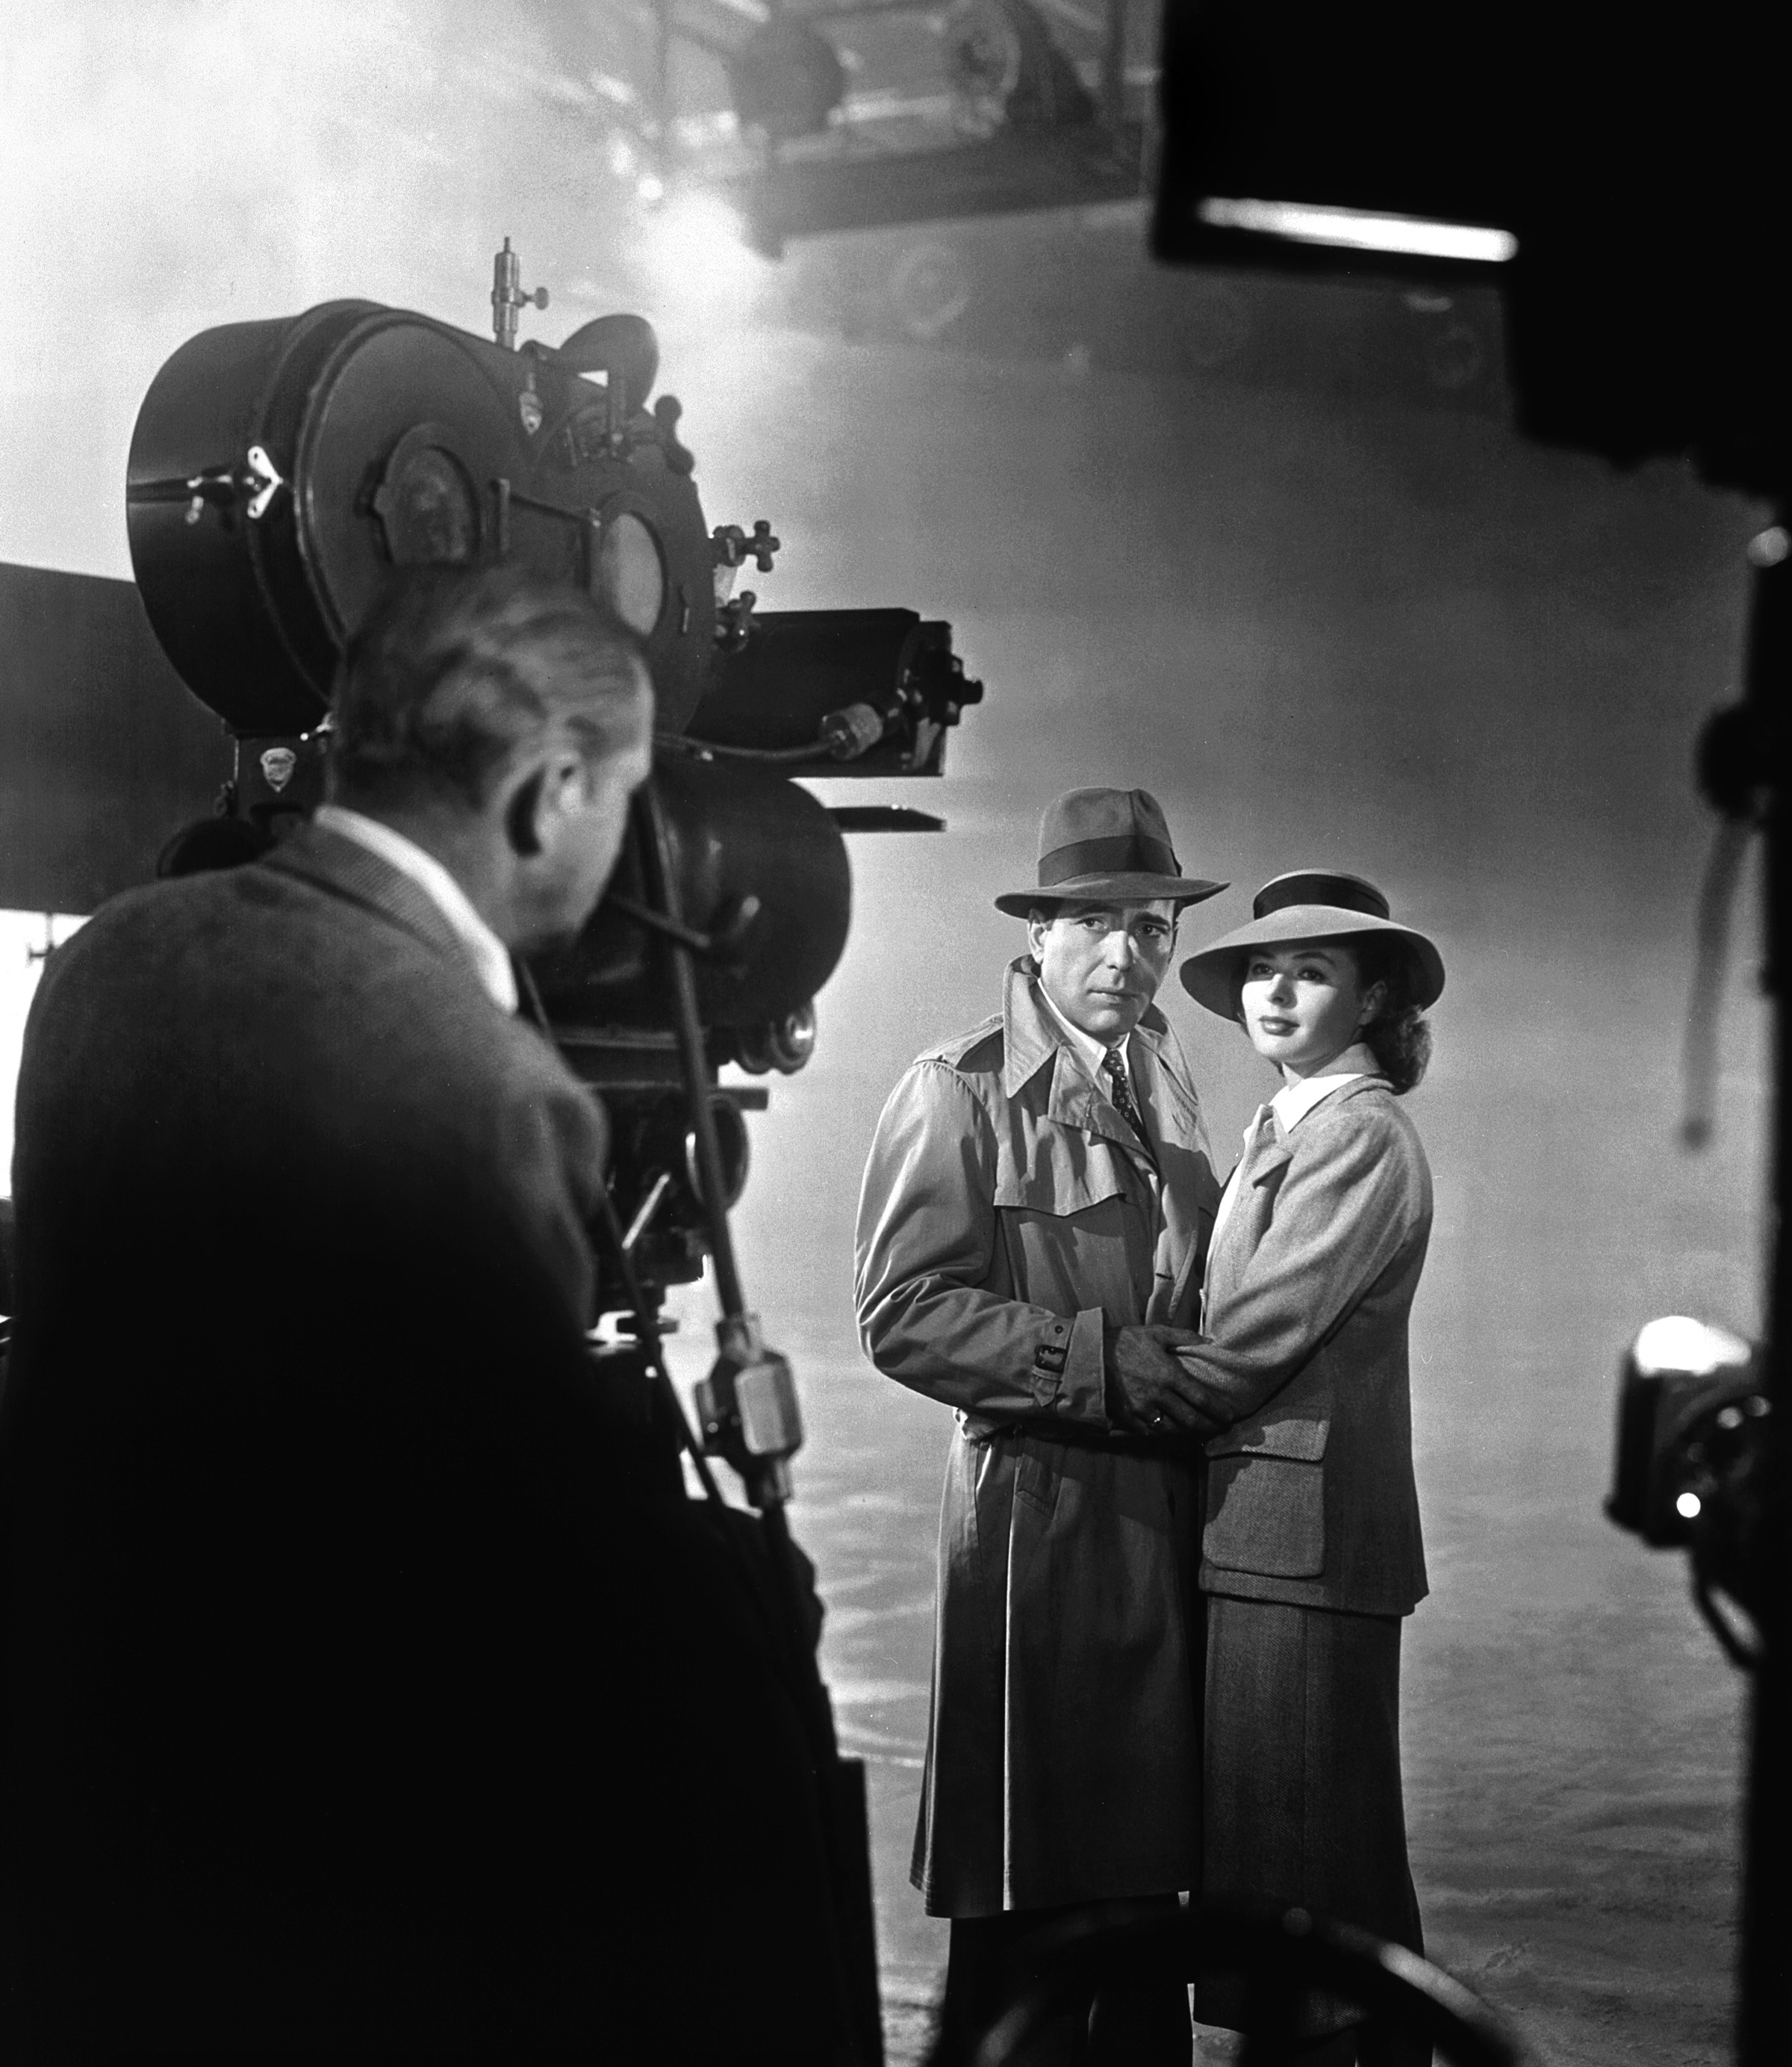
production
Although "Casablanca" started production on May 25 1942, the script was still not complete. No one knew how the film would end.
Ingrid Bergman had no idea who her character would end up with until later in production, so she didn't know how to portray her emotions in the scenes filmed early on. "Play it in between," she was told.

Slide 9
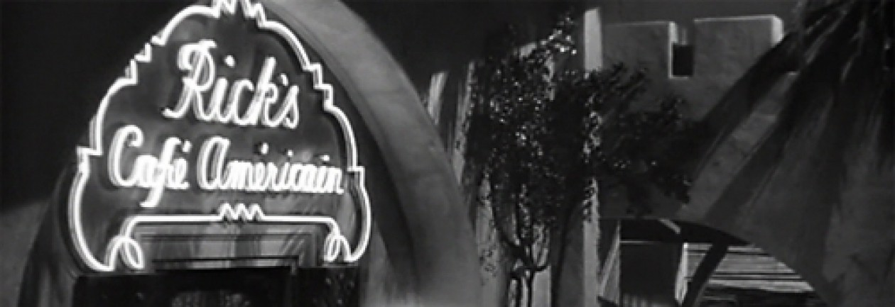
the entire film was shot at the studio
New Sets were built on Stage 8 at the Warner Bros. studios. (the main room, a gambling room, and Rick's quarters) Other locations in the film made use of some of the existing sets at the studio. Back lot streets and fragments of other sets. With the exception of a brief scene of Major Strasser arriving at Casablanca's airport (which was filmed at the old Metropolitan airport) the entire film was shot at the studio.

Slide 10
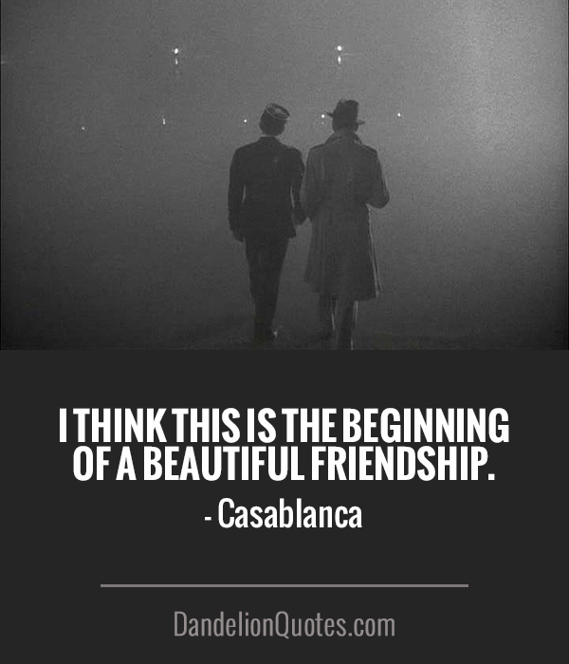
The last line in the film was reportedly written by Hal Wallis, and recorded in post production by Humphrey Bogart: "Louis, I think this is the beginning of a beautiful friendship.“
After fifty-nine days of filming (eleven days over schedule), "Casablanca" wrapped principal photography on August 3, 1942. Editor Owen Marks completed a cut of the film shortly afterward, having already been working alongside the production.

Slide 11
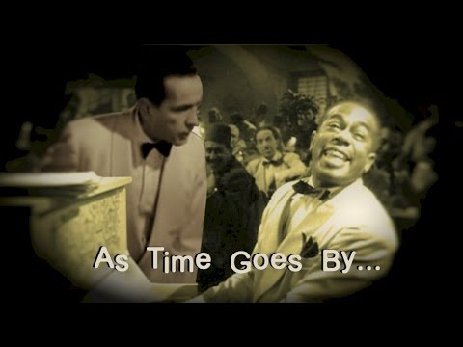
Post production
Max Steiner, was assigned to write the score for the film on July 11. After viewing the film, he did not want "As Time Goes By" to be used, and lobbied to replace it with an original composition he would create for the film.
This would mean some scenes that directly referred to the song would have to be reshot - and Ingrid Bergman had already cut her hair for her role as Maria in "For Whom the Bell Tolls." "As Time Goes By" stayed in the film.
In 1943, the song would be on the radio program "Hit Parade" for 21 straight weeks.

Slide 12
Release
Casablanca was premiered in New York on 26 November 1942, coinciding with the Allied invasion of North Africa and the capture of the city of Casablanca. It was more widely released on 23 January, 1943, during the high-profile meeting between Churchill and Roosevelt in Casablanca itself.
with his role in "Casablanca," and previously "The Maltese Falcon," Humphrey Bogart was established as a romantic star - and his new contract with Warner Bros. made him the highest paid actor in the world.

Slide 13
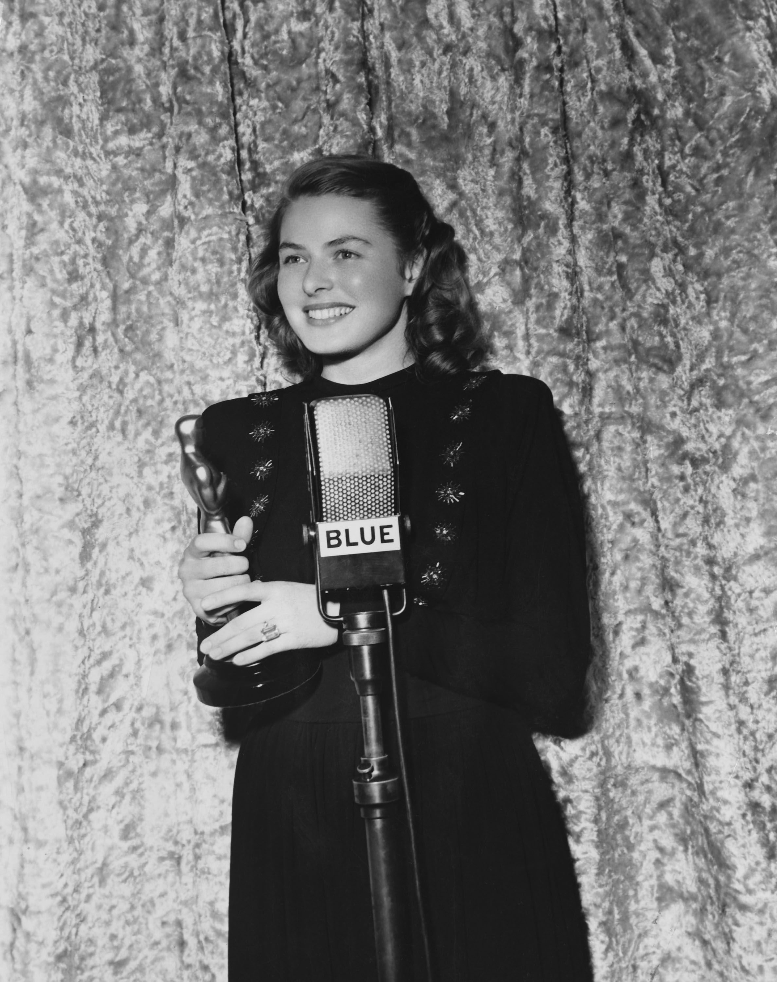
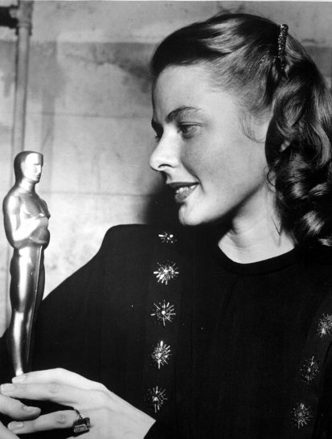
Reception to film
Budget: $950,000
Box Office returns: $2,875,243 (to date)
The critical reception to the film was consistently good:
The New York Times - "The Warner’s have a picture which makes the spine tingle and the heart take a leap."
and it was nominated for eight Academy® Awards and won three.
the Academy® Awards for:
Outstanding motion Picture
Best Director
Best Adapted Screenplay

