Slide 1
Jacopo di Cione
1369
The Crucifixion
Gothic
(National Gallery, London)
Link to zoom: https://www.nationalgallery.org.uk/paintings/jacopo-di-cione-the-crucifixion

Slide 2
Masaccio
Holy Trinity
1425
Sta Maria Novella
Italian Renaissance

Slide 3
Jan Van Eyck
The Ghent Altarpiece
(closed)
1432

Slide 4
Jan Van Eyck
The Ghent Altarpiece
(open)
1432
Northern Renaissance

Slide 5
Raphael
The Mond Crucifixion
1502
Italian Renaissance

Slide 6
Matthias Grunewald
Isenheim Altarpiece
1512
Northern Renaissance

Slide 7
Rubens
Descent from the Cross
1614-16
Antwerp Cathedral
Flemish Baroque

Slide 8
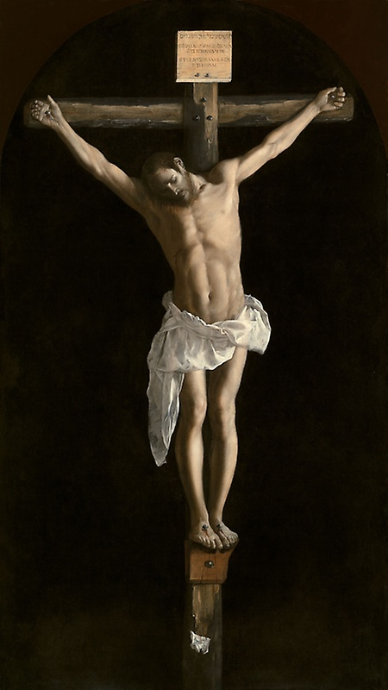
Zurburan
The Crucifixion
1627
Spanish Baroque

Slide 9
Gauguin Yellow Christ
1888
Post Impressionism

Slide 10
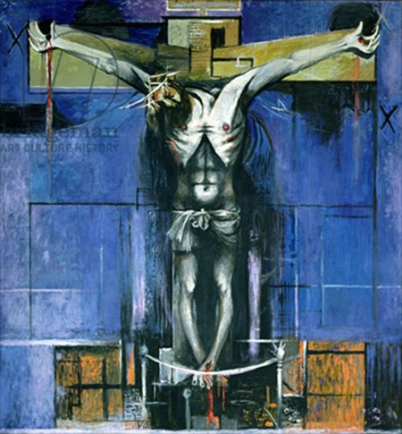
Graham Sutherland
The Crucifixion 1946
British 20th century
‘Neo-Romantic’

Slide 11
FN Souza
The Crucifixion
1959 (Tate)
Art Brut

