Slide 1
PREP (RWS 15): Other Market Structures DUE FOR w/b 6th November (3 hours worth)
RETAIL ENERGY MARKETS (DOMESTIC GAS AND ELECTRICITY SALES)
Watch the following documentaries from 2006 and 2008 (all found on e-stream)
VIDEO 1 (2008): Dispatches - The Truth about your Energy Bills - 1 hour long
VIDEO 2 (2006): Panorama - The High Price of Gas - 38 minutes long
Research these markets today (2017) using the internet and Newspaper websites (e.g. Guardian, Daily Telegraph, The Economist - using the library access, and any other useful internet sources you may find). – roughly 1 to 1hour 30 mins
TASK: Research ONE of the markets to the left and as a bare minimum, you must answer the questions below (WORD PROCESSED and MIND MAP?) so that you are an ‘expert’ in your particular market (minimum of 1 side of A4 and maximum of 2 sides of A4 for your notes. Print out a version for your partner as well as yourself):
Structure of the Market
What is the market share of the top six providers in the market
Is this a competitive market in your view? Why?
Strategy within the Market
Is there any evidence of ‘price collusion’ in your market?
Is there any evidence of ‘price competition’ in your market?
Are there any examples of any other sorts of competition in your market other than price??
Benefits and Costs - what have been the advantages and disadvantages of the structure of the market to society from what you have read and seen (a table please)?
Similarities and Differences between 2006ish (documentaries) and 2017 (internet research) - please present in a table form. Maybe a conclusion at the end to judge whether the market has changed at all?
Old
Students
GROCERY MARKET (SUPERMARKETS)
Watch the following documentaries from 2007 or 2011 (all found on estream)
VIDEO 1 (2011): Panorama - The Truth about Supermarkets (Chapter 1) - 30 mins long
VIDEO 2 (2007): The Money Programme - Tesco Supermarket Superpower - 30 mins long
VIDEO 3 (2007): Dispatches - The Supermarket that’s Eating Britain (Chapter 1 only) - 38 mins long
Research this market today (2017) using the internet and Newspaper websites (e.g. Guardian, Daily Telegraph, The Economist - using the library access, and any other useful internet sources you may find) roughly 1 to 1hour 30 mins
New
Students

Slide 2
PREP HOMEWORK PARTNERS Students on left are (Old) and Students on right are (New)
Cosmo & Hugh
Michaela & George H
Laura & Emily
Sam & Lewis
Eddie & Ethan
Jess & Phoebe
Harry & George G & Josh
Tom & Miles
Noor & Chris

Slide 3
PREP HOMEWORK KEY TERMS
KEY WORDS:
Oligopoly - Where there are 3 or more dominant firms in a market whose action may affect each other
Duopoly - Where there are 2 dominant firms in a market whose actions affect each other
Strategy - a tactic employed by a firm to maximise its profits
Competition (tactic #1) - is where there are many (or just a few) firms battling for customers to shop/spend with their firm. Competition can take on two forms; either price competition (where firms might lower prices to attract customers) and non-price competition (where firms might use advertising campaigns and brand creation)
Collusion (tactic #2) - is where several firms join together (covertly or overtly) to raise the price within the market so that they all benefit. They are in effect creating a near pure monopoly by joining forces. This type of behaviour is illegal under British Competition Law.
Monopsony Power - Where a ‘buyer’ within a market has the power to be able to influence prices, normally to provide the sellers with a lower price
Monopoly Power - Where a ‘seller’ within a market has the power to influence prices, normally to provide the buyer with a higher price. A legal monopoly in the UK is 25% of market share but there might be companies which have 100% monopoly power; they are called a ‘Natural Monopoly’.
Market Share (or Concentration Ratio) - a proportion of the market controlled by the company (maybe judged by number of sales as a percentage of the total)

Slide 4
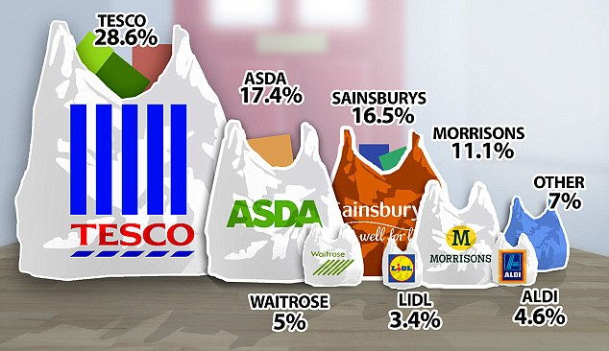

Slide 5
