Slide 1
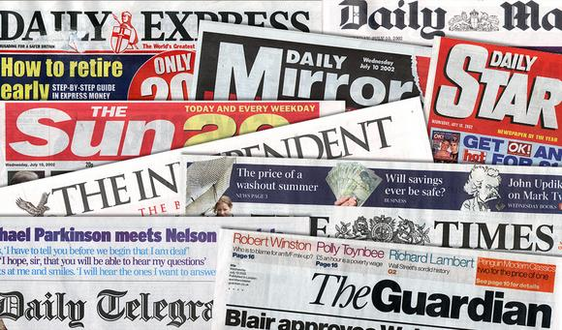
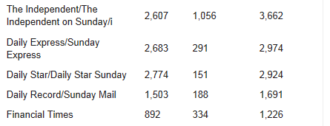
The Newspaper Industry in the UK
Associated News (now called DMG Media)
Daily Mail
Mail on Sunday
News International (now called ‘News UK’)
The Sun
The Times
The Sunday Times
Press Holdings (Telegraph Media Group)
Daily Telegraph
Sunday Telegraph
Scott Trust Limited
Guardian
The Observer
Alexander Lebedev’s Indpendent Print Ltd
Independent Newspaper
Northern and Shell (Richard Desmond)
Daily Express
Sunday Express
Daily Star
Daily Star Sunday
Trinity Mirror
Daily Mirror
Sunday Mirror
Pearson PLC
Financial Times
FT Weekend

Slide 2
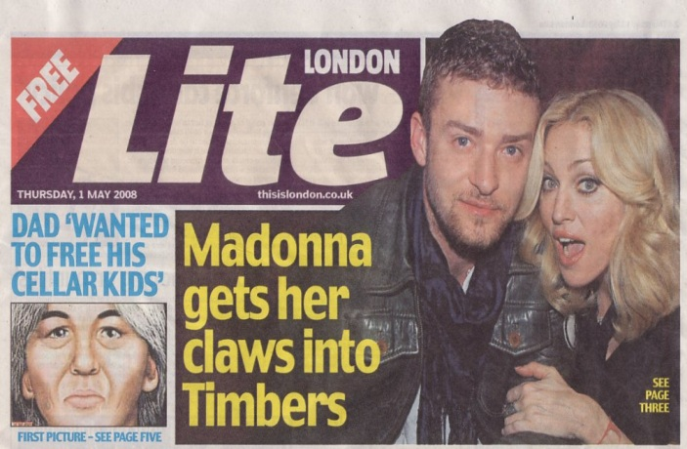
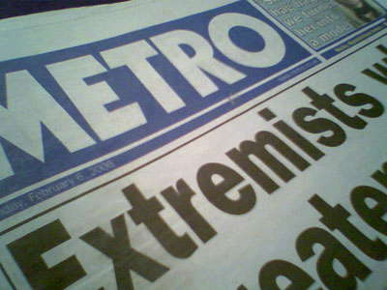
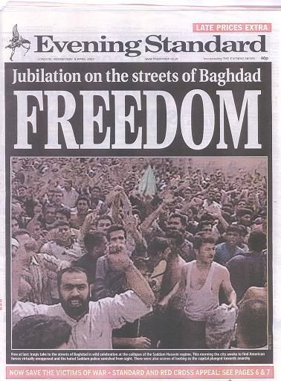
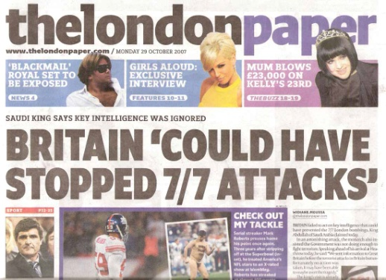
London Newspaper Industry
1960 - 3 large companies selling papers. One of these is the Associated Newspapers famous ‘Evening Standard’ with 2.2 million copies being sold. They are sold in the Evening for commuters as they return home to share the days news.
1980 - Evening Standard becomes a monopoly for a pure London based ‘local’ paper by lowering it’s prices - this pushes out existing firms and deters other firms from entering or if they do enter, from staying too long.
1990’s - Even though it has monopoly power, sales of the Evening Standard fall to just 340,000 copies being sold (things are looking bad for the Evening Standard compared to 1960). However advertising revenues increased by 34 per cent over the same period). Therefore still profitable with 75% of revenue coming from advertising and 25% from the cover price.
2000 - Associated Newspapers launched a second paper, the ‘Metro’, a free newspaper for those travelling on the London underground. Metro costs money to produce but doesn’t raise any revenues from the cover price (because it is free) and only earns money from advertising. The Metro is also much smaller and it’s stories are very short compared to the Evening Standard.
2004 - Associated Newspapers launched a third paper, the ‘London Lite’ which was another free newspaper distributed at lunchtimes from the same central London newsstands that sell the Evening standard
2006 - News International (a rival company) launch ‘thelondonpaper’ which was available for free in the afternoon AND evening. Associated Newspapers responded by making ‘London Lite’ available at the same times.
2007 - by the end of the year both ‘London Lite’ and ‘thelondonpaper were making a loss
2009 - ‘thelondonpaper’ is taken from circulation due to making £12.9m losses; it never made any profit. The ‘London Lite’ is pulled from circulation 3 weeks later.
2009 - The Evening Standard is taken over by a Russian businessman for £1 (takes 75% stake in the business) and The Evening Standard was launched for the first time in it’s 180 year history as a free paper. The Metro continues to be owned by Associated Newspapers and branches out to other urban areas.
2014 - All London newspapers are starting to struggle as advertising revenues fall

