Slide 1
WEEK 1

Slide 2
RWS 15 (Macro): Financial Markets
STARTER TASK (first 8 minutes)
Discuss with your partner what you think ‘money’ is? Or what the characteristics of money are?
Read the article on ‘Bitcoin’ and be thinking….can we classify Bitcoins as money?

Slide 3
Revision Worksheet 15 (MACRO)
What is Money
Financial Markets (and Instruments)
The Role of Banks
Globalisation (Hot Money Flows)
Market Failure
Financial Markets
Notes:
5: Introduction
What is Money
10: What do you think money is?
5: Economics debate over money
10: Task 1
15: Ed Story and Bitcoin Video
10:Task 2 and 3

Slide 4
What is Money? ECONOMIC CONTROVERSIES
What do you think money is?
The Function of Money: What the economics textbooks say
Medium of exchange (ability for groups to specialise and trade)
Store of value (value needs to stay the same over a period of time)
Unit of account (Measure of value)
Traditional view of money and barter
Barter
Money (Cash)
Commodity: Agree on a form of cash.
Representative: Gold as a form of cash and development of IOUs. Has intrinsic value.
Fiat money: legal tender and bank deposits. Based on trust
Credit
Modern view of money as credit
Credit
Money
Barter (via money!)
Money Today?
Narrow money = cash (notes and coins)
Broad money = cash and bank deposits
Bank of England view? VIDEO
TASKS:
Why are the following types of money good and bad? (a) Shells, (b) Cigarettes, (c) Honey, (d) large heavy man made stones with a hole in the middle
To what extent is Bitcoin money?
Ed’s story – what type of money did Ed create?
Notes:
Positive Money Website - http://positivemoney.org/videos/introduction/

Slide 5
Financial Markets IN THEORY: The Impact on the Wider Economy
Saving and Borrowing (Circular Flow)
Raise finance (borrowing and equity)
Facilitating exchange (specialisation)
Insurance (forwards and contracts)
GOVERNMENT
SPENDING (G)
INJECTION
EXPORTS (X)
INVESTMENT (I)
OUTPUT (GDP)
LEAKAGE
WORLD
ECONOMY
GOVERNMENT
FINANCIAL
MARKETS
HOUSEHOLD
EXPENDITURE (Consumption)
FIRM
INCOME (Wages, Profits etc.)
SAVINGS (S)
INPUT (Labour, Capital etc.)
IMPORTS (M)
TAXATION (T)
INJECTION
LEAKAGE

Slide 6
Financial Markets IN REALITY
Options
Derivatives
Swaps
Oil
Commodities
Forwards
Gold
Short-term debt
Money Markets
CDO’s
Futures
Pork Bellies
Frozen OJ
“CITY OF LONDON”
Bills of Exchange
Inter-Bank Lending
Insurance
Capital Markets
Corporate Bonds
Foreign Exchange
Govt. Bonds
Reminibi
Equity (Shares)
Pounds
Yen
Dollars
Euros
Notes:
Money Markets: Bills of Exchange
Treasury Bills (maturity of less than a year)
Commercial Bills (maturity of less than a year)
Capital Markets: Bonds
Government Bonds or Gilts (maturity of more than a year)
Commercial Bonds (maturity of more than a year)

Slide 7
Financial Markets AGENTS IN THE MARKETS
Corporations
Insurance Companies
Governments
Borrowers
AGENTS…
Central Banks
Pension Funds
Mutual Funds
Investors (Savers!)
Commercial (or retail)
Banks
Investment Banks
Private Equity
Individuals
Investment
Hedge Funds

Slide 8
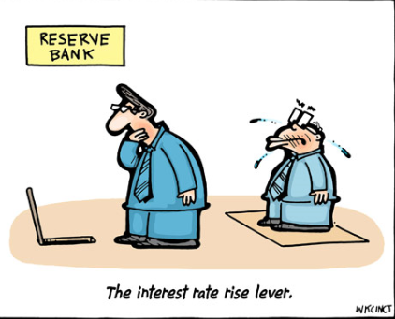
Financial Markets THE IMPORTANCE OF INTEREST RATES
Interest rate set by Bank of England
LIBOR rate
Inverse relationship between bond prices and ‘yields’

Slide 9
THE BOND MARKET
WHAT ARE BONDS?
Bonds are ways of borrowing money by Governments (Treasury Bonds or ‘Gilts’ in the UK and Corporate Bonds (issued by firms)
HOW DO THEY WORK
Government wants to borrow £1000. So it issues a 10 year bond (or ‘Gilt’).
A saver is someone with excess money they haven’t used for consumption. Sometimes they can be misleadingly called investors. A saver may decide to buy a bond (so the Government gets £1000) rather than save their money using alternatives (e.g. buy a share)
The saver will require the money back in say 10 years. Because the bond ties up the savers money, they will want compensation for this lack of liquidity. The yield also compensates for risk. If the Government is a strong one, then the yield might be lower than a riskier Government where the yield would be higher.
Therefore the Government also agrees to pay a ‘yield’ of say 5%. So every year, the saver receives an annual £50 as compensation for not seeing their money again for 10 years. At the end of the process the saver will have made £500.
However the original saver (saver 1) might decide to sell their bond to someone else (saver 2) at a price (probably higher than £1000 but not necessarily). Then the income stream from the Government and the final bond would now be transferred to saver 2 until the bond finishes.
.

Slide 10
THE BOND MARKET
WHY ARE BOND PRICES AND YIELDS INVERTED?
Suppose the government issued a £1000, 5 year treasury bond at an interest rate of 5%.
This means that if you bought the treasury bill at £1,000 you will receive a fixed interest rate of £50 every year.
You can hold onto a government bond until maturity. At the end of the fixed period, 5,10 or 20 years, the government will repay your £1,000.
However, bonds are often bought and sold on the open market.
If the government buys bonds, demand rises and so the price of bonds rises to reflect the increased demand.
Suppose the price of bonds rises from £1,000 to £1,500. This bond is being sold for more than its face value, but, the interest payment remain the same £50 a year.
This means that now bonds have a market price of £1,500, the effective interest rate is £50 / £1,500 = 3.33%
Therefore because demand for bond rises, the price of bonds rises and the effective interest rate (yield) falls.
BONDS AND INFLATION
Bonds HATE inflation. If you have a bond with a yield of 5% and inflation is at 6% then you are making a 1% loss per year on your savings.
BONDS AND INTEREST RATES
If Government cut Interest rates
Suppose when the bond is issued, the Bank of England base rate is 5%. This means that the bond with yield of 5% is a competitive interest rate.
However, if interest rates were cut. to 2%, these bonds would look more attractive because they are paying an interest rate above the market equilibrium.
Therefore more people would buy bonds causing price to rise. If the price of bonds rose to £2,500. The effective interest rate would be £50 / £2,500 = 2%.
So a cut in interest rates is likely to increase the price of bonds. A rise in interest rates is likely to reduce the price of bonds.
In the real world it is much more complicated. Many factors affect price of bonds such as expectations, confidence, relative risk e.t.c. But, these simple examples, should explain the basic principle of the inverse relationship between bond yields and bond prices
.

Slide 11
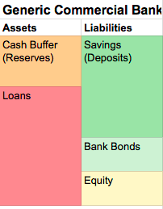
The Role of Banks TRADITIONAL v MODERN BANKING
Balance Sheets, the Objectives of Banks and Zombie Banks!
Money Creation:
Traditional Banking: Banks as a medium between buyers and sellers
Modern Banking:
Fractional reserve banking and the money multiplier
The privatisation of money?
Asset Bubbles?
Money creation depends on confidence of the banks not the central bank?
Investment banking and the invention of financial derivatives
Debt to other banks
Notes:
Bank of England Link: http://www.bankofengland.co.uk/publications/Pages/quarterlybulletin/2014/qb14q1.aspx
UK has no reserve ratio! But regulators have a capital reserve ration which is a ratio of debt to equity
Sovereign money system: Everyone has a bank account with the central bank who fully controls the money supply. Banks are required to collect deposits and then loan them out but with 100% reserve ratio.

Slide 12
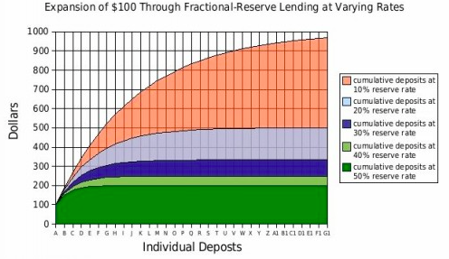
Banks Create Money……

Slide 13
Global Finance GLOBALISATION
The Gold Standard
Bretton Woods = The ‘Dollar’ Standard?
Importance of the dollar?
Financial Crash

Slide 14
Market Failure in Financial Markets FINANCIAL CRASHES AND FRAUDULENT BEHAVIOUR
EFFECTS of Market Failure
Market ‘Crashes’ / Financial Crisis
1999 Asian Financial Crisis
2007-8 Global Credit Crunch
2012 ‘Flash Crash’
Fraud
LIBOR Scandal
2011 PPI Scandal
Insider Trading
CAUSES of Market Failure
Assymetric Information
Moral Hazard
Speculation and Market Bubbles
Market Rigging
Negative Externalities

Slide 15
WEEK 2

Slide 16
90

Slide 17
1-2-1’s
Complete your booklets

Slide 18
WEEK 3

Slide 19
45

Slide 20
RWS15: Financial Markets and Banking Final Week
LESSON IN WEEK 1: Introduction to…
The concept and controversies of Money
The key financial markets and instruments
The role of banks
BOOKLET
What is Money
Raising finance for Government’s and Firms through the financial markets (debt .v. equity)
The Objectives of Banks (Liquidity, Security and Profit Conflicts)
Market Failure in the Banking Industry
TODAY
Assess the Booklet (above)
The UK Money Supply: Who’s in Charge?
Fractional Reserve Banking
The Privatisation of Money = goods and bads?
Criticisms of the Banks Today? Market Failure
Too big/powerful and inderdependent = ‘systematic risk’ to the UK economy
Control the money supply
Powerful political lobby
HOMEWORK: complete revision worksheets on Micro and Macro for RWS 15

Slide 21
RWS15: Financial Markets and Banking Money and Financial Markets
Bitcoin? A good form of money?
Money, Capital and Currency Markets
True of false?
Financial markets channel individuals/institutions with surplus funds to those people to those that have a shortage of funds
Channeling funds for loans must take place through banks
Foreign governments are not permitted to buy UK Government bonds
The Money market provides short-term loans to individuals, firms and governments.
Money markets are used when companies want to raise funds by selling shares in their companies

Slide 22
RWS15: Financial Markets and Banking Raising Finance for Governments - Treasury Bills and ‘Gilts’
What is a bond? Difference between corporate and government bond?
Why is inflation the enemy of bond holders?
Primary and secondary bond markets? Money or capital markets?
Australian Bond?
Task 1:
Q: The annual coupon payment on a 40 year bond issued last year is £8. When the bond was first sold, the long run rate of interest was 8%. The bond’s maturity value is £100. Within the last year, interest rates have fallen to 4%.
Calculate the approximate current market price of this bond on the capital markets.
Answer
Maturity length = 40 years
Coupon payment of £8 on a £100 maturity value = 8%
TODAY: Long term interest rates = 4% means that the bond is more attractive as you can get a better return than 4% (the return of putting your money in a bank). Therefore the bond could be worth up to £200 to keep the 8% coupon rate
Notes:
Maturity length = 40 years
Coupon payment of £8 on a £100 maturity value = 8%
TODAY
Long term interest rates = 4% means that the bond is worth £200 to keep the 8% coupon rate.

Slide 23
RWS15: Financial Markets and Banking Raising Finance for Firms: Debt .v. Equity
Equity Financing
Having an investor write you a check might seem like the perfect solution if you want to expand your business without taking on debt. After all, it's money without the hassle of repayment or interest. But the dollars always have strings attached: You’ll have to share profits with the venture capitalist or angel investor.
Advantages:
Less risky: You don't have to pay it back, and it's a good option if you can't take on debt.
Networking opportunities: You could connect with the investor's network, which might add more credibility to your business.
Long-term view: Investors think down the road, and might not expect a return on their investment immediately.
Deferred risk: There's no requirement to pay back the investment if the business fails.
More Cash: Less pressure to pay dividends compared to paying coupon rates to investors or interest rates to banks
Disadvantages:
Total cost: It could actually cost much more than what you’d pay for a loan.
Less control: The investor(s) will require some ownership of your company and a portion of the profit.
Asking for approval: You’ll have to consult with investors before making big (or even routine) decisions—and you might disagree.
Time and effort: You’ll have to search to find and assess the right investor for your company.
Debt Financing
The business relationship with a bank that loans you money or an investor that agrees a bond contract with you is much different than selling part of the company to an investor. You won’t need to give up part of your company, but if you take on too much debt, you could stifle growth.
Advantages:
Temporary: The business relationship ends when the money is paid back or the bond matures.
Appropriate timing: Loans can be short-, medium-, or long-term, depending on needs.
Easier to plan: Principal and interest are known, predictable figures and therefore easier to plan for in a budget (provided you don't take a variable rate loan).
Freedom and flexibility: The bank or lending institution (like the Small Business Administration) has no say in how run your business, and holds no ownership.
Disadvantages:
Firm deadlines: Money must be paid back by a fixed date.
Lower investor potential: If you carry too much debt you’ll be labelled "high risk" by investors, which could limit your ability to raise future capital by equity financing.
Debt can make it difficult for a business to grow because of the higher cost of repaying the loan.
VIDEO - 3 Mins
Why is debt more popular and why might this be changing?

Slide 24
RWS15: Financial Markets and Banking Types of Banking: Commercial .v. Investment Banks
Decide which of the statements below applies to commercial banks and which applies to investment banks. Write (C) or (I) next to each statement. Note: Some statements could appear under both headings
Advise on new share issues
Provide loans and over drafts for small businesses
Accept deposits from households
Provide help with mergers and takeovers
Underwrite new share issues
Trade in bond and equities for clients
Buying and selling foreign exchange
Trade shares, corporate bonds and government bonds on their own behalf
Provide mortgages to finance house purchase
Arrange loans to help finance large infrastructure projects
Participate in commodity trading
Give advice to individuals and small businesses about financial matters
Manage large investment portfolios on behalf of clients. E.g pension funds

Slide 25
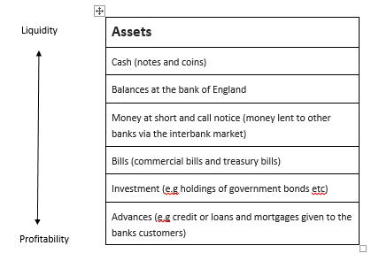
RWS15: Financial Markets and Banking Conflicting Objectives of Banks: Liquidity & Security .v. Profit
The Bank’s Balance Sheet
Assets are the claim that a bank has against others and represents how the bank has used its funds.
Liabilities are the claims that other people have on the bank and they show the source of the banks funds. Liabilities can be divided into ‘shareholders’ funds and money that the bank has borrowed from depositors or, for example issuing bonds. Shareholder funds are the bank’s capital and comprise the money that was received when shares were issued plus any retained profits.
Assets | Liabilities (and Equity)
Cash (notes and coins) | Share capital
Balances at the bank of England (All settlement banks and some others have an account at the Bank of England. Many of the smaller banks have an account with a different, large bank) | Reserves (retained profits)
Money at call and short notice (e.g money lent to other banks via the interbank market) | Long term borrowing (eg bonds issued by the bank)
Bills, commercial and treasury bills | Short term borrowing from money markets
Investments (e.g holdings of government and corporate bonds) | Deposits (sight deposits and time deposits
Advances (eg loans and mortgages made to the customers of the bank)
Fixed assets (eg premises) | EQUITY
Note: the capital of the bank (shareholders’ funds) comprises issued share capital plus reserves
The first four items on the asset side of the balance sheet are fairly liquid whereas investments and advances are less liquid but are generally much more profitable. It is important to note that banks have to manage their portfolio of assets to ensure that they can meet their customers’ demands for cash whilst also aiming to make a profit for their shareholders.
It is important to note that banks generally borrow short term and lend long term. This puts them at risk because depositors may decide to withdraw their money but the bank cannot insist that the people to whom they have lent money, eg mortgage holders, repay immediately.

Slide 26
RWS15: Financial Markets and Banking Conflicting Objectives of Banks: Liquidity & Security .v. Profit
ASSETS
LIABILITIES (AND EQUITY)
Which balance sheet belongs to a bank and which to a business producing computing products?
What are the differences between the two?
How do banks make profit?
Using the concept of leverage, explain how the banks can make even more profit?
Why are Liquidity and Security (against insolvency) Issues important when considering the profitability of banks?
HOUSING PORTFOLIO
CUSTOMER DEPOSITS
LOANS TO ‘SECURE PEOPLE’
MONEY BORROWED FROM OTHER BANKS
LOANS TO ‘RISKY PEOPLE’ (UNSECURED)
CASH RESERVES
EQUITY
ASSETS
LIABILITIES (AND EQUITY)
INVESTMENTS
LOANS FROM BANKS
EQUIPMENT
CORPORATE BOND COUPON PAYMENTS
PROPERTY
EQUITY
MONEY IN BANK

Slide 27
RWS15: Financial Markets and Banking Conflicting Objectives of Banks: Liquidity & Security .v. Profit
NOTES
Profit - banks make profit by taking deposits or borrowing money and lending it out or investing in assets which provide a return. If all their assets were cash reserves, then they would just be a ‘safe deposit’ box.
Leverage - Borrowing more to obtain more assets (which provide income streams). For the bank the income streams are from interest payments on loans etc. For businesses, the equipment they have means they can produce output for sale which then gives income. Similar to buying a house; your parents will have ‘leveraged their income’ to afford to buy a house by taking out a loan. If a bank kept all its deposits as cash in bank vaults. It would have a large quantity of liquid capital. Whenever a customer came to demand his deposits back, the bank could go to the bank vaults and pay everything back. This is a very conservative method of banking. The bank wouldn’t have to worry about a fall in the value of assets or loans not paid back. However, this type of banking is not very profitable. Keeping capital reserves in the bank vaults doesn’t earn you any money.
Instead the bank will lend a percentage of its deposits to customers wishing to take out a loan. This enables the firm to gain a better rate of return on its deposits. The more the bank lends, the greater the potential to make profit. This is leverage.
Leverage ratio is the proportion of debts (liabilities) that a bank has compared to its equity. So bank above has say 5% equity. So for every £1 of capital reserves, £20 is lent out (5/5 and 100/5) therefore the leverage ratio is 1/20 or 5%. A leverage ratio of 4% would mean that for every £1 of capital that a bank holds in reserve, the bank can lend £25. (1/25 = 4%). If the leverage ratio falls to 3%, it would mean that for every £1 of capital that a bank holds in reserve, the bank can lend £33 (1/33 = 3%). As the percentage drops (i.e. the ratio becomes smaller) we can say leverage has increased (i.e. the bank is using more of it’s money to try and get into more debt and therefore boost it’s assets to make more profit).
Security - banks need to ensure that the assets they are investing in are secure. The less secure, the more chance for greater profit but also the greater chance of defaulting. If loans (assets for banks) become worthless because of a default, tthen the firm has essentially lost that money and any future income streams. This may mean they are unable to pay their liabilities and as a result are considered ‘insolvent’. In this case the central bank would need more than a ‘cash injection’, they would need to cover the loss of the bank or let it fail (in which case customers might lose all their money!)
Liquidity - if a bank wanted to pay debts off, how easily could it do it with a sell-off of assets? See the liquidity table. A bank does not want to hold too many illiquid assets otherwise it may not be able to pay off it’s debts and could effectively be insolvent. A liquidity crisis is where banks do not have access to enough cash in the short term. They have assets but there are tied up in long term loans etc. Therefore a bank would respond to a liquidity crisis by not lending out any more money and using everything they could to ‘pay down their debts’. If banks are unable to meet their immediate liablities (say a ‘bank run’ where all the customers want their money back, then this can cause a catastrophic failure. A firm in a liquidity crisis could still be ‘solvent’ but just not pay all of it’s debts immediately.

Slide 28
90

Slide 29
RWS15: Financial Markets and Banking Conflicting Objectives of Banks: Liquidity & Security .v. Profit
£10
Use the animation to explain how banks make profit?
Draw a balance sheet for HSBC bank in this scenario
Why might the bank be at risk of becoming ‘insolvent’?
Why might the bank be facing a ‘liquidity crisis’?
What is the reserve ratio of the bank?
EXTENSION: What is the leverage ratio of the bank!?!
£8
SAM
(The Saver)
BOB
(The Borrower)
Save
Loan (5yr)
£10
HSBC BANK
£8
1% Interest
=£0.10
20% Interest per annum for 5 years
=£1.60 per year = £8 in total
Notes:
(1)
(2)
See next slide
(3)
WHAT IS BANK CAPITAL - https://dealbook.nytimes.com/2013/07/10/what-is-bank-capital-anyway/?_r=0

Slide 30
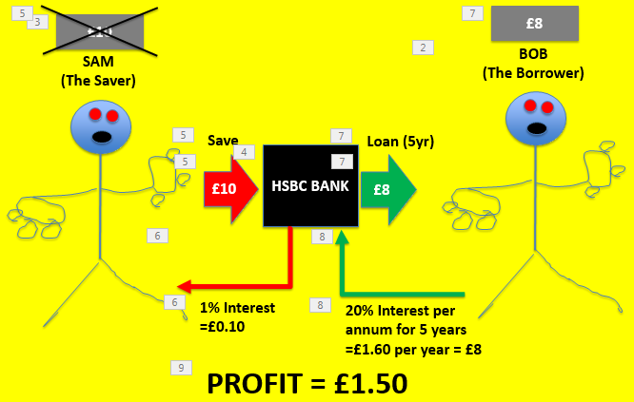
RWS15: Financial Markets and Banking Conflicting Objectives of Banks: Liquidity & Security .v. Profit
Assets
Liabilities (and Equity)
Bob’s Loan = £16
Sam’s Deposit and interest payments = £10.50
Equity = £7.50
Cash Reserve = £2
Notes:
(1)
(2)
Assets = £8 plus £8 = £16 Loan and £2 Cash Reserve
Liabilities (and Equity) = £10 (

Slide 31
RWS15: Financial Markets and Banking Conflicting Objectives of Banks: Liquidity & Security .v. Profit
TRADITIONAL BANKING
HSBC making profit just from customer deposits
MODERN BANKING
HSBC making profit from customer deposits but also from inter-bank lending
Assets
Liabilities (and Equity)
Liabilities (and Equity)
Assets
Bob’s Loan = £16
Sam’s Deposit and Interest Payments = £10.50
Bob’s Loan = £16
Sam’s Deposit and Interest Payments = £10.50
At the end of the day, the equity is a ‘safety net’ if the bank fails and represents the true worth of a business
Loan from Barclays = £20
CDO’s (mortgage backed security) = £25
Equity = £7.50
Equity = £12.50
Cash Reserve = £2
Cash Reserve = £2
LEVERAGE RATIO = 46% (for every £1 of equity, £2.13 is loaned out)
LEVERAGE RATIO = 41% (for every £1 of equity, £2.44 is loaned out)
Notes:
The balance sheet on the right is more heavily leveraged….so the bank is making more profit but it is also taking more risk

Slide 32
Market Failure: Financial Crash 2007/8
APPLE 2008
Assets £30 Billion
Liabilities £12 Billion
Equity £18 Billion
Leverage 0.66 to 1
Under leverage - could pay off liabilities and keep business
OLLY
Assets £604,000
Liabilities £302,000
Equity £302,000
Leverage 1 to 1
Very safe = can pay off liabilities and keep assets
RBS 2008
Assets £1900 Billion
Liabilities £1,809 Billion
Equity £91 Billion
Leverage 20 to 1
Borrowing 20 times more than can pay back without losing assets. Will only keep 91 billion which is very small for a large organisation like RBS
Banks Leverage as of 2008
Barclays 62 to 1 (1.6%)
UBS (Swiss Bank) 47 to 1 (2.1%)
Deutsche Bank 53 to 1 (1.9%)
Lloyds TSB 34 to 1 (2.9%)
HSBC 20 to 1 (5%)
RBS 20 to 1 (5%)
If Olly was able to leverage like Barclays bank in 2008?
62 to 1 = £18,724,000 of Assets
Notes:
Have a discussion about whether financial markets are positive in promoting development?

Slide 33
RWS15: Financial Markets and Banking UK Commercial Banking Market - ‘Too Big to Fail’ and ‘Systemic Risk’?

Slide 34
RWS15: Financial Markets and Banking Banks, the Money Supply and Market Failure
3:97 Ratio
Fractional reserve banking
Problems with the privatisation of money?
How do you limit the power of the banks?

Slide 35
Stage 2: Bank Basics - Magic Money! The importance of credit: Why is banking so important to the economy
LIABILITIES | ASSETS
£200 Total £200 Deposit from Saver 1 | £200 Total £160 Shares of Firm 1 £40 in Cash Reserve (20% of total Liabilities)
£360 Total £200 Deposit from Saver 1 £160 Deposit from Firm 1 | £360 Total £160 Shares of Firm 1 £128 Shares in Firm 2 £72 in Cash Reserve (20% of total Liabilities)
£488 Total £200 Deposit from Saver 1 £160 Deposit from Firm 1 £128 Deposit from Firm 2 | £488 Total £160 Shares of Firm 1 £128 Shares in Firm 2 £102.40 Loan for House £97.60 in Cash Reserve (20% of total Liabilities)
£590.40 Total £200 Deposit from Saver 1 £160 Deposit from Firm 1 £128 Deposit from Firm 2 £102.40 Deposit from Firm 3 | £590.40 Total £160 Shares of Firm 1 £128 Shares in Firm 2 £102.40 Loan for House £81.92 for……. £118.08 in Cash Reserve (20% of total Liabilities)
SAVER
Bank buys £160 worth of shares in Firm 1
FIRM 1
FIRM 1
Bank buys £128 worth of shares in Firm 2
FIRM 2
FIRM 2
Bank loans £102.40 to consumers to buy a house
Household
FIRM 3
(House building Firm)
FIRM 3
(House building Firm)
Bank uses £81.92 for…….
????????
Notes:
Have a discussion about whether financial markets are positive in promoting development?

Slide 36
Stage 2: Bank Basics - Magic Money! The importance of credit: Why is banking so important to the economy
LIABILITIES | ASSETS
£200 Total £200 Deposit from Saver 1 | £200 Total £160 Shares of Firm 1 £40 in Cash Reserve (20% of total Liabilities)
£360 Total £200 Deposit from Saver 1 £160 Deposit from Firm 1 | £360 Total £160 Shares of Firm 1 £128 Shares in Firm 2 £72 in Cash Reserve (20% of total Liabilities)
£488 Total £200 Deposit from Saver 1 £160 Deposit from Firm 1 £128 Deposit from Firm 2 | £488 Total £160 Shares of Firm 1 £128 Shares in Firm 2 £102.40 Loan for House £97.60 in Cash Reserve (20% of total Liabilities)
£590.40 Total £200 Deposit from Saver 1 £160 Deposit from Firm 1 £128 Deposit from Firm 2 £102.40 Deposit from Firm 3 | £590.40 Total £160 Shares of Firm 1 £128 Shares in Firm 2 £102.40 Loan for House £81.92 for……. £118.08 in Cash Reserve (20% of total Liabilities)
SAVER
Bank buys £160 worth of shares in Firm 1
FIRM 1
FIRM 1
Bank buys £128 worth of shares in Firm 2
FIRM 2
FIRM 2
Bank loans £102.40 to consumers to buy a house
Household
FIRM 3
(House building Firm)
FIRM 3
(House building Firm)
Bank uses £81.92 for…….
????????
Notes:
Have a discussion about whether financial markets are positive in promoting development?

Slide 37
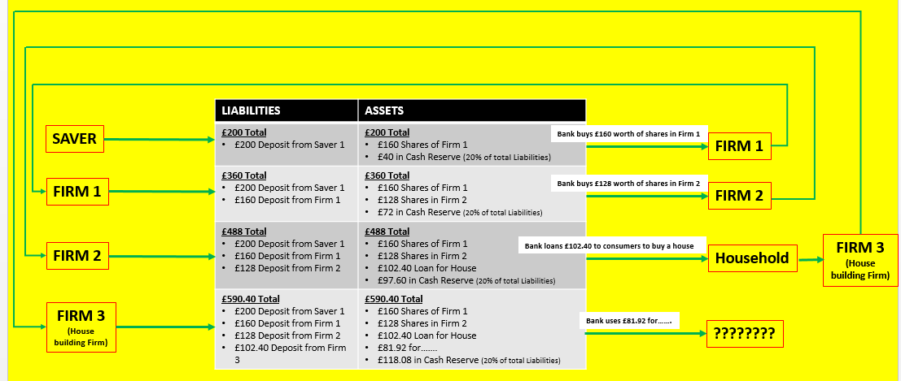
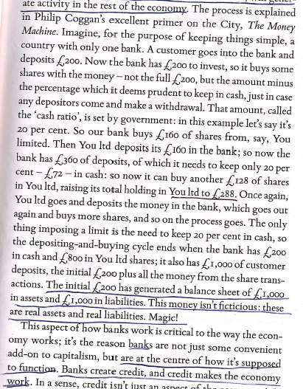
Stage 2: Bank Basics - Magic Money The importance of credit: Why is banking so important to the economy
MAGIC MONEY EXPLAINED
The Money Multiplier
DISCLAIMER: Positive Money is a UK based lobby group who have a specific idea about how our money works. This video gives you an overview of the money multiplier and why banks make money but then they claim it is all wrong!! You just need to know the theory which is how money is created which is right but perhaps wrong for the UK as we do not have a reserve ratio.
VIDEO: Explains the money multiplier (even though it is sceptical - see above!) - https://www.youtube.com/watch?v=SkAzDrrKkME
VIDEO: Explains why the money multiplier is infinite and it is not a pyramid if you want more detail - https://www.youtube.com/watch?v=KvpbQlQwl0A
Notes:
Have a discussion about whether financial markets are positive in promoting development?

Slide 38
END

Slide 39
Stage 2: Bank Basics How do banks work?
How does a bank make money?
Issuing Loans
Selling ‘Debt Packages’
What is a balance sheet?
Balance sheet for Olly
Assets
House £544,000
Deposits in Bank £5,000
Car £5,000
Stuff I own £10,000
Pension £40,000
Total £604,000
Liabilities
House owned by bank £300,000
Credit Card Debt £1,000
Car Loan £1,000
Total £302,000
Equity £302,000
Total Liabilities & Equity £604,000
Balance sheet for Royal Bank of Scotland in 2008
Assets Millions
Balance at central bank £17,866
Treasury Bills/Bonds £18,229
Loans £1,048,710
Derivatives £337,410
Other £478,304
Total £1,900,519
Liabilities
Deposits by banks £312,663
Deposits by customers £682,365
Other £814,065
Total £1,809,093
Equity £91,246
Total Liabilities & Equity £1,900,519
Notes:
Have a discussion about whether financial markets are positive in promoting development?

Slide 40
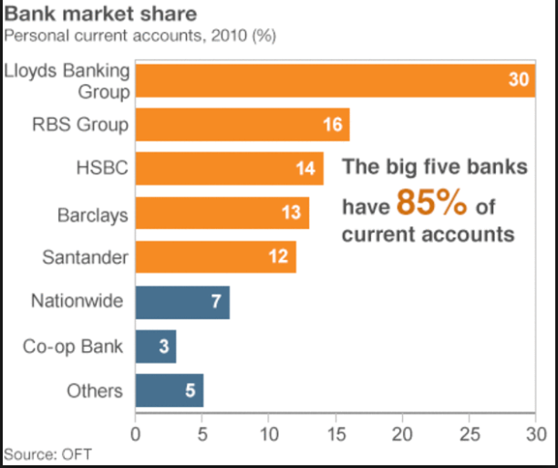
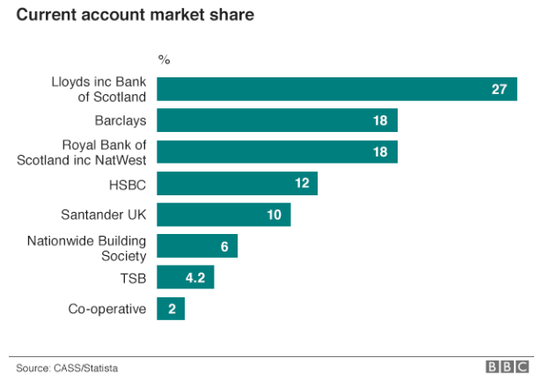
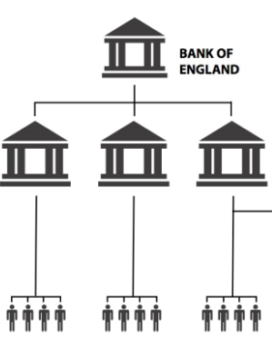
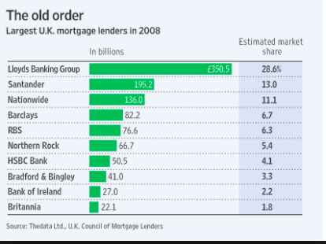
Stage 2: Bank Basics The Overall Banking System: The Role of the Central Bank and the UK Banking Market
2015
Deposits
PRIVATE BANKS
Deposits
Deposits
Deposits
SAVERS
Notes:
Have a discussion about whether financial markets are positive in promoting development?

Slide 41
Stage 3: Banks Advanced Bank Balance Sheets, Leverage and Zombie Banks
What is a balance sheet?
How do banks and business balance sheets differ?
Balance sheet for Royal Bank of Scotland in 2008
Assets Millions
Balance at central bank £17,866
Treasury Bills/Bonds £18,229
Loans £1,048,710
Derivatives £337,410
Other £478,304
Total £1,900,519
Liabilities
Deposits by banks £312,663
Deposits by customers £682,365
Other £814,065
Total £1,809,093
Equity £91,246
Total Liabilities & Equity £1,900,519
Balance sheet for Olly
Assets
House £544,000
Deposits in Bank £5,000
Car £5,000
Stuff I own £10,000
Pension £40,000
Total £604,000
Liabilities
House owned by bank £300,000
Credit Card Debt £1,000
Car Loan £1,000
Total £302,000
Equity £302,000
Total Liabilities & Equity £604,000
Notes:
Have a discussion about whether financial markets are positive in promoting development?

