Slide 1
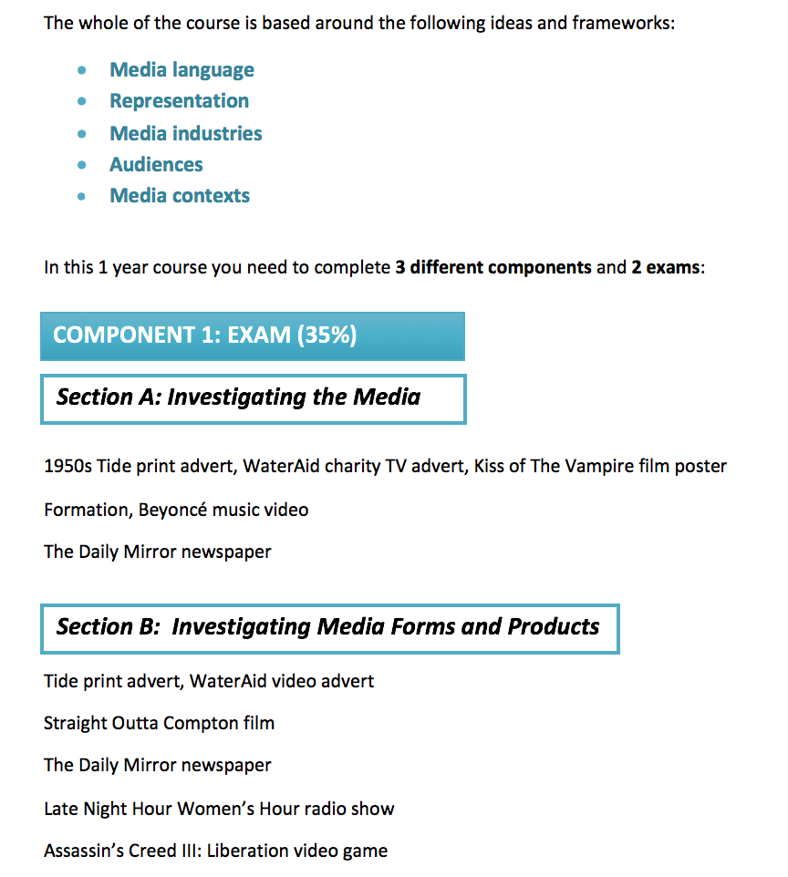

Slide 2
STRAIGHT OUTTA COMPTON (2015)
COMPONENT 1: MEDIA INDUSTRIES and audiences

Slide 3
aims
For this part of Component we shall be looking at the film industry (and specifically Straight Outta Compton) in terms of:
the significance of patterns of ownership and control, including conglomerate ownership, vertical integration and diversification
how marketing is used to reach a range of audiences nationally and globally
the regulatory framework of contemporary media in the UK and the role of regulation in global production, distribution and circulation
the processes of production, distribution and circulation and the impact of digitally convergent platforms

Slide 4
BACKGROUND
Straight Outta Compton is a biopic, produced by Legendary Pictures (part of Legendary Entertainment), distributed by Universal Pictures and directed by F. Gary Gray.
The film follows the story of hip hop band N.W.A. in 1980s America. Members of the band (Ice Cube and Dr. Dre) were co-producers.
The film was a major commercial success, making more than $200 million – it had a $50 million total budget ($28 million production budget). Awards nominations (including for the Academy Award for Best Original Screenplay) also contributed to its success.
It is the highest grossing music biopic to date.

Slide 5
HISTORICAL CONTENT
The film portrays events set predominantly in mid-1980’s California.
The depiction of this period in a contemporary film - and the possible glorification of N.W.A. as agents of social change - may have been impacted by the social upheaval caused by the racial tensions prevalent within the US and events following this period such as the LA Riots in 1992 and the Rodney King killing (taxi driver beaten to death by LAPD in 2012).
How is this relevant today?

Slide 6
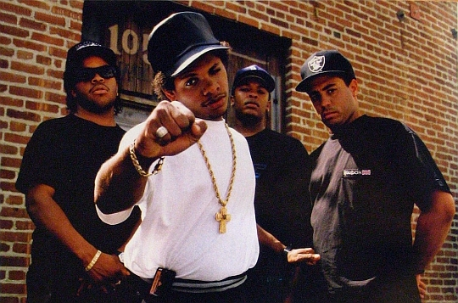
BACKGROUND
N.W.A (from Compton, California) were among the earliest and most significantly popular and controversial figures of the gangsta rap subgenre, and are widely considered one of the greatest and most influential groups in the history of hip hop music.
Active from 1986 to 1991, the group attracted controversy owing to their music's explicit lyrics; attitudes towards women; glorification of drugs and crime and their deep hatred of the police system.
The group was subsequently banned from many mainstream American radio stations. In spite of this, the group has sold more than 10 million units in the United States alone.

Slide 7
PRODUCTION
DISTRIBUTION
EXHIBITION
FILM INDUSTRY
PRODUCTION
Finance
Stars
Director
Storyboarding
Filming
Editing

Slide 8
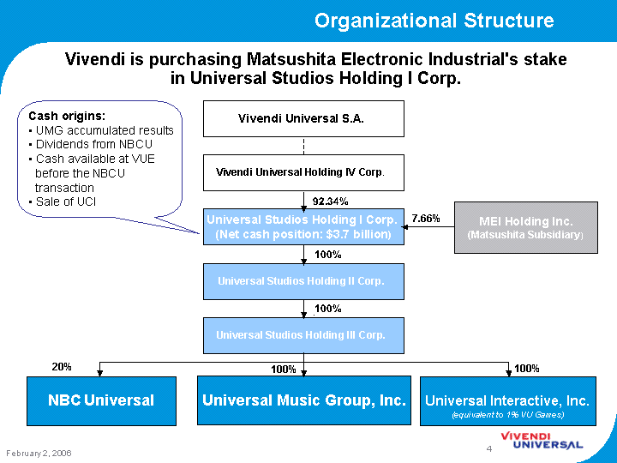
production
Straight Outta Compton was produced by Legendary Pictures who entered into partnership with Universal Pictures (the film’s distributor) in 2014.
Universal is owned by NBC Universal, a Comcast company. The fact that the film was produced and distributed by a major, vertically integrated film studio that is part of a media conglomerate is significant in terms of funding, possibilities for cross-promotion and reaching a global audience.

Slide 9
Comcast
Universal Studios
Universal Pictures
Comcast Interactive Media
Comcast Television Network
Comcast Spectator
NBC Universal Television
NBC Universal News Group
SyFy
NBC Universal
Universal Parks & Resorts
Universal Filmed Entertainment Group
Dreamworks
Working Title
Focus Films
NBC Universal Television Distibution

Slide 10
Key Terms
Horizontal Integration: The consolidation of holdings across multiple industries, it is a strategy used by a business or corporation that seeks to sell a type of product in numerous markets.
Conglomerate: A large corporate that is made up of a number of different businesses. One company owns a controlling stake in a number of smaller companies; these smaller companies are called subsidiaries. E.g. Comcast
Subsidiary: The smaller companies which operate under the conglomerate. E.g. Universal Filmed Entertainment Group
Synergy: Interconnected marketing and distribution of media and film products across a range of platforms and sectors, achieved through the conglomerates and their subsidiaries.

Slide 11
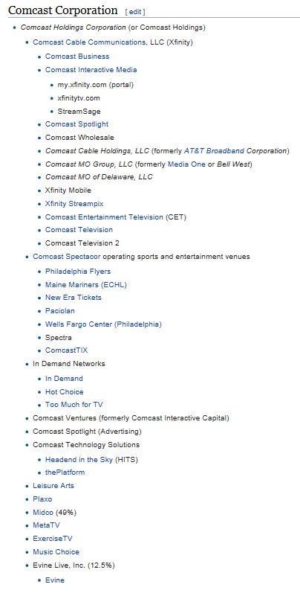
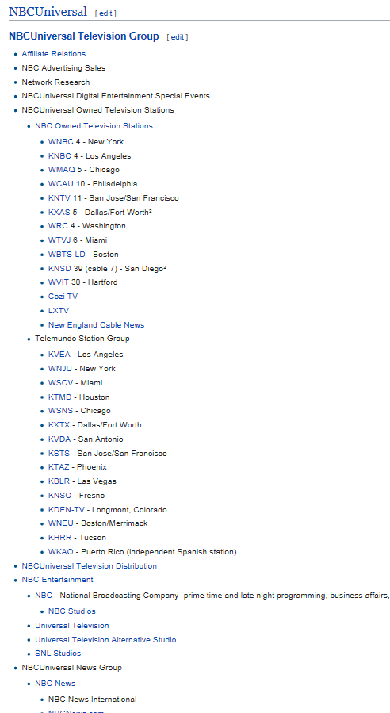
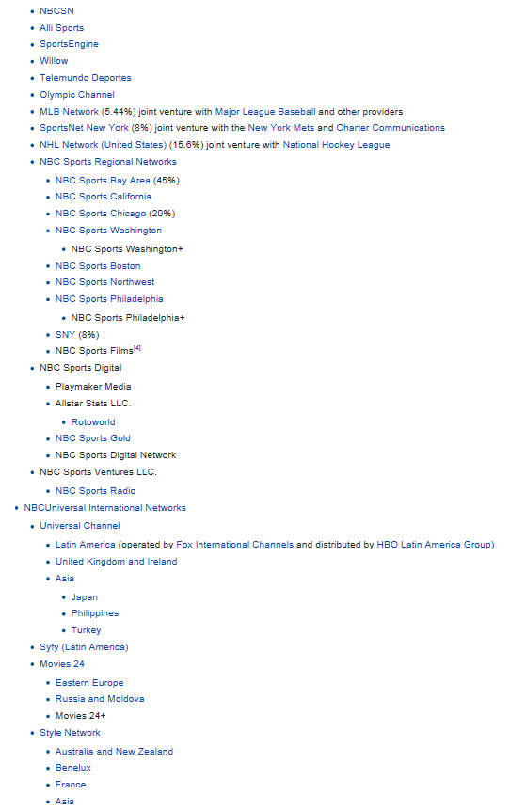

Slide 12
Film Industry
Production
securing finance
planning, shooting and editing the film
Distribution
The process of launching a film into the marketplace .
Exhibition
Showing of the film within cinemas, festivals.
Getting it from camera to cinema

Slide 13
Production
Distribution
Exhibition
Studios produce their own films,
Then distributed the films to their own cinemas.
This cut out “the middle man,” maximising profits and crucially, ensured what ever films the Studios made, they could get them screened at a cinema and get the captive audience to pay to see them!
Vertical Integration: When a Media Company owns different businesses in the same chain of production, distribution and exhibition. For example, Warner Brothers (Owned by Time Warner) owns New Line Cinema which makes films, Warner Brothers Television Distribution and Warner Brothers International Cinemas. They own parts of chain so that they can make money from every part of it.
Now read the Comcast article on Vertical Integration

Slide 14
DISTRIBUTION
Acquiring a film (buying the rights)
When to release the film
Where to release the films
How many prints of a film to make
How much to spend on marketing and promotion
Create trailers and promotional material for a film
Create Publicity
Develop promotions with partner’s

Slide 15
Distributor's Role
Distribution involves acquiring a film and trying to make it reach the widest possible audience, by selling it to exhibitors (i.e. cinemas)
In order to break even at the box office a film must make about two and a half times its initial development and production costs
The distributor usually aims to make 20-25% of the film’s profits.

Slide 16
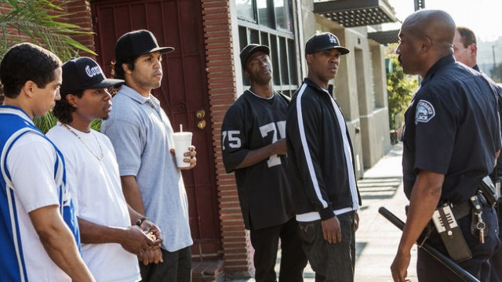
Trailer – audience appeal
Familiar conventions used include: duration, green band disclaimer/rating card, use of production logos/idents (possibly establishing status/reputation of film), use of intertitles, use of music, condensing the film to showcase dramatic scenes and establish narrative expectation including a three-act structure, links to social media/website. Also absence of conventions (no traditional trailer voice over, no specific release date).
Identification with protagonists in the trailer - audiences encouraged to align with hip hop artists as underdogs/disenfranchised minority, for example, the two specific instances where members of the gang are forcefully restrained by police.

Slide 17
AUDIENCE APPEAL - TRAILER
Rap and the sub–genre of gangsta rap have specific and well identified fan bases. Fans of the genre/N.W.A. for instance may be attracted to trailer scenes of the band being formed or the music being discussed and recorded but wider audiences may be more interested in scenes of social tension, cultural change or personal drama.
Star appeal (including in this case the appeal of the “real life” characters represented on screen and identified using intertitles). The names of actors and director are absent from the trailer and instead replaced with the real names of some of the members of N.W.A.
Film logo – explicit design reference to music parental advisory notice
(social conventions of rebellion, challenge to authority etc.).

Slide 18
Target AUDIENCE
Fans of N.W.A (older fans who lived through the period, younger fans attracted to the band for their cultural significance etc.)
Fans of rap/gangsta rap (predominantly American audience or world-wide appeal? Urban dwellers who share experiences with the artists? Middle class youths whose lives are vastly different to the perceived struggles of the artists?)
Fans of biopic films (open-minded, educated, older, global audience without a specific interest in N.W.A.?)
Fans of the film studios/producers (consider previous releases of Legendary/Universal)
The pre-sold Hip Hop fan base of the band N.W.A. (the appeal of ‘real-life’ story and the music itself) might serve to offset the economic risk of the film production. Similarly, the success of other hip hop biopics/music drama films Get Rich or Die Tryin’ (2005), Notorious (2009), 8 Mile (2002), might help to guarantee an audience for the film.

Slide 19
REGULATION
The MPAA rates films in America where Straight Outta Compton gained an ‘R’ rating (‘restricted’ - under 17s cannot attend without a parent). Consider global distribution - the film was rated differently in different countries (it was banned in Malaysia for example but gained an 11 rating in Sweden).
The BBFC (an independent, non-governmental body) age rates film and video releases in the UK. However, local councils have the power to overrule BBFC decisions and rate films differently (e.g. This is England was rated 18 by the BBFC but several councils rated it 15). The theatrical release of Straight Outta Compton gained a 15 certificate, although the Director’s Cut DVD was an 18.

Slide 20
Cultural/economic and political contexts –
DISCUSSION POINTS
Cultural Context:
N.W.A. were significant in terms of social change as advocates for free speech, producers of protest songs and as highly successful black men from disenfranchised American urban communities.
N.W.A. were also heavily criticised for their misogynistic lyrics and their promotion of a lifestyle that objectified and marginalised women.
Economic and Political Contexts:
Two members of the original band N.W.A. co-produced the film, so consider the possible significance of this in relation to funding and to the portrayal of historical events (could this be considered a sanitised attempt to “cash in” by band members?).

