Slide 1
BTEC Creative Media Unit 8 – Responding to a commission

Slide 2
What did we produce over the past few weeks?
Rationale
Pitch
Proposal
Treatment

Slide 3
1. Rationale

Slide 4
1. Rationale – primary research

Slide 5
1. Rationale - x2 secondary research

Slide 6
1. Rationale - Competitors within the same industry

Slide 7
1. Rationale - Understanding the client commission

Slide 8
1. Rationale - Ideas generation x3

Slide 9
1. Rationale - Selecting 1 idea, development and justification

Slide 10
2. Pitch

Slide 11
3. Proposal

Slide 12
3. Proposal

Slide 13
3. Proposal

Slide 14
3. Proposal
Be Aspirational
“Dream Big”

Slide 15
3. Proposal

Slide 16
4. Treatment
Storyboard and justification document –
15 storyboarded images, with 15 justification
paragraphs.

Slide 17
Approximate timings
Research – 10 hours independent, 2 Hours in class
Rationale – 1 hour
Pitch – 30mins to 1 hour
Proposal – 2 hours
Treatment – 2 to 3 hours
To be completed - Dec
To be completed under exam conditions - Jan

Slide 18
The plan for now up until Christmas break…

Slide 19
Unit 8 Prep
Wk. 1 12th – 15th Start Rationale and 3 pages of Notes
Wk. 2 (Jan) 3rd – 6th Finish Rationale and 3 pages of Notes
Wk. 3 (Jan 9th – 11th Finish Rationale and 3 pages of Notes

Slide 20
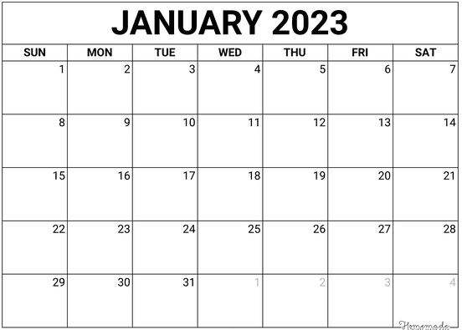
Unit 8
Save the date(s)…
January 12th you will be off timetable for your Unit 8 Media Assessment.
Notes:
Actual date TBC

