Slide 1
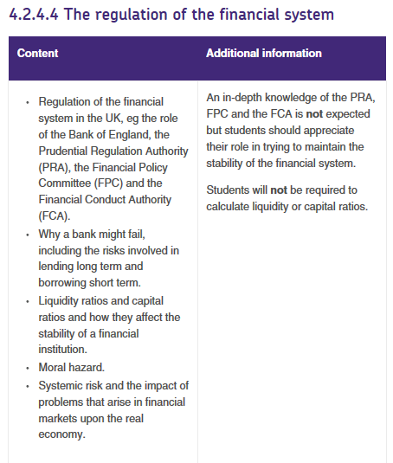

Slide 2
RWS 16: UK Monetary Policy
WEEK 1
PREP - Reading on quantitative easing
30: Who controls the money supply?
90: Regulation breakdown to combat financial crisis
WEEK 2
RWS
30: Quantitative Easing Debate?
90: 45: Role of the MPC Committee / 45: Effectiveness of Monetary Policy on the UK economy?

Slide 3
WEEK 09

Slide 4
45

Slide 5
RWS 16: Monetary Policy in the UK Starter Activity: Reviewing 1st Year Work
What are the similarities and differences between monetary and fiscal policy for a Government?
Explain how monetary policy (through use of interest rates) can be used to reduce the level of inflation in an economy? Use four bullet points only to show your clear chain of reasoning
Explain, using a diagram how monetary policy (via interest rates) can be used to achieve: High economic growth and low unemployment
Evaluate questions 2 and 3 above (in other words, why might they not achieve their aim and/or what conflicts might they create?)

Slide 6
RWS 16: Monetary Policy in the UK Introduction to this Revision Worksheet
Functions of the Central Bank
Monetary stability: Being sole issuer of UK currency and conducting monetary policy to ensure stable prices and confidence in the currency. Many countries have an inflation target – often set by the Government for a central bank to achieve. E.g. the UK Government sets the Bank of England an inflation target of 2%. Their aim is to keep the annual rate of consumer prices inflation (CPI) within 1% of the target. This has proved difficult in recent years with UK CPI inflation averaging over 3% since the start of recession in 2008. Inflation returned to the 2% target in December 2013 for the first time in 60 months!
Financial stability: This means overseeing the financial system so that there is an efficient flow of savings and loans and confidence in financial intermediaries such as banks. Depositors need to know for example that their savings are safe and that banks and other lenders are acting responsibly. Bank of England’s role is to minimise ‘systematic risk’ otherwise when when financial stability breaks down there are damaging economic and social consequences.
1. Monetary policy function
A) Setting of the main monetary policy interest rate
B) Quantitative easing
C) Exchange rate intervention (managed/fixed currency systems)
D) Forward Guidance
2. Financial stability & regulatory function
A) Supervision of the wider financial system
B) Prudential policies designed to maintain financial stability
C) Lender of last resort to the banking system
D) Managing liquidity in the commercial banking system

Slide 7
Bank of England
QUESTIONS YOU SHOULD KNOW!
Why is the Bank of England different from HSBC or Barclays?
What is the role of the MPC in the Bank of England?
What two roles does the Bank of England have today?
How does the Bank of England change the interest rate?
HISTORY OF BANK OF ENGLAND
1694: Bank of England formed to act as Government banker and debt-manager
1844: Gold Standard introduced and Bank became ‘Lender of Last Resort’ to commercial banks. Also given monopoly on note issue.
1997-today: Bank of England Independence
2012: Financial Services Act gave monitoring of financial markets to the Bank

Slide 8
90

Slide 9
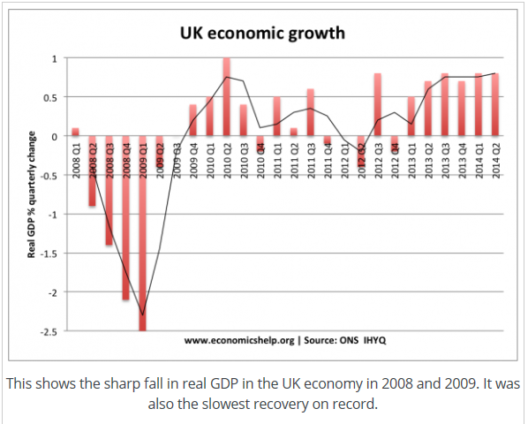
RWS16: Monetary Policy Financial Stability
Black-Scholes Equation 1971
What caused the financial crash
1971 Loss of the Gold Standard (leading to growth of dollars and ‘fiat money’)
1973 Invention of the ‘Black-Scholes’ Equation (hedging risk using options!)
1986 Big Bang in the UK! Deregulation of the financial markets.
1989 Fall of the Berlin Wall (Capitalism’s ‘check’ destroyed) and growth of Globalisation begins
1997 JP Morgan’s ‘away weekend’ and the invention of CDO’s (Collateral Debt Obligations OR for some = Financial Weapons of Mass Destruction!!)
2000 Start of period of relatively low interest rates (encouraging ‘credit money’)
2007 CDO’s in Mortgage backed securities are assets on banks balance sheets and they are ‘hedged’ through CDS’s (credit default swaps) via insurance brokers like AIG. So if they fail, then AIG pay out insurance compensation to these banks. ‘Win Win’? Unless the majority of the CDO’s are worth nothing (due to a failure of the housing market in the USA) and then we have a crisis! Insolvent and illiquid banks and a ‘credit crunch’!
Why are the financial markets prone to the financial crisis? (TASK: Write notes on each one, explaining the term and why this makes the financial markets prone to failure? HINT: You should be thinking of talking about balance sheets of banks with some of these answers)
Over-leveraged?
Insolvency?
Lack of liquidity?
‘Too big to fail’? (Systemic risk) [VIDEO - 5 Minutes and the Wobbly Bridge]
The Great Recession 2008-2013
Notes:
Financial Crash https://www.youtube.com/w
Webinar Financial Markets Regulation https://www.youtube.com/watch?v=GGS-XZZKJT8atch?v=KX2RMSTWjOI

Slide 10
RWS16: Monetary Policy Financial Stability - Gordon Brown’s Legacy
VIDEO - Introduction
What was the response to the financial crisis of 2008?
UK: Immediate response - Bank bailouts, cuts in interest rates, adoption of QE, expansionary fiscal policy. Longer response - Financial Services Act 2013
US: Delayed response - Let Lehman Brothers go bust but THEN bailout of AIG, cuts in interest rates and adoption of QE and expansionary fiscal policy
Types of market failure in the financial markets
Negative externalities (and systemic risk?)
Asymmetric information (valuing assets?)
Moral hazard (excessive risk taking?)

Slide 11
RWS16: Monetary Policy Financial Stability - UK response to the Financial Crash
Bank rescues. Firstly, governments felt obliged to intervene in the banking sector to avoid banks and financial institutions going bust. However, there was some reluctance to bailout those who were blamed for causing the crisis. In 2008, the US decided to allow Lehman Brothers to go bust. This caused a major loss of confidence. After the panic this created, governments realised they couldn’t allow a repeat of this experience. In the UK, the government intervened to bailout out major banks, such as Northern Rock, RBS and Lloyds TSB. The UK National Debt rose from 42% of GDP to 86% of GDP.
Cuts in interest rates. Towards the latter half of 2008 and early 2009, Central Banks cut interest rates to record low levels. The UK cut base rates from 5% to 0.5%. Usually, a major cut in interest rates would make borrowing cheaper and encourage consumption and investment. (e.g. in 1992, when the UK cut interest rates, the economy recovered fairly quickly.) However, cuts in interest rates were less effective in this period.
Quantitative easing. The UK launched QE for the first time in its history by buying up illiquid assets from banks to create cash reserves on their balance sheets which could be used for lending.
Expansionary fiscal policy. The deep recession saw a sharp rise in budget deficits because government tax revenues evaporated. This was particularly noticeable for countries who relied on stamp duty and tax from the finance sector. However, in the UK and US, there was a moderate degree of fiscal expansion. The UK introduced a temporary cut in VAT. In the US, there was also a moderate fiscal stimulus.
It is worth noting that in comparison to the great depression of the 1930s, two things were avoided in the great recession.
1.Large number of banks going bankrupt was avoided (In the 1930s, in the US over 500 commercial banks went bankrupt)
2.There was no major trade war. In the 1930s, a tariff war developed as countries tried to protect domestic industries.

Slide 12
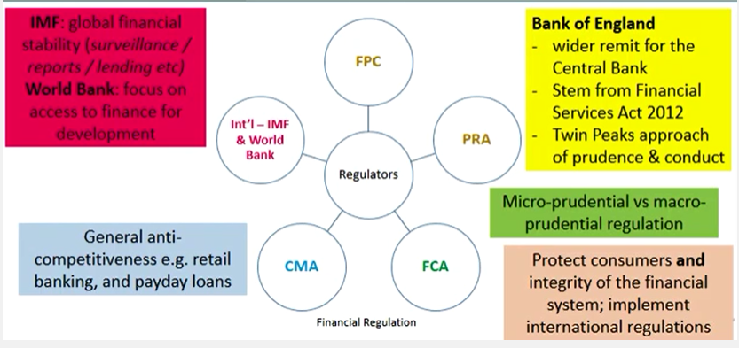
RWS 16: Monetary Policy in the UK Regulation in the Financial Markets
Notes:
https://www.youtube.com/watch?v=GGS-XZZKJT8
WEEK 1
PREP - Reading on quantitative easing
30: Who controls the money supply?
90: Regulation breakdown to combat financial crisis
WEEK 2
RWS
30: Quantitative Easing Debate?
90: 45: Role of the MPC Committee / 45: Effectiveness of Monetary Policy on the UK economy

Slide 13
RWS 16: Monetary Policy in the UK Financial Stability Summary
To what extent has monetary policy through financial stability been successful in the UK 2000-2017?
Successful:
Pre 2008, arguably a global crisis which originated in US
Post 2008, regulatory reforms and bail out of banks
Not Successful:
Pre 2008 = led to worse financial crash since 1930’s
Post 2008 = bailing out of banks led to moral hazard (has anything changed) and national debt problems leading to austerity and delayed recovery.
Notes:
https://www.youtube.com/watch?v=GGS-XZZKJT8
WEEK 1
PREP - Reading on quantitative easing
30: Who controls the money supply?
90: Regulation breakdown to combat financial crisis
WEEK 2
RWS
30: Quantitative Easing Debate?
90: 45: Role of the MPC Committee / 45: Effectiveness of Monetary Policy on the UK economy

Slide 14
WEEK 10

Slide 15
60

Slide 16
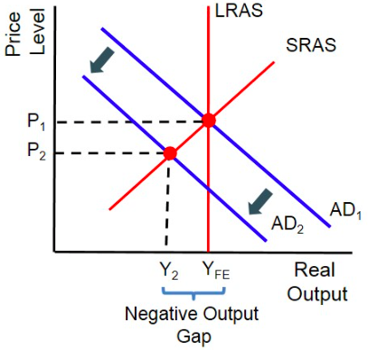
RWS 16: Monetary Policy in the UK Starter Activity: Reviewing 1st Year Work
In November 2017, the MPC raised interest rates by 0.25% to 0.5%. Using an AD/AS Diagram, explain (just through bullet points) what might happen to macroeconomic variables in the economy as a result
Evaluate your analysis above – why might the effect not have happened?
Why did the Bank of England raise interest rates?
Apart from interest rates, what other tools do the Bank of England have?

Slide 17
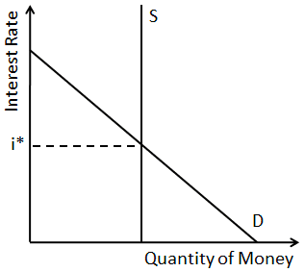
RWS 16: Monetary Policy in the UK What does Monetary Stability involve?
Tools available to the Bank of England
Demand for Money
Interest rates
Exchange Rate manipulation (buying and selling of currency on the FOREX markets)
Forward guidance
Supply of Money
Money supply (through quantitative easing)
Funding for lending
There are two types of Monetary Policy instruments
Those that affect the demand for money (e.g interest rates)
Those that affect the Money Supply ( Reserve asset ratio’s/Quantitative/ Qualitative controls
Why does the demand for money curve slope downwards from left to right?
Money can be used to buy financial assets such as bonds, which yield interest. The higher the rate of interest, the higher the higher the opportunity cost of holding money.
Why is the money supply curve vertical? It is usual to draw the money supply as vertical, as we assume that a central bank such as the Bank of England can control the supply of money in the economy.
Movements along and Shifts in the demand curve. Interest rates will move a point along the demand curve whereas prices and real GDP will increasing may shift the demand of money to the right. Equally a recession or falling prices would shift the demand curve to the left.

Slide 18
RWS 16: Monetary Policy in the UK Transmission Mechanism
Monetary Policy Transmission Mechanism (including interest rates and exchange rates)
Exchange rate fluctuations on AD and macro objectives
External demand
Notes:
WEEK 1
PREP - Reading on quantitative easing
30: Who controls the money supply?
90: Regulation breakdown to combat financial crisis
WEEK 2
RWS
30: Quantitative Easing Debate?
90: 45: Role of the MPC Committee / 45: Effectiveness of Monetary Policy on the UK economy

Slide 19
RWS 16: Monetary Policy in the UK The Transmission Mechanism
Effect of a change in the BoE base rate – increase in interest rate will reduce aggregate demand (shifts to the left) | Evaluate reasons why the interest rate change may not have the desired effect.
Market rate: An increase in the BoE rate means that lenders will increase their interest rates. Thereby dampening consumer spending and spending by firms on investment as it costs more to borrow and it is more attractive to save. | If confidence is already high, then consumers and firms might ignore any interest hikes. Or interest rates could already be very low and therefore an increase of 0.25% is not going to have a large effect?
Asset prices (wealth effect): An increase in interest rates means that mortgages become more expensive and the demand for houses falls. Resulting in falling house prices. Consumers feel less wealthy and readjust their spending downward. | Some mortgage owners might be on fixed rates and not variable rates and therefore the interest rate would have zero effect. Therefore there is often a time lag. Also not everyone owns property with some renting therefore the wealth effect would not have a big impact.
Business confidence: Interest rate rises could signify an overheating economy which harms business confidence and might lead to them cancelling investment decisions etc. | Other factors effect business confidence such as the state of the global economy etc.
Exchange rates: As interest rates increases the inflow of ‘hot money’ into the UK. This increases the demand for money and causes the exchange rate to rise. Import prices reduce cheaper and exports more expensive and so the trade deficit will get bigger. | Exports may not fall immediately because export sales might be on contracts.
Notes:
WEEK 1
PREP - Reading on quantitative easing
30: Who controls the money supply?
90: Regulation breakdown to combat financial crisis
WEEK 2
RWS
30: Quantitative Easing Debate?
90: 45: Role of the MPC Committee / 45: Effectiveness of Monetary Policy on the UK economy

Slide 20
RWS 16: Monetary Policy in the UK The Transmission Mechanism
Effect of a change in the BoE base rate – increase in interest rate will reduce aggregate demand (shifts to the left) | Evaluate reasons why the interest rate change may not have the desired effect.
Market rate: An increase in the BoE rate means that lenders will increase their interest rates. Thereby dampening consumer spending and spending by firms on investment as it costs more to borrow and it is more attractive to save. | If confidence is already high, then consumers and firms might ignore any interest hikes. Or interest rates could already be very low and therefore an increase of 0.25% is not going to have a large effect?
Asset prices (wealth effect): An increase in interest rates means that mortgages become more expensive and the demand for houses falls. Resulting in falling house prices. Consumers feel less wealthy and readjust their spending downward. | Some mortgage owners might be on fixed rates and not variable rates and therefore the interest rate would have zero effect. Therefore there is often a time lag. Also not everyone owns property with some renting therefore the wealth effect would not have a big impact.
Business confidence: Interest rate rises could signify an overheating economy which harms business confidence and might lead to them cancelling investment decisions etc. | Other factors effect business confidence such as the state of the global economy etc.
Exchange rates: As interest rates increases the inflow of ‘hot money’ into the UK. This increases the demand for money and causes the exchange rate to rise. Import prices reduce cheaper and exports more expensive and so the trade deficit will get bigger. | Exports may not fall immediately because export sales might be on contracts.
Notes:
WEEK 1
PREP - Reading on quantitative easing
30: Who controls the money supply?
90: Regulation breakdown to combat financial crisis
WEEK 2
RWS
30: Quantitative Easing Debate?
90: 45: Role of the MPC Committee / 45: Effectiveness of Monetary Policy on the UK economy

Slide 21
RWS 16: Monetary Policy in the UK The Transmission Mechanism
Effect of a change in the BoE base rate – lowering interest rates (shifting the AD curve to the right) | Evaluate reasons why the interest rate change may not have the desired effect.
Market rate:
Asset prices (wealth effect):
Business confidence:
Exchange rates:
Notes:
WEEK 1
PREP - Reading on quantitative easing
30: Who controls the money supply?
90: Regulation breakdown to combat financial crisis
WEEK 2
RWS
30: Quantitative Easing Debate?
90: 45: Role of the MPC Committee / 45: Effectiveness of Monetary Policy on the UK economy

Slide 22
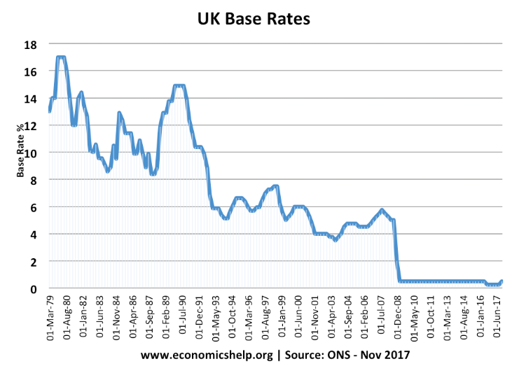
RWS 16: Monetary Policy in the UK The Transmission Mechanism and Post 2008 Crisis
Interest rates slashed and kept low but banks still not lending? Why not?
Therefore Bank of England tried three other instruments to encourage AD in the economy: QE, Funding for Lending and Forward Guidance
Notes:
WEEK 1
PREP - Reading on quantitative easing
30: Who controls the money supply?
90: Regulation breakdown to combat financial crisis
WEEK 2
RWS
30: Quantitative Easing Debate?
90: 45: Role of the MPC Committee / 45: Effectiveness of Monetary Policy on the UK economy

Slide 23
RWS 16: Monetary Policy in the UK Introduction to Quantitative Easing
Effects of QE?
Pushes up price of government bonds (which means the yield of bonds falls and makes borrowing costs lower): Encourages lending
Creates extra cash (“credit money”) into the economy
TASK: Using a diagram (supply and demand for money), explain how quantitative easing reduces interest rates throughout the economy and so therefore acts as a boost to the economy.
Notes:
WEEK 1
PREP - Reading on quantitative easing
30: Who controls the money supply?
90: Regulation breakdown to combat financial crisis
WEEK 2
RWS
30: Quantitative Easing Debate?
90: 45: Role of the MPC Committee / 45: Effectiveness of Monetary Policy on the UK economy

Slide 25
http://www.bankofengland.co.uk/monetarypolicy/pages/qe/default.aspx
RWS 16: Monetary Policy in the UK Quantitative Easing Debate
RECOVERY –
GROWTH - UK economy hit good growth post 2013.
JOBS - Unemployment falling in the UK since 2010. Also falling in the US. At lowest levels since 1970’s
CONFIDENCE – Especially given Austerity, QE important to give firms and households hope that measures being taken to get out of the ‘Great Recession’
EXPORT BOOST – devaluation of currency might occur as investors sell pounds in anticipation of higher inflation.
GOVERNMENT BORROWING – cheaper as bond prices increase and yields fall.
INCREASED LENDING
Cost of borrowing falling as BofE buys up bonds and drives up the price of assets whilst yields (rates of borrowing) fall.
Government’s also face lower borrowing costs
BEATS LIQUIDITY TRAP
RECOVERY? –
‘MAC JOBS’ - New jobs created are part-time? Is the recovery delayed and just part of the natural economic cycle?
INEQUALITY – only benefitting wealthy individuals who own shares and bonds?
EXPORT BOOST? – Export growth has been very slow in the UK and the exchange rate has not fallen hugely and is in fact on the rise against other currencies (Euro and Dollar)
LACK OF LENDING: Complaints that small businesses and home buyers are unable to access loans
ZOMBIE BANKS – to ensure dodgy assets on the balance sheet match banks liabilities, many banks maybe officially insolvent. Therefore they are hoarding the extra cash to ensure their books balance
GOVERNMENT BOND FOCUS – criticisms that too much focus on buying Govt. bonds rather than corporate bonds which would have had a more direct impact for business and reduced the cost of borrowing
FAILED ELSEWHERE
Japan started in 2001 to combat deflationary spiral has not worked
US – similar issues to the UK
MORE DEBT – a system based upon banks lending even more money is not sensible in a debt riddled economy? Financial system is based upon debt and
LONGER TERM PROBLEMS
INFLATIONARY EXPECTTIONS– What happens when the extra cash generated starts circulating more quickly? Danger of sudden inflation in the longer term? Increases volatility
STOCKPILE OF BONDS – what does the central bank do with all these assets? A firesale would result in bond prices crashing and yields increasing- cost of borrowing would soar.
ASSET BUBBLES – danger that QE just leads to asset bubbles in the housing market etc.

Slide 26
Monetary Policy Summary Questions
Name one similarity and one difference between monetary and fiscal policy.
Explain how interest rates affect AD using the monetary transmission mechanism
Provide two evaluation points as to why the transmission mechanism might not work as expected?
Explain how QE was supposed to reverse the problems of the credit crunch?
Name two criticisms of QE

Slide 27
90

Slide 28
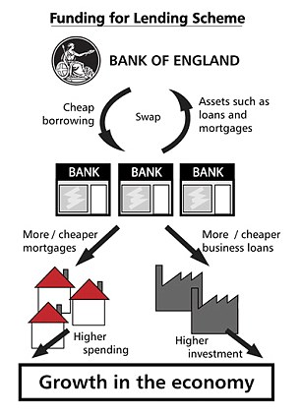
RWS 16: Monetary Policy in the UK Funding for Lending
TASK: Read the article and answer the following Q’s:
Summarise F4L in a maximum of three sentences.
Give two criticisms of F4L
What is a similarity and difference between F4L and QE?
Notes:
WEEK 1
PREP - Reading on quantitative easing
30: Who controls the money supply?
90: Regulation breakdown to combat financial crisis
WEEK 2
RWS
30: Quantitative Easing Debate?
90: 45: Role of the MPC Committee / 45: Effectiveness of Monetary Policy on the UK economy

Slide 29
RWS 16: Monetary Policy in the UK Forward Guidance
What is the Bank of England’s new monetary strategy? (Read the extract below)
Governor Mark Carney defended the Bank of England's radical new forward guidance policy today, insisting it has “reinforced the recovery”. Mr Carney told MPs the new strategy of linking interest rate rises to unemployment has given households and businesses greater "certainty and clarity". And he told the Treasury Select Committee the Bank remains "vigilant" over a house price bubble, as prices and demand are pumped up by Government stimulus schemes. It could recommend banks set limits on how much households can borrow, he said. The Bank revealed a new strategy of pinning rate rises to unemployment last month. It will not consider lifting rates from their record 0.5% low until unemployment has dropped to 7%, unless there are fears of a sharp spike in price rises. The Bank expects this to take around three years, but sterling and the cost of Government borrowing have risen sharply in recent weeks as markets expect the jobless total to fall more sharply.
What is forward guidance?
What are the aims of forward guidance?
http://www.bbc.co.uk/news/business-23145755
Notes:
WEEK 1
PREP - Reading on quantitative easing
30: Who controls the money supply?
90: Regulation breakdown to combat financial crisis
WEEK 2
RWS
30: Quantitative Easing Debate?
90: 45: Role of the MPC Committee / 45: Effectiveness of Monetary Policy on the UK economy

Slide 30
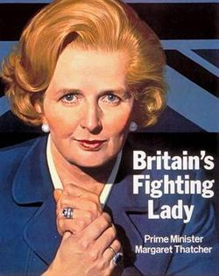
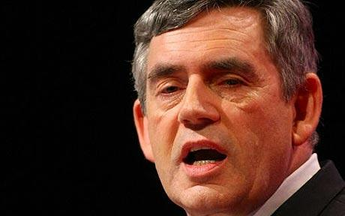
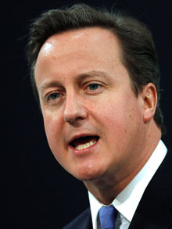
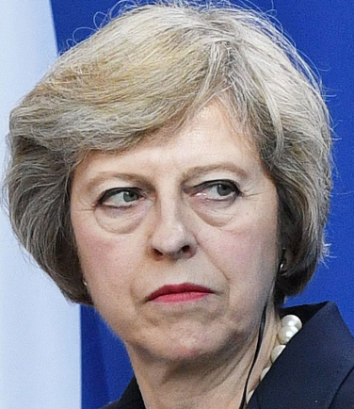
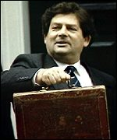
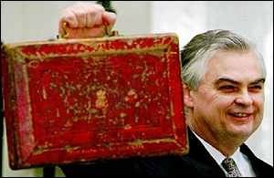
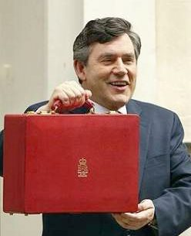
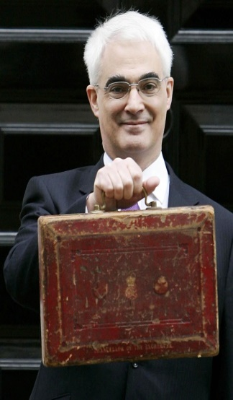
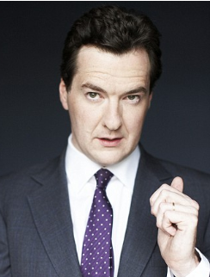
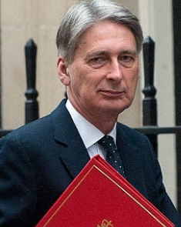
Monetary Policy in the UK 1979 - 2017
Funding for Lending
Independence of the BofE 1997
Forward Guidance
Interest Rates & Money Supply
Money Supply
Interest Rates & Money Supply
Money Supply
Exchange Rates
Interest Rates
1979-1986
1986-1990
1990-1992
1992-1997
1997- 2007
2007 -2010
2010-2016
2016-2017
Notes:
https://www.theguardian.com/business/2016/mar/05/timeline-seven-years-of-record-low-interest-rates-bank-of-england

Slide 31
RWS 16: Monetary Policy in the UK Effectiveness of Monetary Policy
Interest rates
There are always time lags between changes in rates and their impact on aggregate demand, output and prices
Some factors may dampen the impact of rate changes:
(1) Mortgage rates do not always follow base rate changes
(2) Many home-owners are on fixed rate mortgages
(3) People in rented property see no direct effects from changes
(4) Credit-card lenders may not change rates immediately
(5) If businesses are operating with spare capacity, a fall in rates will not necessarily lead to higher planned capital investment
(6) Many sources of funding for capital spending (e.g. loans and debentures) are at fixed rates of interest
Notes:
WEEK 1
PREP - Reading on quantitative easing
30: Who controls the money supply?
90: Regulation breakdown to combat financial crisis
WEEK 2
RWS
30: Quantitative Easing Debate?
90: 45: Role of the MPC Committee / 45: Effectiveness of Monetary Policy on the UK economy

Slide 32
Monetary Policy A useful tool for Government?
RESPONSIVE – Aggregate demand responds to changes in interest rates (interest rate elastic). Changes to interest rates tend to have instant effects on confidence within the economy
FLEXIBLE - it changes more frequently (monthly) than say fiscal policy. Also there are three policy levers – interest rates, money supply and exchange rates
INDEPENDENCE – Removed from Government influence leads to experts making the right decision for the economy and not reelection
GOLDILOCKS ECONOMY - Good way to control inflation. Death of inflation since 1990’s when interest rates and inflation targetting
POLICY CONFLICT – Controlling inflation leads to issue with unemployment, output and balance of payments
LEVERS ARE LIMITED
LIQUIDITY TRAP) – nominal interest rates cannot fall below 0% in reality and so there are limitations; see Japan and arguably UK and Eurozone currently?
MONEY SUPPLY - Problems with Quantitative Easing (banks unwilling to lend) and Money Supply. Issues with controlling money supply because it’s hard to define.
GEOPOLITICAL? Exchange rate manipulation can cause geopolitical issues as well.
LACK OF MICROECONOMICS: Microeconomic tools like fiscal policy.
ONE SIZE FITS ALL– Dual economy; a booming service sector .v. declining manufacturing leads to the need for different monetary policy. Equally, regional disparities (poor North .v. rich South).
TIME LAG – estimated to be 1 year on output and 2 years on price levels. Makes it very hard to use the policy and does this make it inflexible?
INDEPENDENCE? – How independent is the BofE? Governor still appointed by Government and still accountable to Govt.
FINANCIAL CRISIS and ASSET BUBBLE – Did the BofE keep interest rates to low in the lead up to the financial crisis? Led to asset bubble.

Slide 33
Question: why couldn’t the Bank of England accurately predict what the rate of inflation would be in 2015/2016 back in 2010?

Slide 34
THE END

Slide 35
To what extent has the independence of the Bank of England in 1997 been a success for the UK economy?
The Gains From Independence
Fall in long term interest rates - long term rates incorporate expectations of future inflation - Investors require a rate of interest that will take into account the expected rate of inflation. If this falls then the rate of interest required by investors also falls. A fall in long term interest rates reduces the cost of borrowing for companies, the government and also mortgage payers. Indeed by August 2001, mortgage rates were at their lowest levels for forty years.
Inflation has continued to surprise people - the rate of underlying inflation since early 1999 has persistently under-shot the mid range of the target level. In part this is due to the sustained strength of the sterling exchange rate, particularly against the Euro since it was launched as a traded currency in January 1999. The Bank of England has also been helped by a very benign global inflation environment. Consumer price inflation in the G7 and OECD countries has been falling over the last ten years.
The general perception is that the Monetary Policy Committee has worked in a harmonious manner (there have been few if any public disagreements between MPC members) and that their deliberations have been genuinely free from political influence. Many industrial lobby groups, trade unions and other organisations seek to influence the MPC in the immediate run up to MPC meetings through the broadcast and print media. And although the Bank might, on occasions be seen to have acted in part on the basis of special pleading - there is little substance to this as a criticism.
Inflation expectations have fallen in Britain. The Bank of England can claim some credit for this - if people believe that price inflation is under control, this is factored into their wage negotiations and helps to control wage inflation throughout the labour market.
CONCERNS ABOUT AN INDEPENDENT BANK
Monetary "fine-tuning" is an inexact science. Giving the Bank a degree of independence is no guarantee of macro-economic stability in the long run. A recent study from the National Institute of Economic and Social Research (NIESR) claimed that had the Bank kept interest rates at 6% during the first two and a half years of its life as an independent bank, the final outcome in terms of output and inflation would been broadly similar from the actual out-turn.
MPC may react too easily to short-term economic indicators - it should engage in more research about long-term economic trends (and structural changes in the economy) to aid its decision-making
If the BOE is too pessimistic about inflation risks in the economy - higher interest rates can impart a deflationary bias in the economy and risk an economic recession and higher unemployment
Overly aggressive cutting of interest rates might also be de-stabilising for the UK economy in the medium term
The Bank cannot determine inflation - only influence it in the medium term (the time lags involved are uncertain)
The Monetary Policy Committee has insufficient expertise in the areas of industry and the labour market. It is dominated by Bank "insiders" and academics with inadequate real-world experience
Is it REALLY independent - Chancellor still has right to grant the Governor; how democratic is letter writing?!

Slide 36
The MPC meets every month to set the interest rate. Throughout the month, the MPC receives extensive briefing on the economy from Bank of England staff. This includes a half-day meeting – known as the pre-MPC meeting – which usually takes place the week before the MPC's interest rate setting meeting. The nine members of the Committee are made aware of all the latest data on the economy and hear explanations of recent trends and analysis of relevant issues. The Committee is also told about business conditions around the UK from the Bank's Agents. The Agents' role is to talk directly to business to gain intelligence and insight into current and future economic developments and prospects.
Activity
You are all members of the monetary policy committee (MPC). What information (be as specific as possible) will you need to have in order to make an informed decision about future monetary policy
Demand Side Factors | Supply Side Factors
International Factors
With your partner decide which 3 factors above do you think are the most important for the bank of England. Be prepared to explain your answer.

Slide 37
Quantitative Easing History
US (total: $3.7-$4.5 trillion)
QE1 – 2008: $1.7 trillion over 14 months to buy up CDO’s
QE2 – 2010: $600 billion to buy up Govt Bonds
QE3 – 2012-2014: $85 billion per month to buy up Bonds and CDO’s
UK (£375 billion)
2009 - £200 billion
Oct 2011 - £75 billion
Feb 2012 - £50 billion
July 2012 - £50 billion

