Slide 1
MICROECONOMICS
Theory of the Firm (RWS 13-16): Impact of firms on society

Slide 2
Theory of production: cost, revenue and profit diagram (and analysis)
Market conditions
Examples
Market conditions
Perfect Competition Model
Pure Monopoly Model
Theory of production: cost, revenue and profit diagram (and analysis)
Evaluation: efficiency and welfare
Examples
Evaluation: efficiency and welfare
MICROECONOMICS
THEORY OF THE FIRM: (RWS 13-16) – Impact of Firms on Society
Nationalisation and Privatisation
Oligopoly model
Competition and Industrial Policy
Other Models
Instruments: Price Caps, Fining, Windfall Taxes and Monopoly busting!
Theory of Contestability
Monopolistic Competition Model
Regulation
Competition Policy
History of regulation in the energy and grocery markets
Types of regulation in the UK today

Slide 3
Past Paper Questions – MICROECONOMICS Theory of the Firm (13-16): Impact of Firms on Society
15 Marker Questions
Explain the main sources of monopoly power
Explain what is meant by ‘economies of scale’ and analyse how two types of economy of scale could affect the grocery market
Explain what is meant by ‘concentrated markets’ and analyse two possible consequences of energy being supplied through concentrated markets
Explain the term ‘price taker’ and analyse the likely effects of an increase in the world demand for a firm in such an industry on their output and profits
Explain the term ‘Barriers to entry’ and analyse two ways in which technological change can affect entry into a particular industry
Explain the market conditions that enable firms to charge different customers different prices for a product.
Explain why a perfectly competitive firm might be regarded as statically efficient while a monopoly might be regarded as dynamically efficient.
Explain how a firm can experience diminishing returns in the short run and economies of scale in the long run
Explain why some firms might be able to continue to make supernormal profits in the long run
Explain what ‘competition policy’ is in terms of the UK?
Explain why nationalisation is an unpopular policy for especially right-wing economists.
25 Marker Questions
Evaluate the view that consumers are always better off and producers are always worse off if monopolies are broken up to encourage as much competition as possible.
Assess whether price discrimination is always undesirable (25 marks)
To what extent should Government’s intervene into markets to prevent monopoly power?
Evaluate the impact of competition policy in the UK
To what extent should competition policy be designed to achieve perfect competition in all markets?
Evaluate the importance of price caps in regulating firms in markets with monopoly power
Evaluate whether oligopolistic markets should face Government intervention?
Discuss whether technological developments, such as the internet, are making markets more competitive and making perfect competition theory more realistic?
Discuss whether large firms in the UK today are necessarily more efficient than small firms.
Evaluate whether profit maximisation is always the most important objective of firms.
Evaluate the view that mergers between two firms are beneficial for society

Slide 4
MACROECONOMICS
Monetary Policy and Financial Markets (RWS 16-17)

Slide 5
Money, Capital and FOREX markets
Government and Corporate Bonds
Types of banks
Balance sheets: how do banks make money?
Financial Markets Introduction
The Role of the Banks in the Economy
The conflicting objectives of Banks
Financial Instruments
The UK Banking Market
Market failure in the financial markets
Equity.v.Debt for Commercial Firms
MACROECONOMICS
MONETARY POLICY AND FINANCIAL MARKETS (RWS 15 and 16)
How do banks set interest rates?
Evaluating the Transmission Mechanism through interest rates
Regulation pre 2013
Monetary Policy Instruments
Monetary Stability
Financial Stability
Exchange rate manipulation
Evaluating effectiveness of monetary policy
‘Systemic Risk’ and Stress Tests
Regulation Post 2013
Monetary Policy History?
Evaluating Forward Guidance
Evaluating QE, F4L and T4F schemes

Slide 6
Past Paper Questions – MACROECONOMICS Monetary Policy and Financial Markets (RWS 15 and 16)
15 Marker Questions
Explain the monetary transmission mechanism
Explain how monetary policy can influence the macroeconomic objectives of the economy
Explain the role of the financial markets to the wider economy
Why are banks often blamed for the financial crisis of 2008?
Explain what is meant by a liquidity crisis in an economy
What is ‘quantitative easing’ and how is the UK version supposed to stimulate growth?
Explain how financial markets are regulated in the UK today
What is ‘systemic risk’ and why are financial markets prone to market failure?
What is ‘moral hazard’ and explain two other causes of market failure in the financial markets
Explain the conflict of objectives in banks between liquidity and security on one hand and profit on the other
What is a ‘bank’s balance’ sheet and why might a bank face a liquidity crisis?
25 Marker Questions
Evaluate the effectiveness of monetary policy in targeting inflation
To what extent are monetary instruments effective in achieving macroeconomic stability?
To what extent can the Bank of England be to blame for the financial crisis and its subsequent effects?
Assess whether quantitative easing is successful in ensuring the UK recovers from the financial crash of 2008
To what extent should the banking sector in the UK be regulated to minimise ‘systemic risk’?

Slide 7
WEEK 6
w/b 04th Decmeber

Slide 8
MON: 90

Slide 9
Benchmark 7 The Big Picture
Benchmark 7
MICROECONOMICS (RWS 13 to 16): Theory of the Firm
MACROECONOMICS (RWS 15 & 16): Financial Markets and Monetary Policy
1 Hour Exam: Tuesday 12th December 2017 at 1315
15 Marks (Micro or Macro)
25 Marks (Micro or Macro)
Homework = 6 hours of revision for MICRO and MACRO
Mind Map Drafts (1 Hour)
Past Paper Questions: Plans (3 Hours)
Past Paper Questions: Timed answers (2 Hours)
Draw a DRAFT mind map using A3 paper in 3’s (15 minutes – 7.5m Micro and Macro)
Using the handout of mind maps, start to write ‘DRAFT 2’ of the mind map

Slide 10
True or False?
10 MINS: Construct 5 Micro Questions and 5 Macro ‘true or false’ Questions for another team
5 MINS: You will then answer someone else quiz
5 MINS: Marking
5 MINS: Grounds for Appeal?
Winner? Who has the lowest score?

Slide 11
Key Terms Test
20 Minutes: Individual Test
15 Minutes: Feedback to Questions

Slide 12
TUE: 90

Slide 13
15 Marker Where do the marks come from?

Slide 14
15 Marker Where do the marks come from?
Olly translation
Definition with example(s)
Aim for 3 explanations or points (with diagrams if appropriate - maybe not for each…)
Each explanation could benefit from an example to illustrate your point and show ‘application’ skills if appropriate
Each explanation should have ‘logical chains of reasoning’
Do not evaluate UNLESS it tells you to explicitly (so no conclusion either)
Make sure you know your stuff! Accurate explanations and definitions!
Structure is - definitions, explanations…no need for introduction or conclusion like in an essay

Slide 15
15 Mark Questions: What am I thinking?
Explain what is meant by ‘economies of scale’ and analyse how economies of scale could effect the grocery market 15 Marks
Economies of scale definition (bottom of the LRAC) and explain a few sources (purchasing, technical, financial?), external and internal?
Greater abnormal profits – greater dynamic efficiency. Improvements in online shopping, organisation of shops etc.
Lower prices? Grocery market competitive with the big four – better for consumers (greater surplus). Price wars before Xmas in supermarkets.
Barrier to entry? Prevents competition from smaller companies? Recent Booker and Tesco deal?

Slide 16
15 Mark Questions: Your go….
2 Mins: Individually Plan
2 Mins: Peer Assess
3 Mins: Discussions in threes and agree on a group version
Explain what is meant by ‘concentrated markets’ and analyse possible consequences of energy being supplied through concentrated markets (15 Marks)
Concentrated markets (Several big firms dominating market – oligopoly) e.g. Grocery and Energy markets. Concentration is high between small amount of firms
Consequence 1: Price competition = Monopoly diagram and not profit maximising
Consequence 2: Price collusion = Monopoly diagram and profit maximisation
Consequence 3: Non-Price competition = Kinked demand curve

Slide 17
15 Mark MACRO: what am I thinking?
What is ‘moral hazard’ and explain two other causes of market failure in the financial markets (15 Marks)
‘Financial Markets’ definition (briefly)
Moral hazard (excessive risk taking encouraged because of CDS’s insurance and Government bail outs, over-leverage and taking out illiquid and risky assets)
Asymmetric information (lack of information about asset you are buying – e.g. housing debt derivatives for financial crash, means balance sheet for banks assets less than they think)
Negative externalities (spread of market failure due to systemic risk across whole financial sector and reliance of banks lending from each other)

Slide 18
15 Mark Questions: Your go….
2 Mins: Individually Plan
2 Mins: Peer Assess
3 Mins: Discussions in threes and agree on a group version
Explain the monetary transmission mechanism (15 Marks)
Monetary transmission mechanism (Bank of England setting interest rates triggering AD change – diagram?)
Market rates and confidence (incentives to borrow OR save)
Asset Prices (interest rates affect prices of assets = wealth effect)
Exchange Rates (hot money flows lead to changes in ER and therefore effects on trade balance and ‘external demand’ etc.)

Slide 19
THU: 90

Slide 20
Revision Worksheets Back (1st 5 Minutes)
INSTRUCTIONS TO COMPLETE BY 1050
Look at comments from revision worksheet and marks
Read through A3 sheet comments and last benchmark - what do you have to concentrate on in the benchmark for Tuesday (3 things you will be doing differently that you can share with the class)
TODAYS LESSON
Review revision worksheets and A3 sheets in prep for B7 on Tuesdasy
General essay guidance
Specific Macro Essay practice
Key terms test!?
MONDAYS LESSON
Review micro mind map
Specific Micro Essay practice
TUESDAY = Benchmark 7!!!!

Slide 21
TODAY: MACRO ESSAYS! Essays in General - take notes….
Evaluation needed! Throughout the essay and vitally in the conclusion at the end
Introduction (3 aspects)
Definitions (key definitions and areas?)
Context (historical, set the scene, show off to the examiner about how much current affairs you know!)
Route through essay (what are the main issues)
Conclusion (3 aspects)
Position
Supporting the position (why arguments for this position carry a lot of weight)
Defending position (why arguments for this position do NOT carry a lot of weight)
Main Body Structure
2-3 points each with supporting argument paragraph (s) and then evaluative argument paragraph (s)
Each argument paragraph should where possible have (structure)
Opening statement (for supporting, refer to question. For evaluative, use words like ‘however’ or ‘on the other hand’
Economic analysis (diagrams, step by step logical reasoning - economic theory),
Application (so examples to help explain - real life case studies or hypothetical examples?)
Link back to the question (use the wording in the question)

Slide 22
To what extent has monetary policy been effective to the UK Government? Version#1
It has been effective for the UK Government to control inflation and monetary stability
As: Transmission mechanism and record of the independent Bank of England! The Great Moderation etc.
Ae: Time lags of transmission mechanism and conflicts of policy (i.e. cost push causes of inflation are not helped by interest rates). Also is it too blunt an instrument? And how independent is the Bank of England really?
It has not been effective for the UK Government in terms of the lead up to the financial crash of 2008 and therefore has failed in terms of financial stability
As: Inflation targeting meant interest rates kept too low and regulation too lax
Ae: International issue and even if we had the hardest regulation, the financial crash might have of affected us
It has been effective for the UK Government in terms of responding to the financial crash of 2008 and therefore has succeeded in terms of financial stability
As: Lowering of interest rates, quantitative easing and other versions, forward guidance and financial regulations prevented deflationary spiral
Ae: Liquidity trap, QE meaning banks still not lending, forward guidance is not useful and financial regulations have not teeth (stress tests not stressful enough, banking lobby group very strong).

Slide 23
To what extent has monetary policy been effective to the UK Government? Version#2
It has been effective for the UK Government to control inflation via interest rates and maintain monetary stability
As: Transmission mechanism and record of the independent Bank of England! The Great Moderation etc.
Ae: Time lags of transmission mechanism and conflicts of policy (i.e. cost push causes of inflation are not helped by interest rates). Also is it too blunt an instrument? And how independent is the Bank of England really? Liquidity trap?
It has been effective for the UK Government to prevent deflation via the money supply and maintain monetary stability
As: Quantitative easing and other versions, forward guidance etc prevented deflationary spiral after financial crash of 2008
Ae: QE meaning banks still not lending, forward guidance is not useful and problems with funding 4 lending.
It has not been effective for the UK Government in terms of financial stability (regulation)
As: Inflation targeting meant interest rates kept too low and regulation too lax. Financial regulations have no teeth (stress tests not stressful enough, banking lobby group very strong) before and after the crash
Ae: Financial crash was an international issue and even if we had the hardest regulation, the financial crash might have of affected us. Also positive signs with regulation post 2013 - stress test (only RBS not meeting stress test requirements)

Slide 24
Evaluate the effectiveness of monetary policy instruments for the UK Government?
Interest Rates
As: Transmission mechanism and record of the independent Bank of England! The Great Moderation etc.
Ae: Time lags of transmission mechanism and conflicts of policy (i.e. cost push causes of inflation are not helped by interest rates; only helps demand pull). Also is it too blunt an instrument? And how independent is the Bank of England really?
Quantitative Easing (Money Supply)
As: Record of Bank of England to encourage lending and reduce interest rates in the long run (explain how it works)
Ae: Funding for lending and Terms of Funding schemes suggest Bank’s are not lending!
Manipulating Exchange Rates
As: Influence imports (SRAS) and also exports (AD) - so effective for cost push and demand pull inflation
Ae: Other factors affect the exchange rate mitigating the effects, J-curve analysis, can cost the BofE reserves…will not last forever (Black Wednesday and George Soros)

Slide 25
WEEK 7

Slide 26
90

Slide 27
STARTER ACTIVITY (Finish by 0855) Each of these points to the right are what you might make in an essay on this topic. I would like you to read through them and think of evaluation points for each of them.
CREATIVE DESTRUCTION: Free markets can take care of monopolies as they will not last because of ‘creative destruction’
As: Technology increases contestability and abnormal profits attract new firms
Ae:
NATURAL MONOPOLY: Pure Monopoly leads to efficiency
As: natural monopoly & economies of scale and dynamic efficiency
Ae:
PERFECT COMPETITION: Perfect Competition leads to efficiency and no deadweight loss
As: Static efficiency
Ae:
REALITY: Should we be worried about monopolies forming? Do monopolies really exist in reality; aren’t most industries Oligopolies?
As: No (competitive oligopolies - price and non-price
Ae:
GOVERNMENT: Competition Policy is effective at preventing monopoly (CMA and Utility Regulators of Privatised Utilities)
As: Government Intervention: Promotion of public interest, availability of regulator (price caps, fines, windfall taxes and forceable break up tools available to regulators) and deregulation opportunities
Ae:
GOVERNMENT: Industrial Policy is effective at dealing with established monopoly (mostly about nationalisation….why?)
As: Positives of nationalisation and privatisation
Ae:
TODAY’s LESSON
Microeconomic essay points and arguments
2 Types of Microeconomics Essay on this topic
Writing an A* paragraph (if time)
TUESDAY
Benchmark
THURSDAY
Introduction to RWS 17 and 18 and Xmas learning!

Slide 28
Planning MICRO ESSAYS: Possible Points and Arguments
CREATIVE DESTRUCTION: Free markets can take care of monopolies as they will not last because of ‘creative destruction’
As: Technology increases contestability and abnormal profits attract new firms
Ae:
NATURAL MONOPOLY: Pure Monopoly leads to efficiency
As: natural monopoly & economies of scale and dynamic efficiency
Ae:
PERFECT COMPETITION: Perfect Competition leads to efficiency and no deadweight loss
As: Static efficiency
Ae:
REALITY: Should we be worried about monopolies forming? Do monopolies really exist in reality; aren’t most industries Oligopolies?
As: No, not worried (competitive oligopolies - price and non-price)
Ae:
GOVERNMENT: Competition Policy is effective at preventing monopoly (CMA and Utility Regulators of Privatised Utilities)
As: Government Intervention: Promotion of public interest, availability of regulator (price caps, fines, windfall taxes and forceable break up tools available to regulators) and deregulation opportunities
Ae:
GOVERNMENT: Industrial Policy is effective at dealing with established monopoly (mostly about nationalisation….why?)
As: Positives of nationalisation
Ae:

Slide 29
Planning MICRO ESSAYS: Possible Points and Arguments
CREATIVE DESTRUCTION: Free markets can take care of monopolies as they will not last because of ‘creative destruction’
As: Technology increases contestability and abnormal profits attract new firms
Ae: Natural for monopolies to develop because of capitalist nature - dog eat dog! Structural unemployment, how long is the long run!)
NATURAL MONOPOLY: Pure Monopoly leads to efficiency
As: natural monopoly & economies of scale and dynamic efficiency
Ae: static inefficiency, deadweight loss and x-inefficiency (money to shareholders etc.)
PERFECT COMPETITION: Perfect Competition leads to efficiency and no deadweight loss
As: Static efficiency
Ae: Dynamic inefficiency
REALITY: Should we be worried about monopolies forming? Do monopolies really exist in reality; aren’t most industries Oligopolies?
As: No (competitive oligopolies - price and non-price
Ae: Yes (collusive oligopolies)
GOVERNMENT: Competition Policy is effective at preventing monopoly (CMA and Utility Regulators of Privatised Utilities)
As: Government Intervention: Promotion of public interest, availability of regulator (price caps, fines, windfall taxes and forceable break up tools available to regulators) and deregulation opportunities
Ae: Government failure: regulatory capture and too much deregulation leading to negative externalities
GOVERNMENT: Industrial Policy is effective at dealing with established monopoly (mostly about nationalisation….why?)
As: Positives of nationalisation
Ae: Negatives of nationalisation

Slide 30
MICRO ESSAYS – Theory of the Firm
TYPE 1: Do we need Competition Policy?
To what extent should Government’s have a competition policy?
To what extent is competition policy a useful way of controlling monopolies?
Evaluate the effectiveness of competition policy in the UK?
TYPE 2: What is the best method of intervention?
Assess how Government’s should deal with monopoly power?
“OFGEM have come into particular criticism in recent years”. Assess the methods that could be used by the UK Government to promote competition in the energy markets.
Evaluate the implementation of price caps to regulate an industry
ALTERNATIVE 1:
ALTERNATIVE 2:

Slide 31
MICRO ESSAYS – Theory of the Firm
TYPE 1: Do we need Competition Policy?
To what extent should Government’s have a competition policy?
YES: Monopolies are bad for society
YES: Competition Policy is effective: Pre-emptive (CMA)
YES: Competition Policy is effective: Established(Utility Regulators)
To what extent is competition policy a useful way of controlling monopolies?
Monopolies do not need controlling – Natural monopoly
Competition policy is useful? Price caps, fining etc.
Nationalisation is a better alternative?
Evaluate the effectiveness of competition policy in the UK?
Natural monopoly and creative destruction – no need for CP
CMA and Competition Policy: Grocery Markets and Fines
Regulation of privatised industries: Energy Markets and Price Caps
TYPE 2: What is the best method of intervention?
Assess how Government’s should deal with monopoly power?
No need for intervention: free markets prevent monopolies and/or monopoly not realistic
Competition Policy: CMA and Utility Regulators
Industrial Policy: Nationalisation?
“OFGEM have come into particular criticism in recent years”. Assess the methods that could be used by the UK Government to promote competition in the energy markets.
Price caps and Fining
Other alternatives
Nationalisation
Evaluate the implementation of price caps to regulate an industry
ALTERNATIVE 1:
Price caps are effective implementation
There are alternatives to price caps: windfall taxes, fines etc.
Do we need to regulate an industry?
ALTERNATIVE 2:
Price caps are effective implementation (Energy Markets)
Alternatives to price caps: fines (Grocery Markets)
Alternatives: windfall taxes

Slide 32
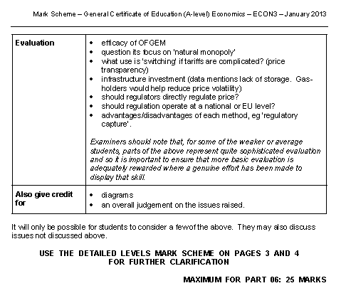

Slide 33
Writing an A* Point (2 Paragraphs)
1000-1200 WORDS (3-4 Sides of A4) in 35-40 MINUTES
(5 minutes planning on top of this remember )
INTRODUCTION = 100-150 Words
POINT 1 As = 150 Words
POINT 1 Ae = 150 Words
POINT 2 As = 150 Words
POINT 2 Ae = 150 Words
POINT 3 As = 150Words
POINT 3 Ae = 150 Words
CONCLUSION = 150 words
PARAGRAPH 1:
Point (Statement relating to question, using the wording!)
Application and Analysis
Link to Question
PARAGRAPH 2:
Point (Statement relating to paragraph above using wording like ‘however’, ‘on the other hand’ etc.)
Application and Analysis
Link to Question

Slide 34
Writing an A* Point (2 Paragraphs)
To what extent should Governments have a ‘Competition Policy’?
Government’s should have a competition policy because of the detrimental effects of firms with monopoly power. Monopoly firms are associated with static inefficiency. This means they

Slide 35
INTRODUCTION
To what extent should Governments have a ‘Competition Policy’?
Competition policy in the UK is designed to promote competition in the ‘public interest’. In the UK the CMA (Competition and Markets Authority) is the general regulator for all markets which has the license to monitor and investigate any market in the UK to prevent monopolies forming. There are also utility regulators (such as OFGEM) who are in place to monitor established monopolies or industries where natural monopolies are prone to form. One one hand, monopolies are a bad force in society, raising prices and restricting output however some industries need larger firms and the pursuit of too much competition loses the advantages of these firms. Secondly, if there is competition policy then how effective is it in reality? Are these regulators really doing a good job and therefore to what extent should they exist?
135 Words

Slide 36
INTRODUCTION
To what extent should Governments have a ‘Competition Policy’?
Government’s should have a ‘competition policy’ because of the negative effects of firms with monopoly power on society. Monopoly firms profit maximise (point A where MR=MC) which means they can restrict output in a market to raise prices and earn abnormal profit (hatched area on figure 1). This means that monopolies are not statically efficienty; they are both allocatively inefficient by withholding supply to the market (P>MC) and they are productively inefficient (not producing at the bottom of the AC curve).
However,
Also, pure monopoly firms are rare and most
135 Words

Slide 37
90

Slide 38
Benchmark!!

Slide 39
90

Slide 40
Introduction to RWS 17 and 18
MICRO
RWS 17: Wage Determination in the Labour Market
Labour Market in General
MRP Theory and Elasticity of Demand
Theory of Supply and Elasticity of Supply
Wage Equilibrium
RWS 18: Market Failure and Government Intervention in the Labour Market
Imperfect Competition (Trade Unions and Monopsony Employers)
Discrimination (Gender and other protected characteristics)
Inequality and Poverty
MACRO
RWS 17: Phillips Curve Analysis (Policy Conflicts)
Unemployment RECAP and the Causes (Keynesianism .v. Classical Debates)
Inflation RECAP, Neo-classical Quantity Theory of Money .v. Keynesian demand pull and cost push inflation
SRPC and LRPC Analysis
RWS 18: Fiscal and Supply Side Policies
Taxation - types and effectiveness (Canons) and Government Spending -
Structural, Cyclical Budget Deficit/Surpluses and the National Debt (was Austerity worth it?)
Concepts of Crowding Out and In
Solving the Productivity Puzzle - interventionist .v. Free market solutions

Slide 41
END

Slide 42
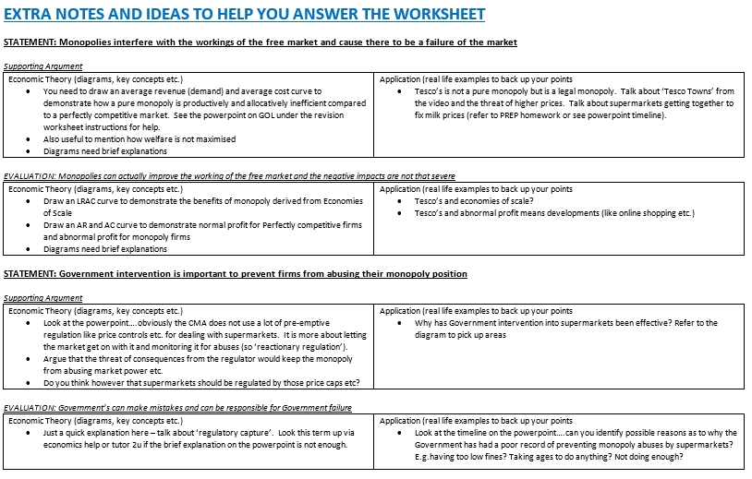

Slide 43
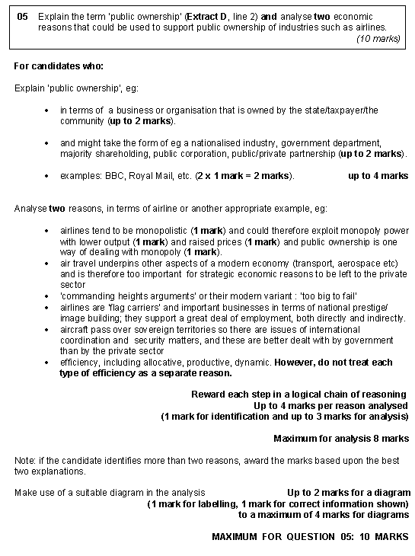

Slide 44
Essay Questions
GOVERNMENT INTERVENTION: What do you do with MONOPOLY?
Nationalisation
Privatisation and Regulation
Competition Policy
Deregulation
Increased Regulation
Greater powers for regulators
Price caps
Windfall taxes
Monopoly Busting
Can often be split into:
Market Success (i.e. markets will solve the problem of monopoly and anyway can’t monopoly be good in some circumstances?)
Market Failure (i.e. monopoly is bad and leads to inefficiency in the market)
Government Intervention (i.e. the Government needs to intervene in the market)
Government Failure (i.e. the Government might make things worse or not solve the problem)

