Slide 1

MechYr1 Chapter 10 ::
Forces and Motion
jfrost@tiffin.kingston.sch.uk
www.drfrostmaths.com
@DrFrostMaths
Last modified: 28th February 2018

Slide 2

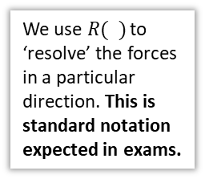




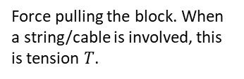






Force Diagrams and Common Forces
The reaction force of the plane on the block (i.e. resisting the block sinking into the plane)
We consider the forces acting on each object one at a time.
$$R$$
$$F$$
$$P$$
Force pulling the block. When a string/cable is involved, this is tension $T$.
Recall that we often model an object as a particle, i.e. a point with negligible dimensions.
Resistances to motion, in this case the friction between the block and the plane.
$$W$$
The weight of the block.
! Newton’s 1st Law of Motion states than an object at rest will stay at rest and that an object moving with constant velocity will remain at that velocity unless an unbalanced force acts on the object.
In other words, if the object is not accelerating, the forces are balanced in every direction, e.g. forces up = forces down and forces left = forces right.
We use $R( )$ to ‘resolve’ the forces in a particular direction. This is standard notation expected in exams.
! The ‘resultant force’ is the overall force acting on the object. An object will accelerate in the direction of the resultant force.
$$40 N$$
$$R\left(↑\right): 40−5=35 N$$
$$R\left(→\right): 30−30=0 N$$
$$30 N$$
$$30 N$$
$$35 N$$
Therefore a ‘resultant’ force of 35 N upwards and the object will accelerate upwards.
$$5 N$$

Slide 3













Quickfire Examples
$$5 N$$
$$R\left(↑\right):$$
$$3 N$$
$$P N$$
$$R\left(→\right):$$
$$5 N$$
$$4 N$$
$$R\left(↑\right):$$
$$7 N$$
$$2 N$$
$$R\left(→\right):$$
$$3 N$$
$$6 N$$

Slide 4



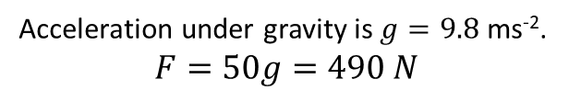

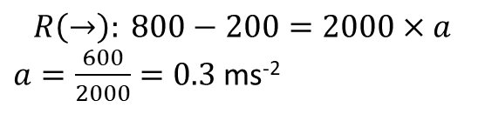
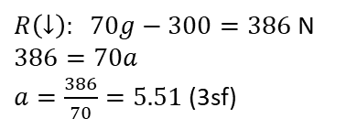




Forces and Acceleration
! Newton’s 2nd Law of Motion: $F=ma$
(where the force $F$ and acceleration $a$ are in the same direction)
This ‘feels’ right: if we doubled the force, we double the rate at which it accelerates. Similarly, if we have an object of twice the mass, we’d require twice the force to make it accelerate at the same rate.
A child has a mass of 50kg. What is the gravitational force acting on the child? (i.e. its weight)
A car of 2000kg has a driving force of 800N and forces of 200N resisting its motion. Determine its acceleration.
Acceleration under gravity is $g=9.8$ ms⁻².
$$F=50g=490 N$$
$$a$$
Preference: Use double arrow to indicate direction (and value if known) of acceleration.
$$200$$
2000kg
$$800$$
! Weight $W=mg$
Fro Preference: Put mass of particle inside circle/square.
A falling sheep of mass 70kg experiences air resistance of 300 N. Determine the sheep’s acceleration as it plummets towards the ground.
$$R\left(→\right): 800−200=2000×a$$
$a=\frac{600}{2000}=0.3$ms⁻²
$$300$$
$R\left(↓\right): 70g−300=386$ N
$$386=70a$$
$a=\frac{386}{70}=5.51$(3sf)
70kg
$$70g$$

Slide 5
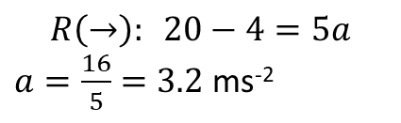




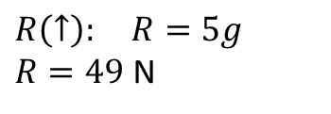

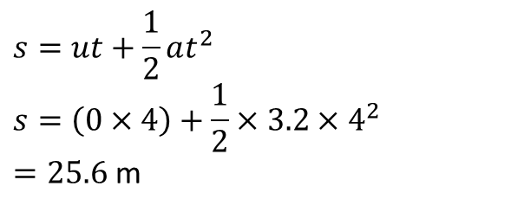
Combining $F=ma$ with $suvat$ equations
Since $F=ma$ involves both force and acceleration, it allows us to connect calculations involving forces with a calculations involving $suvat$ values.
[Textbook] A body of mass 5kg is pulled along a rough horizontal table by a horizontal force of magnitude 20N against a constant friction force of magnitude 4N. Given that the body is initially at rest, find:
the acceleration of the body
the distance travelled by the body in the first 4 seconds
the magnitude of the normal reaction between the body and the table
$$a$$
a
$$R\left(→\right): 20−4=5a$$
$a=\frac{16}{5}=3.2$ ms⁻²
$$R$$
$$4$$
5 kg
$$20$$
b
$$s=ut+\frac{1}{2}at^{2} \\ s=\left(0×4\right)+\frac{1}{2}×3.2×4^{2}$$
$=25.6$ m
$$5g$$
c
$$R\left(↑\right): R=5g$$
$R=49$ N
If the object is not accelerating in a particular direction, e.g. up-down, then forces up = forces down.

Slide 6
Exercise 10C
Pearson Stats/Mechanics Year 1
Pages 164-166

Slide 7
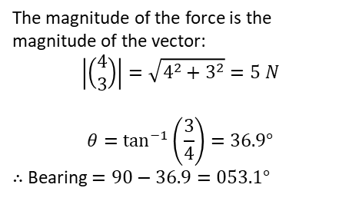
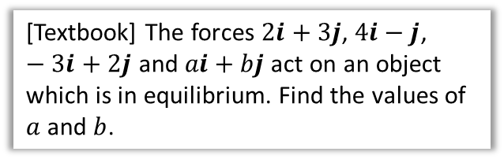

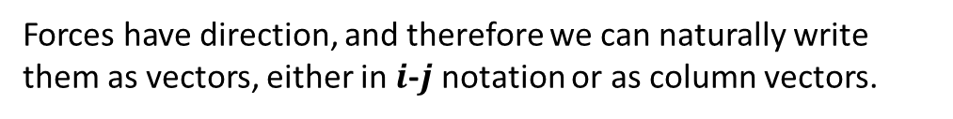

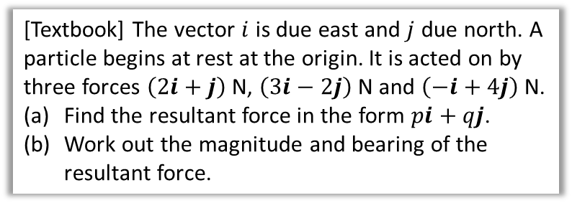
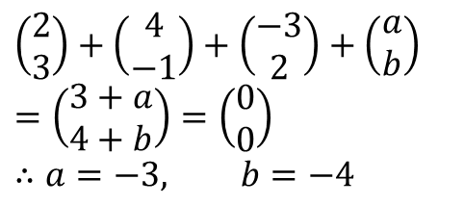
Forces as Vectors
Forces have direction, and therefore we can naturally write them as vectors, either in $i$-$j$ notation or as column vectors.
! You can find the resultant of two or more forces given as vectors by adding the vectors.
[Textbook] The forces $2i+3j$, $4i−j$, $−3i+2j$ and $ai+bj$ act on an object which is in equilibrium. Find the values of $a$ and $b$.
[Textbook] The vector $i$ is due east and $j$ due north. A particle begins at rest at the origin. It is acted on by three forces $\left(2i+j\right)$ N, $\left(3i−2j\right)$ N and $\left(−i+4j\right)$ N.
Find the resultant force in the form $pi+qj$.
Work out the magnitude and bearing of the resultant force.
$$\left(\begin{matrix}2 \\ 3\end{matrix}\right)+\left(\begin{matrix}4 \\ −1\end{matrix}\right)+\left(\begin{matrix}−3 \\ 2\end{matrix}\right)+\left(\begin{matrix}a \\ b\end{matrix}\right) \\ =\left(\begin{matrix}3+a \\ 4+b\end{matrix}\right)=\left(\begin{matrix}0 \\ 0\end{matrix}\right)$$
$$∴a=−3, b=−4$$
If in equilibrium, resultant force is 0.
a
$$\left(\begin{matrix}2 \\ 1\end{matrix}\right)+\left(\begin{matrix}3 \\ −2\end{matrix}\right)+\left(\begin{matrix}−1 \\ 4\end{matrix}\right)=\left(\begin{matrix}4 \\ 3\end{matrix}\right)=4i+3j$$
b
The magnitude of the force is the magnitude of the vector:
$$\left|\left(\begin{matrix}4 \\ 3\end{matrix}\right)\right|=\sqrt{4^{2}+3^{2}}=5 N$$
$$θ=\tan^{−1}\left(\frac{3}{4}\right)=36.9°$$
$∴$ Bearing $=90−36.9=053.1°$
3
$$θ$$
4

Slide 8
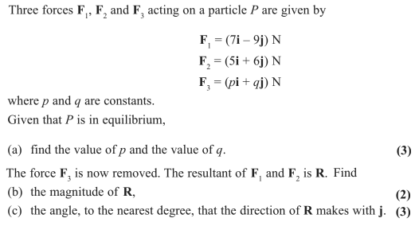
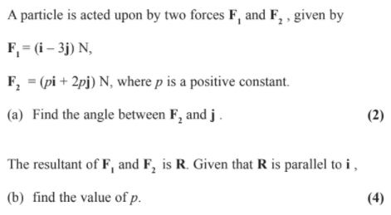

Test Your Understanding
Edexcel M1 Jan 2012 Q3
Edexcel M1 May 2009 Q2
Fro Tip: If a vector is parallel to say $\left(\begin{matrix}1 \\ 2\end{matrix}\right)$, then it could be any multiple of it, i.e. $\left(\begin{matrix}k \\ 2k\end{matrix}\right)$

Slide 9
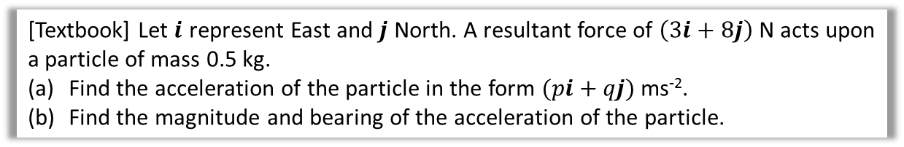

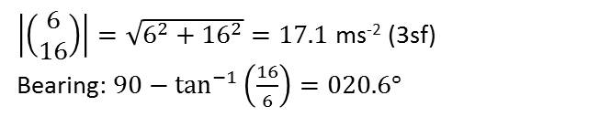
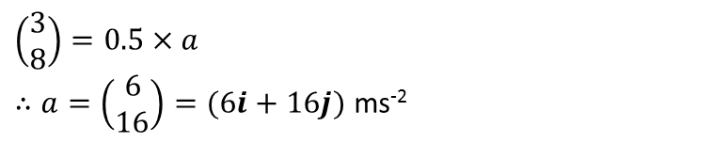
Motion in 2 dimensions
In Chapter 8 we saw that many physical quantities could have both direction and magnitude, and therefore could be represented as a vector:
Can be a vector: Force, acceleration, velocity, displacement
Scalar only: Mass, area, volume
This naturally means that $F=ma$ works with vectors too.
[Textbook] Let $i$ represent East and $j$ North. A resultant force of $\left(3i+8j\right)$ N acts upon a particle of mass 0.5 kg.
Find the acceleration of the particle in the form $(pi+qj)$ ms⁻².
Find the magnitude and bearing of the acceleration of the particle.
a
$$\left(\begin{matrix}3 \\ 8\end{matrix}\right)=0.5×a$$
$∴a=\left(\begin{matrix}6 \\ 16\end{matrix}\right)=(6i+16j)$ ms⁻²
b
$\left|\left(\begin{matrix}6 \\ 16\end{matrix}\right)\right|=\sqrt{6^{2}+{16}^{2}}=17.1$ ms⁻² (3sf)
Bearing: $90−\tan^{−1}\left(\frac{16}{6}\right)=020.6°$
16
$$θ$$
6

Slide 10
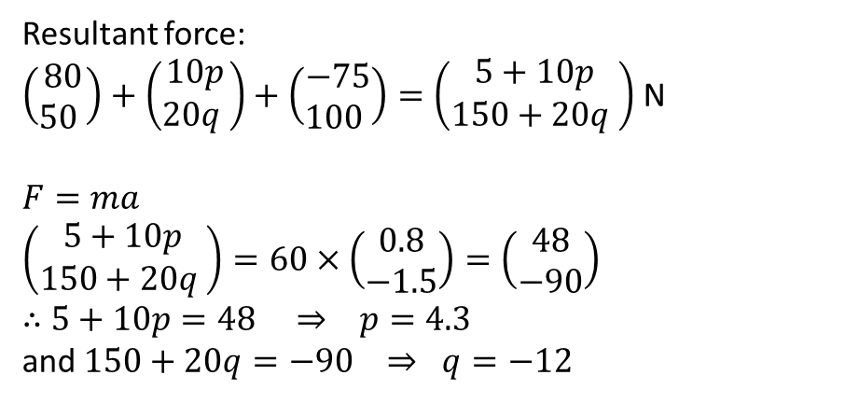
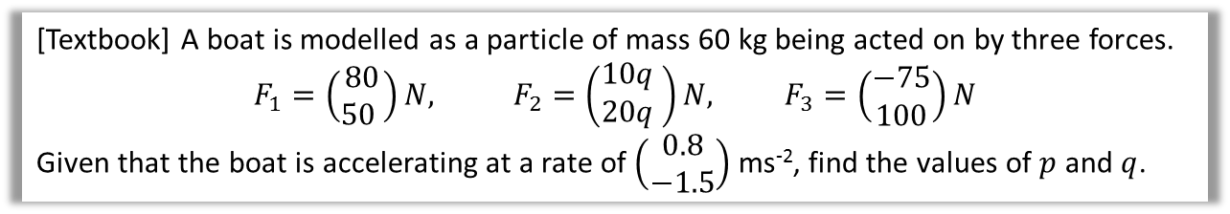
Test Your Understanding
[Textbook] A boat is modelled as a particle of mass 60 kg being acted on by three forces.
$$F_{1}=\left(\begin{matrix}80 \\ 50 \end{matrix}\right)N, F_{2}=\left(\begin{matrix}10q \\ 20q\end{matrix} \right)N, F_{3}=\left(\begin{matrix}−75 \\ 100\end{matrix}\right)N$$
Given that the boat is accelerating at a rate of $\left(\begin{matrix}0.8 \\ −1.5\end{matrix}\right)$ ms⁻², find the values of $p$ and $q$.
Resultant force:
$\left(\begin{matrix}80 \\ 50 \end{matrix}\right)+\left(\begin{matrix}10p \\ 20q \end{matrix}\right)+\left(\begin{matrix}−75 \\ 100 \end{matrix}\right)=\left(\begin{matrix}5+10p \\ 150+20q \end{matrix}\right)$ N
$F=ma$
$$\left(\begin{matrix}5+10p \\ 150+20q \end{matrix}\right)=60×\left(\begin{matrix}0.8 \\ −1.5\end{matrix}\right)=\left(\begin{matrix}48 \\ −90\end{matrix}\right)$$
$∴$ $5+10p=48 ⇒ p=4.3$
and $150+20q=−90 ⇒ q=−12$

Slide 11
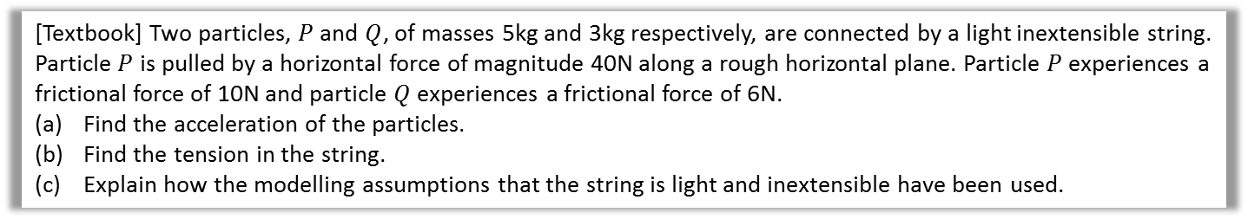
Connected Particles
Up to now we’ve only considered one particle at a time.
When we have multiple connected objects moving in the same direction, they can be considered as a single particle:
[Textbook] Two particles, $P$ and $Q$, of masses 5kg and 3kg respectively, are connected by a light inextensible string. Particle $P$ is pulled by a horizontal force of magnitude 40N along a rough horizontal plane. Particle $P$ experiences a frictional force of 10N and particle $Q$ experiences a frictional force of 6N.
Find the acceleration of the particles.
Find the tension in the string.
Explain how the modelling assumptions that the string is light and inextensible have been used.

Slide 12












$$a$$
$$R_{1}$$
$$R_{2}$$
$$Q$$
$$P$$
$$40 N$$
3kg
$$T$$
5kg
$$T$$
$$6 N$$
$$10 N$$
$$3g N$$
$$5g N$$

Slide 13





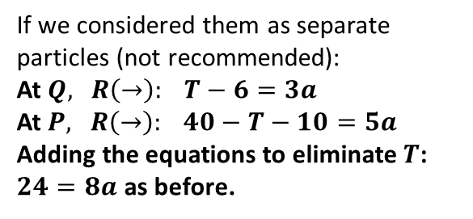




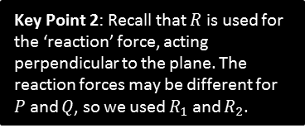




Connected Particles
Up to now we’ve only considered one particle at a time.
When we have multiple connected objects moving in the same direction, they can be considered as a single particle:
[Textbook] Two particles, $P$ and $Q$, of masses 5kg and 3kg respectively, are connected by a light inextensible string. Particle $P$ is pulled by a horizontal force of magnitude 40N along a rough horizontal plane. Particle $P$ experiences a frictional force of 10N and particle $Q$ experiences a frictional force of 6N.
Find the acceleration of the particles.
Find the tension in the string.
Explain how the modelling assumptions that the string is light and inextensible have been used.
? Diagram
If we considered the two particles as one, we can ignore the tensions (they cancel as they are in opposite directions):
$$R\left(→\right):40−10−6=8a \\ 8a=24$$
$a=3$ ms⁻²
$$a$$
a
?
$$R_{1}$$
$$R_{2}$$
$$Q$$
$$T$$
$$P$$
3kg
$$T$$
5kg
$$40 N$$
$$6 N$$
$$10 N$$
$$3g N$$
$$5g N$$
If we considered them as separate particles (not recommended):
At $Q,$ $R\left(→\right): T−6=3a$
At $P,$ $R\left(→\right): 40−T−10=5a$
Adding the equations to eliminate $T$:
$24=8a$ as before.
Key Point 1: The tension in a given piece of string is the same in any part of the string (at a given time). The tension acts away from each particle in the direction of the string.
Key Point 2: Recall that $R$ is used for the ‘reaction’ force, acting perpendicular to the plane. The reaction forces may be different for $P$ and $Q$, so we used $R_{1}$ and $R_{2}$.

Slide 14


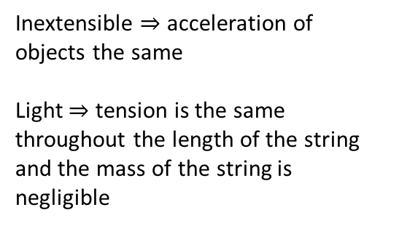

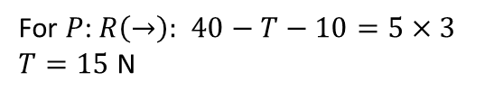
Connected Particles
[Textbook] Two particles, $P$ and $Q$, of masses 5kg and 3kg respectively, are connected by a light inextensible string. Particle $P$ is pulled by a horizontal force of magnitude 40N along a rough horizontal plane. Particle $P$ experiences a frictional force of 10N and particle $Q$ experiences a frictional force of 6N.
Find the acceleration of the particles.
Find the tension in the string.
Explain how the modelling assumptions that the string is light and inextensible have been used.
For $P$: $R\left(→\right):$ $40−T−10=5×3$
$T=15$ N
b
?
$$a$$
$$R_{2}$$
$$R_{1}$$
Inextensible $⇒$ acceleration of objects the same
Light $⇒$ tension is the same throughout the length of the string and the mass of the string is negligible
c
?
$$Q$$
$$T$$
$$P$$
3kg
$$T$$
5kg
$$40 N$$
$$6 N$$
$$10 N$$
$$3g N$$
$$5g N$$

Slide 15
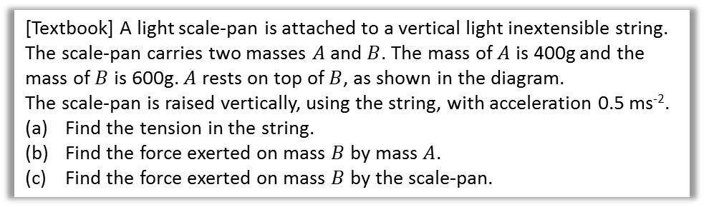
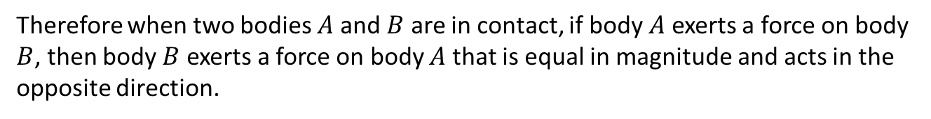


Newton’s 3rd Law
! Newton’s 3rd Law: For every action there is an equal and opposite reaction.
Therefore when two bodies $A$ and $B$ are in contact, if body $A$ exerts a force on body $B$, then body $B$ exerts a force on body $A$ that is equal in magnitude and acts in the opposite direction.
Confusion I had as a student: “If the opposite is equal but opposite, surely the object can’t move?”
Solution: The forces are acting on different objects!
[Textbook] A light scale-pan is attached to a vertical light inextensible string. The scale-pan carries two masses $A$ and $B$. The mass of $A$ is 400g and the mass of $B$ is 600g. $A$ rests on top of $B$, as shown in the diagram.
The scale-pan is raised vertically, using the string, with acceleration 0.5 ms⁻².
Find the tension in the string.
Find the force exerted on mass $B$ by mass $A$.
Find the force exerted on mass $B$ by the scale-pan.
$$A$$
0.4 kg
0.6 kg
$$B$$

Slide 16
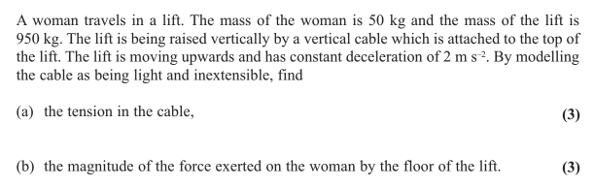
Test Your Understanding
Edexcel M1 May 2013 Q2

Slide 17




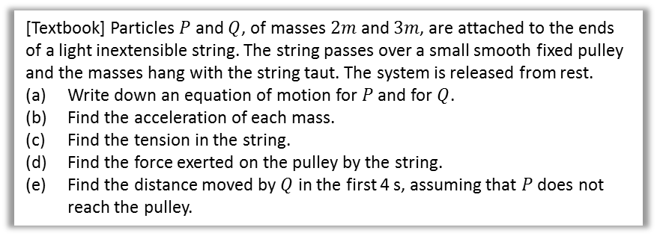





Pulleys
A pulley is a wheel on which a rope/string/cable passes.
For the purposes of Mechanics Year 1, the two particles hanging either side will either be horizontal or vertical.
[Textbook] Particles $P$ and $Q$, of masses $2m$ and $3m$, are attached to the ends of a light inextensible string. The string passes over a small smooth fixed pulley and the masses hang with the string taut. The system is released from rest.
Write down an equation of motion for $P$ and for $Q$.
Find the acceleration of each mass.
Find the tension in the string.
Find the force exerted on the pulley by the string.
Find the distance moved by $Q$ in the first 4 s, assuming that $P$ does not reach the pulley.
Why can’t we just model both particles as a single particle as before?
The particles are moving in different directions, so the tensions do not cancel.
Under what conditions is the tension in each part of the string the same?
Single piece of string and smooth pulley.
$$F$$
$$T$$
$$T$$
Remember that tension acts away from each object in the direction of the string. This includes the pulley!
$$a$$
$$a$$
$$T$$
$$T$$
$$3m$$
$$2m$$
$$3mg$$
$$2mg$$
Ensure that you add the direction of acceleration at each moving particle, and resolve forces in this direction.

Slide 18

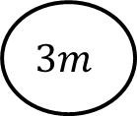

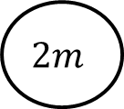






$$F$$
$$T$$
$$T$$
$$a$$
$$T$$
$$T$$
$$3m$$
$$2m$$
$$3mg$$
$$2mg$$

Slide 19
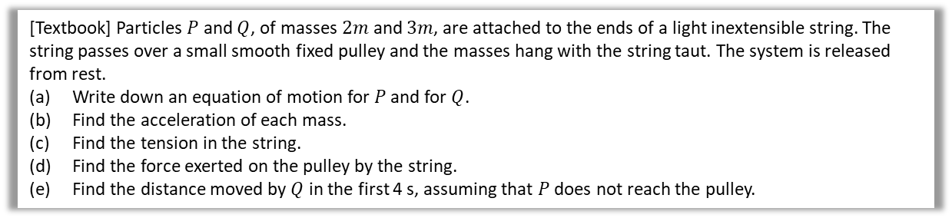
[Textbook] Particles $P$ and $Q$, of masses $2m$ and $3m$, are attached to the ends of a light inextensible string. The string passes over a small smooth fixed pulley and the masses hang with the string taut. The system is released from rest.
Write down an equation of motion for $P$ and for $Q$.
Find the acceleration of each mass.
Find the tension in the string.
Find the force exerted on the pulley by the string.
Find the distance moved by $Q$ in the first 4 s, assuming that $P$ does not reach the pulley.

Slide 20





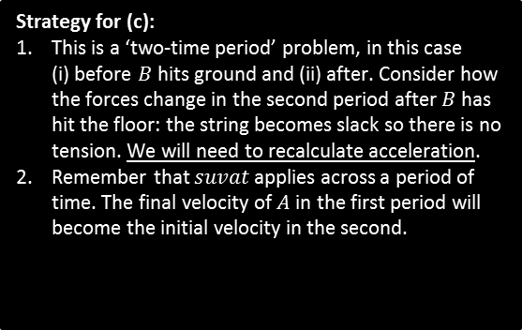




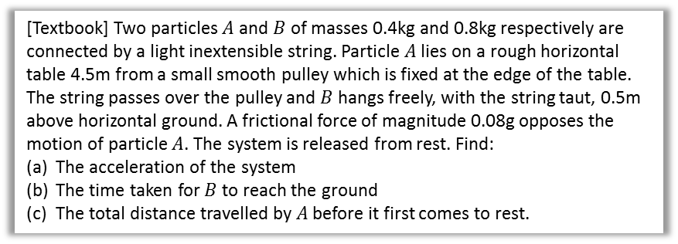




Horizontal and vertical string
$$R$$
$$a$$
[Textbook] Two particles $A$ and $B$ of masses 0.4kg and 0.8kg respectively are connected by a light inextensible string. Particle $A$ lies on a rough horizontal table 4.5m from a small smooth pulley which is fixed at the edge of the table. The string passes over the pulley and $B$ hangs freely, with the string taut, 0.5m above horizontal ground. A frictional force of magnitude 0.08g opposes the motion of particle $A$. The system is released from rest. Find:
The acceleration of the system
The time taken for $B$ to reach the ground
The total distance travelled by $A$ before it first comes to rest.
$$A$$
$$T$$
$$T$$
$$0.08g$$
$$0.4kg$$
$$T$$
$$a$$
$$0.4g$$
$$T$$
$$0.8kg$$
$$B$$
$$0.8g$$
Strategy for (c):
This is a ‘two-time period’ problem, in this case
(i) before $B$ hits ground and (ii) after. Consider how the forces change in the second period after $B$ has hit the floor: the string becomes slack so there is no tension. We will need to recalculate acceleration.
Remember that $suvat$ applies across a period of time. The final velocity of $A$ in the first period will become the initial velocity in the second.
$A,B$ start moving.
$B$ hits ground.
$A$ comes to rest.
$$u=0$$
$$s=0.5$$
$$v→u$$
$$s=?$$
$$v=0$$
Time

Slide 21








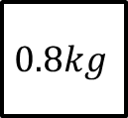


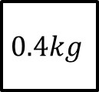


$$R$$
$$a$$
$$A$$
$$T$$
$$T$$
$$0.08g$$
$$0.4kg$$
$$T$$
$$a$$
$$0.4g$$
$$T$$
$$B$$
$$0.8kg$$
$$0.8g$$

Slide 22
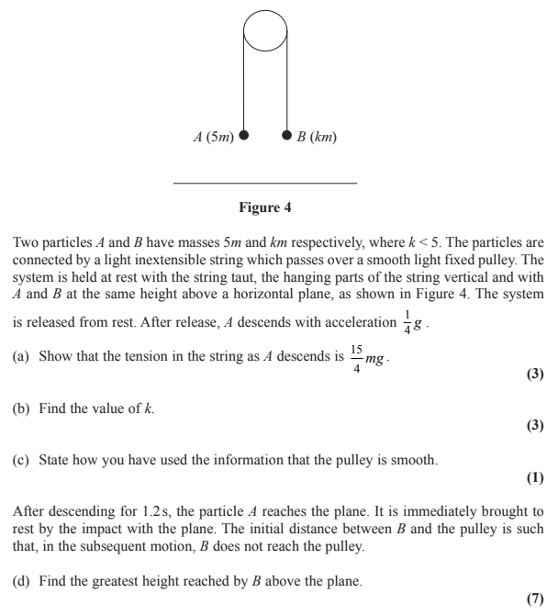
Test Your Understanding
Edexcel M1 Jan 2010 Q6

