Slide 1

P1 Chapter 11 :: Vectors
jfrost@tiffin.kingston.sch.uk
www.drfrostmaths.com
@DrFrostMaths
Last modified: 23rd July 2018

Slide 2







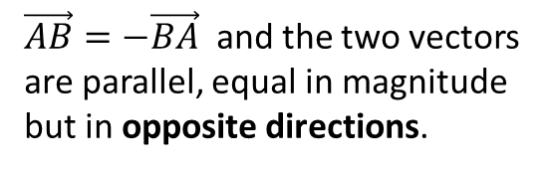
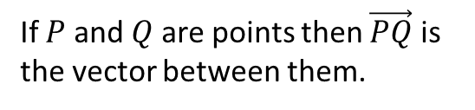




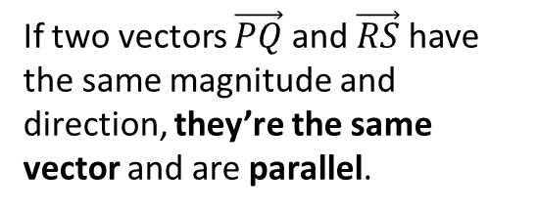


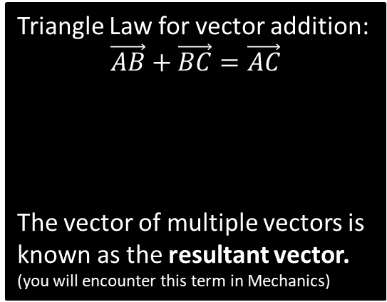





Vector Basics
Whereas a coordinate represents a position in space, a vector represents a displacement in space.
C
$\vec{AB}=−\vec{BA}$ and the two vectors are parallel, equal in magnitude but in opposite directions.
A
$$a$$
$$B$$
A vector has 2 properties:
Direction
Magnitude (i.e. length)
$$B$$
$$A$$
$$−a$$
$$A$$
D
Triangle Law for vector addition:
$$\vec{AB}+\vec{BC}=\vec{AC}$$
The vector of multiple vectors is known as the resultant vector. (you will encounter this term in Mechanics)
If $P$ and $Q$ are points then $\vec{PQ}$ is the vector between them.
$$B$$
$$b$$
$$a$$
$$Q$$
$$C$$
$$P$$
$$A$$
$$a+b$$
B
If two vectors $\vec{PQ}$ and $\vec{RS}$ have the same magnitude and direction, they’re the same vector and are parallel.
This might seem obvious, but students sometimes think the vector is different because the movement occurred at a different point in space. Nope!
$$Q$$
$$P$$
$$S$$
$$R$$

Slide 3
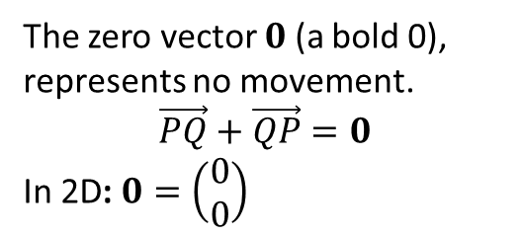



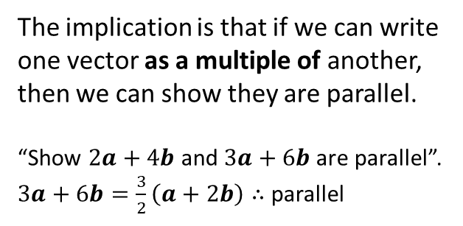
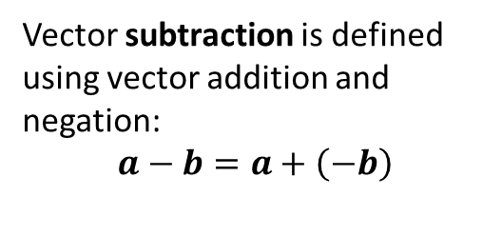






Vector Basics
E
Vector subtraction is defined using vector addition and negation:
$$a−b=a+\left(−b\right)$$
G
A scalar is a normal number, which can be used to ‘scale’ a vector.
The direction will be the same.
But the magnitude will be different (unless the scalar is 1).
$$a$$
$$a$$
$$b$$
$$−b$$
$$a$$
$$a−b$$
$$2a$$
If scalar is negative, opposite direction.
F
The zero vector $0$ (a bold 0), represents no movement.
$$\vec{PQ}+\vec{QP}=0$$
In 2D: $0=\left(\begin{matrix}0 \\ 0\end{matrix}\right)$
$$−\frac{1}{2}a$$
H
Any vector parallel to the vector $a$ can be written as $λa$, where $λ$ is a scalar.
The implication is that if we can write one vector as a multiple of another, then we can show they are parallel.
“Show $2a+4b$ and $3a+6b$ are parallel”.
$3a+6b=\frac{3}{2}\left(a+2b\right)∴$parallel

Slide 4
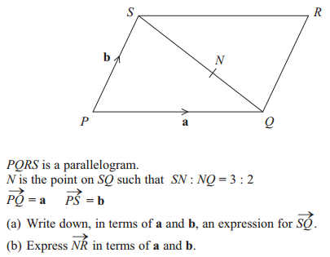

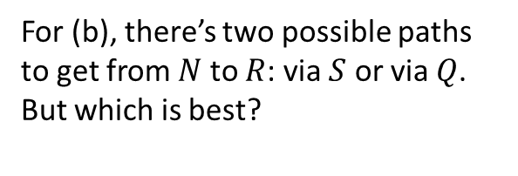
Example
Edexcel GCSE June 2013 1H Q27
a
$$\vec{SQ}=$$
For (b), there’s two possible paths to get from $N$ to $R$: via $S$ or via $Q$. But which is best?
b

Slide 5
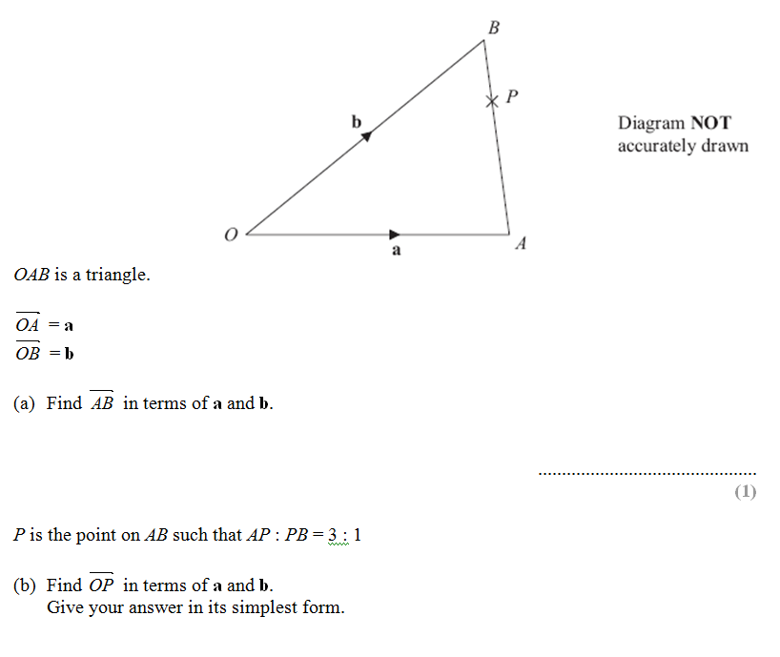
Test Your Understanding
Edexcel GCSE June 2012

Slide 6


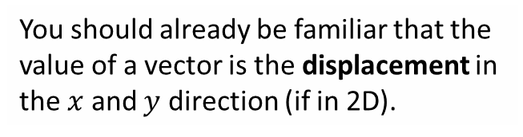

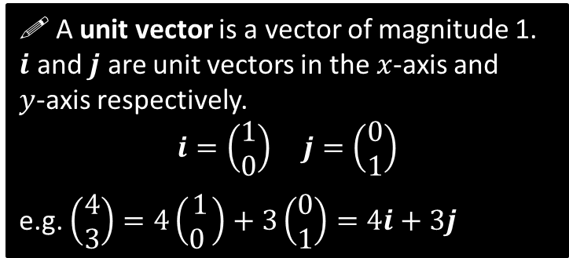


Representing Vectors
You should already be familiar that the value of a vector is the displacement in the $x$ and $y$ direction (if in 2D).
$$\left(\begin{matrix}3 \\ −2 \end{matrix}\right)$$
$$a=\left(\begin{matrix}3 \\ −2 \end{matrix}\right), b=\left(\begin{matrix}0 \\ −1\end{matrix}\right) \\ a+b=$$
$$2a=$$
$$j$$
! A unit vector is a vector of magnitude 1.
$i$ and $j$ are unit vectors in the $x$-axis and
$y$-axis respectively.
$$i=\left(\begin{matrix}1 \\ 0\end{matrix}\right) j=\left(\begin{matrix}0 \\ 1\end{matrix}\right)$$
e.g. $\left(\begin{matrix}4 \\ 3\end{matrix}\right)=4\left(\begin{matrix}1 \\ 0 \end{matrix}\right)+3\left(\begin{matrix}0 \\ 1\end{matrix}\right)=4i+3j$
$$i$$

Slide 7
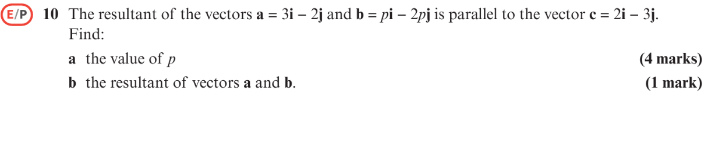
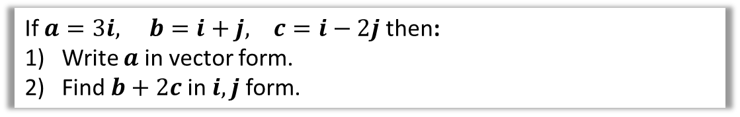
Examples
If $a=3i, b=i+j, c=i−2j$ then:
Write $a$ in vector form.
Find $b+2c$ in $i,j$ form.

Slide 8



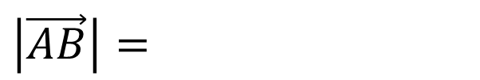





Lesson 2: Magnitude of a Vector
! The magnitude $|a|$ of a vector $a$ is its length.
If $a=\left(\begin{matrix}x \\ y\end{matrix}\right) \left|a\right|=\sqrt{x^{2}+y^{2}}$
$$\left(\begin{matrix}3 \\ 4\end{matrix}\right)$$
$$B$$
4
$$\left|\vec{AB}\right|=$$
$$A$$
3
$$\left|\left(\begin{matrix}1 \\ −1\end{matrix}\right)\right|=$$
$$\left|\left(\begin{matrix}−5 \\ −12\end{matrix}\right)\right|=$$
$$a=\left(\begin{matrix}4 \\ −1\end{matrix}\right) \left|a\right|=$$
$$b=\left(\begin{matrix}2 \\ 0\end{matrix}\right) \left|b\right|=$$

Slide 9



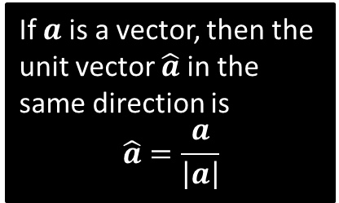
Unit Vectors
! A unit vector is a vector whose magnitude is 1
There’s certain operations on vectors that require the vectors to be ‘unit’ vectors. We just scale the vector so that its magnitude is now 1.
$$a=\left(\begin{matrix}3 \\ 4\end{matrix}\right)$$
If $a$ is a vector, then the unit vector $\hat{a}$in the same direction is
$$\hat{a}=\frac{a}{\left|a\right|}$$
Test Your Understanding: Convert the following vectors to unit vectors.
$$a=\left(\begin{matrix}12 \\ −5\end{matrix}\right)$$
$$b=\left(\begin{matrix}1 \\ 1\end{matrix}\right)$$

Slide 10
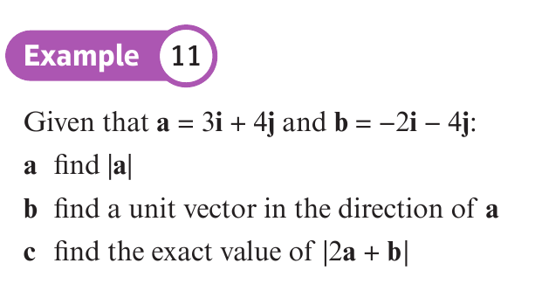
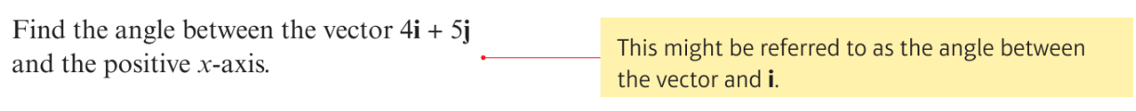

Slide 11
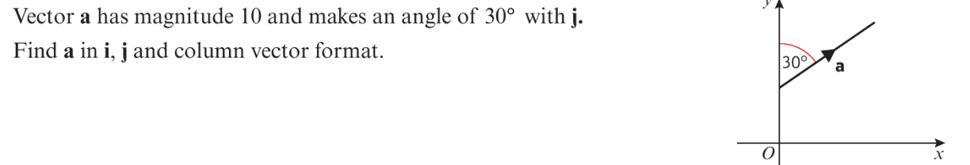
Trickier Example

Slide 12




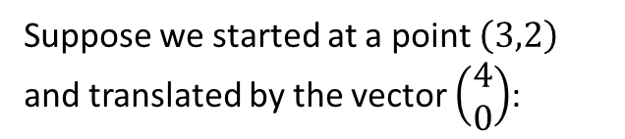


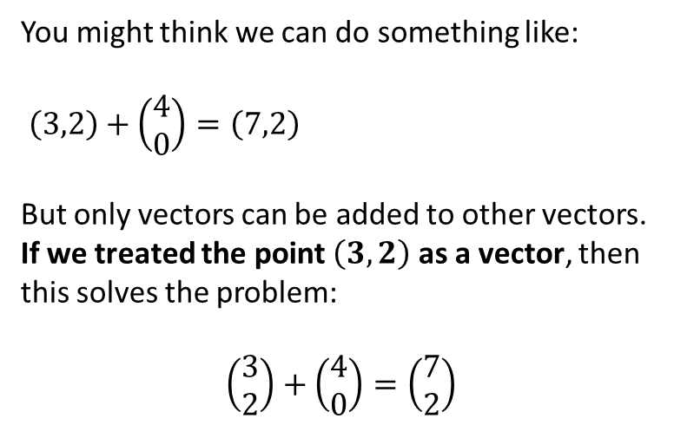
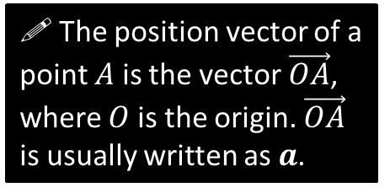


Lesson 3: Position Vectors
$$y$$
Suppose we started at a point $\left(3,2\right)$ and translated by the vector $\left(\begin{matrix}4 \\ 0\end{matrix}\right)$:
$$a=\left(\begin{matrix}3 \\ 2\end{matrix}\right)$$
$$A\left(3,2\right)$$
$$\left(\begin{matrix}4 \\ 0\end{matrix}\right)$$
$$O$$
$$x$$
$$A\left(3,2\right)$$
$$?$$
A vector used to represent a position is unsurprisingly known as a position vector.
A position can be thought of as a translation from the origin, as per above. It enables us to use positions in all sorts of vector (and matrix!) calculations.
You might think we can do something like:
$\left(3,2\right)+\left(\begin{matrix}4 \\ 0\end{matrix}\right)=\left(7,2\right)$
But only vectors can be added to other vectors.
If we treated the point $\left(3,2\right)$ as a vector, then this solves the problem:
$$\left(\begin{matrix}3 \\ 2\end{matrix}\right)+\left(\begin{matrix}4 \\ 0\end{matrix}\right)=\left(\begin{matrix}7 \\ 2\end{matrix}\right)$$
! The position vector of a point $A$ is the vector$\vec{OA}$, where $O$ is the origin. $\vec{OA}$ is usually written as $a$.

Slide 13

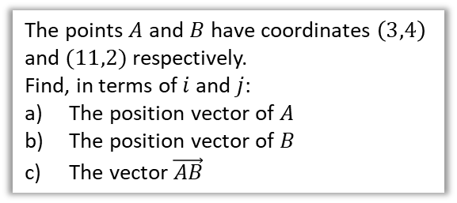

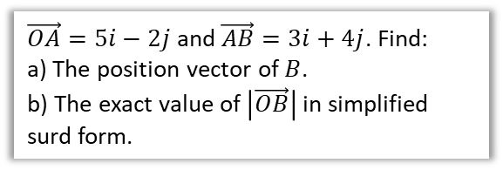
Example
The points $A$ and $B$ have coordinates $\left(3,4\right)$ and $(11,2)$ respectively.
Find, in terms of $i$ and $j$:
The position vector of $A$
The position vector of $B$
The vector $\vec{AB}$
$\vec{OA}=5i−2j$ and $\vec{AB}=3i+4j$. Find:
a) The position vector of $B$.
b) The exact value of $\left|\vec{OB}\right|$ in simplified surd form.
a
$$\vec{OA}=$$
$$\vec{OB}=$$
$$\vec{AB}=$$
a
$$\vec{OB}=$$
$$\left|\vec{OB}\right|=$$
b
c
b

Slide 14






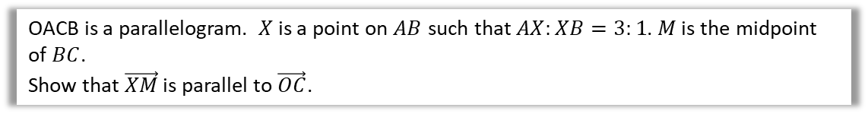


Lesson 4: Solving Geometric Problems
$$A$$
$$C$$
$$a$$
$$X$$
$$M$$
$$O$$
$$b$$
$$B$$
OACB is a parallelogram. $X$ is a point on $AB$ such that $AX:XB=3:1$. $M$ is the midpoint of $BC$.
Show that $\vec{XM}$ is parallel to $\vec{OC}$.

Slide 15






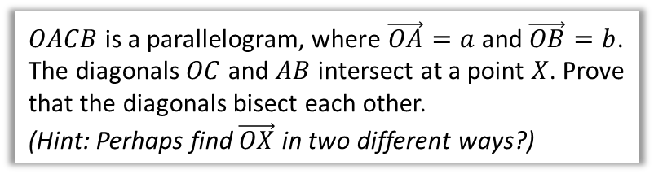

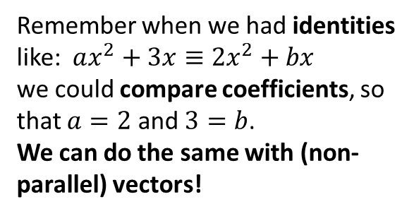
Introducing Scalars and Comparing Coefficients
Remember when we had identities like: $ax^{2}+3x≡2x^{2}+bx$
we could compare coefficients, so that $a=2$ and $3=b$.
We can do the same with (non-parallel) vectors!
$$O$$
$$a$$
$$A$$
$$X$$
$$b$$
$OACB$ is a parallelogram, where $\vec{OA}=a$ and $\vec{OB}=b$. The diagonals $OC$ and $AB$ intersect at a point $X$. Prove that the diagonals bisect each other.
(Hint: Perhaps find $\vec{OX}$ in two different ways?)
$$B$$
$$C$$

Slide 16






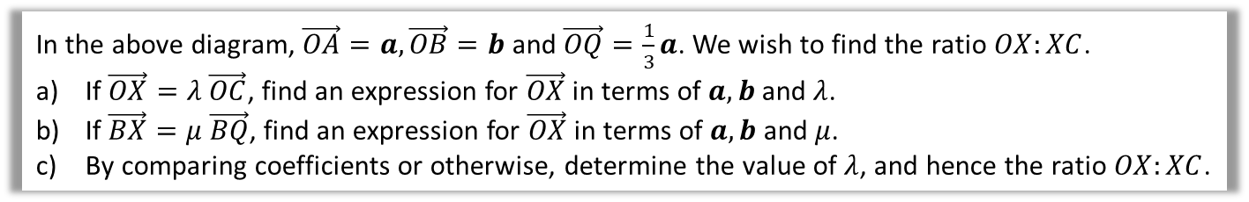


Test Your Understanding
$$a$$
$$O$$
$$Q$$
$$A$$
$$X$$
$$b$$
$$B$$
$$C$$
In the above diagram, $\vec{OA}=a, \vec{OB}=b$ and $\vec{OQ}=\frac{1}{3}a$. We wish to find the ratio $OX:XC$.
If $\vec{OX}=λ \vec{OC}$, find an expression for $\vec{OX}$ in terms of $a,b$ and $λ$.
If $\vec{BX}=μ \vec{BQ}$, find an expression for $\vec{OX}$ in terms of $a,b$ and $μ$.
By comparing coefficients or otherwise, determine the value of $λ$, and hence the ratio $OX:XC$.

Slide 17






Area of a Triangle
$\vec{AB}=3i−2j$ and $\vec{AC}=i−5j$. Determine $∠BAC$.
Strategy:
$$A$$
$$\left(\begin{matrix}3 \\ −2\end{matrix}\right)$$
$$B$$
$$\left(\begin{matrix}1 \\ −5\end{matrix}\right)$$
$$C$$

Slide 18
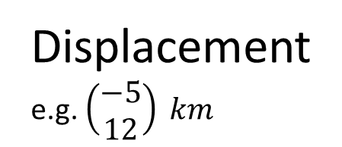

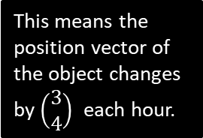
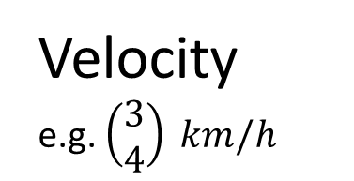

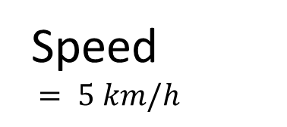

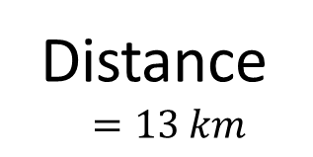
Lesson 4: Modelling
In Mechanics, you will see certain things can be represented as a simple number (without direction), or as a vector (with direction):
Remember a ‘scalar’ just means a normal number (in the context of vectors). It can be obtained using the magnitude of the vector.
Vector Quantity
Equivalent Scalar Quantity
Velocity
e.g. $\left(\begin{matrix}3 \\ 4\end{matrix}\right) km/h$
Speed
$= 5 km/h$
This means the position vector of the object changes by $\left(\begin{matrix}3 \\ 4\end{matrix}\right)$ each hour.
…which is equivalent to moving 5km each hour.
$$5$$
$$4$$
$$3$$
Displacement
e.g. $\left(\begin{matrix}−5 \\ 12\end{matrix}\right) km$
Distance
$$=13 km$$

Slide 19



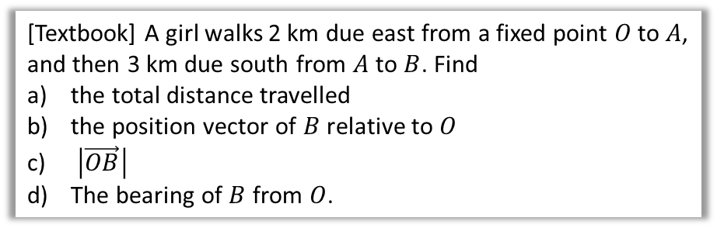



Example
[Textbook] A girl walks 2 km due east from a fixed point $O$ to $A$, and then 3 km due south from $A$ to $B$. Find
the total distance travelled
the position vector of $B$ relative to $O$
$\left|\vec{OB}\right|$
The bearing of $B$ from $O$.
N
$$2$$
$$A$$
$$O$$
$$θ$$
$$3$$
$$B$$

Slide 20
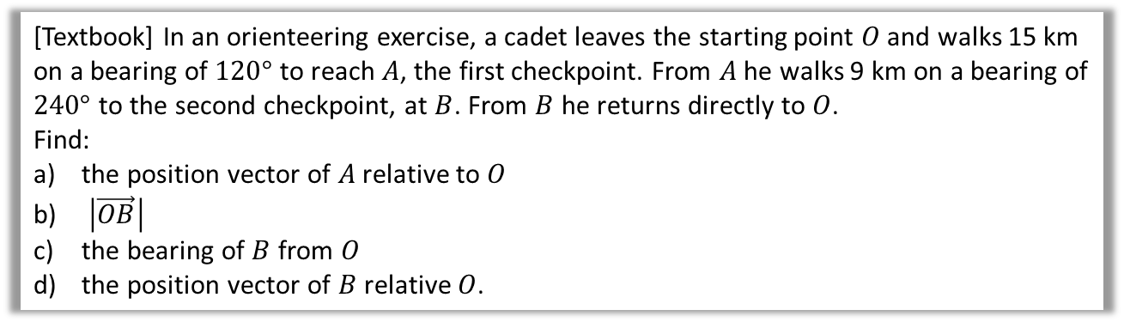
Further Example
[Textbook] In an orienteering exercise, a cadet leaves the starting point $O$ and walks 15 km on a bearing of $120°$ to reach $A$, the first checkpoint. From $A$ he walks 9 km on a bearing of $240°$ to the second checkpoint, at $B$. From $B$ he returns directly to $O$.
Find:
the position vector of $A$ relative to $O$
$\left|\vec{OB}\right|$
the bearing of $B$ from $O$
the position vector of $B$ relative $O$.
I have no specific advice to offer except:
Draw a BIG diagram.
Remember bearings are measured clockwise from North.
Don’t forget units (on vectors!)

Slide 21
Further Example
[Textbook] In an orienteering exercise, a cadet leaves the starting point $O$ and walks 15 km on a bearing of $120°$ to reach $A$, the first checkpoint. From $A$ he walks 9 km on a bearing of $240°$ to the second checkpoint, at $B$. From $B$ he returns directly to $O$.
Find:
the position vector of $A$ relative to $O$
$\left|\vec{OB}\right|$
the bearing of $B$ from $O$
the position vector of $B$ relative $O$.

