Slide 1
P1 Chapter 12 :: Differentiation
Student Notes

Slide 2
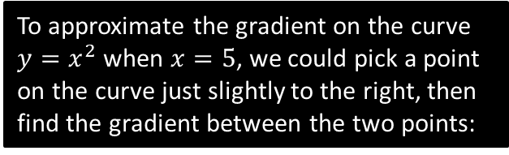


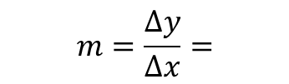








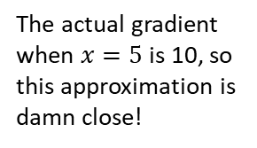
Finding the Gradient Function
The question is then: Is there a method to work out the gradient function without having to draw lots of tangents and hoping that we can spot the rule?
To approximate the gradient on the curve $y=x^{2}$ when $x=5$, we could pick a point on the curve just slightly to the right, then find the gradient between the two points:
As the second point gets closer and closer, the gradient becomes a better approximation of the true gradient:
$$y=x^{2}$$
$$\left(6, \right)$$
$$11$$
$$\left(5.01, \right)$$
$$1$$
$$0.01$$
$$0.1001$$
$$\left(5, \right)$$
$$\left(5,25\right)$$
$$m=\frac{Δy}{Δx}=$$
$$m=$$
The actual gradient when $x=5$ is 10, so this approximation is damn close!

Slide 3




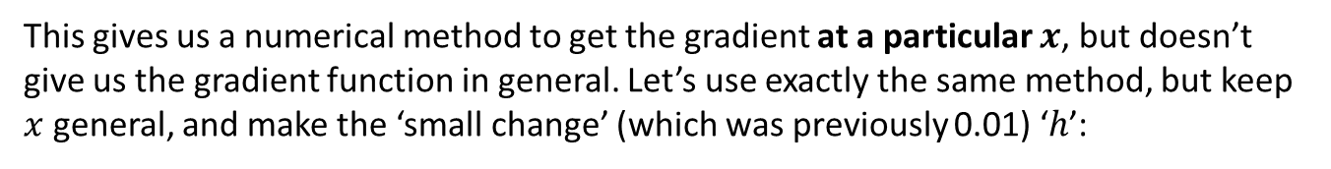
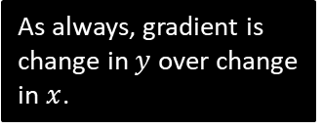

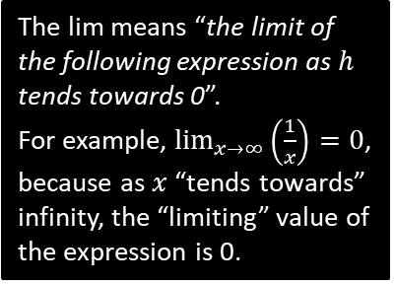


Finding the Gradient Function
This gives us a numerical method to get the gradient at a particular $x$, but doesn’t give us the gradient function in general. Let’s use exactly the same method, but keep $x$ general, and make the ‘small change’ (which was previously 0.01) ‘$h$’:
$$y=x^{2}$$
$$\left(x+h,{\left(x+h\right)}^{2}\right)$$
As always, gradient is change in $y$ over change in $x$.
$$gradient$$
$$\left(x,x^{2}\right)$$
$$?$$
$$?$$
The lim means “the limit of the following expression as $h$ tends towards 0”.
For example, $\lim_{x→∞}\left(\frac{1}{x}\right)=0$, because as $x$ “tends towards” infinity, the “limiting” value of the expression is 0.
The $h$ disappears as $h$ tends towards 0, i.e. we can effectively treat it as 0 at this point.

Slide 4
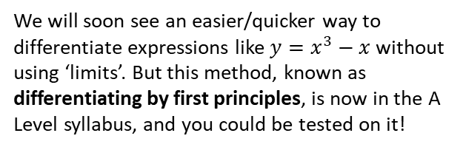
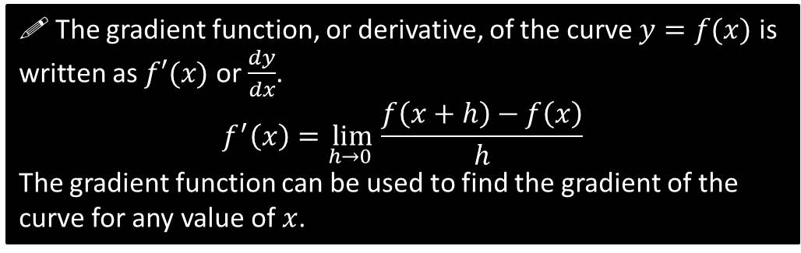
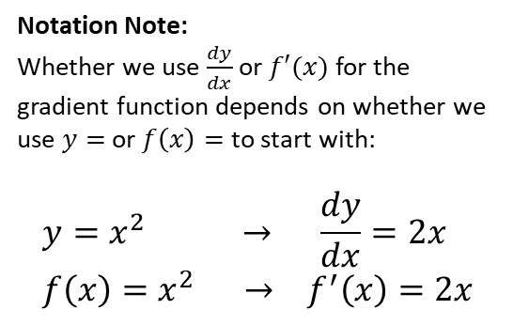
Finding the Gradient Function
! The gradient function, or derivative, of the curve $y=f(x)$ is written as $f′(x)$ or $\frac{dy}{dx}$.
$$f^{′}\left(x\right)=\lim_{h→0 }{\frac{f\left(x+h\right)−f\left(x\right)}{h}}$$
The gradient function can be used to find the gradient of the curve for any value of $x$.
Notation Note:
Whether we use $\frac{dy}{dx}$ or $f′(x)$ for the gradient function depends on whether we use $y=$ or $f\left(x\right)=$ to start with:
$$y=x^{2} → \frac{dy}{dx}=2x \\ f\left(x\right)=x^{2} → f^{′}\left(x\right)=2x$$
We will soon see an easier/quicker way to differentiate expressions like $y=x^{3}−x$ without using ‘limits’. But this method, known as differentiating by first principles, is now in the A Level syllabus, and you could be tested on it!
“Leibniz’s notation”
“Lagrange’s notation”

Slide 5
Test Your Understanding
Prove from first principles that the derivative of $x^{3}$ is $3x^{2}$.

Slide 6

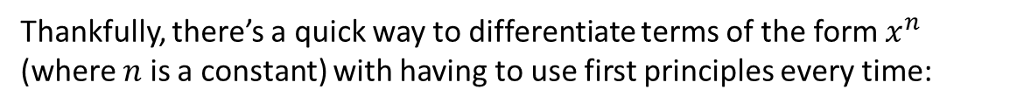
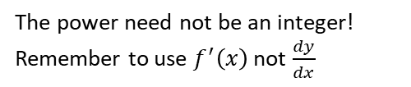


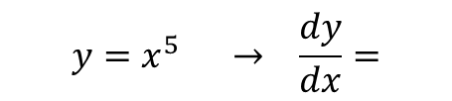
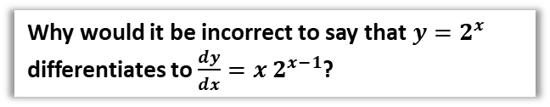
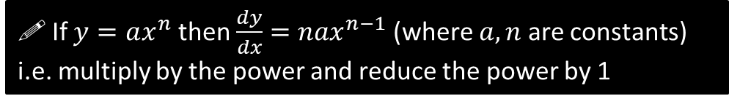

Differentiating $x^{n}$
Thankfully, there’s a quick way to differentiate terms of the form $x^{n}$ (where $n$ is a constant) with having to use first principles every time:
If $y=ax^{n}$ then $\frac{dy}{dx}=nax^{n−1}$ (where $a,n$ are constants)
i.e. multiply by the power and reduce the power by 1
Examples:
$$y=x^{5} → \frac{dy}{dx}=$$
Power is 5, so multiply by 5 then reduce power by 5.
$$f(x)=x^{\frac{1}{2}} →$$
The power need not be an integer!
Remember to use $f^{′}\left(x\right)$ not $\frac{dy}{dx}$
Why would it be incorrect to say that $y=2^{x}$ differentiates to $\frac{dy}{dx}=x 2^{x−1}$?
$$y={2x}^{6} →$$
$$f\left(x\right)=\frac{x}{x^{4}}=x^{−3} →$$
$$y=\sqrt{x^{6}}=$$

Slide 7

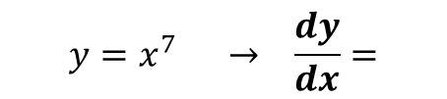


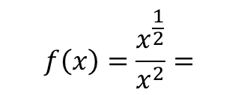
Test Your Understanding
$$y=x^{7} → \frac{dy}{dx}=$$
1
$$y=3x^{10} →$$
2
$$f\left(x\right)=\frac{x^{\frac{1}{2}}}{x^{2}}=$$
3
$$y=ax^{a}$$
4
5
$$f(x)=\sqrt{49x^{7}}$$

Slide 8
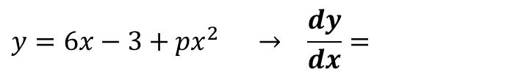
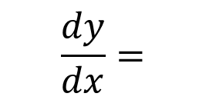
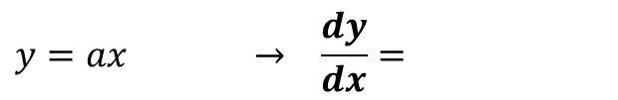

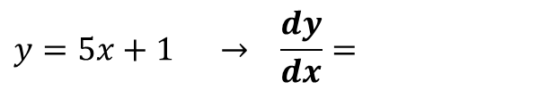
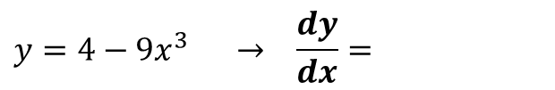

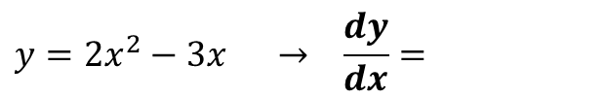

Differentiating Multiple Terms
Differentiate $y=x^{2}+4x+3$
$$\frac{dy}{dx}=$$
Quickfire Questions
$$y=2x^{2}−3x → \frac{dy}{dx}=$$
$$y=ax → \frac{dy}{dx}=$$
1
4
(where $a$ is a constant)
2
$$y=4−9x^{3} → \frac{dy}{dx}=$$
$$y=6x−3+px^{2} → \frac{dy}{dx}=$$
5
(where $p$ is a constant)
$$y=5x+1 → \frac{dy}{dx}=$$
3

Slide 9
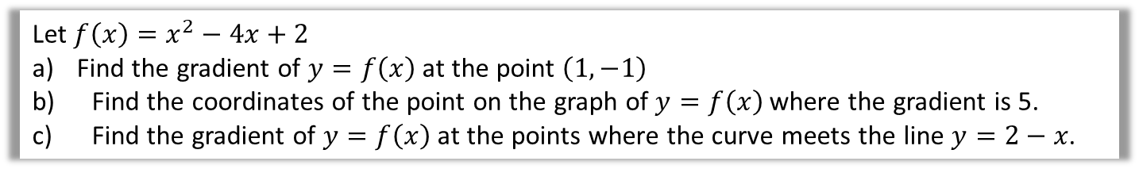
Test Your Understanding
Let $f\left(x\right)=x^{2}−4x+2$
Find the gradient of $y=f\left(x\right)$ at the point $\left(1,−1\right)$
Find the coordinates of the point on the graph of $y=f\left(x\right)$ where the gradient is 5.
Find the gradient of $y=f\left(x\right)$ at the points where the curve meets the line $y=2−x$.

Slide 10

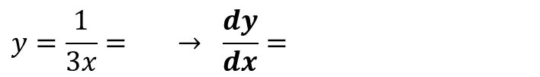
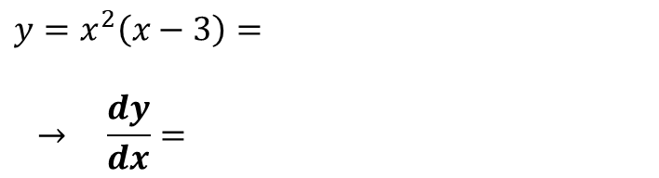


Lesson 2: Differentiating Harder Expressions
If your expression isn’t a sum of $x^{n}$ terms, simply manipulate it until it is!
1. Turn roots into powers:
$$y=\sqrt{x}= → \frac{dy}{dx}=$$
$$y=\frac{1}{\sqrt[3]{x}}= → \frac{dy}{dx}=$$
2. Split up fractions.
$$y=\frac{x^{2}+3}{\sqrt{x}}=$$
$\frac{dy}{dx}=$
3. Expand out brackets.
$$y=x^{2}\left(x−3\right)=$$
$$→ \frac{dy}{dx}=$$
4. Beware of numbers in denominators!
$$y=\frac{1}{3x}= → \frac{dy}{dx}=$$

Slide 11
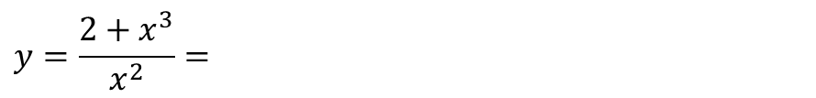
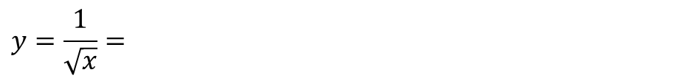
Test Your Understanding
Differentiate the following.
$$y=\frac{1}{\sqrt{x}}=$$
$$y=\frac{2+x^{3}}{x^{2}}=$$
$$y=\frac{1+2x}{3x\sqrt{x}}=$$

Slide 12

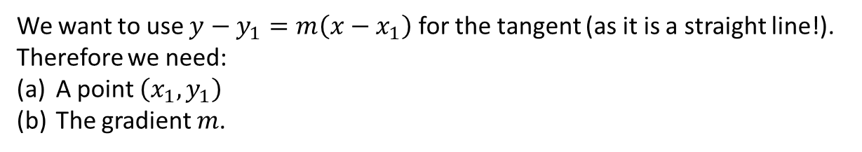
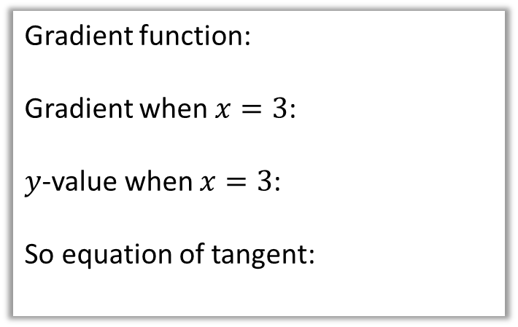
Finding equations of tangents
Find the equation of the tangent to the curve $y=x^{2}$ when $x=3$.
We want to use $y−y_{1}=m\left(x−x_{1}\right)$ for the tangent (as it is a straight line!). Therefore we need:
A point $\left(x_{1},y_{1}\right)$
The gradient $m$.
Gradient function:
Gradient when $x=3$:
$y$-value when $x=3$:
So equation of tangent:
tangent
$$(3,?)$$

Slide 13
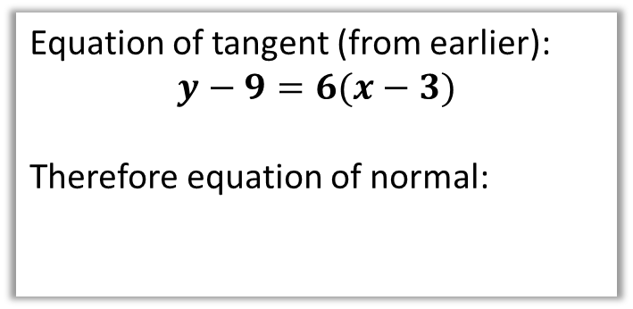

Finding equations of normals
Find the equation of the normal to the curve $y=x^{2}$ when $x=3$.
The normal to a curve is the line perpendicular to the tangent.
Equation of tangent (from earlier):
$$y−9=6(x−3)$$
Therefore equation of normal:
normal
tangent
$$(3,9)$$
Exam Tip: A very common error is for students to accidentally forget whether the question is asking for the tangent or for the normal.

Slide 14
Test Your Understanding
Find the equation of the normal to the curve $y=x+3\sqrt{x}$ when $x=9$.

Slide 15
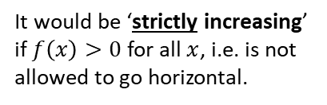
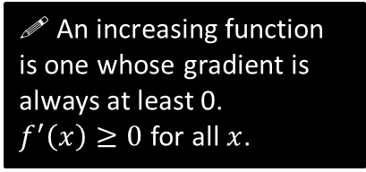


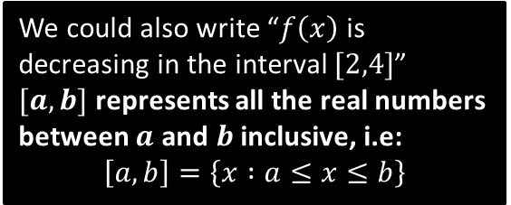
Lesson 3: Increasing and Decreasing Functions
A function can also be increasing and decreasing in certain intervals.
$$\left(2,3\right)$$
What do you think it means for a function to be an ‘increasing function’?
$$\left(4,−1\right)$$
! An increasing function is one whose gradient is always at least 0.
$f^{′}\left(x\right)≥0$ for all $x$.
We could also write “$f\left(x\right)$ is decreasing in the interval $[2,4]$”
$[a,b]$ represents all the real numbers between $a$ and $b$ inclusive, i.e:
$$\left[a,b\right]=\left\{x :a≤x≤b\right\}$$
It would be ‘strictly increasing’ if $f\left(x\right)>0$ for all $x$, i.e. is not allowed to go horizontal.

Slide 16
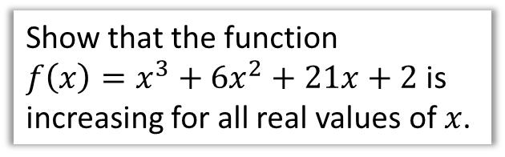
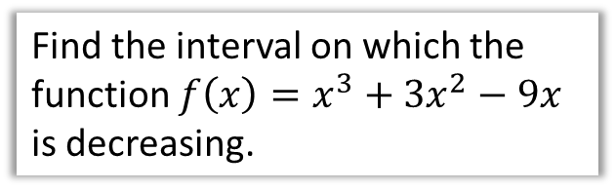
Examples
Show that the function
$f\left(x\right)=x^{3}+6x^{2}+21x+2$ is increasing for all real values of $x$.
Find the interval on which the function $f\left(x\right)=x^{3}+3x^{2}−9x$ is decreasing.
Tip: To show a quadratic is always positive, complete the square, then indicate the squared term is always at least 0.

Slide 17
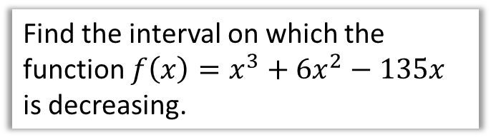
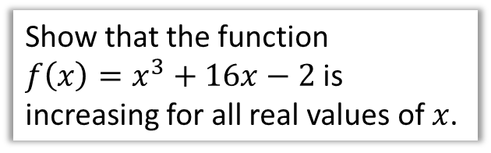
Test Your Understanding
Show that the function
$f\left(x\right)=x^{3}+16x−2$ is increasing for all real values of $x$.
Find the interval on which the function $f\left(x\right)=x^{3}+6x^{2}−135x$ is decreasing.

Slide 18
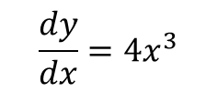




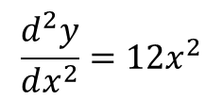
Second Order Derivatives
When you differentiate once, the expression you get is known as the first derivative.
Unsurprisingly, when we differentiate a second time, the resulting expression is known as the second derivative. And so on…
Original Function
First Derivative
Second Derivative
Leibniz’s
$$\frac{dy}{dx}=4x^{3}$$
$$\frac{d^{2}y}{dx^{2}}=12x^{2}$$
$$y=x^{4}$$
Lagrange’s
$$f\left(x\right)=x^{4}$$
$$f′\left(x\right)=4x^{3}$$
$$f′′\left(x\right)=12x^{2}$$

Slide 19
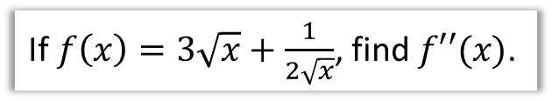
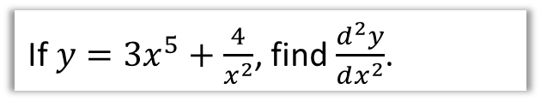
Examples
If $y=3x^{5}+\frac{4}{x^{2}}$, find $\frac{d^{2}y}{dx^{2}}$.
If $f\left(x\right)=3\sqrt{x}+\frac{1}{2\sqrt{x}}$, find $f′′(x)$.

Slide 20
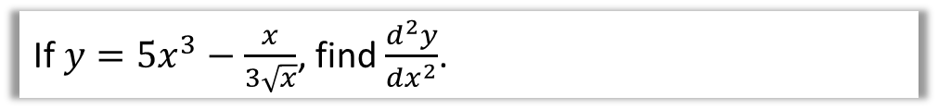
Test Your Understanding
If $y=5x^{3}−\frac{x}{3\sqrt{x}}$, find $\frac{d^{2}y}{dx^{2}}$.

Slide 21


Lesson 4: Stationary/Turning Points
A stationary point is where the gradient is 0, i.e. $f^{′}\left(x\right)=0$.
Local maximum
$$f^{′}\left(x\right)=0$$
Fro Note: It’s called a ‘local’ maximum because it’s the function’s largest output within the vicinity. Functions may also have a ‘global’ maximum, i.e. the maximum output across the entire function. This particular function doesn’t have a global maximum because the output keeps increasing up to infinity. It similarly has no global minimum, as with all cubics.
Local minimum
$$f^{′}\left(x\right)=0$$
Find the coordinates of the turning points of $y=x^{3}+6x^{2}−135x$

Slide 22


More Examples
Find the least value of
$$f\left(x\right)=x^{2}−4x+9$$
Find the turning point of
$$y=\sqrt{x}−x$$

Slide 23


Points of Inflection
There’s a third type of stationary point (that we’ve encountered previously):
A point of inflection is where the curve changes from convex concave (or vice versa).
$$f^{′}\left(x\right)=0$$
concave
convex
(the same terms used in optics!)
Technically we could label these either way round depending on where we view the curve from. What’s important is that the concavity changes.
i.e. the line curves in one direction before the point of inflection, then curves in the other direction after.
Fro Side Note: Not all points of inflection are stationary points, as can be seen in the example on the right.
A point of inflection which is a stationary point is known as a saddle point.
$$f^{′}\left(x\right)≠0$$

Slide 24
How do we tell what type of stationary point?
Method 1: Look at gradient just before and just after point.
Local Maximum
Gradient just before | Gradient at maximum | Gradient just after
+ve | 0 | -ve
Point of Inflection
Gradient just before | Gradient at p.o.i | Gradient just after
+ve | 0 | +ve
Local Minimum
Gradient just before | Gradient at minimum | Gradient just after
-ve | 0 | +ve

Slide 25
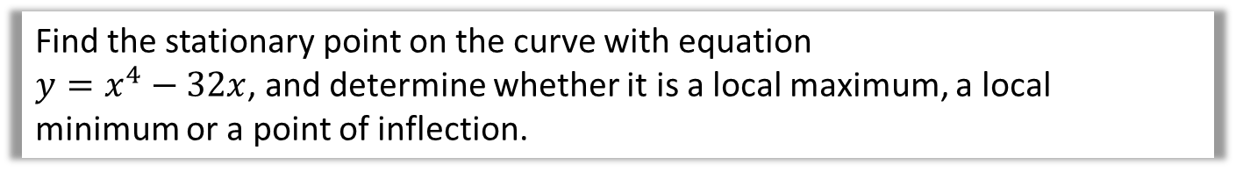
How do we tell what type of stationary point?
Method 1: Look at gradient just before and just after point.
Find the stationary point on the curve with equation
$y=x^{4}−32x$, and determine whether it is a local maximum, a local minimum or a point of inflection.

Slide 26
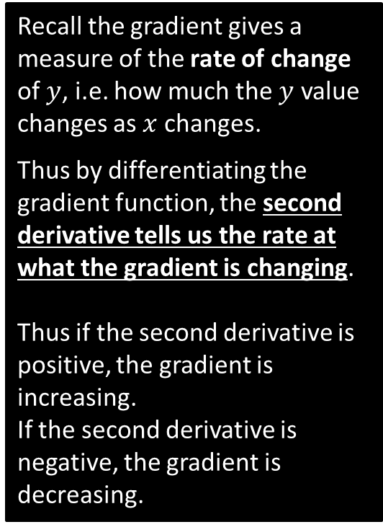
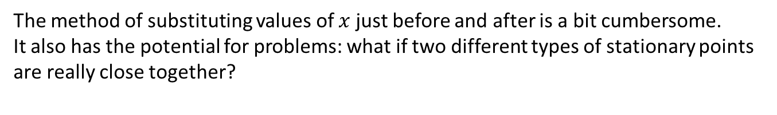
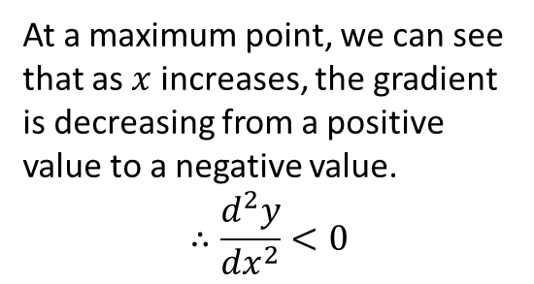
Method 2: Using the second derivative
The method of substituting values of $x$ just before and after is a bit cumbersome.
It also has the potential for problems: what if two different types of stationary points are really close together?
0
gradient
Recall the gradient gives a measure of the rate of change of $y$, i.e. how much the $y$ value changes as $x$ changes.
Thus by differentiating the gradient function, the second derivative tells us the rate at what the gradient is changing.
Thus if the second derivative is positive, the gradient is increasing.
If the second derivative is negative, the gradient is decreasing.
+ve
gradient
-ve
gradient
At a maximum point, we can see that as $x$ increases, the gradient is decreasing from a positive value to a negative value.
$$∴\frac{d^{2}y}{{dx}^{2}}<0$$

Slide 27
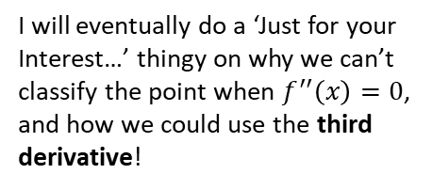
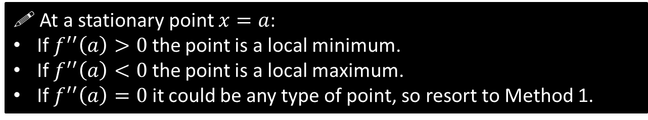

Method 2: Using the second derivative
! At a stationary point $x=a$:
If $f^{′′}\left(a\right)>0$ the point is a local minimum.
If $f^{′′}\left(a\right)<0$ the point is a local maximum.
If $f^{′′}\left(a\right)=0$ it could be any type of point, so resort to Method 1.
I will eventually do a ‘Just for your Interest…’ thingy on why we can’t classify the point when $f^{′′}\left(x\right)=0$, and how we could use the third derivative!
The stationary point of $y=x^{4}−32x$ is $\left(2,−48\right)$. Use the second derivative to classify this stationary point.

Slide 28

Test Your Understanding
Edexcel C2 May 2013 Q9

Slide 29

Sketching Graphs
All the way back in Chapter 4, we used features such as intercepts with the axes, and behaviour when $x→∞$ and $x→−∞$ in order to sketch graphs.
Now we can also find stationary/turning points!
[Textbook] By first finding the stationary points, sketch the graph of $y=\frac{1}{x}+27x^{3}$

Slide 30






Lesson 5: Sketching Gradient Functions
The new A Level specification specifically mentions being able to sketch $y=f′(x)$.
If you know the function $f′(x)$ explicitly (e.g. because you differentiated $y=f(x)$), you can use your knowledge of sketching straight line/quadratic/cubic graphs.
But in other cases you won’t be given the function explicitly, but just the sketch.
$$y$$
The gradient of $y=f\left(x\right)$ is negative, but increasing.
$$y=f\left(x\right)$$
The gradient at the turning point is 0.
The gradient of $y=f\left(x\right)$ is positive, and increasing.
$$x$$

Slide 31



A Harder One
Gradient is positive: initially increases but then decreases.
Mentally describe the gradient of each section of the curve, starting your mental sentence with “The gradient is…” and using terms like “positive”, “but increasing”, “but not changing”, etc.
Gradient is negative, but increasing.
$$y$$
Gradient is positive: initially increases but then decreases.
Gradient is 0.
Gradient is 0.
Gradient is 0, but positive before and after.
Gradient is negative. Initially decreases but then tends towards 0.
$$y=f\left(x\right)$$
$$x$$

Slide 32


Test Your Understanding
$$y$$
Gradient is negative, but increasing.
Gradient is positive; initially increases but then decreases.
$$y=f\left(x\right)$$
Gradient is 0.
$$x$$
Gradient is positive, but tending towards 0.

Slide 33




Optimisation Problems/Modelling
We have a sheet of A4 paper, which we want to fold into a cuboid. What height should we choose for the cuboid in order to maximise the volume?
$$h$$
These are examples of optimisation problems: we’re trying to maximise/minimise some quantity by choosing an appropriate value of a variable that we can control.
We have 50m of fencing, and want to make a bear pen of the following shape, such that the area is maximised. What should we choose $x$ and $y$ to be?
$$x$$
$$y$$

Slide 34



‘Rate of change’
Up to now we’ve had $y$ in terms of $x$, where $\frac{dy}{dx}$ means “the rate at which $y$ changes with respect to $x$”.
But we can use similar gradient function notation for other physical quantities.
Real Life Maths!
A sewage container fills at a rate of 20 cm³ per second.
How could we use appropriate notation to represent this?
$$\frac{dV}{dt}=20 cm^{3}/s$$
“The rate at which the volume $V$ changes with respect to time $t$.”

Slide 35





Example Optimisation Problem
Optimisation problems in an exam usually follow the following pattern:
There are 2 variables involved (you may have to introduce one yourself), typically lengths.
There are expressions for two different physical quantities:
  One is a constraint, e.g. “the surface area is 20cm²”.
  The other we wish to maximise/minimise, e.g. “we wish to maximise the volume”.
We use the constraint to eliminate one of the variables in the latter equation, so that it is then just in terms of one variable, and we can then use differentiation to find the turning point.
[Textbook] A large tank in the shape of a cuboid is to be made from 54m² of sheet metal. The tank has a horizontal base and no top. The height of the tank is $x$ metres. Two of the opposite vertical faces are squares.
a) Show that the volume, V m³, of the tank is given by
$V=18x−\frac{2}{3}x^{3}$.
$$x$$
$$x$$
$$y$$
b) Given that $x$ can vary, use differentiation to find the maximum or minimum value of $V$.

Slide 36

Test Your Understanding
Edexcel C2 May 2011 Q8

