Slide 1

P1 Chapter 14 :: Exponentials & Logarithms
jfrost@tiffin.kingston.sch.uk
www.drfrostmaths.com
@DrFrostMaths
Last modified: 20th October 2017

Slide 2
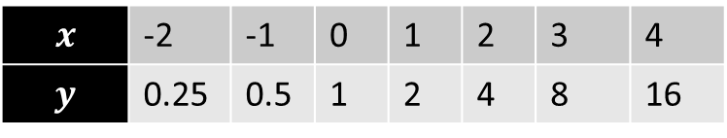

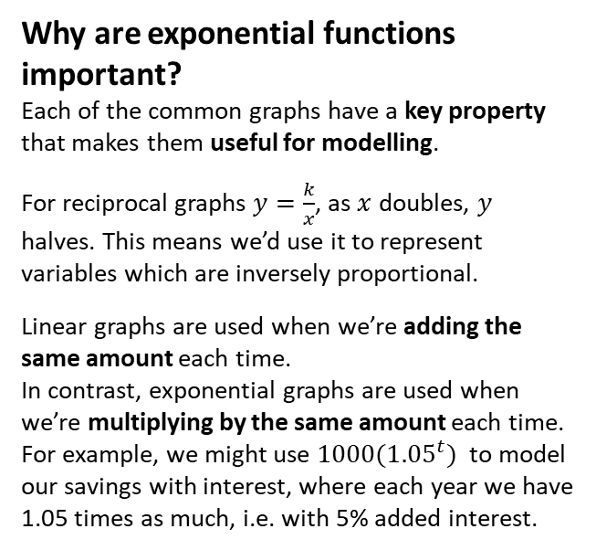

8
20
16
12
8
4
-4
$$y=2^{x}$$
$$x$$ | -2 | -1 | 0 | 1 | 2 | 3 | 4
$$y$$ | 0.25 | 0.5 | 1 | 2 | 4 | 8 | 16
?
?
?
?
?
?
?
Fro Note: Ensure that you can distinguish between a $x^{a}$ (e.g. polynomial) term and an $a^{x}$ exponential term. In the former the variable is in the base, and in the letter the variable is in the power. $2^{x}$ behaves very differently to $x^{2}$, both in its rate of growth (i.e. exponential terms grow much faster!) and how it differentiates.
Why are exponential functions important?
Each of the common graphs have a key property that makes them useful for modelling.
For reciprocal graphs $y=\frac{k}{x}$, as $x$ doubles, $y$ halves. This means we’d use it to represent variables which are inversely proportional.
Linear graphs are used when we’re adding the same amount each time.
In contrast, exponential graphs are used when we’re multiplying by the same amount each time. For example, we might use ${1000(1.05}^{t})$ to model our savings with interest, where each year we have 1.05 times as much, i.e. with 5% added interest.
-2 -1 1 2 3 4 5 6 7
Notes:
Get students to sketch axes and tables in their books.

Slide 3
Contrasting exponential graphs
On the same axes sketch $y=3^{x}, y=2^{x}$, $y={1.5}^{x}$
On the same axes sketch $y=2^{x}$ and $y={\left(\frac{1}{2}\right)}^{x}$

Slide 4

Graph Transformations
Sketch $y=2^{x+3}$

Slide 5



Differentiating $y=ae^{kx}$
! If $y=e^{kx}$, where $k$ is a constant, then $\frac{dy}{dx}=ke^{kx}$
Different $e^{5x}$ with respect to $x$.
Different $e^{−x}$ with respect to $x$.
Different $4e^{3x}$ with respect to $x$.

Slide 6

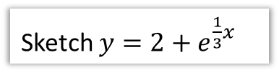

More Graph Transformations
Sketch $y=e^{3x}$
Sketch $y=5e^{−x}$
Sketch $y=2+e^{\frac{1}{3}x}$

Slide 7

Test Your Understanding
Sketch $y=e^{−2x}−1$

Slide 8


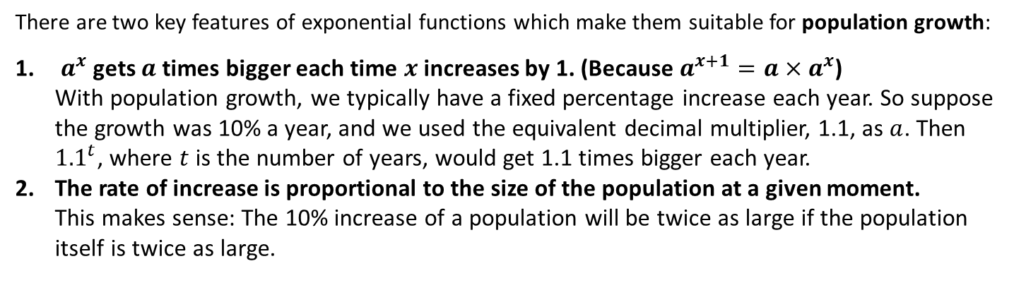

Exponential Modelling
There are two key features of exponential functions which make them suitable for population growth:
$a^{x}$ gets $a$ times bigger each time $x$ increases by 1. (Because $a^{x+1}=a×a^{x}$)
With population growth, we typically have a fixed percentage increase each year. So suppose the growth was 10% a year, and we used the equivalent decimal multiplier, 1.1, as $a$. Then ${1.1}^{t}$, where $t$ is the number of years, would get 1.1 times bigger each year.
The rate of increase is proportional to the size of the population at a given moment.
This makes sense: The 10% increase of a population will be twice as large if the population itself is twice as large.
Suppose the population $P$ in The Republic of Dave is modelled by $P=100e^{3t}$ where $t$ is the numbers years since The Republic was established.
$$P$$
What is the initial population?
What is the initial rate of population growth?
$$t$$

Slide 9
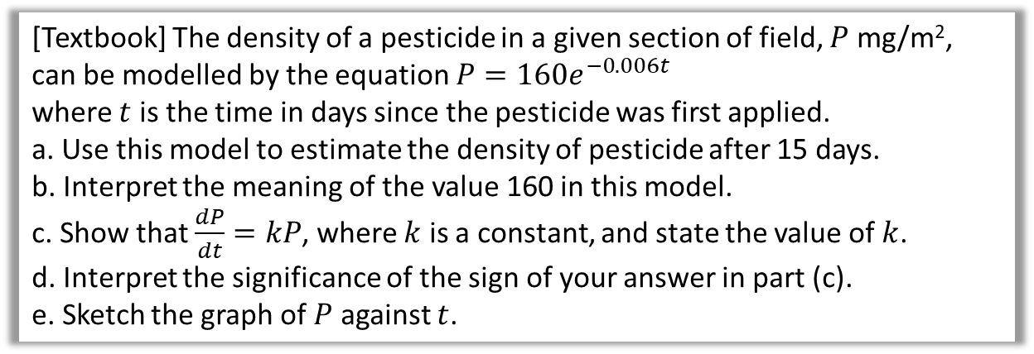
Another Example
[Textbook] The density of a pesticide in a given section of field, $P$ mg/m², can be modelled by the equation $P=160e^{−0.006t}$
where $t$ is the time in days since the pesticide was first applied.
a. Use this model to estimate the density of pesticide after 15 days.
b. Interpret the meaning of the value 160 in this model.
c. Show that $\frac{dP}{dt}=kP$, where $k$ is a constant, and state the value of $k$.
d. Interpret the significance of the sign of your answer in part (c).
e. Sketch the graph of $P$ against $t$.

Slide 10










Logarithms
You know the inverse of many mathematical operations; we can undo an addition by 2 for example by subtracting 2. But is there an inverse function for an exponential function?
Function
Inverse
12
4
$$x×3$$
$$x÷3$$
4
?
7
4
$$x+3$$
$$x−3$$
4
?
16
4
$$x^{2}$$
$$\sqrt{x}$$
4
?
1024
4
$$x^{5}$$
$$\sqrt[5]{x}$$
4
?
81
4
$$3^{x}$$
$$\log_{3}{x}$$
4
?
Such functions are known as logarithms, and exist in order to provide an inverse to exponential functions.

Slide 11
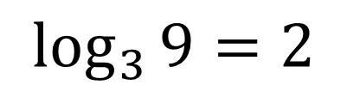
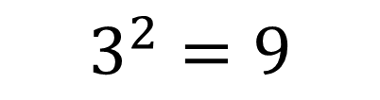
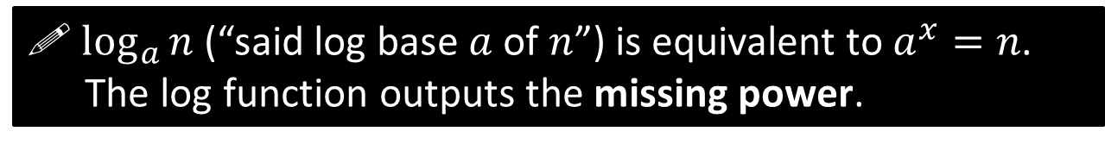
Interchanging between exponential and log form
! $\log_{a}{n}$ (“said log base $a$ of $n$”) is equivalent to $a^{x}=n$.
The log function outputs the missing power.
$$3^{2}=9$$
$$\log_{3}{9}=2$$

Slide 12
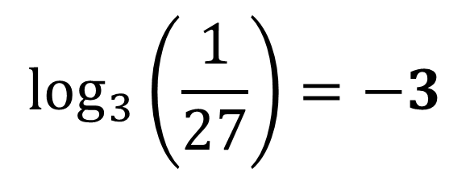
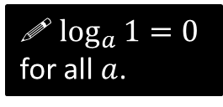
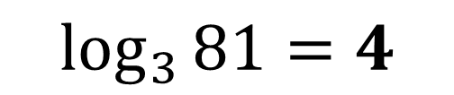
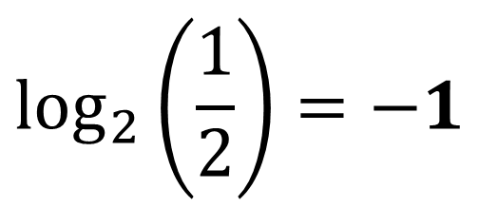

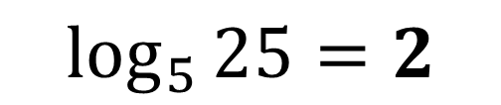

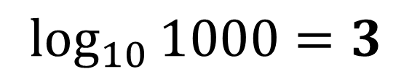
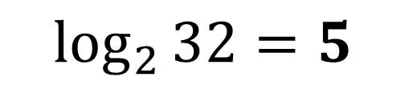
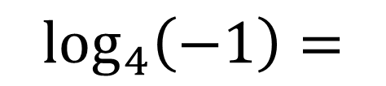
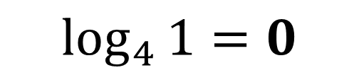
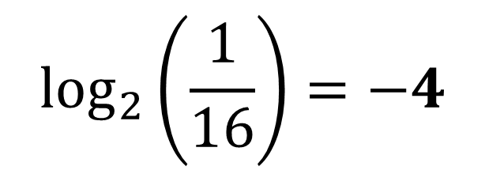
Examples
$$\log_{3}\left(\frac{1}{27}\right)=−3$$
$$\log_{5}{25}=2$$
Think: “5 to the power of what gives you 25?”
$$\log_{3}{81}=4$$
$$\log_{2}\left(\frac{1}{16}\right)=−4$$
$$\log_{2}{32}=5$$
$$\log_{10}{1000}=3$$
$$\log_{a}\left(a^{3}\right)=3$$
$$\log_{4}{1}=0$$
! $\log_{a}{1}=0$ for all $a$.
$$\log_{4}\left(−1\right)=$$
NOPE
$$\log_{4}{4}=1$$
$$\log_{2}\left(\frac{1}{2}\right)=−1$$

Slide 13




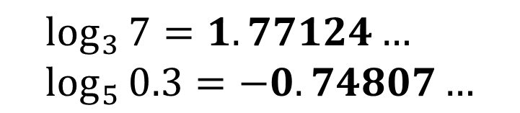
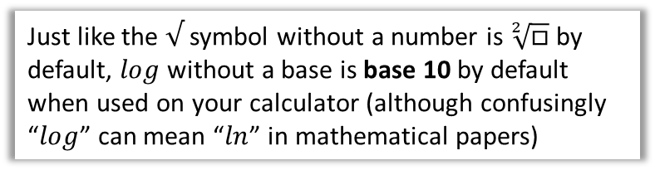

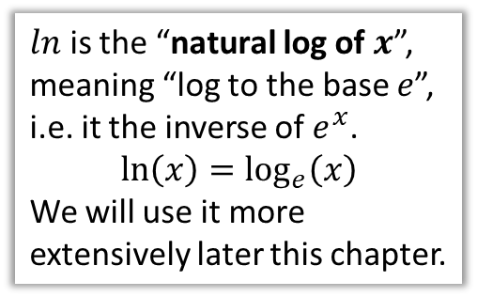
With Your Calculator
There are three buttons on your calculator for computing logs:
$$\log_{□}{□}$$
$$\log_{3}{7}=1.77124… \\ \log_{5}{0.3}=−0.74807…$$
$$ln$$
$$\ln{10}=2.30258… \\ \ln{e}=1$$
$ln$ is the “natural log of $x$”, meaning “log to the base $e$”, i.e. it the inverse of $e^{x}$.
$$\ln\left(x\right)=\log_{e}\left(x\right)$$
We will use it more extensively later this chapter.
$$log$$
$$\log{100}=2$$
Just like the $√$ symbol without a number is $\sqrt[2]{□}$ by default, $log$ without a base is base 10 by default when used on your calculator (although confusingly “$log$” can mean “$ln$” in mathematical papers)

Slide 14
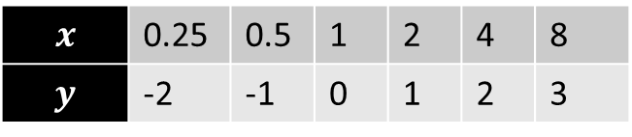
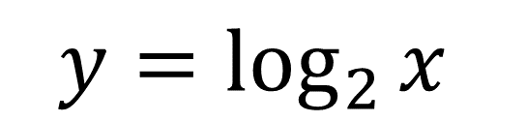
8
4
3
2
1
-1
-2
$$y=\log_{2}{x}$$
$$x$$ | 0.25 | 0.5 | 1 | 2 | 4 | 8
$$y$$ | -2 | -1 | 0 | 1 | 2 | 3
-2 -1 1 2 3 4 5 6 7
Notes:
Get students to sketch axes and tables in their books.

Slide 15
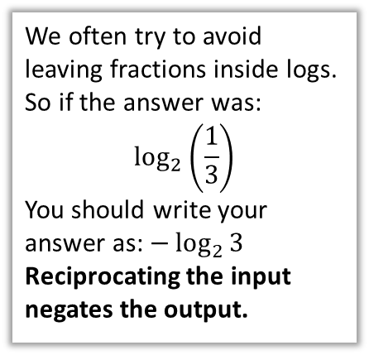
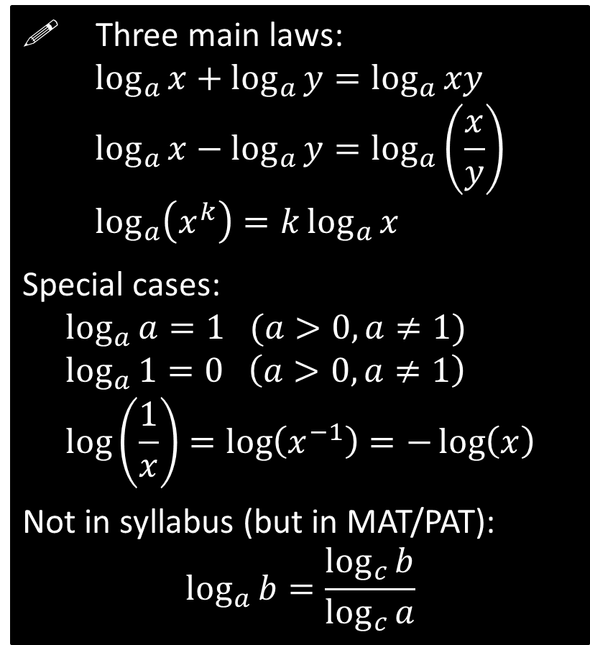
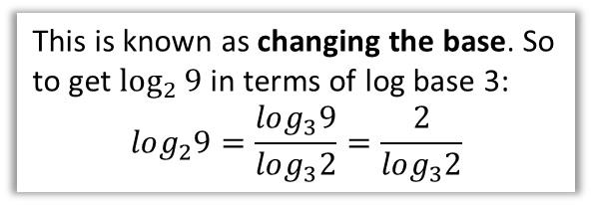
Laws of Logs
! Three main laws:
$$\log_{a}{x}+\log_{a}{y}=\log_{a}{xy} \\ \log_{a}{x}−\log_{a}{y}=\log_{a}\left(\frac{x}{y}\right) \\ \log_{a}\left(x^{k}\right)=k\log_{a}{x}$$
Special cases:
$$\log_{a}{a}=1 (a>0, a≠1) \\ \log_{a}{1}=0 \left(a>0, a≠1\right) \\ \log\left(\frac{1}{x}\right)=\log\left(x^{−1}\right)=−\log\left(x\right)$$
Not in syllabus (but in MAT/PAT):
$$\log_{a}{b}=\frac{\log_{c}{b}}{\log_{c}{a}}$$
The logs must have a consistent base.
i.e. You can move the power to the front.
We often try to avoid leaving fractions inside logs.
So if the answer was:
$$\log_{2}\left(\frac{1}{3}\right)$$
You should write your answer as: $−\log_{2}{3}$
Reciprocating the input negates the output.
This is known as changing the base. So to get $\log_{2}{9}$ in terms of log base 3:
$$log_{2}9=\frac{log_{3}9}{log_{3}2}=\frac{2}{log_{3}2}$$

Slide 16
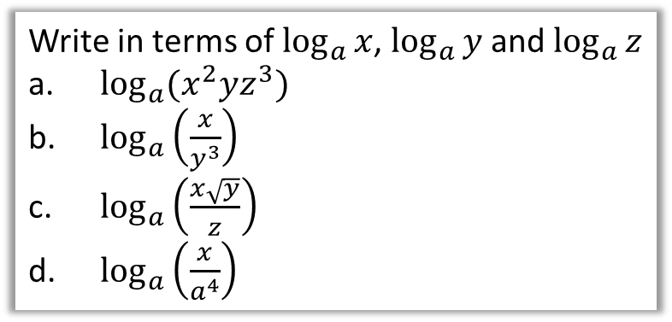
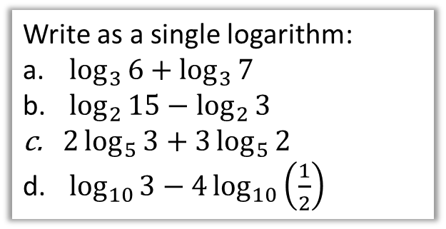
Examples
Write as a single logarithm:
$\log_{3}{6}+\log_{3}{7}$
$\log_{2}{15}−\log_{2}{3}$
$2\log_{5}{3}+3\log_{5}{2}$
$\log_{10}{3}−4\log_{10}\left(\frac{1}{2}\right)$
Write in terms of $\log_{a}{x}$, $\log_{a}{y}$ and $\log_{a}{z}$
$\log_{a}{(x^{2}yz^{3}})$
$\log_{a}\left(\frac{x}{y^{3}}\right)$
$\log_{a}\left(\frac{x\sqrt{y}}{z}\right)$
$\log_{a}\left(\frac{x}{a^{4}}\right)$

Slide 17

Solving Equations with Logs
Solve the equation $\log_{10}{4}+2\log_{10}{x}=2$
This is a very common type of exam question.
The strategy is to combine the logs into one and isolate on one side.

Slide 18
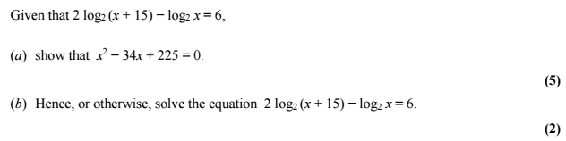
Test Your Understanding
Edexcel C2 Jan 2013 Q6

Slide 19


Solving equations with exponential terms
Solve $3^{x}=20$
This is often said “Taking logs of both sides…”
Solve $5^{4x−1}=61$

Slide 20

Solving equations with exponential terms
Solve $3^{x}=2^{x+1}$

Slide 21
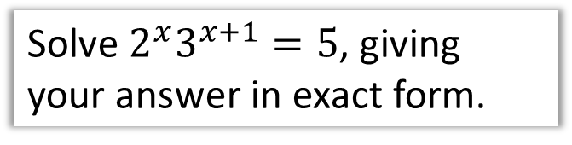
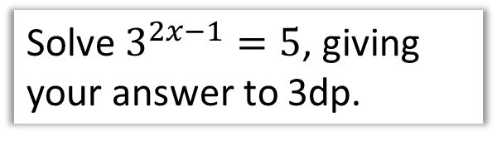
Test Your Understanding
1
Solve $3^{2x−1}=5$, giving your answer to 3dp.
3
Solve $2^{x}3^{x+1}=5$, giving your answer in exact form.
2
Solve $3^{x+1}=4^{x−1}$, giving your answer to 3dp.

Slide 22


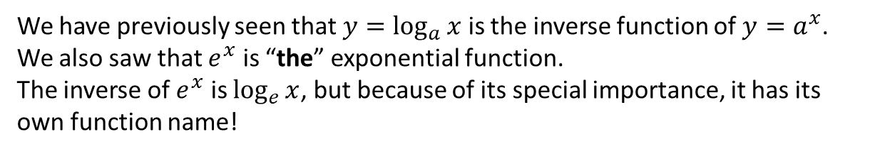

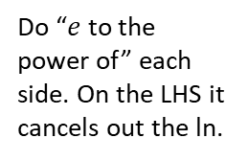
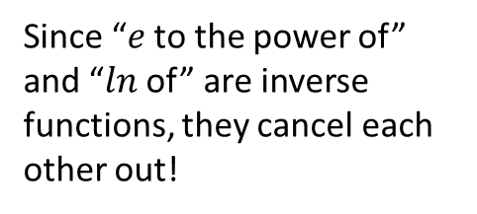

Natural Logarithms
We have previously seen that $y=\log_{a}{x}$ is the inverse function of $y=a^{x}$.
We also saw that $e^{x}$ is “the” exponential function.
The inverse of $e^{x}$ is $\log_{e}{x}$, but because of its special importance, it has its own function name!
! The inverse of $y=e^{x}$ is $y=\ln{x}$
$$\ln{e^{x}}=x \\ e^{\ln{x}}=x$$
Since “$e$ to the power of” and “$ln$ of” are inverse functions, they cancel each other out!
Solve $e^{x}=5$
Solve $2\ln{x}+1=5$
Do “$e$ to the power of” each side. On the LHS it cancels out the ln.

Slide 23
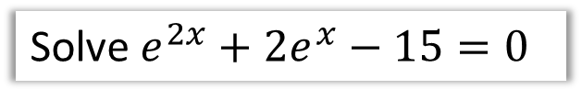

Quadratics in $e^{x}$
In previous chapters we’ve already dealt with quadratics in disguise, e.g. “quadratic in sin”. We therefore just apply our usual approach: either make a suitable substitution so the equation is then quadratic, or (strongly recommended!) go straight for the factorisation.
Solve $e^{2x}+2e^{x}−15=0$
Solve $e^{x}−2e^{−x}=1$

Slide 24


Test Your Understanding
Solve $\ln\left(3x+1\right)=2$
Solve $e^{2x}+5e^{x}=6$
Solve $2^{x}e^{x+1}=3$ giving your answer as an exact value.

Slide 25






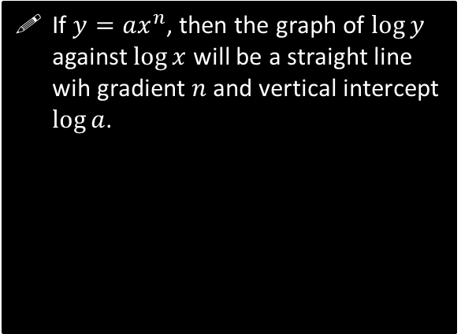
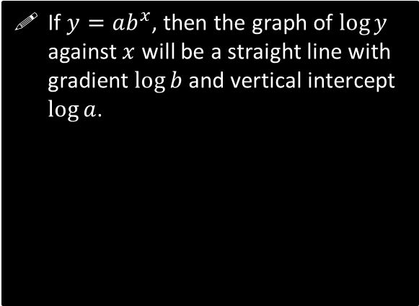
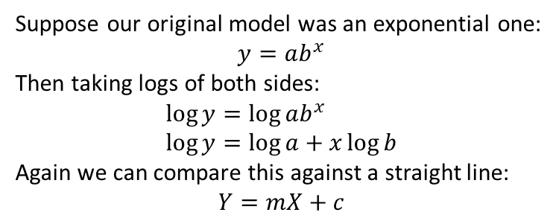
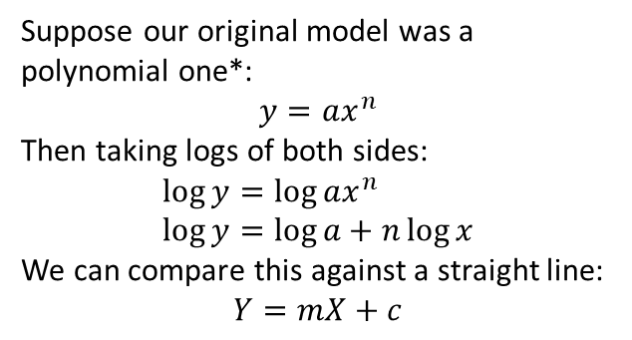


Turning non-linear graphs into linear ones
Case 1: Polynomial $→$ Linear
Case 2: Exponential $→$ Linear
Suppose our original model was a polynomial one*:
$$y=ax^{n}$$
Then taking logs of both sides:
$$\log{y}=\log{ax^{n}} \\ \log{y}=\log{a}+n\log{x}$$
We can compare this against a straight line:
$$Y=mX+c$$
Suppose our original model was an exponential one:
$$y=ab^{x}$$
Then taking logs of both sides:
$$\log{y}=\log{ab^{x}} \\ \log{y}=\log{a}+x\log{b}$$
Again we can compare this against a straight line:
$$Y=mX+c$$
If $y=ax^{n}$, then the graph of $\log{y}$ against $\log{x}$ will be a straight line wih gradient $n$ and vertical intercept $\log{a}$.
If $y=ab^{x}$, then the graph of $\log{y}$ against $x$ will be a straight line with gradient $\log{b}$ and vertical intercept $\log{a}$.
$$\log{y}$$
$$\log{y}$$
$$\log{a}$$
$$\log{a}$$
$$\log{x}$$
$$x$$

Slide 26

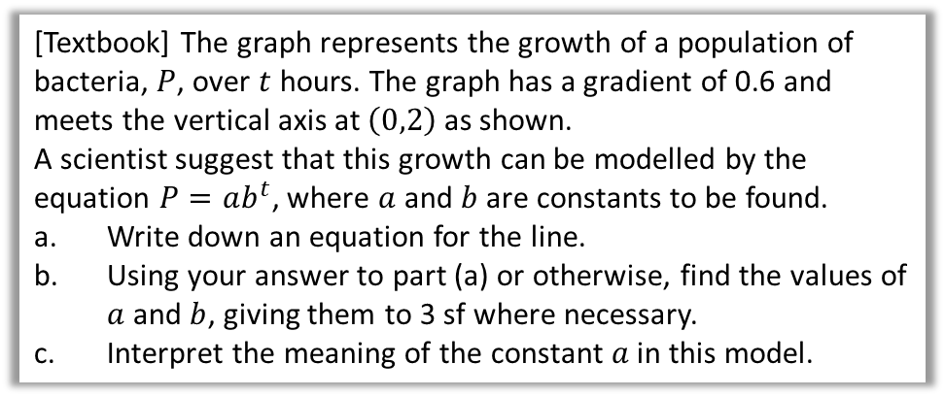


Example
[Textbook] The graph represents the growth of a population of bacteria, $P$, over $t$ hours. The graph has a gradient of 0.6 and meets the vertical axis at $\left(0,2\right)$ as shown.
A scientist suggest that this growth can be modelled by the equation $P=ab^{t}$, where $a$ and $b$ are constants to be found.
Write down an equation for the line.
Using your answer to part (a) or otherwise, find the values of $a$ and $b$, giving them to 3 sf where necessary.
Interpret the meaning of the constant $a$ in this model.
$$log⁡(P)$$
$$2$$
$$t$$

Slide 27

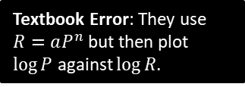
Example
[Textbook] The table below gives the rank (by size) and population of the UK’s largest cities and districts (London is number 1 but has been excluded as an outlier).
City B’ham Leeds Glasgow Sheffield Bradford
Rank, $R$ 2 3 4 5 6
Population, $P$ 1 000 000 730 000 620 000 530 000 480 000
The relationship between the rank and population can be modelled by the formula:
$P=aR^{n}$ where $a$ and $n$ are constants.
Draw a table giving values of $\log{R}$ and $\log{P}$ to 2dp.
Plot a graph of $\log{R}$ against $\log{P}$ using the values from your table and draw the line of best fit.
Use your graph to estimate the values of $a$ and $n$ to two significant figures.
Textbook Error: They use $R=aP^{n}$ but then plot $\log{P}$ against $\log{R}$.

Slide 28
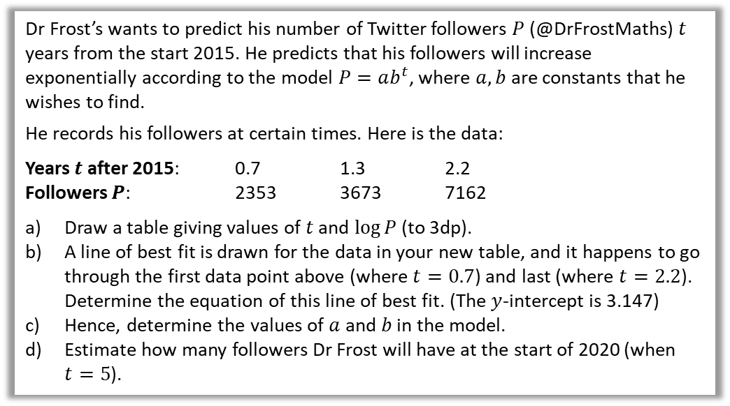
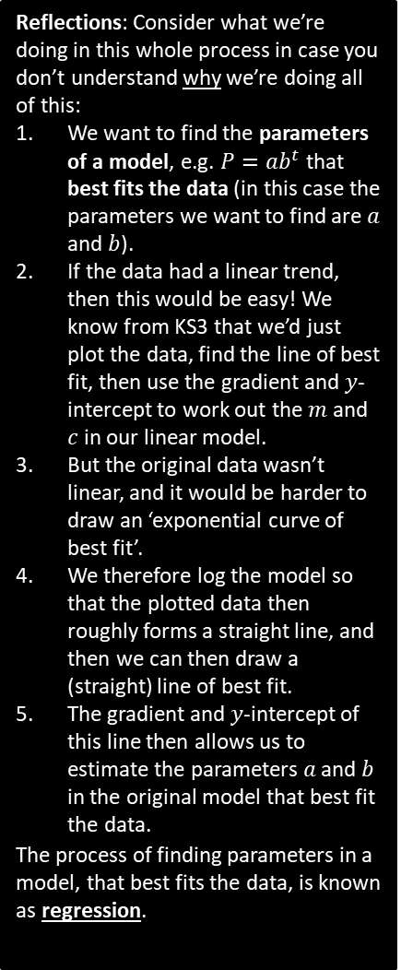
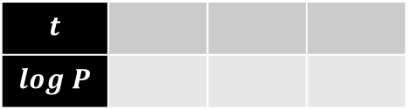
Test Your Understanding
Reflections: Consider what we’re doing in this whole process in case you don’t understand why we’re doing all of this:
We want to find the parameters of a model, e.g. $P=ab^{t}$ that best fits the data (in this case the parameters we want to find are $a$ and $b$).
If the data had a linear trend, then this would be easy! We know from KS3 that we’d just plot the data, find the line of best fit, then use the gradient and $y$-intercept to work out the $m$ and $c$ in our linear model.
But the original data wasn’t linear, and it would be harder to draw an ‘exponential curve of best fit’.
We therefore log the model so that the plotted data then roughly forms a straight line, and then we can then draw a (straight) line of best fit.
The gradient and $y$-intercept of this line then allows us to estimate the parameters $a$ and $b$ in the original model that best fit the data.
The process of finding parameters in a model, that best fits the data, is known as regression.
Dr Frost’s wants to predict his number of Twitter followers $P$ (@DrFrostMaths) $t$ years from the start 2015. He predicts that his followers will increase exponentially according to the model $P=ab^{t}$, where $a,b$ are constants that he wishes to find.
He records his followers at certain times. Here is the data:
Years $t$ after 2015: 0.7 1.3 2.2
Followers $P$: 2353 3673 7162
Draw a table giving values of $t$ and $\log{P}$ (to 3dp).
A line of best fit is drawn for the data in your new table, and it happens to go through the first data point above (where $t=0.7$) and last (where $t=2.2$).
Determine the equation of this line of best fit. (The $y$-intercept is 3.147)
Hence, determine the values of $a$ and $b$ in the model.
Estimate how many followers Dr Frost will have at the start of 2020 (when $t=5$).
a
b
$$t$$
$$log P$$
c
d

