Slide 1
NO et MOI
Essai 1
Autumn Benchmark
« Lou et No s’entendent si bien parce que leurs vies sont similaires. » Dans quelle mesure êtes-vous d’accord avec ce jugement ?

Slide 2
AQA mark scheme Content (20 marks)
Top marks: Excellent critical and analytical response to the question with knowledge of the film or text consistently accurate and detailed. Opinions, views and conclusions are consistently supported by relevant & appropriate evidence. Essay demonstrates excellent evaluation of the issues, themes & cultural and social contexts of the text or film.
Quality of language (20 marks)
Top marks: The language is mainly accurate with only occasional minor errors. Consistent secure grasp of grammar and able to manipulate complex structures accurately. Wide range of vocabulary appropriate to task and context.

Slide 3
Content
Excellent critical and analytical response to the question with knowledge of the film or text consistently accurate and detailed.
Opinions, views and conclusions are consistently supported by relevant & appropriate evidence.
Essay demonstrates excellent evaluation of the issues, themes & cultural and social contexts of the text or film.

Slide 4
Structure:
INTRODUCTION: Identify the topic without rewriting the essay title. You ned to show your understanding of the question and work. Single paragraph which respond CONCISELY to the essay question.
Body of the essay:
In several interconnected paragraphs you should give evidence to support a number of main points.
Each point will carefully pick up and develop a point.
Each paragraph should start with a sentence stating what each paragraph is about.
Make sure you follow a clear logic all to lead to the conclusion.

Slide 5
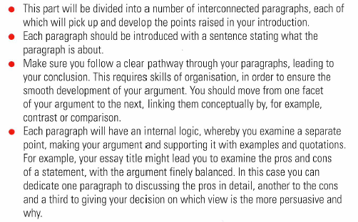
Body of the essay

Slide 6
Content
Excellent critical and analytical response to the question with knowledge of the film or text consistently accurate and detailed.
Opinions, views and conclusions are consistently supported by relevant & appropriate evidence.
Essay demonstrates excellent evaluation of the issues, themes & cultural and social contexts of the text or film.

Slide 7
Conclusion

Slide 8
« Lou et No s’entendent si bien parce que leurs vies sont similaires. » Dans quelle mesure êtes-vous d’accord avec ce jugement ?
Leurs vies sont-elles similaires?
Quelles sont leurs différences?
Sont-elles essentielles? Dans quelle mesure le sont-elles ou pas?
Et dans quelle mesure est-ce important?

