Slide 1
Influential films
wider context

Slide 2
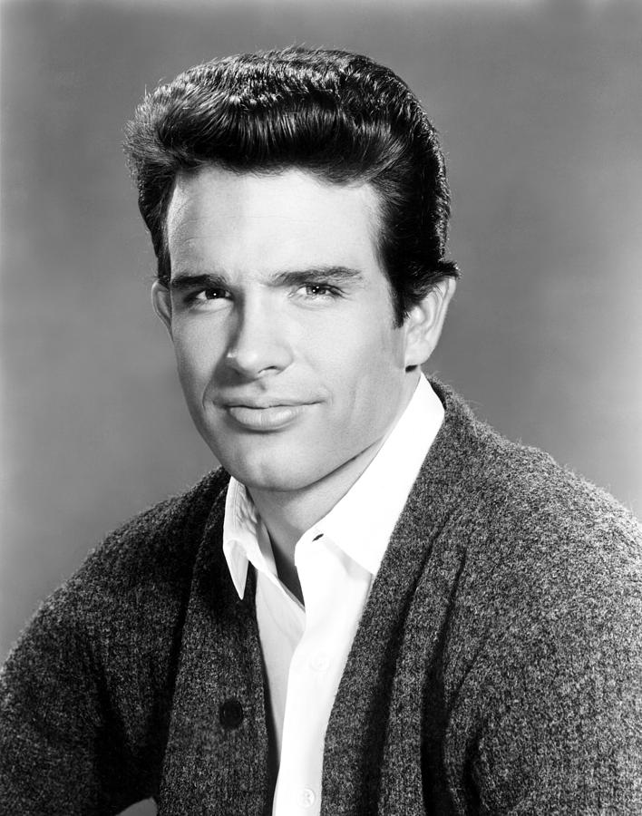
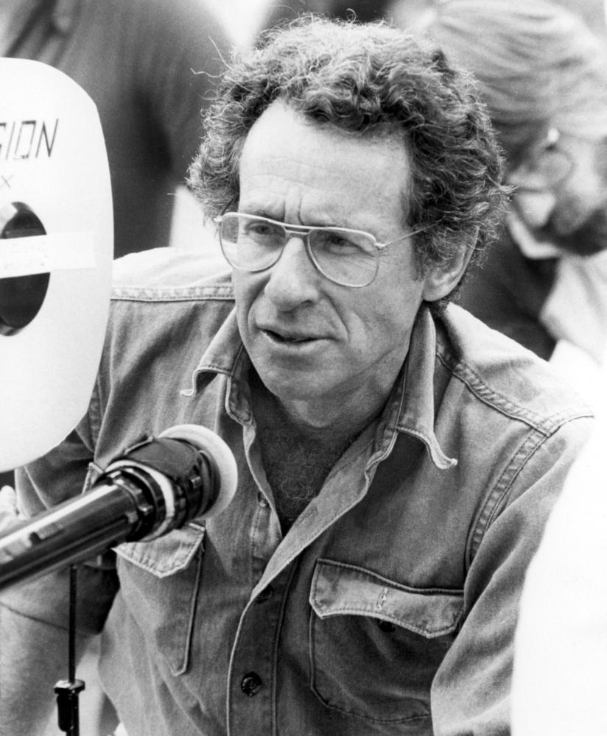
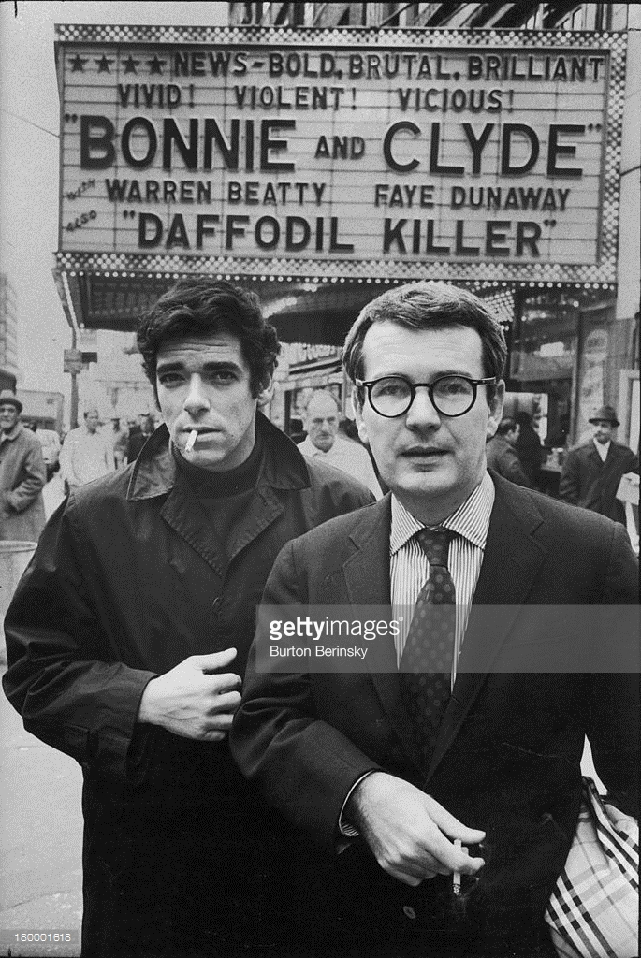
Auteur
‘The auteur theory, holds that the director, who oversees all audio and visual elements of the motion picture, is more to be considered the “author” of the movie than is the writer of the screenplay. In other words, such fundamental visual elements as camera placement, blocking, lighting, and scene length, rather than plot line, convey the message of the film. Supporters of the auteur theory further contend that the most cinematically successful films will bear the unmistakable personal stamp of the director.’
But is it as simple as naming the director as the Auteur in Bonnie and Clyde?
Who had the most influence over the films visual style and ideology?

Slide 3
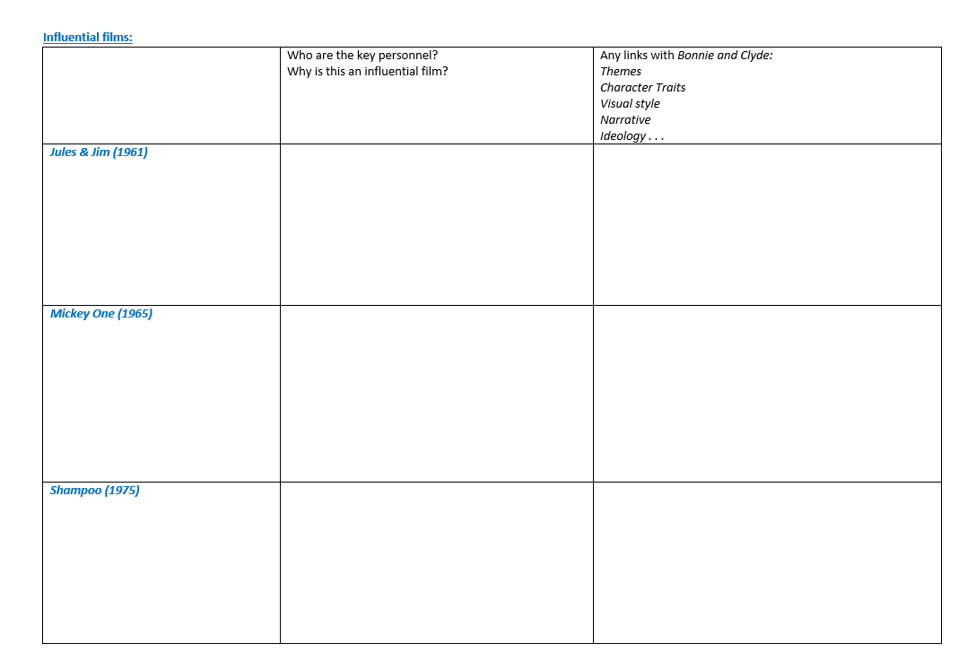
WORK SHEET

Slide 4
Jules & Jim (1961)
David Newman and Robert Benton were said to be ‘captivated by the zest and spirit of the French New Wave directors, Francois Truffaut and Jean-Luc Godard when writing Bonnie and Clyde.
Two of Truffaut’s films provided lasting influence on the writers; Shoot the Piano Player (1960) with it’s stylish combination of humour and darkness within a milieu of noir gangsterism and Jules and Jim (1961) a love triangle drenched in an atmospheric past which spoke to the problems of the present.
Truffaut was offered the opportunity to direct Bonnie and Clyde but turned it down to make Fahrenheit 451 (1966). However, he did provide notes on crucial visual and dramatic ideas that found their way into the final script.

Slide 5
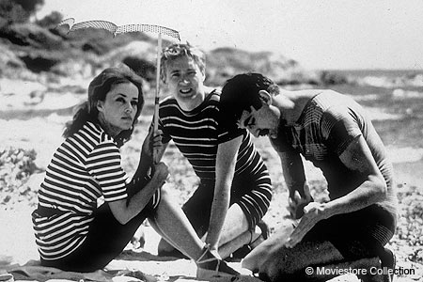
Watch the first 25 mins and take notes on your worksheet.

Slide 6
Mickey One (1965)
Mickey One is an art house film, heavily influence by the French New Wave, starring Warren Beatty and directed by Arthur Penn, from a script by Alan Surgal. Its kaleidoscopic camerawork, film noir atmosphere, lighting and design aspects, philosophical themes and Warren Beatty’s performance in the title role, turned the film into a cult classic.
Mickey One is certainly the director’s most overtly European picture, replete with Nouvelle Vague-like jump cuts, narrative ellipses and fragmentation and a frequent use of loaded symbols such as mirrors. Even so, Beatty’s protagonist is very much a typical Penn character, one in search of a stable identity and understanding of himself.
While retaining a deep concern for quintessentially American themes, Penn also explored a mode of vividly stylised cinema in works such as Mickey One and The Chase that engaged in a crucial dialogue with the French New Wave.
http://hcl.harvard.edu/hfa/films/2008janfeb/penn.html (Article on Arthur Penn as Auteur)
http://sensesofcinema.com/2003/great-directors/penn/ (The works of Arthur Penn)

Slide 7
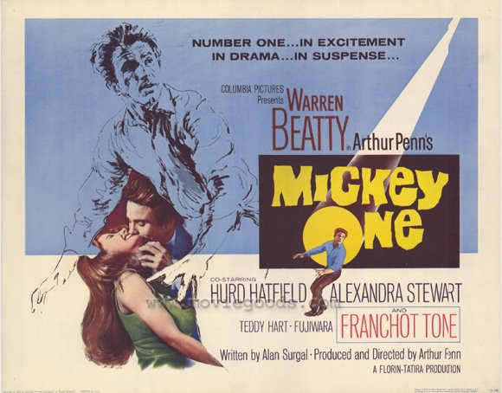
Watch the first 25 mins and take notes on your worksheet.

Slide 8
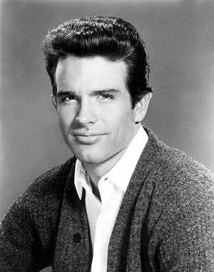
Shampoo (1975)
Shampoo is an American satirical romantic comedy-drama written by Robert Towne and Warren Beatty, and directed by Hal Ashby. It stars Warren Beatty, Julie Christie, and Goldie Hawn and, in a first film appearance, Carrie Fisher.
Beatty hired Towne to write a draft for a fee of $25,000 while they were making Bonnie and Clyde. Towne experienced writer’s block in 1968 and 1969, and it led to difficulties with Beatty.. He asked Robert Towne to write the screen play after the revisions Towne had made to Bonnie and Clyde’s original screenplay.
The main theme of the film is not presidential politics, but sexual politics; it is renowned for its sharp satire of late-1960s sexual and social manner.
If Shampoo had an auteur, it was probably Beatty. From the start Ashby was at a disadvantage. Beatty had filled the key production slots with his own people, and Hal had no allies, except for editor Bob Jones.
“Hal hated authority, and on that picture, Warren represented authority,”
“It was tough for him. I’d go on the set, and Warren and Towne would be off whispering in the corner. Hal would be sitting in the other corner.”
“I visited the set a number of times, Hal was like an office boy on that, and he wasn’t used to being that way. Warren chewed Hal up and spit him out.”
http://sensesofcinema.com/2005/spotlight-on-screenwriter-robert-towne/shampoo/ - Article on Shampoo

Slide 9
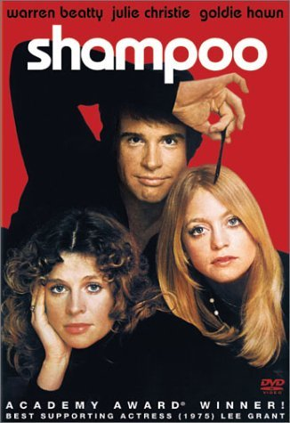
Watch the first 25 mins and take notes on your worksheet.

