Slide 1
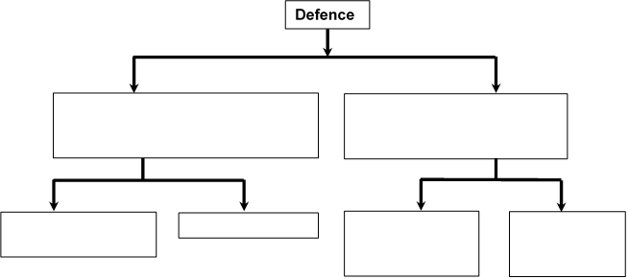
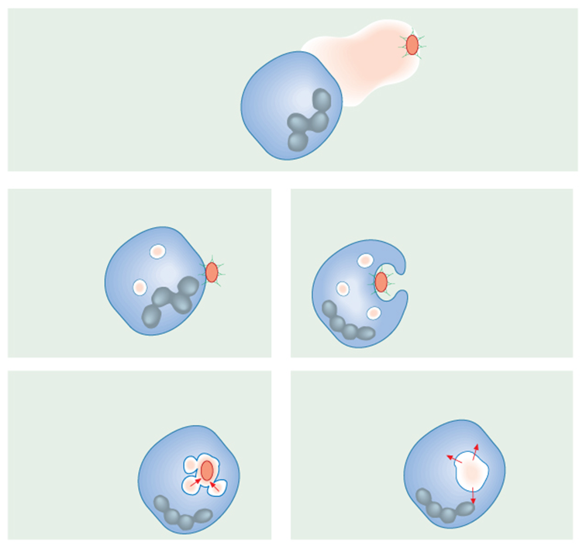
3.2.4 Cell recognition and the immune system
What is the first line of defence against disease?
Key words: can you define these?
Pathogen; immunity; lymphocytes; phagocytes; phagocytosis; phagosome; antigens; antigen-presenting; B lymphocytes; cell-mediated; T lymphocytes; antibodies; antigenic variability; humoral immunity; memory cells; mitosis; plasma cells;
Label the diagram to explain phagocytosis
Complete the overview map of the body’s defence mechanisms
Describe what antigens are and differentiate between self and non-self antigens
What are the two main types of lymphocyte and where are they formed?

Slide 2
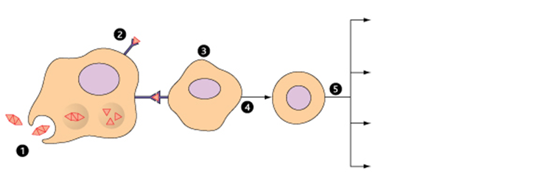
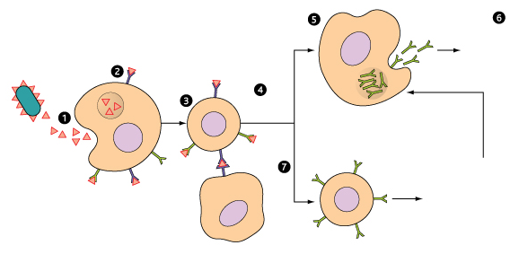
3.2.4 Cell recognition and the immune system
Label the diagram and explain the 5 steps of cell mediated immunity:
Label the diagram and label the steps of humoral immunity:
Draw and label an antibody. Explain the structure and function of antibodies

