Slide 1
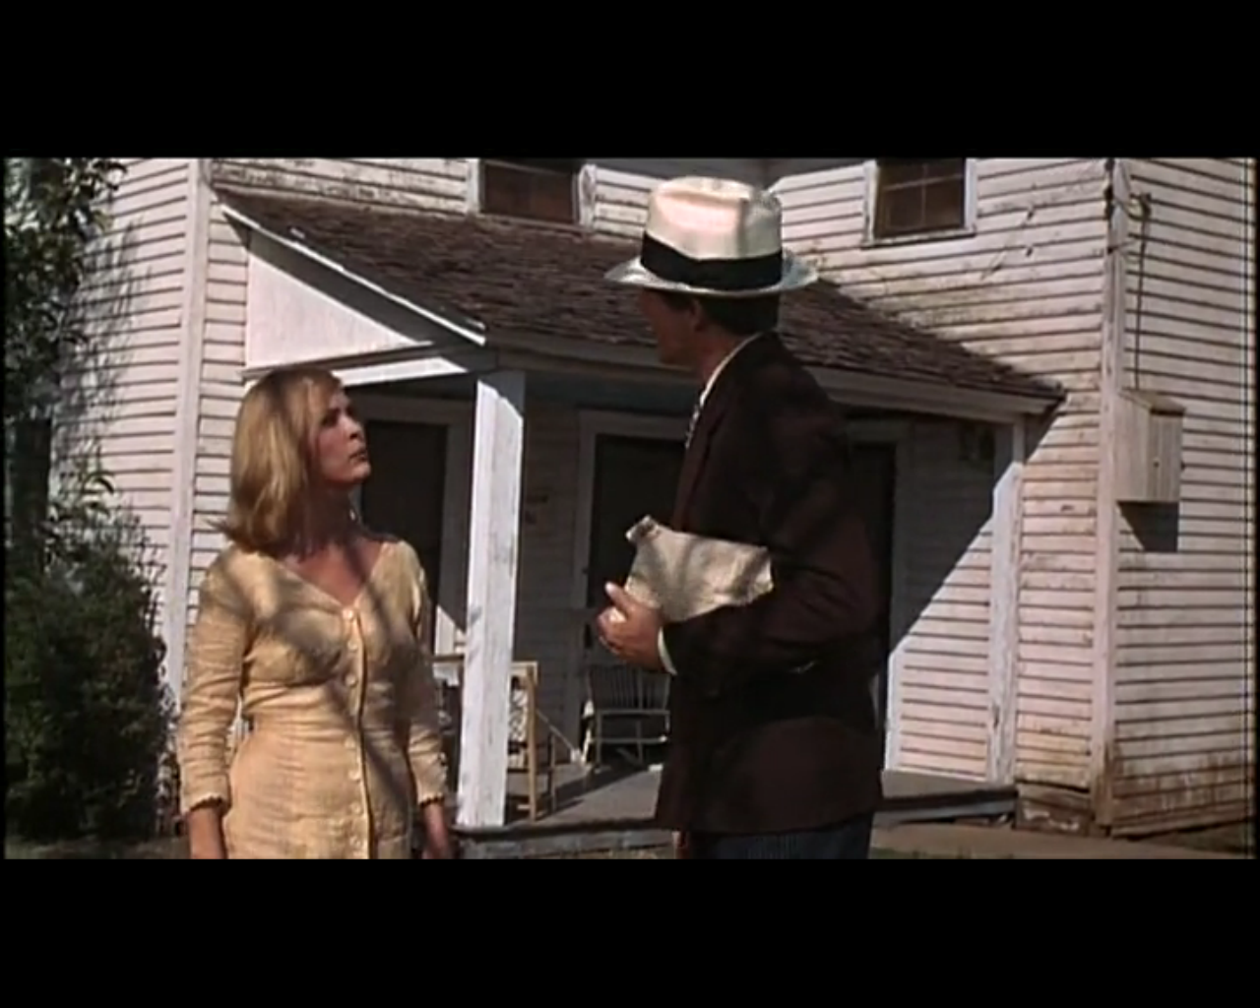
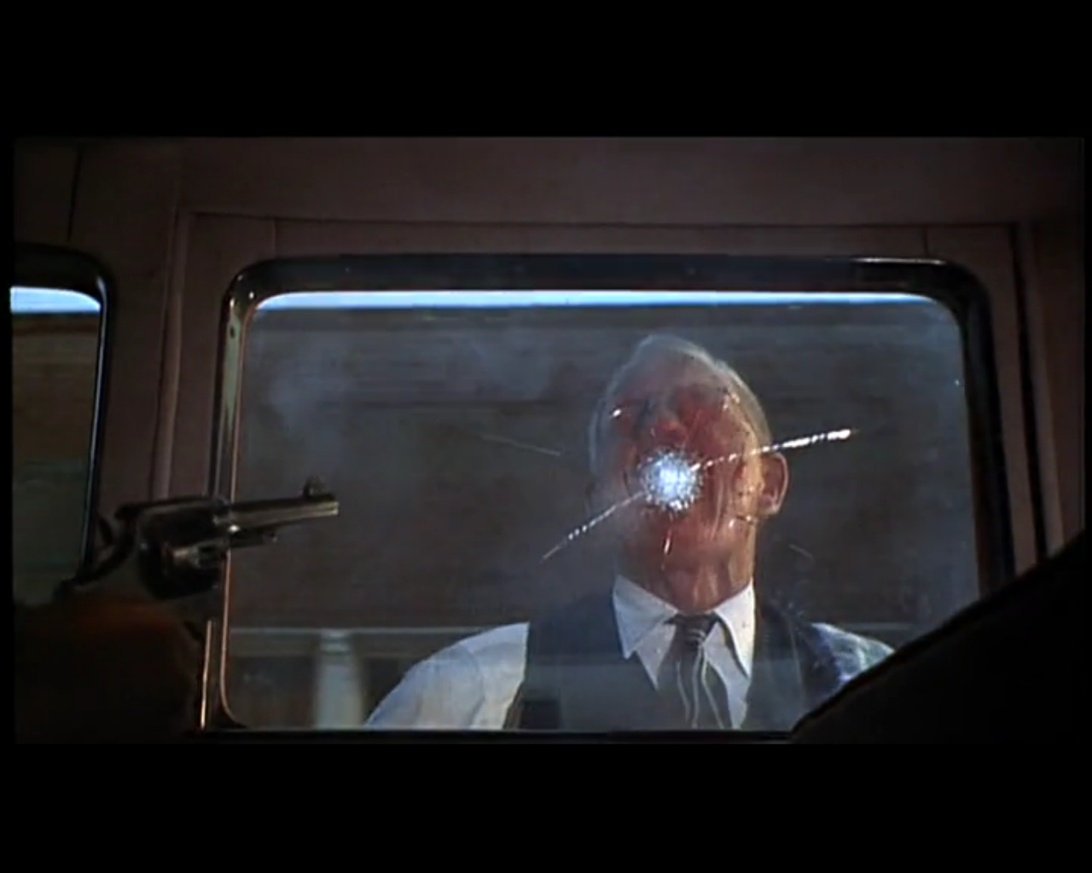
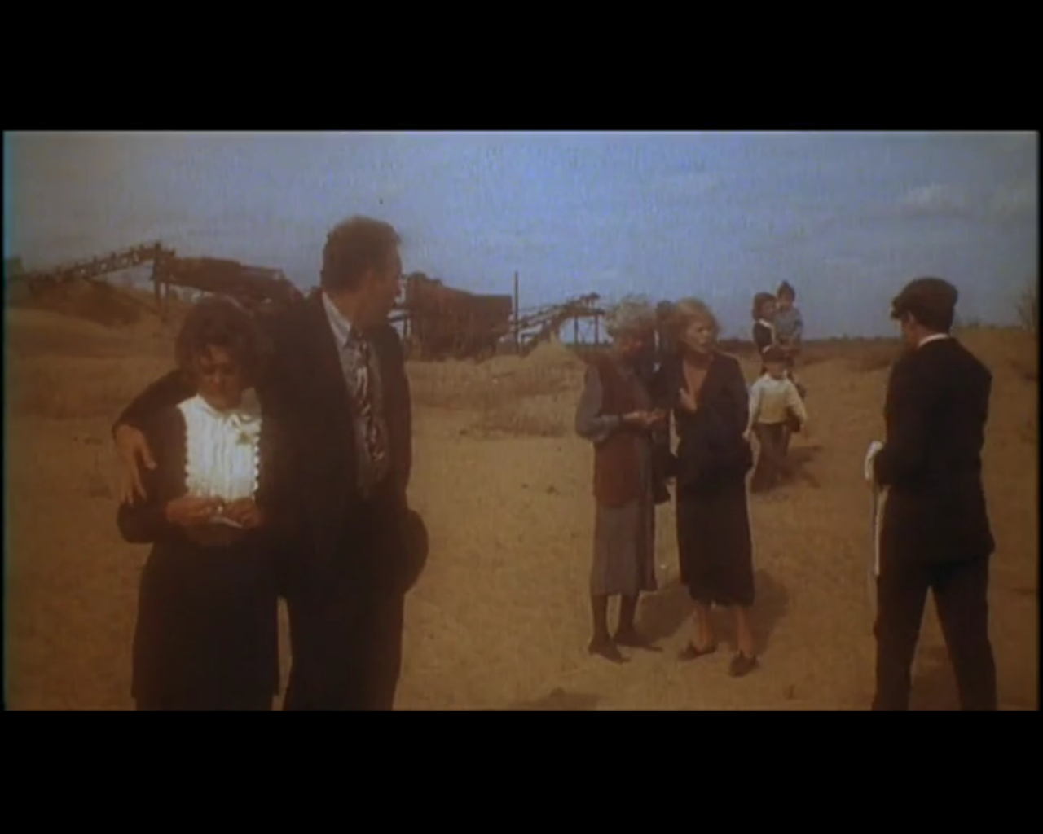
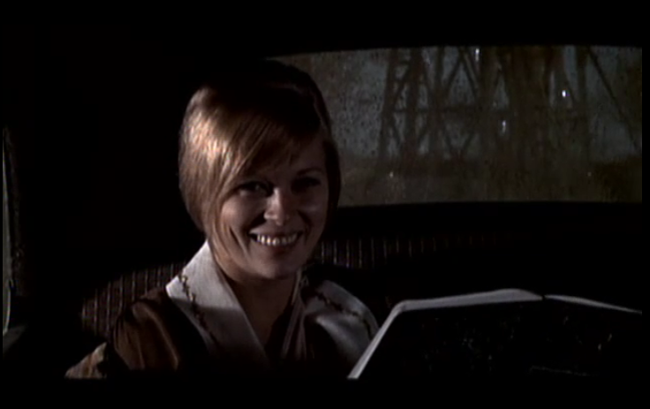
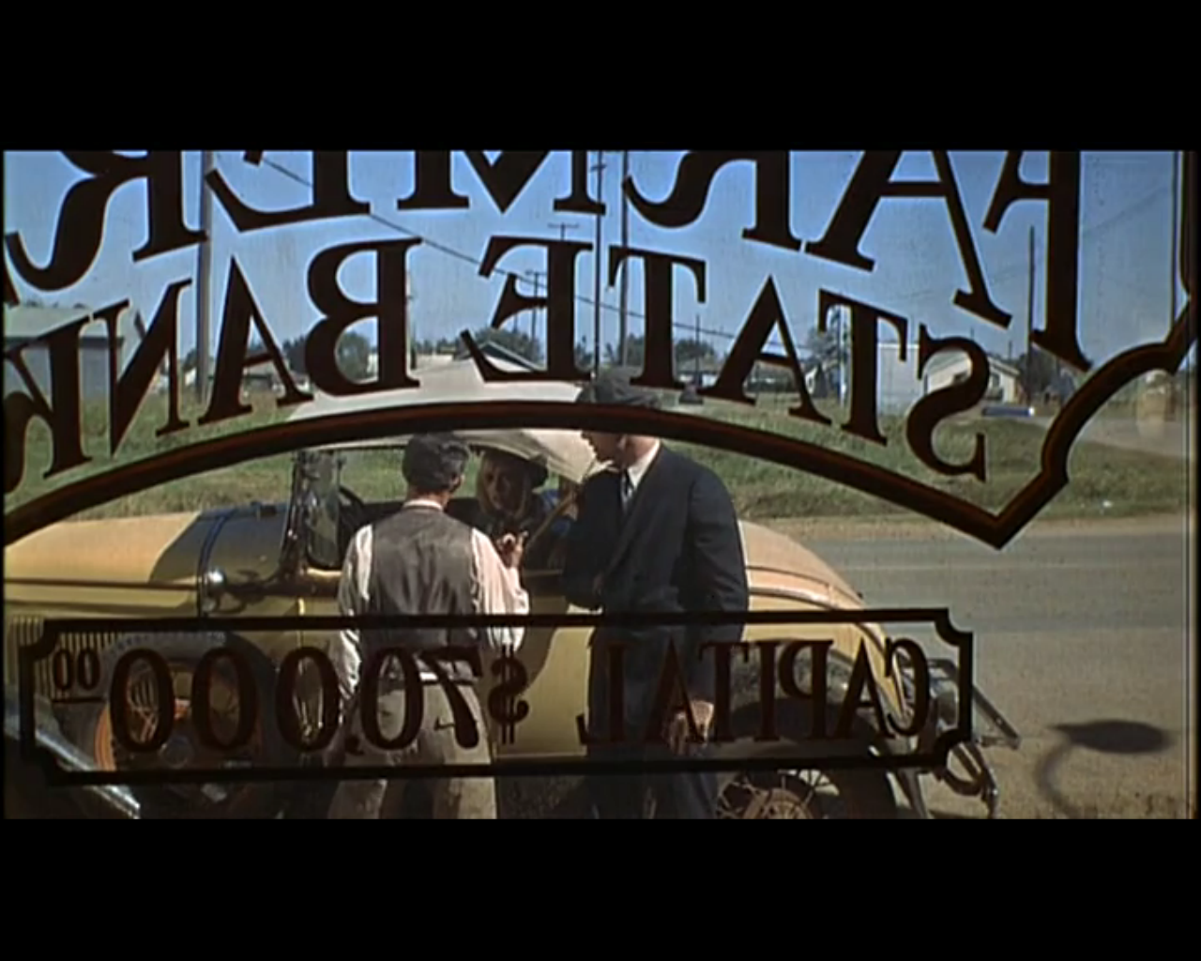
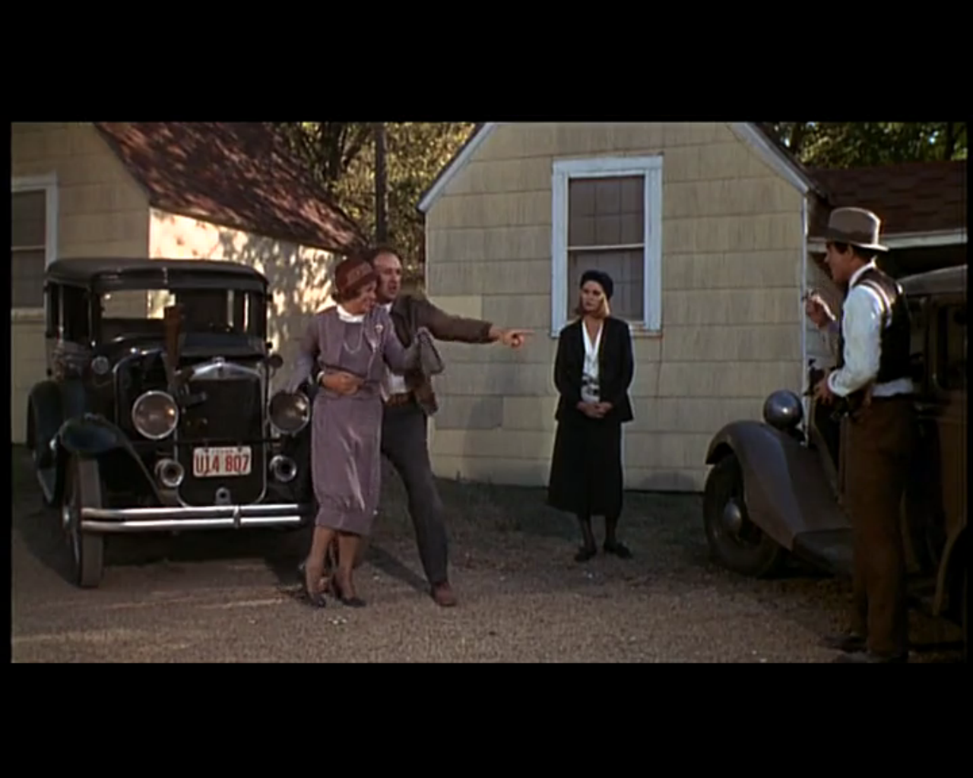
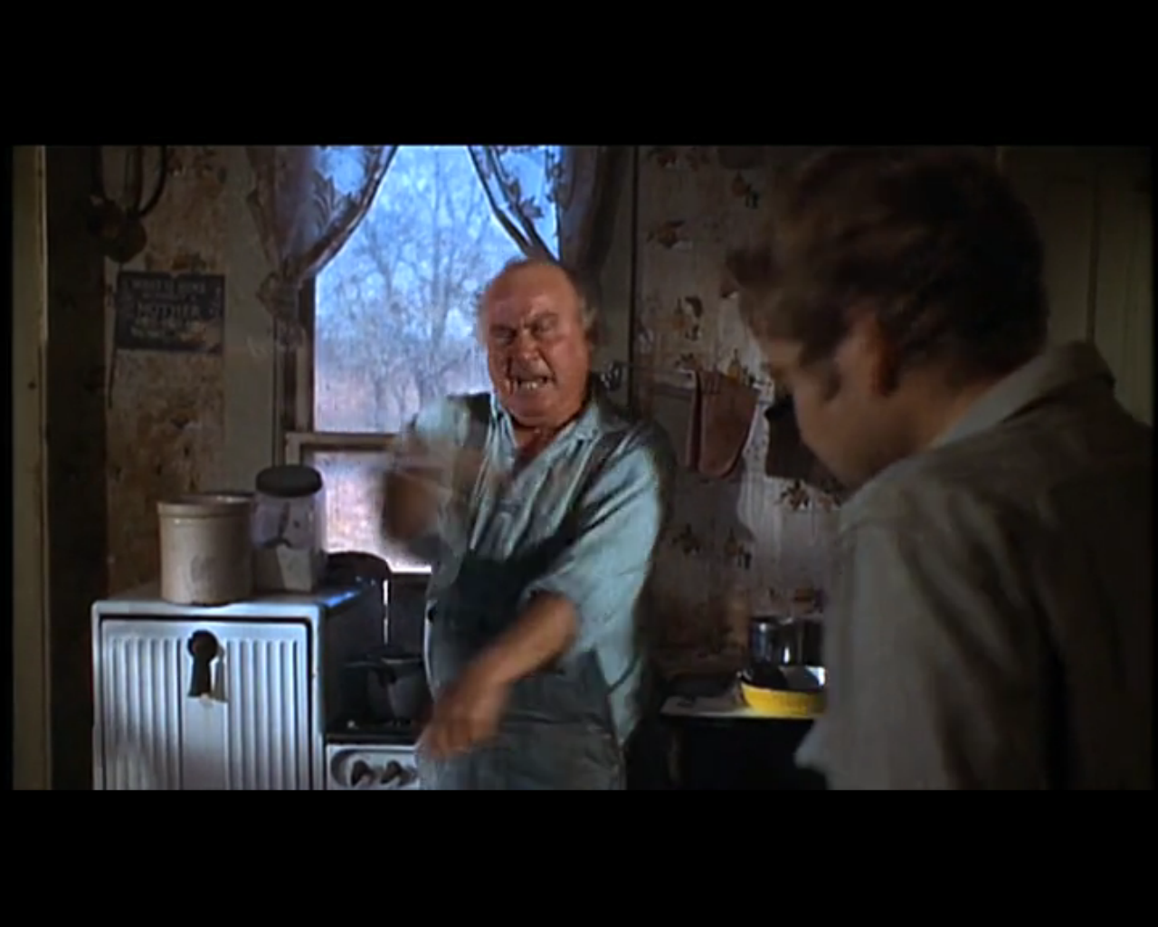
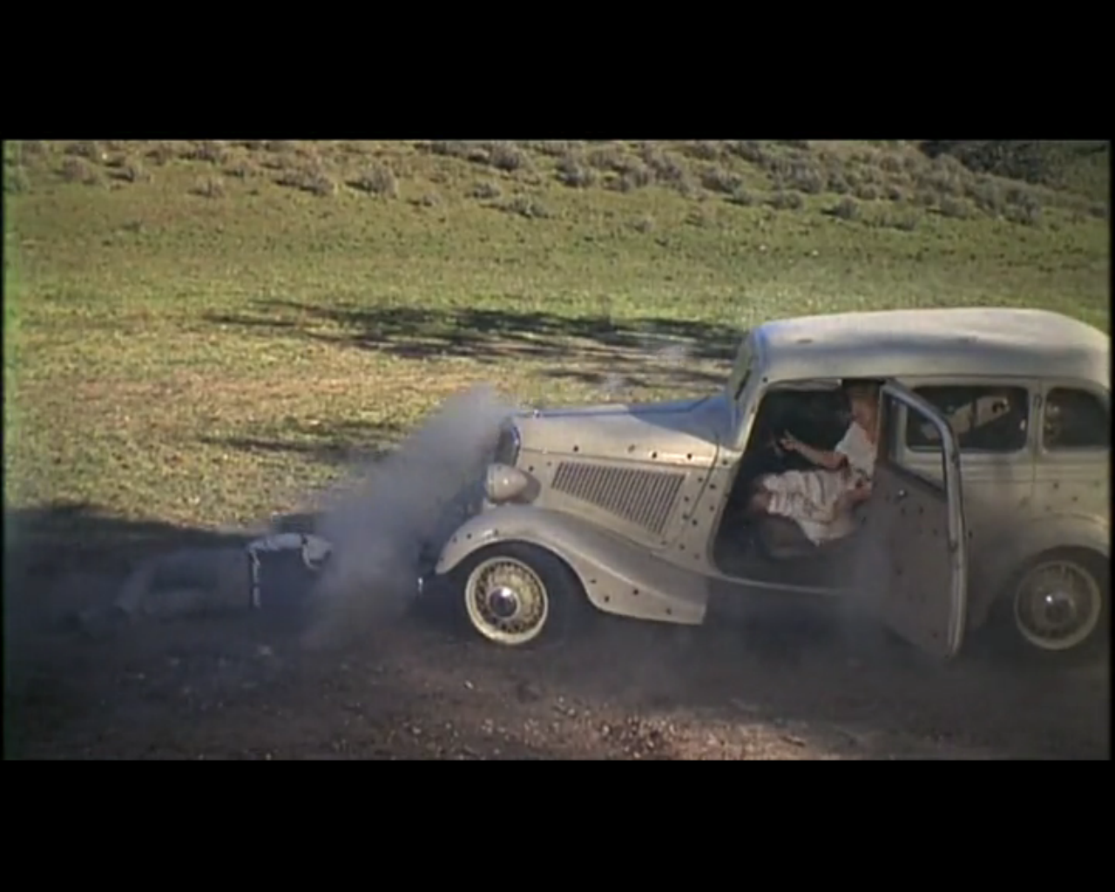
Narrative
The rather dream-like reunion where the pair try to reconnect with everyday society ends with harsh realisation and foreshadows their death.
Linear. Cause and effect
Structure
Bonnie reads a poem about her and Clyde. When published in the newspaper, he is then able consummate their relationship.
The Mineola bank robbery goes wrong with C.W. parking the getaway car and Clyde shooting an innocent man in the face.
A sense of equilibrium disrupted
once Clyde enters, about to steal
Bonnie’s mum’s car.
The pair grow in confidence as they graduate from grocery stores to banks. “We rob banks”, is what Clyde tells an evicted landowner- before they’ve actually done so.
The arrival of Buck and Blanche solidifies the surrogate family. It causes a rift between Bonnie and Clyde, not least because Bonnie takes an instant dislike to Blanche, but leaves little opportunity for B&C to be alone.
Offended by his son’s tattoo, Malcom rats out Bonnie and Clyde, which will ultimately lead to their demise.
The pair are ambushed one last time. Their death an ugly beautiful elaborate dance. Closure, but no new
equilibrium.

