Slide 1
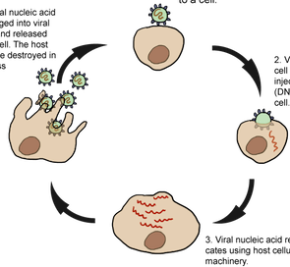
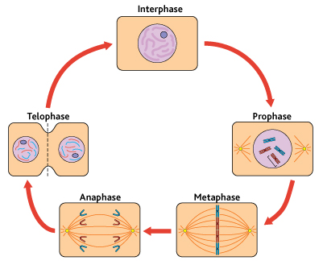
3.2.2 All cells arise from other cells
Structure of a chromosome – label and annotate.
Cell division in prokaryotic cells.
Describe the process that take place during the different stages of mitosis:
Replication of viruses
Explain the role of mitosis in:
growth:
repair:
reproduction:
Key words:

Slide 2
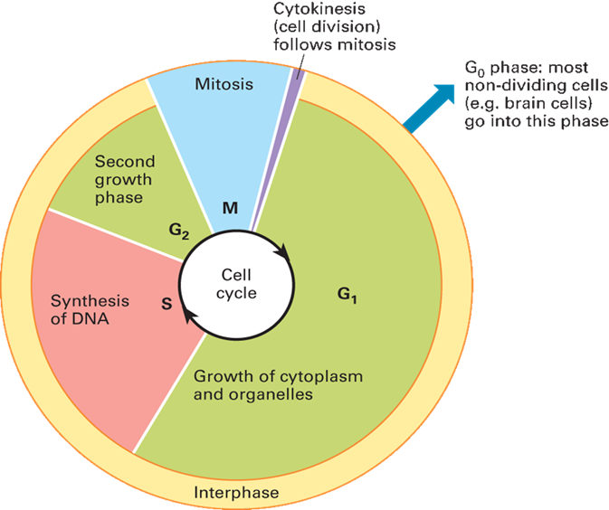
3.2.2 All cells arise from other cells
Cell cycle and its significance.
Explain what happens to the mass of the cell and mass of DNA during the cell cycle.
How does cancer affect the cell cycle.
Describe how mitosis can be observed in a root tip.
Describe how you calculate the mitotic index.
Treatment of cancer
Key words:

