Slide 1
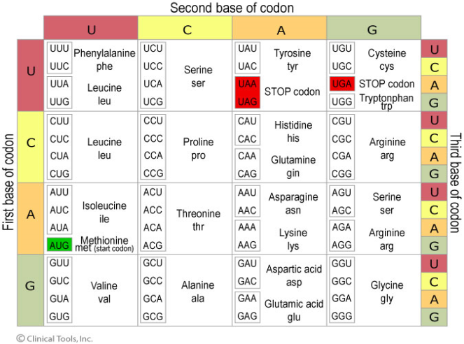
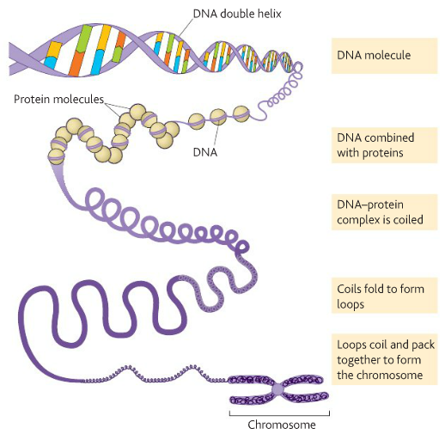
3.4.1 DNA, genes and chromosomes
What is a gene?
Key words: can you define these?
Gene, locus, triplicate code, polypeptide, amino acid, degenerate code, non-overlapping, universal, exon, intron, histone, chromosome, chromatid, homologous chromosomes, allele, codon, mRNA, tRNA, rRNA, anticodon, genome, proteome
What is the genetic code?
Features of the genetic code. What do degenerate code, non-overlapping and universal mean?
What are introns and exons?
Draw and label a prokaryotic and eukaryotic cell.
How does DNA in prokaryotic organisms differ from the DNA in eukaryotic organisms?
Fill in the boxes to show how DNA in packed into a chromosome:

Slide 2
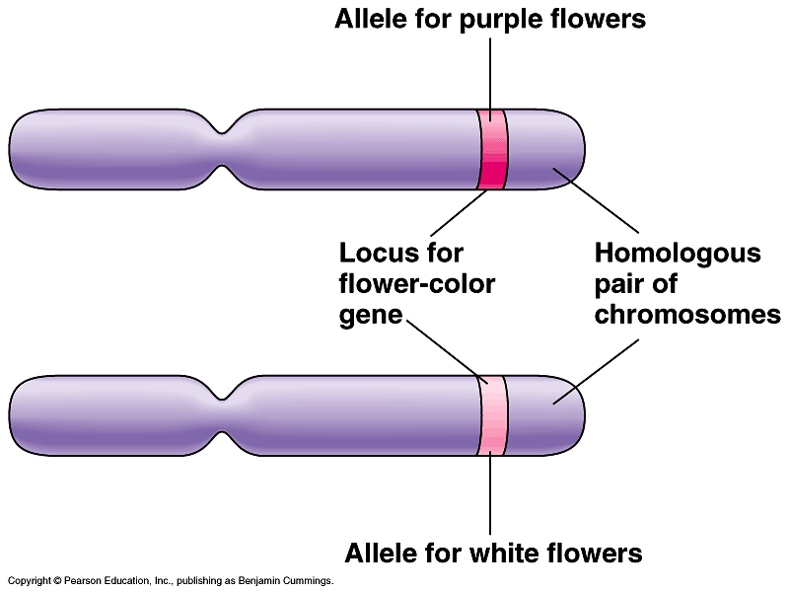
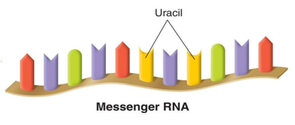
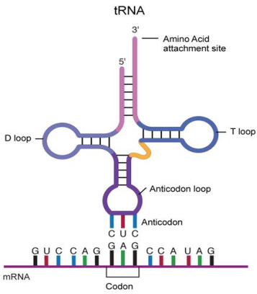
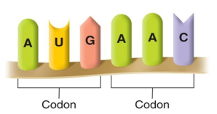
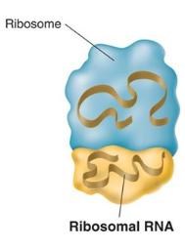
3.4.1 DNA, genes and chromosomes
Define and explain:
Homologous chromosomes
Locus
Allele
Structure of a chromosome- label and annotate
Label the structures of RNA:
Describe the structure and role of messenger RNA:
Describe what a codon is?
Describe the structure and role of transfer RNA:
Complete the table summarising the structure, function and composition of DNA and RNA
Describe the structure and role of ribosomal RNA:
 | DNA | mRNA | tRNA | rRNA
Number of strands
Name of pentose sugar
Location in cell
Relative size
Organic bases
Quantity in cell
Define genome and proteome:

Slide 3
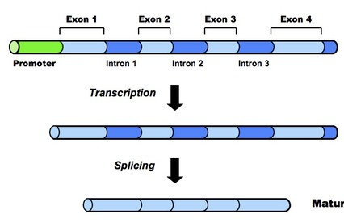
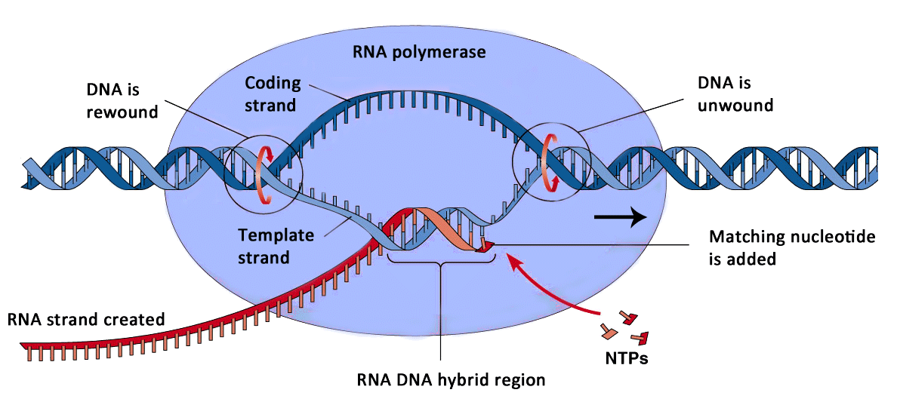
3.4.2 Protein Synthesis
Describe the process of transcription, use diagrams to help:
Key words: can you define these?
nucleotides, transcription, translation, splicing, DNA replication, DNA helicase, hydrogen bonds, template strand, codons, anticodons, peptide bond
Describe the process splicing, use diagrams to help:
Complete the table below outlining the similarities and differences between DNA replication and DNA synthesis
Similarities | Differeneces
Summarise the key events in protein synthesis

Slide 4
3.4.2 Protein Synthesis
Explain the process of translation in protein synthesis:
Explain how proteins are assembled.

