Slide 1
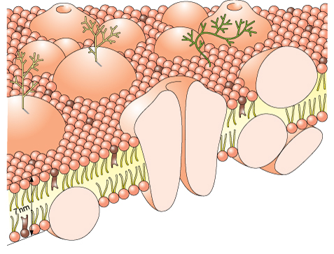
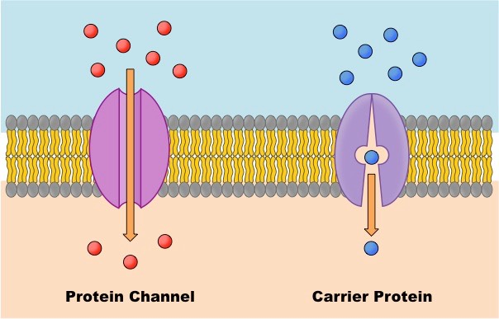
3.2.3 Transport across membranes
Label the diagram to show the structure of the cell surface membrane and the function of it’s components:
Key words:
extrinsic protein; fluid-mosaic; intrinsic protein; phospholipid; plasma membrane; cholesterol; glycolipid; glycoprotein; concentration gradient; diffusion pathway; facilitated diffusion; surface area; channel protein; carrier protein
Main function of cell surface membranes:
Functions of organelle membranes:
What factors affect the rate of diffusion?
Explain and define simple diffusion and draw a diagram to show how it occurs:
Which molecules are transported by simple diffusion:
Explain how facilitated diffusion occurs outlining the difference between channel and carrier proteins :

Slide 2
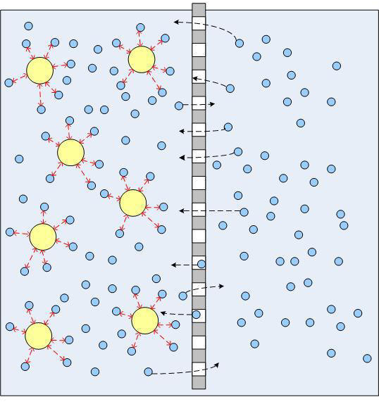
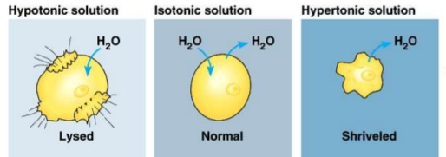
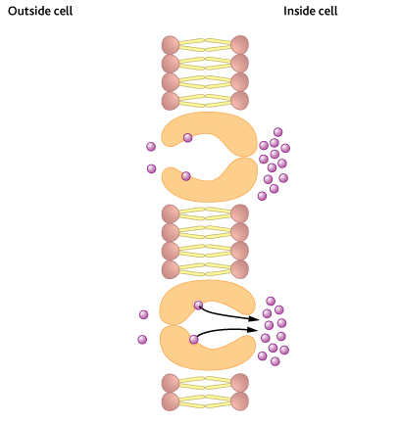
3.2.3 Transport across membranes
Explain osmosis, include information on the affect of water potential:
Key words:
Active transport; cell wall; incipient plasmolysis kilopascals; osmosis; plasmolysis turgid vacuole; water potential; ATP; co-transport; sodium-potassium pump
Information on water potential
Explain how osmosis affects animal cells:
Label the diagram then define and explain active transport:
The role of ATP is missing, add it to the diagram
Explain how osmosis affects plant cells:

Slide 3
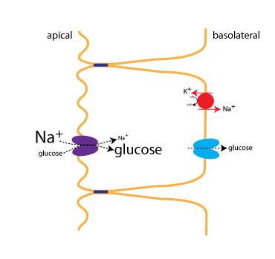
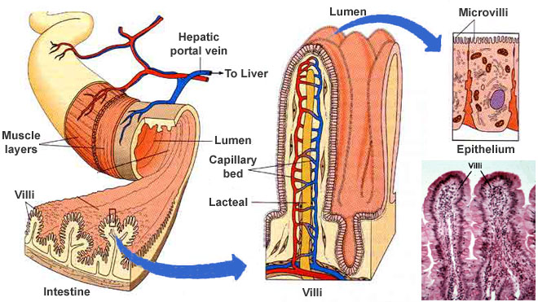
3.2.3 Transport across membranes
Label and annotate the diagram below to show how diffusion, active transport and co-transport are used in the absorption of glucose in the ileum:
Explain the role of diffusion in absorption
Explain the role of active transport in absoption
Key words:
lumen; microvilli; villi; co-transport;
How does the structure of the villi and microvilli help the absorption of molecules in the gut?
Definitions:
Simple diffusion:
Facilitated diffusion:
Active transport:
Osmosis:
Co-transport:
The role of ATP is missing, add it to the diagram

