Slide 1
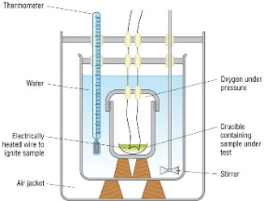
3.5.3 Energy and ecosystems
Explain how the following groups of organisms obtain their energy & nutrients:
Producer:
Consumer:
Saprobiont:
Define the following terms and explain their importance:
Food chain
Trophic level:
Food web
Key words:
producers; consumers; saprobiont; trophic level; food chain; food web; habitat; detritivores; ecosystem; net production; energy transfer; percentage efficiency; tropic level; gross productivity; net productivity; pests; pesticides; biodegrade; cost-effective; accumulation; monoculture; conservation;
Define biomass and explain how it can be measured.
Explain what gross primary productivity and net primary productivity are and write an equation to show the relationship between them.
Define calorimetry and describe how a bomb calorimeter works.
Using the diagram, explain:
What percentage of energy is transferred from one trophic level to the next:
How energy is lost along the food chain:
Why most food chains have no more than five trophic levels:
Why do plants only convert between 1-3% of the suns energy into organic matter?

Slide 2
3.5.3 Energy and ecosystems and 3.5.4 Nutrient Cycles
The efficiency of energy transfers is calculated using the following equation:
$$energy transfer=\frac{energy avaliable after the transfer }{energy avaliable before the transfer }×100$$
Calculate the energy efficiency for this example:
Energy available after the transfer = 50kJm⁻²year⁻¹
Energy available before the transfer = 250kJm⁻²year⁻¹
In agricultural systems what is meant by productivity?
List the ways in which farming practises can increase the efficiency of energy transfers in agricultural ecosystems.
Explain how controlling pests effectively increases productivity:
Explain the basis of all nutrient cycles using the diagram to help:
Explain how simplifying food webs can reduce energy losses to non-human food chains.

Slide 3
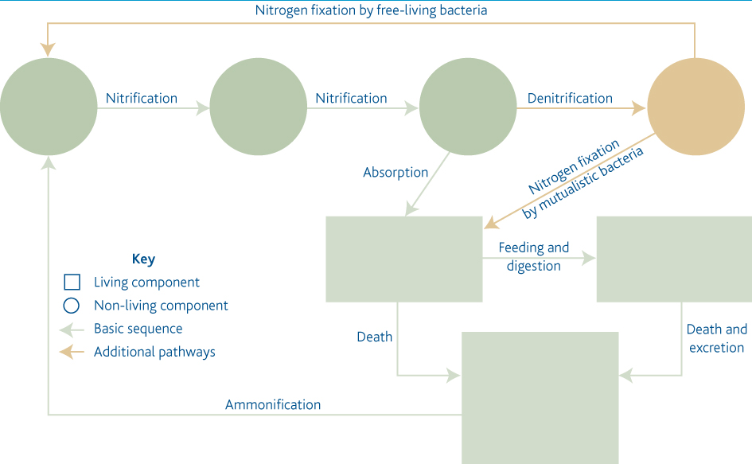
3.5.4 Nutrient Cycles
Complete the diagram of the nitrogen cycle. Show where nitrogen enters the living and non-living component of the ecosystem.
Key words:
ammonification; nitrification; nitrogen fixation; denitrification; saprobiotic microorganisms; natural/organic fertilisers; artificial/inorganic fertilisers; species diversity; leaching; eutrophication
Describe the following steps of the nitrogen cycle:
Ammonification
Nitrification:
Nitrogen fixation
Denitrification:
Draw the phosphorus cycle below and add notes to explain it’s importance and the processes involved.
What is the role of mycorrhizae in nutrient cycles?
Explain why fertilisers are needed in agricultural ecosystems:

Slide 4
3.5.4 Nutrient Cycles
Explain how natural and artificial fertilisers differ:
Explain how fertilisers increase productivity
Describe the main environmental effects of using nitrogen fertilisers:
Explain what leaching means and the effects it can have on the environment
List the stages of eutrophication and identify the effects it can have on the environment:
Extra notes.

