Slide 1
3.6.1 Stimuli & Responses: Taxes, Kineses and Tropism
Fill in the blanks to show your understanding of stimulus and response:
Stimulus → __________ → __________ → __________ → response
Key words:
taxes, kineses, tropisms, neurones, effector, synapse, motor, sensory, central nervous system, peripheral nervous system, voluntary, autonomic, spinal cord, sympathetic, parasympathetic, medulla oblongata, sinoatrial node, chemoreceptors, pressure receptors, Pancinian corpus, rod cells, bipolar cells, visual acuity, generator potential, cone cells
Define taxes, explain how it works with examples
Define kineses, explain how it works with examples
Define tropism, explain how it works with examples
List the different types of tropism:
1
2
3
Explain how IAA controls phototropism in roots and shoots
Explain how IAA controls gravitropism in roots and shoots
Shoot
Root
Shoot Root

Slide 2
3.6.1 Stimuli & Responses: Taxes, Kineses and Tropism
Require practical 10: Investigation into the effect of an environmental variable on the movement of an animal using either a choice chamber or maze.
(Know possible variables, methodology, likely results and how to analyse them)
Use this space for any extra information on this topic
Explain the role of plant growth factors, use Darwin’s, Boysen-Jensen’s, Paal’s and Brigg’s experiments in your explanation: (draw diagrams of each experiment)

Slide 3
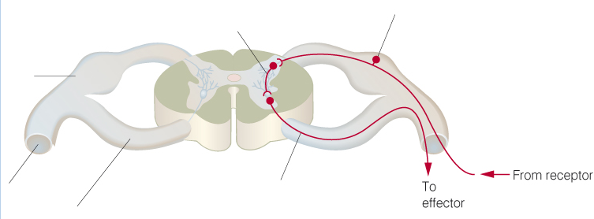
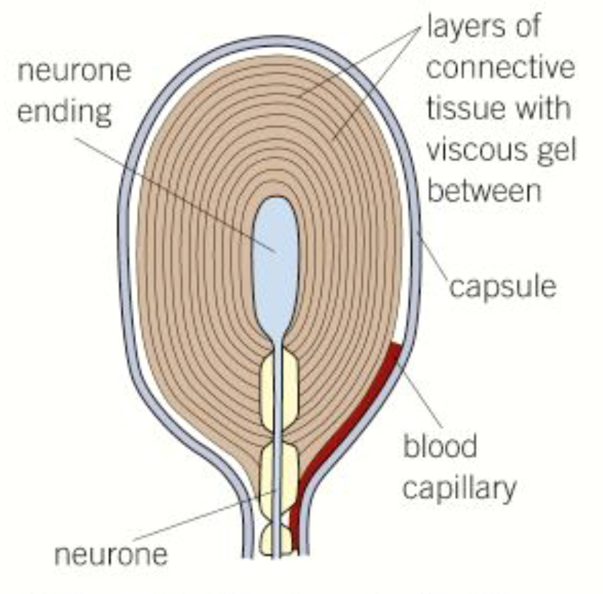
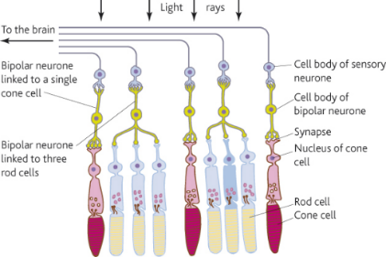
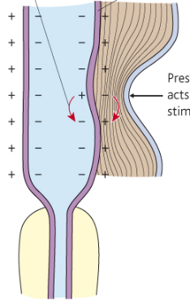
3.6.1 Stimuli & Responses: Reflex Arc and Receptors (Pacinian corpuscle, Rods & Cones)
Complete the diagram to show the organisation of the nervous system:
Label the diagram to show how the nerves are arranged in the spinal cord:
Nervous system
Brain
Reflex arc – explain the main stages and the importance of it.
Motor nervous system
Voluntary nervous system
Describe the structure and function of the Pacinian corpuscle:
Describe the structure and function of rod and cone cells in the retina:
 | Rod | Cone
Shape
Number
Distribution
Visual acuity
Sensitivity in low light conditions

Slide 4
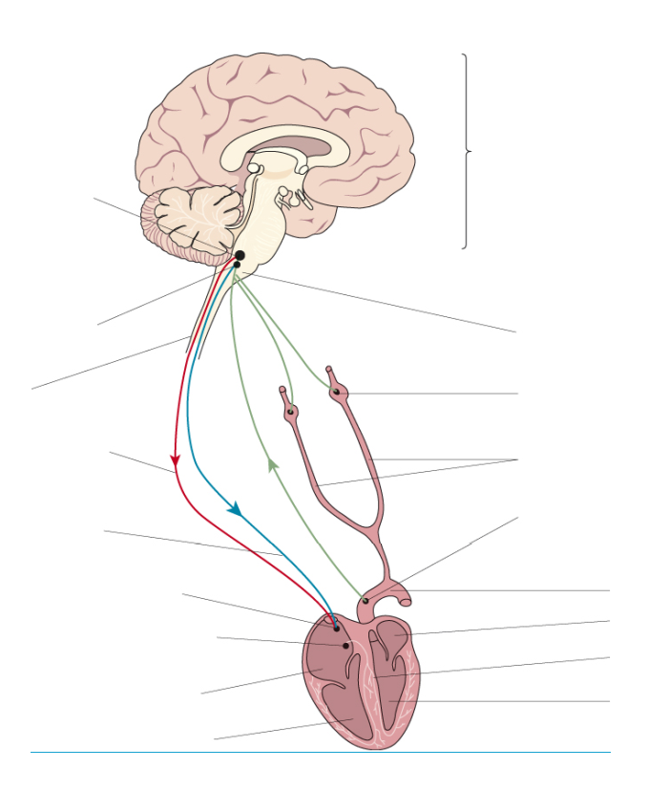
3.6.1 Stimuli & Responses: Control of Heart Rate
What effect do these two systems have on heart rate:
Sympathetic:
Parasympathetic:
Key words:
sympathetic, parasympathetic, medulla oblongata, sinoatrial node, chemoreceptors, pressure receptors
Label the diagram to summarise the control of heart rate:
Explain the role chemoreceptors play in controlling heart rate:
Explain the role pressure receptors play in controlling heart rate:
Require practical 10: Investigation into the effect of an environmental variable on the movement of an animal using either a choice chamber or maze.
(Know possible variables, methodology, likely results and how to analyse them)
Explain the role of diffusion in absorption
Explain the role of active transport in absoption

Slide 5
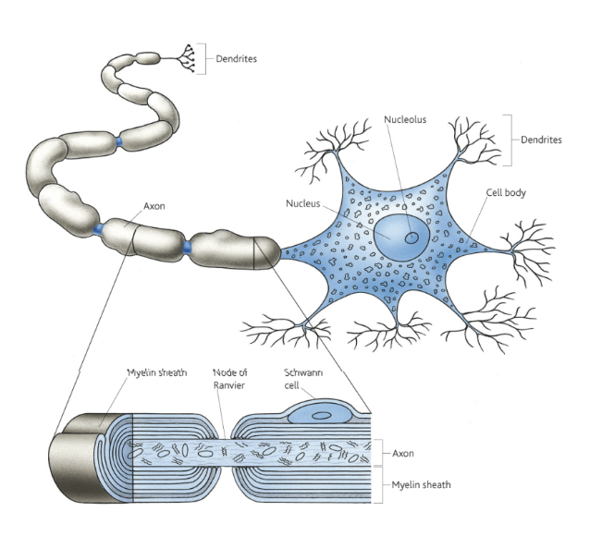
3.6.2 Nervous Coordination
Compare the hormonal and nervous systems in terms of coordination.
Key words:
nervous system, hormonal system, neurotransmitters, resting potential, action potential, phospholipid, intrinsic proteins, sodium-potassium pump, depolarisation, repolarisation, hyperpolarisation, action potential, myelin, axon, polarised, node of Ranvier, saltatory conduction, sodium-potassium pump, voltage-gated channels, refractory period, threshold potential
Draw diagrams and state the function of a motor neurone, sensory neurone and intermediate neurone.
Describe the structure and function of the parts of a neurone:
Explain what resting potential is, including the role of potassium and sodium ions in its generation:

Slide 6
3.6.2 Nervous Coordination
Explain what is happening at points 1-6 on the graph:
Explain, using diagrams, how an action potential moves along an unmyelinated axon:
Explain, using diagrams, how an action potential moves along a myelinated axon
State the factors that affect the speed of conductance of an action potential
Explain how the refectory period separated one impulse from the next and why is this important
Explain what the refectory period is
Explain what the “all or nothing” principle is:

Slide 7
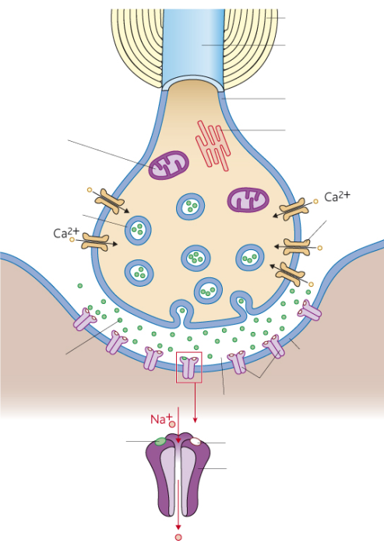
3.6.2 Synaptic Transmission
Explain the structure and function of the parts of the synapse:
Key words:
unidirectionality, temporal summation, spatial summation, inhibition, neurotransmitter, synaptic cleft, pre & postsynaptic neurone
Explain the following functions of a synapse:
Unidirectionality:
Summation:
Temporal summation:
Spatial summation:
Explain the effects of drugs on how information is transmitted across a synapse:
Inhibitory synapses – explain how these make it less likely to generate action potentials.

