Slide 1
A2 Level Paper 2 and 3 - Topics 5-8
Section 3.5: Energy transfers in and between organisms
3.5.1 Photosynthesis
3.5.2 Respiration
3.5.3 Energy and ecosystems
3.5.4 Nutrient cycles
Section 3.7: Genetics, populations, evolution and ecosystems
3.7.1 Inheritance
3.7.2 Populations
3.7.3 Evolution may lead to speciation
3.7.4 Populations in ecosystems
Section 3.6 Organisms respond to changes in their internal and external environments
3.6.1 Stimuli, both internal and external, are detected and lead to a response
3.6.1.1 Survival and response
3.6.1.2 Receptors
3.6.1.3 Control of heart rate
3.6.2 Nervous co-ordination
3.6.2.1 Nerve impulses
3.6.2.2 Synaptic transmission
3.6.3 Skeletal muscles are stimulated to contract by nerves and act as effectors
3.6.4 Homeostasis is the maintenance of a stable internal environment
3.6.4.1 Principles of homeostasis
3.6.4.2 Control of blood glucose concentration
3.6.4.3 Control of blood water potential
Section 3.8 The control of gene expression
3.8.1 Alteration of the sequence of bases in DNA can alter the structure of proteins
3.8.2 Gene expression is controlled by a number of features
3.8.2.1 Most of a cell’s DNA is not translated
3.8.2.2 Regulation of transcription and translation
3.8.2.3 Gene expression and cancer
3.8.3 Using genome projects
3.8.4 Gene technologies allow the study and alteration of gene function allowing a better understanding of organism function and the design of new industrial and medical processes
3.8.4.1 Recombinant DNA technology
3.8.4.2 Differences in DNA between individuals of the same species can be exploited for identification and diagnosis of heritable conditions
3.8.4.3 Genetic fingerprinting

Slide 2
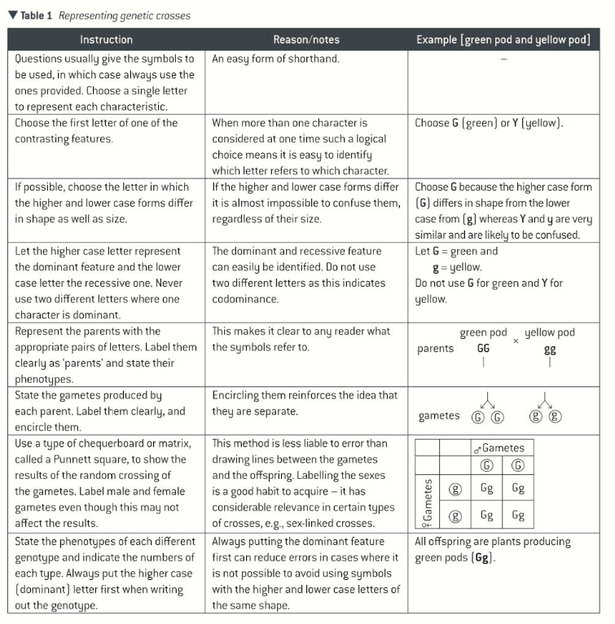
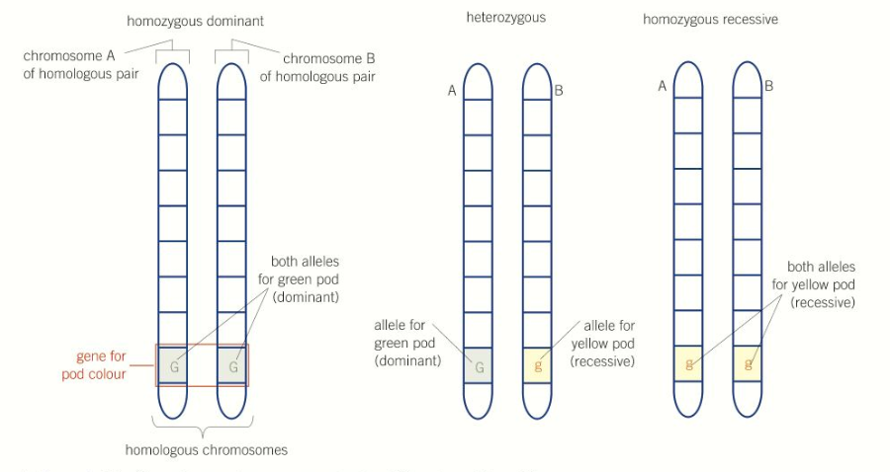
Topic 7: Genetics, populations, evolution and ecosystems - 3.7.1 Inheritance (p418)
What is meant by the term genotype and phenotype?
What is monohybrid inheritance?
Give details of an example cross and
F1 intercross. Use a dominant
homozygous individual crossed with
a recessive homozygous individual.
What are dominant, recessive and codominant alleles?
Parents Phenotype:
Parents Genotype:
Gametes:
Offspring 1 (F1) genotypes:
Punnet Square
Offspring Genotype:
Offspring Phenotype:
Parents Phenotype:
Parents Genotype:
What are multiple alleles?
Gametes:
Offspring 2 (F2) genotypes:
Punnet Square
Offspring Genotype:
Offspring Phenotype:

Slide 3
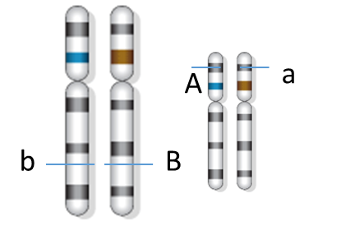
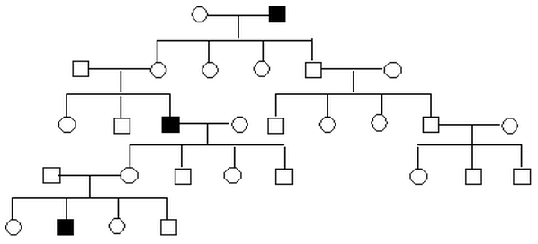
Topic 7: Genetics, populations, evolution and ecosystems - 3.7.1 Inheritance (p424)
How is sex determined genetically?
Explain dihybrid inheritance:
Eg. Peas height of plant T = tall, t = dwarf and flower colour R = purple, r = white
Parents Phenotype:
Parents Genotype:
Gametes:
Offspring 1 (F1) genotypes:
Punnett Square:
Offspring Genotype:
Offspring Phenotype:
Parents Phenotype:
Parents Genotype:
Gametes:
Offspring 2 (F2) genotypes:
Punnett Square:
Offspring Genotype:
Offspring Phenotype:
What is sex linkage?
Show a genetic cross of a male without haemophilia and a female that is a carrier of haemophilia.
 |  | Male gametes
Female gametes
How are pedigree diagrams useful?

Slide 4
Topic 7: Genetics, populations, evolution and ecosystems - 3.7.1 Inheritance (p424)
What is autosomal linkage and how does it affect the combination of alleles in gametes?
How does co-dominance affect the inheritance of characteristics?
How are blood groups inherited in humans?
Possible Genotypes | Phenotype
 | Group A
 | Group A
 | Group AB
 | Group B
 | Group B
 | Group O
How does multiple alleles affect inheritance?

Slide 5
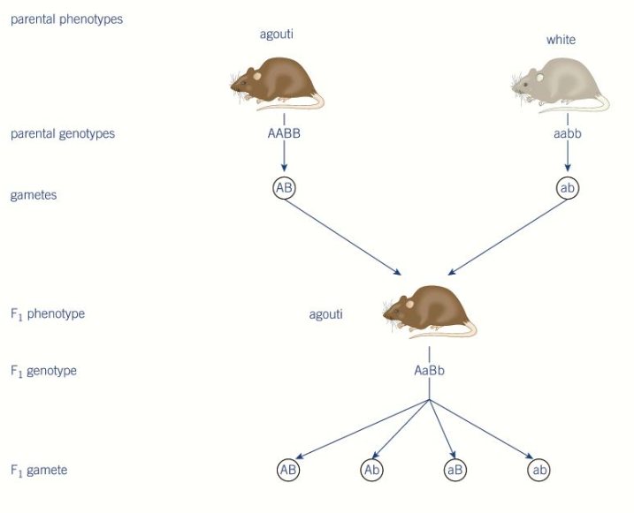
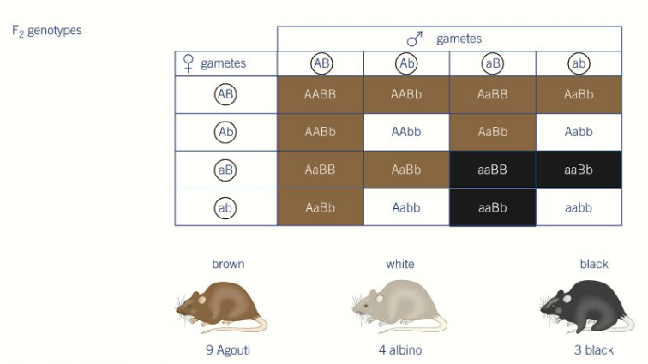
Topic 7: Genetics, populations, evolution and ecosystems - 3.7.1 Inheritance (p424)
What is meant by epistasis?
What are the effects of epistasis?
Explain why results of genetic crosses often differ from predicted results:
What is the chi-squared test and how would you use it in genetics?

Slide 6
Topic 7: Genetics, populations, evolution and ecosystems - 3.7.2 Populations (p448)
What is meant by the terms gene pool and allelic frequency?
Can you use the Hardy-Weinberg principle to calculate allele, genotype and phenotype frequencies?
1) If 81% of a population is homozygous recessive for a given trait. Calculate
  Frequency of homozygous dominant
  Frequency of heterozygotes
  Frequency of dominant and recessive alleles
2) If 51% of the population carries at least one copy of the recessive allele
  What is the predicted frequency of the population expressing the dominant phenotype?
3) The allele y occurs with a frequency of 0.8 in a population of clams. Give the frequency of genotypes YY, Yy, and yy. Show your work!
Define the Hardy-Weinberg principle.
What are the assumptions of the Hardy-Weinberg principle?

Slide 7
Topic 7: Genetics, populations, evolution and ecosystems – 3.7.3 Evolution may lead to speciation (p451)
Can you describe variation due to genetic factors?
Can you explain the role of overproduction of offspring in natural selection:
Can you describe variation due to environmental influences?
Can you explain the role of variation in natural selection:
Define a gene pool
What is selection?
What environmental factors exert selection pressure?
How does reproductive success affect allele frequency within a gene pool?
Why is genetic drift only important in small populations?

Slide 8
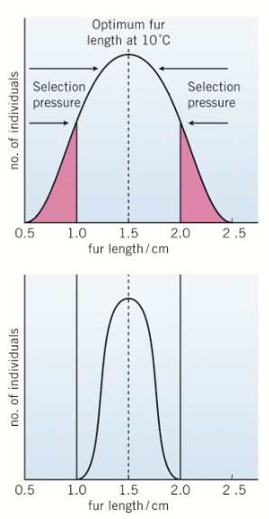
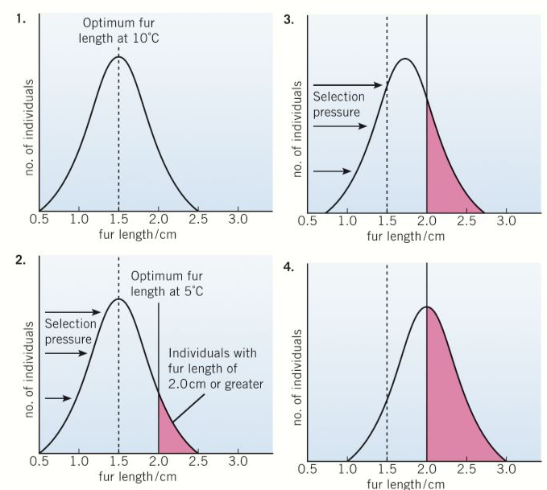
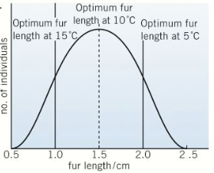
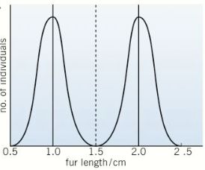
Topic 7: Genetics, populations, evolution and ecosystems - 3.7.3 Evolution may lead to speciation (p456)
Can you describe stabilising selection?
Can you describe directional selection?
Can you describe disruptive selection?
Explain how selection has occurred in the peppered moth:

Slide 9
Topic 7: Genetics, populations, evolution and ecosystems - 3.7.3 Evolution may lead to speciation (p460)
How does selection affect allelic frequencies?
Describe allopatric speciation:
What is a species?
How are new species formed?
Describe sympatric speciation:
How do populations become geographically isolated?

Slide 10
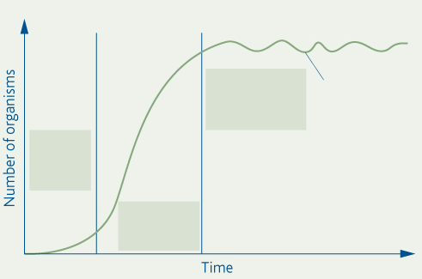
Topic 7: Genetics, populations, evolution and ecosystems - 3.7.4 Populations in ecosystems (p466)
Define the terms:
Environment:
Biotic:
Abiotic:
Biosphere:
How might we plot a growth curve? Include details of when and why it might be necessary to use a logarithmic scale.
Explain what an abiotic factor is and give some examples. Explain how each would influence population size.
What is meant by an ecosystem?
Can you explain the stages of a population growth curve?
Define the terms:
Population:
Community:
Habitat:
What is meant by an ecological niche?

Slide 11
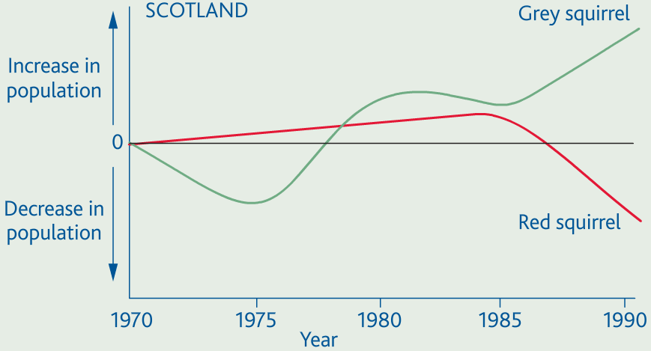
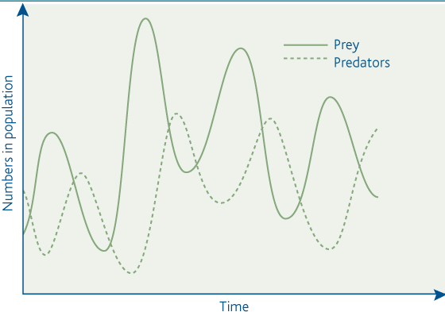
Topic 7: Genetics, populations, evolution and ecosystems - 3.7.4 Populations in ecosystems (p474)
What is meant by interspecific competition?
What is meant by intraspecific competition?
What is predation?
How does the predator-prey relationship affect the population size of the predator and prey?
How does interspecific competition influence population size?
What factors do different species compete for?

Slide 12
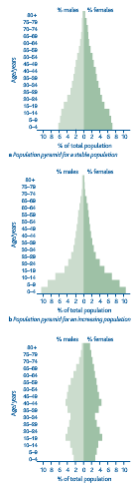
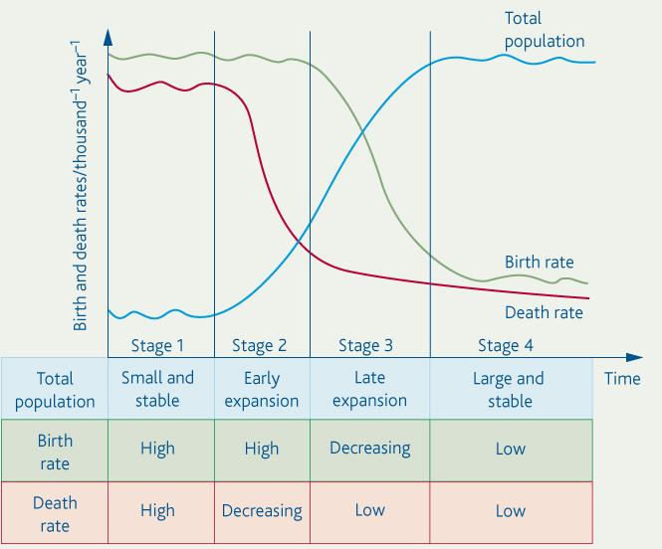
Topic 7: Genetics, populations, evolution and ecosystems - 3.7.4 Populations in ecosystems (p472)
How do you calculate population growth?
How do you calculate percentage population growth (in a given period)?
What are the two types of migration and how do they affect the population?
What do age population pyramids show you?
What are the three typical types of population? Explain what their birth and death rates are.
What is the demographic transition?
Explain each of the four stages:

Slide 13
Topic 7: Genetics, populations, evolution and ecosystems - 3.7.4 Populations in ecosystems (p481)
What factors need to be considered when using a quadrat?
Describe how the abundance of different species is measured:
Explain how you would investigate the effect of a named environmental factor on the distribution of a given species:
Explain what is meant by the term random sampling, and how you would ensure that a sample is truly random:
Can you explain how a transect is used to obtain quantitative data about changes in communities along a line.
How is the mark-release-recapture method used to measure the abundance of motile species?
What assumptions does this technique rely on?

Slide 14
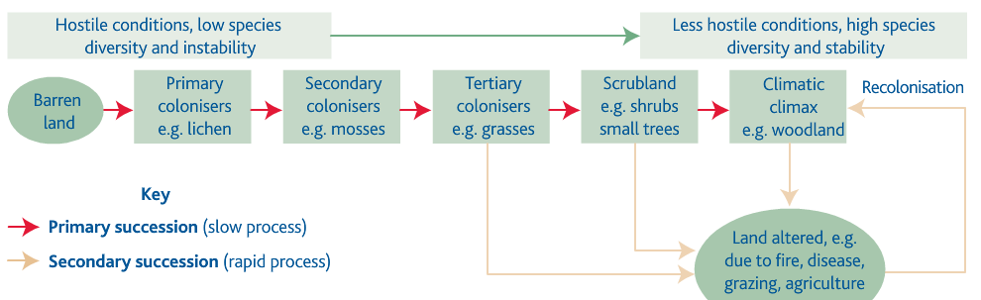
Topic 7: Genetics, populations, evolution and ecosystems - 3.7.4 Populations in ecosystems (p484)
Describe changes that occur in the variety of species that occupy an area over time:
What is meant by the term succession?
What is meant by conservation?
Explain how managing succession can help to conserve habitats:
What is meant by the term climax community?
Describe the difference between primary and secondary succession:

