Slide 1
How effective is Parliament in controlling the executive?
1. At the end of this presentation you should be able to list the ways in which the Executive dominates Parliament.
2. As a challenge to this you should know how the Commons hold the Executive to account.
3. You should know whether Backbenchers are effective in their role.

Slide 2
news
http://www.bbc.co.uk/news/uk-politics-42261967

Slide 3
PMQs

Slide 4
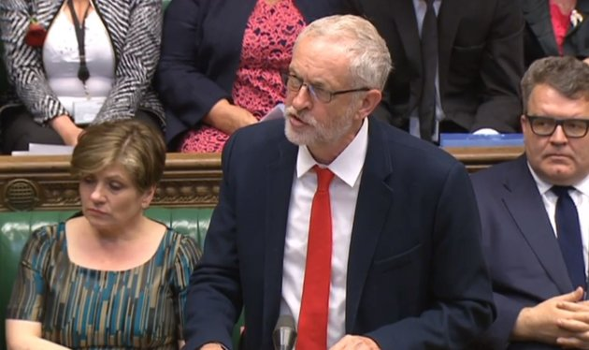
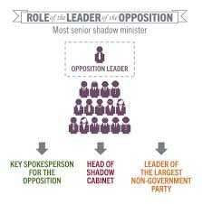
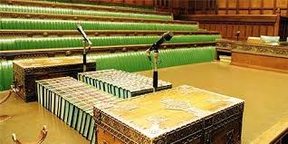
Firstly, how does Parliament hold the Executive to account?
The Role of the Opposition is VITAL in holding the executive to account.
What do you think they do?
Task 18 - On page 25 of your booklet complete the 4 main roles of opposition using your text book page 224

Slide 5
Opposition try to put the Government on the spot by carefully checking their plans and proposals
Task 19
On page 26 of your booklet complete the 4 main functions using your text book page 224

Slide 6
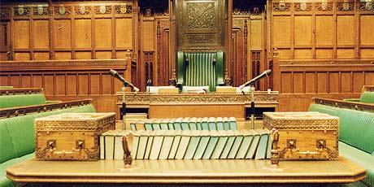
How effective is the Opposition at scrutinising the government?
Working with the person next to you, can you think of arguments on either side?
Add to table on page 27

Slide 7
Scrutiny – which method is most effective?
Give each one a score out of 10 and explain why
Committees
PMQs
Role of the opposition
Extension, how well does Parliament scrutinise overall?

Slide 8
How effective is Parliament at scrutinising the government? Add ideas to your summary table
Effective scrutiny | Not so effective
Scrutiny has been very much improved since departmental select committees and legislative committees were introduced closely checking policy and investigating. | MPs are given relatively little time to scrutinise legislation. MPs may be whipped into party loyalty which makes them vote the way they should.
Calling the government to account and checking executive power is something they can do and we do see back bench rebellions. Liaison Committee questions PM twice a year. | Party loyalty and discipline means that many MPs are reluctant to challenge the government. The government rarely loses a major vote in the Commons. PM Question time has become something of a show.

Slide 9
Legislation – rank these arguments in order of how valid they are on page 28
Effective | Not so effective
Legislation – granting consent on behalf of the people. On the whole this works well and laws are respected because they have been legitimised by Parliament. | Governmental legislation tends to be the only type that stands a high chance of becoming law
The inbuilt majority that often exists in parliament allows for substantial legislative changes to take place | The procedures in Parliament in respect of passing legislation are ancient and can be deemed inefficient. They do tend to take a long time.
PMBs can and have been passed in the past | The process is dominated by the party system, both through whips and bill committees
The House of Lords has the ability to highlight weaknesses in legislation and is listened to | The House of Lords has little real power over the legislative process
Notes:
PRINT this out.

Slide 10
Extension – can you think of specific examples for these points
Effective | Not so effective
Legislation – granting consent on behalf of the people. On the whole this works well and laws are respected because they have been legitimised by Parliament. | Governmental legislation tends to be the only type that stands a high chance of becoming law
The inbuilt majority that often exists in parliament allows for substantial legislative changes to take place | The procedures in Parliament in respect of passing legislation are ancient and can be deemed inefficient. They do tend to take a long time.
PMBs can and have been passed in the past | The process is dominated by the party system, both through whips and bill committees
The House of Lords has the ability to highlight weaknesses in legislation and is listened to | The House of Lords has little real power over the legislative process

Slide 11
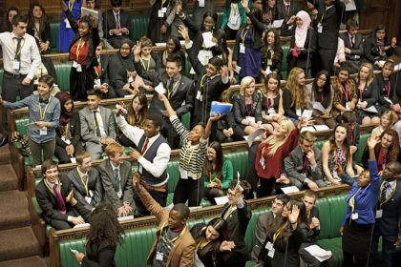
Debate – can you remember so of the ‘great’ debates we looked at last week?

Slide 12
Debate -
Read through the passages on pages 28-30 and answer the questions about Debate on page 31
What are the main purposes of debates in the HoC?
Explain why informal processes are important
Discuss the relative importance of formal and informal processes through which backbench MPs can attempt to influence the work of governments

Slide 13
Debate -
Read through the passages on pages 28-30 and answer the questions about Debate on page 31
Why do you think this is sometimes called yah boo politics?

Slide 14
If you were a Conservative MP for SW Surrey, how would you vote on an increase in higher rate taxation, based on these models?
The Trustee Model | This kind of model is allowed freedom to make choices and respond to situations as he or she sees fit trusted to know best.
The Delegate Model | This kind of model is expected to do exactly as the voter requires, like a puppet.
The Mandate Model | This kind of model is expected to do only what they promised and obtained consent from the voters for.

Slide 15
Theories of representation – copy this information to page 32 in your booklet
The Trustee Model | This kind of model is allowed freedom to make choices and respond to situations as he or she sees fit trusted to know best.
The Delegate Model | This kind of model is expected to do exactly as the voter requires, like a puppet.
The Mandate Model | This kind of model is expected to do only what they promised and obtained consent from the voters for.

Slide 16
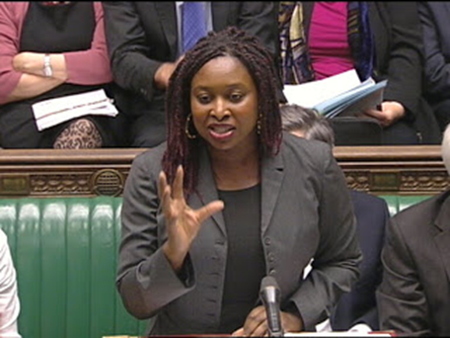
Representation
A key issue with the House of Commons is how well it reflects wider society
Many argue that it is not a ‘microcosm;’ of society as a whole

Slide 17
Representation
How diverse is the House of Commons now?
Read the article on pages 32-33 and answer questions on page 34
If there is time watch “Posh and Posher” (a bit out of date now that Eton doesn’t figure quite so heavily in the Cabinet!)

Slide 18
Representation
Use pages 226-228 to complete the table on page 37

Slide 19
Representation
Yes – good at representation | No – poor at representation

Slide 20
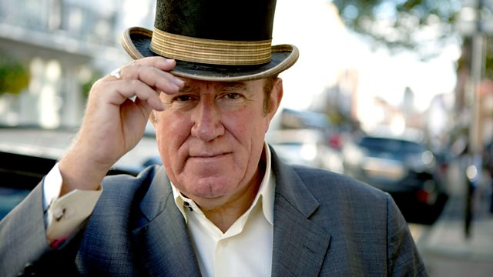
Watch ‘Posh and Posher’ on estream – complete pages 35-36 in the booklet

Slide 21
Homework
Finish watching ‘Posh & Posher’ on estream and answer questions (remember it is a little dated). Complete questions in your booklet, page 35-36.
Finish table on functions
Read article and answer questions on backbench MPs

Slide 22
Homework (for those who missed lesson due to trip)
Read article about debates in your booklet and answer the 3 questions (pages 28-31)
Complete pages 32-34 in your booklet about the Representation function
Watch ‘Posh & Posher’ on estream and answer questions (remember it is a little dated). Complete questions in your booklet, page 35-36.
Use pages 225-226 from the textbook to complete the table on page 37 of your booklet.
Read article and answer questions on backbench MPs

Slide 23
Power of Patronage
The power of appointment to every powerful job in government lies in the hands of the Prime Minister.
Mr Balls is one of the big figures in the Brown inner circle and has been rewarded with the job as secretary of state for children, schools and families.

Slide 24
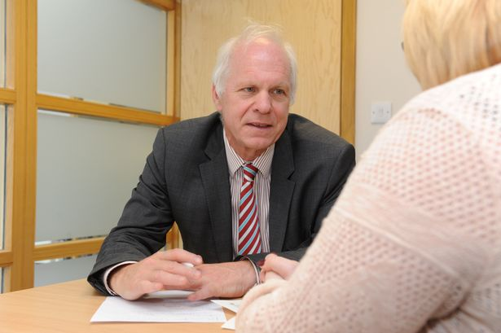
Is Parliament effective at carrying out its representative role?
Scunthorpe MP Nic Dakin talks to a constituent in his surgery held every Friday.
Look at page 226 and 227 to complete grid on representation on page 35

Slide 25
Parliament is supposed to be sovereign, but who is really in charge?
In a normal majority government, it has to be admitted that the Executive can usually tell the Commons what to do and expect them to do it.
Blair in particular only lost two votes during his time as PM – this was on terror laws and the Religious Hatred bill
Using this ppt complete the grid on pages 38 - 39

Slide 26
The Whips
Whips are the MPs appointed by the party leader to ensure loyalty within Parliament.
Whips can threaten an MP with expulsion, or pass on the Prime Minister’s offer of a job, to ensure loyalty.

Slide 27
Parliament still has power!
There are no rules against MPs voting against the government and some rebellions result in government defeats.
March 2016, a group of 27 Conservative MPs rebelled against the bill to extent Sunday trading hours. 317 votes to 286, meant the Government was overruled by Parliament

Slide 28
Rebel MPs
Some MPs rebel are much more likely to rebel
Philip Davies, MP for Shipley (Conservative), rebelled 20% of the time in the last government, from 2010-2015

Slide 29
The Payroll vote
The convention of collective responsibility dictates that all members of the Government must follow (and vote for) the Government’s decisions.
If they can’t they resign as Robin Cook did over Iraq.

Slide 30
Free votes
MPs are allowed free votes on certain issues in which case the whip is removed, allowing them to vote either way. An example of this is the recent Gay Marriage bill when half of the Conservative party during the free vote voted against the proposed legislation (136 MPS).

Slide 31
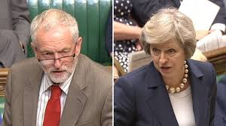
Party disunity
Both main parties have certain issues with loyalty at the moment - Labour over Corbyn’s election and the Conservatives over the ongoing Europe issue

Slide 32
Minority government
This is compounded for May by her position in a minority government needing the DUP to vote with her party to secure a majority. This makes it very easy for any potential defectors to help defeat any vote

Slide 33
Poor resources
MPs have a tiny set of resources at their disposal.
In 1988 there were 1344 people working for MPs.
The government had 500,000 Civil Servants.
This makes it hard for MPs to know enough to challenge Ministers.

Slide 34
Power of dissolution
MPs don’t like elections (they might lose their job).
The PM can threaten to dissolve Parliament and call an election to force party discipline.

Slide 35
Government majority
Perhaps most significant is the fact that in order to be Prime Minister you have to have a majority in Parliament.
FPTP usually provides a big one.
The British political system sanctions the dominance of the Executive over the Legislature.

Slide 36
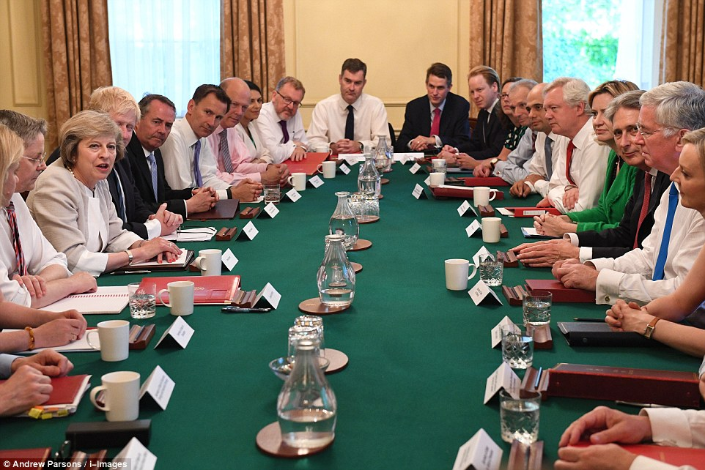
Methods by which the executive dominates.

Slide 37
Question
How effective are backbench MPs at holding the Government to account?
We will prepare an essay for you to do on this subject next week so for Homework please read the article and answer the questions.

