Slide 1
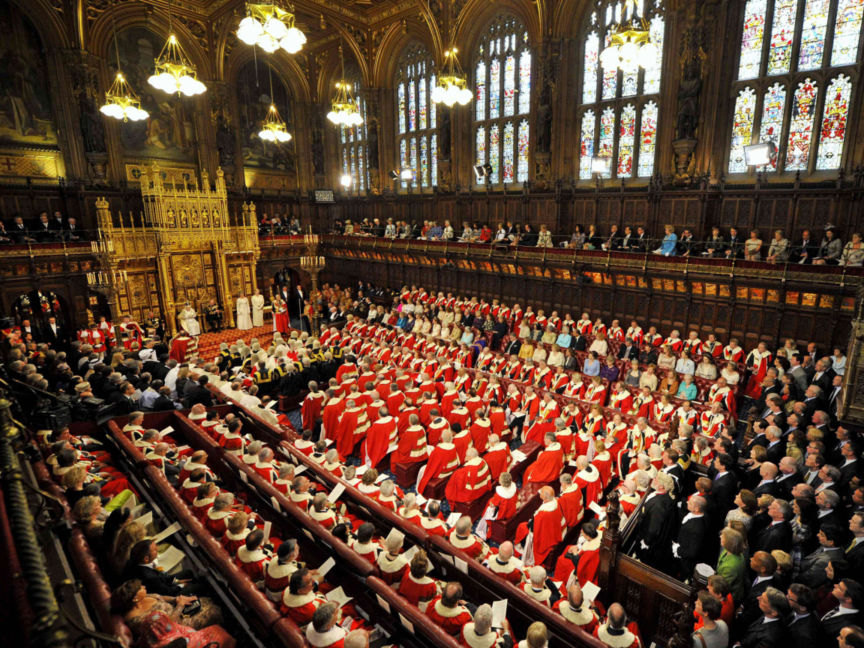
Week 10
Objectives for the week
The Lords

Slide 2
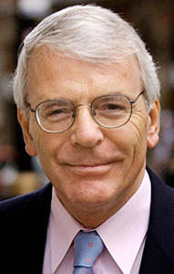
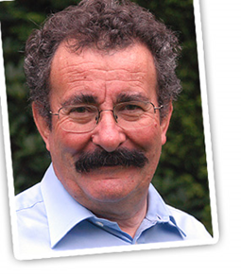
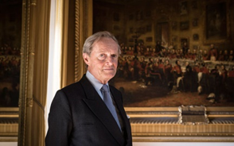
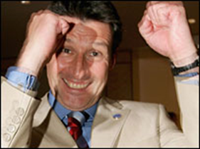
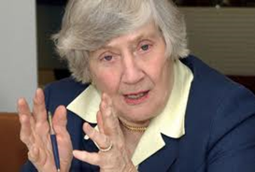
Task 12 - Name that Lord!

Slide 3
Task 12 - Name that Lord!
Life peer – medical expert Lord Winston
Lord spiritual – Justin Welby Archbishiop of Canterbury
Life peer ex PM Lord Major
Life Peer Lord Coe
Hereditary peer – Duke of Wellington
Life Peer – Baroness Williams

Slide 4
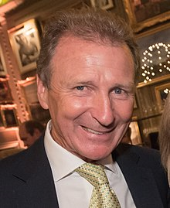
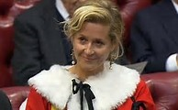
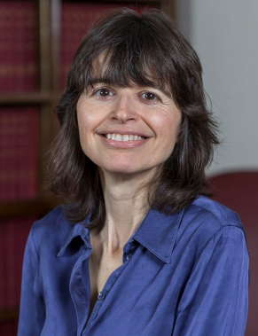
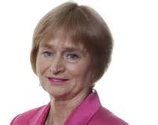
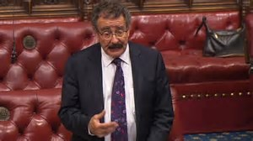
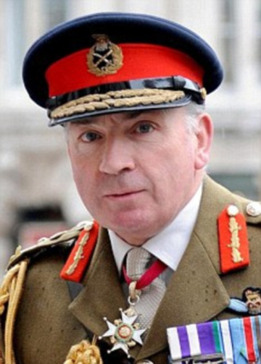
Look up one of the following:
Baroness Lane Fox
Lord O’Donnell
Baroness Corston
Baroness Parminter
Lord Winston
Lord Dannatt
1. Why did they get their title?
2. What party are they supporting?
(or are they a cross bencher?)
3. Are they a hard working peer?

Slide 5
Reforming the Lords
Look at page 209 and find out about Lords’ powers
What is bicameralism?
Would an elected House of Lords be bad for democracy?!!!!
Jump to task 26 – watch the debate and answer the questions in your booklet p. 43 – 45
Read the articles and prepare for a debate

Slide 6
House of Lords debate – which should it be?
Unreformed?
Fully appointed?
Fully elected?
Hybrid?
Abolished altogether?
Research the arguments for one of these and be ready to defend your case.

Slide 7
Homework
Next week we will be studying the functions
So be prepared with the vocab.
Look up the parliamentary definitions and explain – complete page 40

