Slide 1
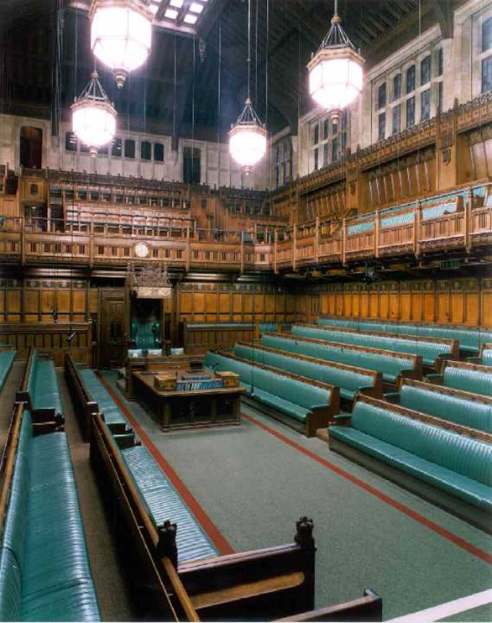
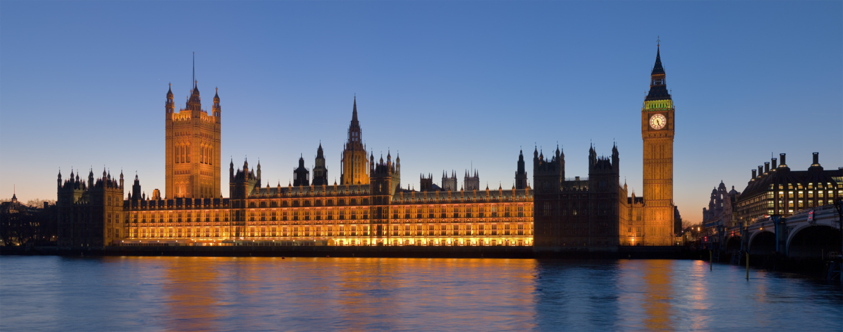
Week 9
Objectives for the week:
1) Check you are keeping up with current events
2) Remind you that Dicey submissions are due this week.
3) Feedback and complete important historical events in the development of Parliament.
4) Consider concepts of Parliamentary Government & Fusion of powers.

Slide 3
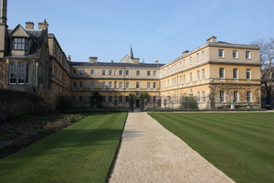
The Dicey 13th – 14thMarch
Don’t forget to submit your letters explaining why should go before Friday 17th November

Slide 4
Checking that you are keeping up with the action
For 15 minutes we will do a quiz. You will answer on your own and then pass your sheet to your neighbour.
We will then go round the class to check the answers.

Slide 5
The development of Parliament:
Task 6
RECAP Research Task – and feedback to class your research on one of the following. You need to explain why it is important in the development of the UK Parliament.
1. The English Civil War of the 1640s
2. The Glorious Revolution of 1688
3. The Great Reform Act of 1832
4. The Parliament Acts of 1911 and 1949
Complete grid so you all have all the information

Slide 6
The English Civil War of the 1640s
War broke out in 1642 and ended with Parliament executing the king in 1649 . Charles tried to rule without Parliament and imposed illegal taxes. When he had to deal with a Scottish rebellion he had to call Parliament for money and they refused to trust him with an army financed by them, and this led to a break down in a capacity to work together. Ever since this civil war and the eleven years of republican government, monarchs in England have been careful to respect the law and the power of parliament.

Slide 7
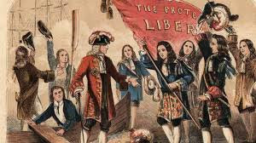
The Glorious Revolution of 1688
The Glorious Revolution ultimately established the supremacy of parliament over the British monarchy. The Gunpowder Plot and The English Civil War had created a deep fear that there was a Catholic conspiracy to overthrow the church and state. It was feared that Louis XIV of France would dominate England.
Anxiety was raised because Charles II fathered no legitimate offspring which meant that the crown would pass to his brother, James, Duke of York, whose conversion to Catholicism had become public knowledge in 1673

Slide 8
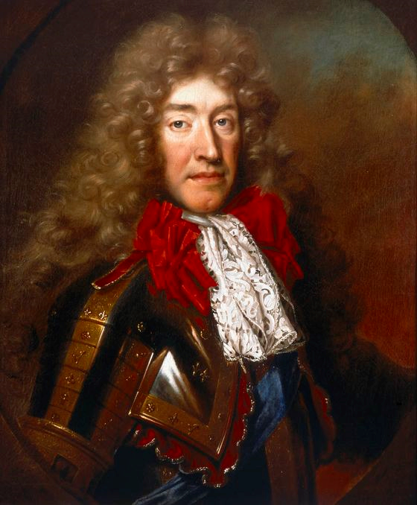
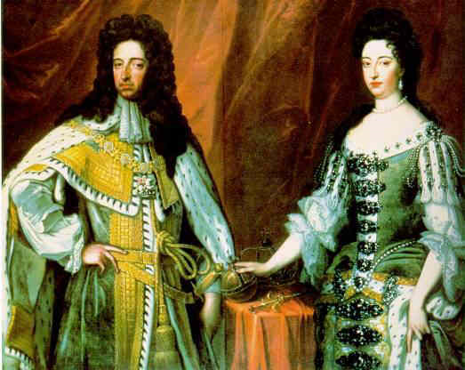
The bill of rights
James succeeded to the throne in 1685 and proceeded to introduce catholic measures. When he had a son people decided they could not tolerate this any more. His protestant daughter and her husband, the ruler of the Netherlands, William of Orange were invited to replace him.
The Dutch arrived and after a bloody skirmish at Reading James fled.
Before they were offered the crown, William and Mary were presented with a document called the Declaration of Rights, later enshrined in law as the Bill of Rights, which affirmed a number of constitutional principles, the prohibition of taxation without parliamentary consent and the need for regular parliaments. This was a tilting of power limiting royal authority.

Slide 9
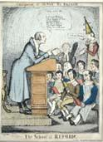
The Great Reform Act of 1832
As the 19th century progressed and the memory of the violent French Revolution faded, there was growing acceptance that some parliamentary reform was necessary. The unequal distribution of seats, the extension of the franchise and 'rotten boroughs' were all issues to be addressed.
When the Tories were pushed out of government in 1830 the Whigs tried to introduce change and on the third attempt they succeeded in 1832, getting rid of 51 boroughs where there virtually no people, and reducing another 31 to 1 MP. They created 67 new constituencies in places that had grown in population and broadened the franchise's property qualification in the counties, to include small landowners, tenant farmers, and shopkeepers and gave the vote to all householders who paid a yearly rental of £10 or more and some lodgers.
It did not go far enough and certainly did not enfranchise everyone but it was a massive step showing that change could be achieved.

Slide 10
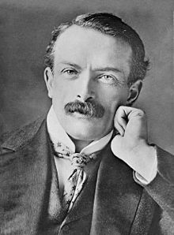
The Parliament Acts of 1911 and 1949
Lloyd George as Chancellor of the Exchequer was trying to introduce old age pensions and a stamp that meant if workers were sick they could claim national insurance.
When the Lords refused, Asquith the Prime Minister asked the King to create more Liberal Lords who would support this bill. The Lords were told they could only delay a bill for two years, not block it completely. Rather than get lots of new Lords this bill was passed. In 1949 it was moderated again and this time Lords were forced to accept that they could only delay a bill for one year.

Slide 11
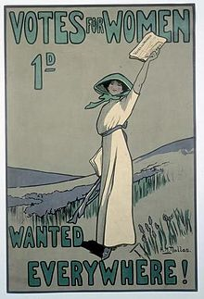
Women get the vote
In 1918, a coalition government passed the Representation of the People Act 1918, enfranchising all men, as well as all women over the age of 30 who met minimum property qualifications. In 1928, the Conservative government passed the Representation of the People (Equal Franchise) Act giving the vote to all women over the age of 21 on equal terms with men.

Slide 12
Parliamentary Government
UK Parliament is the highest source of political authority. The government is drawn from Parliament. This can mean that the government is able to dominate Parliament because a majority of its members are government supporters and so are likely to back the government.
However, Government must be accountable to Parliament. That means the government, including the PM and other Ministers, have to appear in Parliament to explain and justify policies.
Finally you need to know that Parliament does have the power to removed a government through a vote of no confidence. They do not do this very often but on the night of 28 March 1979 when Jim Callaghan's Labour Government fell from office by one vote.
Use page 199 to complete Task 7

Slide 13
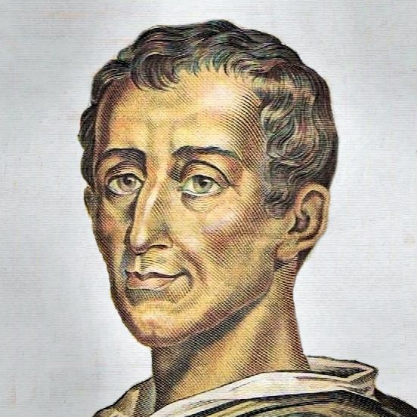
Who Was this man? Montesquieu

Slide 14
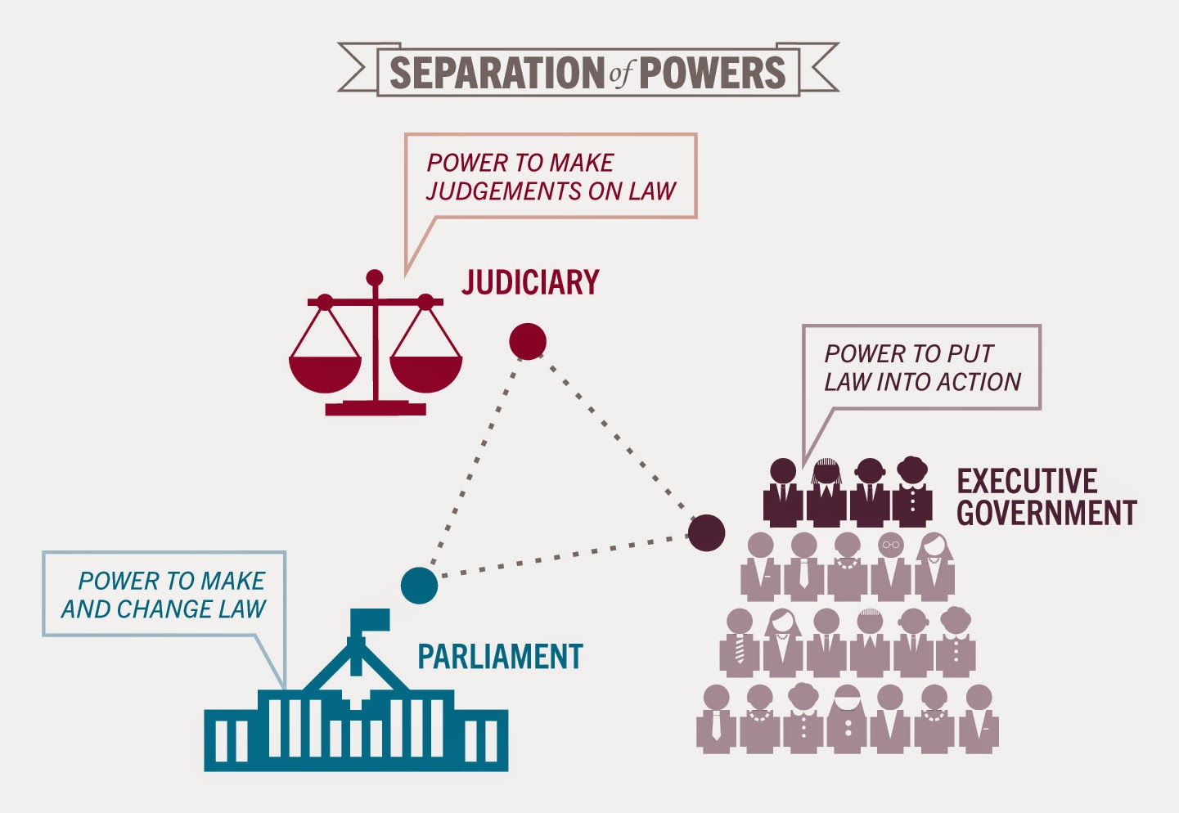
What is the Separation of Powers?

Slide 15
What is the FUSION of powers?
Fusion of powers exists when the executive and legislative branches of government are intermingled. It tends to be a feature of parliamentary democracies and can be contrasted with the stricter separation of powers found in more presidential democracies.
The term fusion of powers is believed to have been first coined by Walter Bagehot, the British Constitutional expert. It exists by design, first arising as a result of how the British political system evolved over centuries, with the power of the monarch being constrained by Parliament. The UK still has a system in which members of the executive are also members of the legislature.
Until 2005, the position of Lord Chancellor was a fusion of all the branches of the UK political system – as the person holding that position was speaker in the House of Lords, a government minister heading the Lord Chancellor’s department and the head of the judiciary. However, the Constitutional reform act of 2005 which created the UK Supreme Court, defused this position, with the Lord Chancellor now being neither the Speaker of the House of Lords (replaced by the Lord Speaker) nor the head of the judiciary (replaced by the Lord Chief Justice)
Answer question 3 on page 6 and then do Task 8

Slide 16
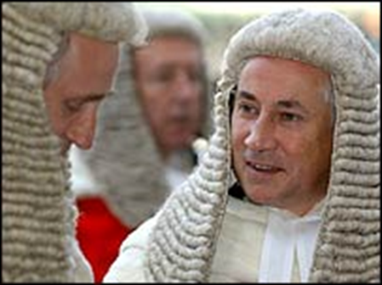
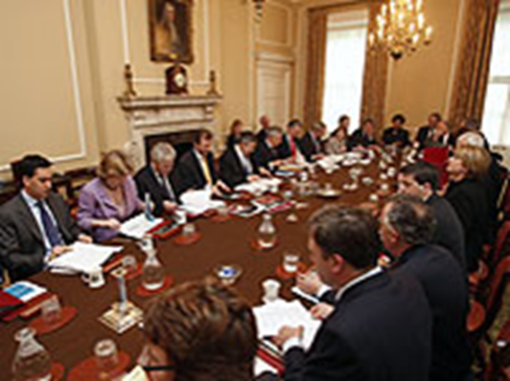
An overlap….
In the UK, the executive and legislature are closely entwined. The Prime Minister and a majority of his or her ministers are Members of Parliament and sit in the House of Commons. The executive is therefore present at the heart of Parliament.
How else do you think they may overlap?
Draw a pre 2005 and post 2005 VENN DIAGRAM

Slide 17
The principles of Parliamentary sovereignty
Parliament is the source of all political power. It delegates power e..g to devolved governments in Scotland, or local authorities, but it can take it back.
Parliament can make any laws it wishes and these will be enforced by the courts. OMNICOMPETENT
Parliament is not bound by its predecessors.
Parliament cannot bind its successors. They can pass any laws, but these cannot be entrenched against future change.
Go to E stream and watch Inside the Commons episode 1 until 14 mins.

Slide 18
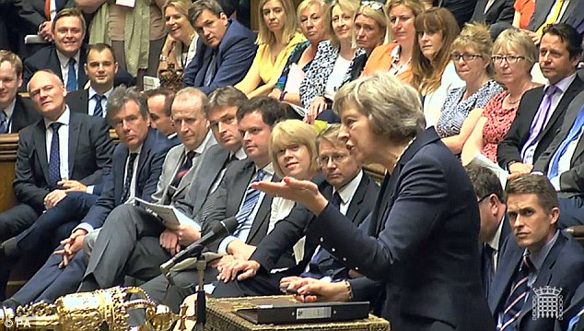
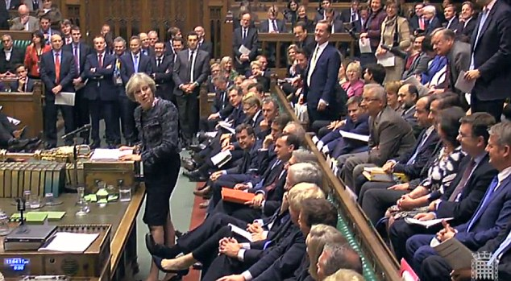
Composition of Parliament
Only 447 seats and 650 MPs so when there are important occasions a lot of MPs have to stand.
Research a front bencher. – Party, constituency, ministry, reputation

Slide 19
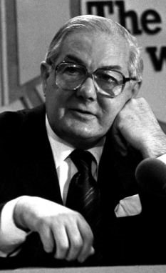
Reserve powers of the Commons
Complete the box on page 10 of your booklet using information from page 200.
When are these powers used?
Jim Callaghan was Labour MP in 1979? Find out what happened when and why he was removed from office? Who replaced him?

Slide 20
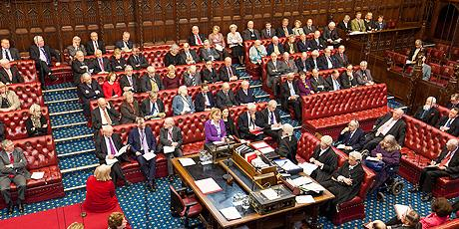
Homework
We are moving on to find out about the other House, the Lords. Read the Article The Lords and the Senate.
Answer the questions 1 – 5 and no 8.

