Slide 1
Objectives for the week:
1) Finish Constitution source question
2) Introduce Parliament topic
3) Consider concepts of Parliamentary Government & Fusion of powers.

Slide 2
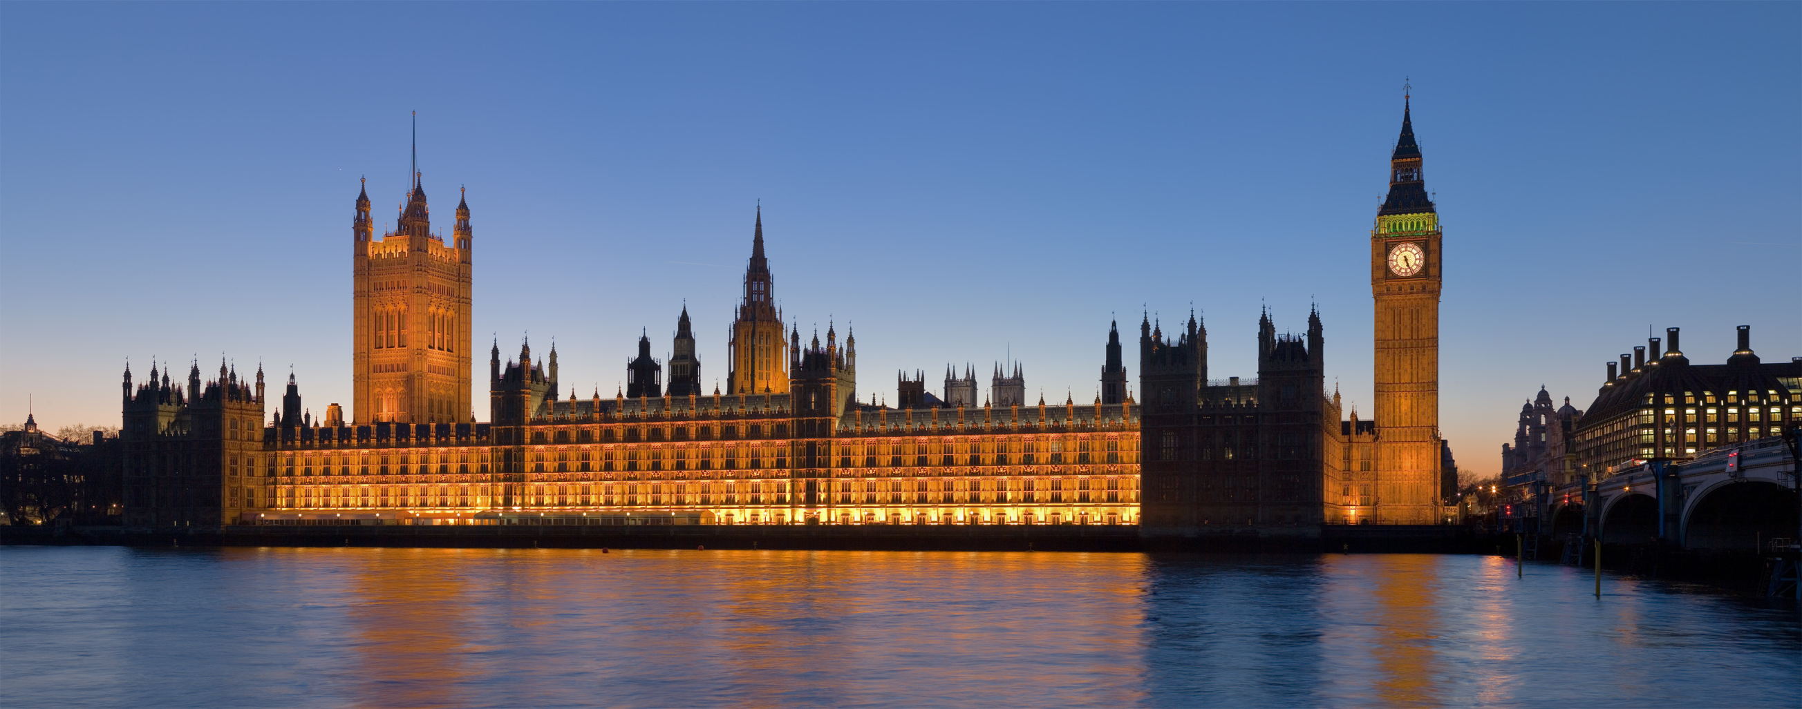
Parliament
What do you think of when you hear this term?

Slide 3
What is Parliament?
https://www.youtube.com/watch?v=RAMbIz3Y2JA

Slide 4
Parliament at work
https://www.theguardian.com/politics/2017/nov/07/theresa-may-meets-parliamentary-staff-to-hear-views-on-abuse
https://www.theguardian.com/politics/2017/nov/07/brexit-impact-studies-anna-soubry-commons-publication
What is happening in these examples?
How do they show Parliament in action?

Slide 5
Parliament at work
What examples have you found?

Slide 6
What are the origins of Parliament?
Research – using page 197 &198:
Task 3 – The history and status of Parliament
The UK Parliament is often described as the mother of parliaments. Look at page 197 and explain why.
Task 4
How did the House of Commons evolve?
Task5
What were the three main functions of the Commons?
Key Developments
1. How often does the modern Parliament meet?
2. When did a full adult suffrage obtain the right to vote?
3. When did the Commons become the more important House?

Slide 7
The development of Parliament:
Task 6
RECAP Research Task – and feedback to class your research on one of the following. You need to explain why it is important in the development of the UK Parliament.
1. The English Civil War of the 1640s
2. The Glorious Revolution of 1688
3. The Great Reform Act of 1832
4. The Parliament Acts of 1911 and 1949

Slide 8
Parliamentary Government
What does this mean?
http://study.com/academy/lesson/parliamentary-government-definition-examples-advantages-disadvantages.html 1st few minutes.

Slide 9
Parliamentary Government
Use page 199 to complete box

Slide 10
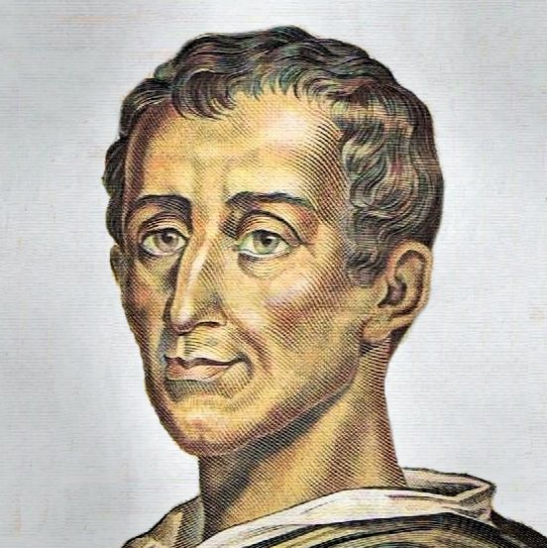
Who Was this man? Montesquieu

Slide 11
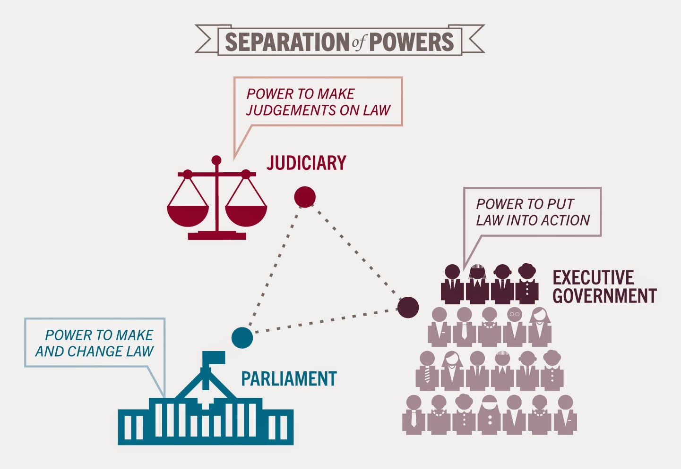
What is the Separation of Powers?

Slide 12
What is the FUSION of powers?
Fusion of powers exists when the executive and legislative branches of government are intermingled. It tends to be a feature of parliamentary democracies and can be contrasted with the stricter separation of powers found in more presidential democracies.
The term fusion of powers is believed to have been first coined by Walter Bagehot, the British Constitutional expert. It exists by design, first arising as a result of how the British political system evolved over centuries, with the power of the monarch being constrained by Parliament. The UK still has a system in which members of the executive are also members of the legislature.
Until 2005, the position of Lord Chancellor was a fusion of all the branches of the UK political system – as the person holding that position was speaker in the House of Lords, a government minister heading the Lord Chancellor’s department and the head of the judiciary. However, the Constitutional reform act of 2005 which created the UK Supreme Court, defused this position, with the Lord Chancellor now being neither the Speaker of the House of Lords (replaced by the Lord Speaker) nor the head of the judiciary (replaced by the Lord Chief Justice)

Slide 13
An overlap….
In the UK, the executive and legislature are closely entwined. The Prime Minister and a majority of his or her ministers are Members of Parliament and sit in the House of Commons. The executive is therefore present at the heart of Parliament.
How else do you think they may overlap?
Draw a pre 2005 and post 2005 VENN DIAGRAM

Slide 14
HOmework
Complete task 7, 8 and 9 in your booklet using textbook pages.
For task 8, find out what the words mean by looking them up.
Write your answers in words that you understand!
FOR MONDAY.
Research what has happened / is happening to: THIS WILL BE USEFUL FOR WHEN WE STUDY THE EXECUTIVE
Priti Patel
Michael Fallon
What did they do wrong? Why were they sacked / in trouble? Consequences for Theresa may?

